Slide 1
WELCOME
স্বাগতম
স্বাগতম
To The Multimedia Class

Slide 2
IDENTITY / পরিচিতি
Teacher
Mohammod Ali
Assistant Teacher – English
Pathanpara High School, Badargonj, Rangpur
Class: Nine – Ten
Unit – 4, Lesson -- 6
Topic: Unity In Diversity – INDIA
Time: 45 minutes

Slide 3
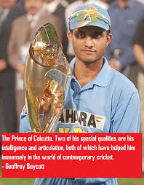
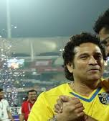
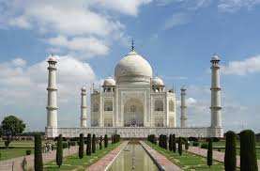
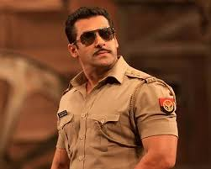
Here are some pictures for you. Look at the picture
Sourov
Sachin
Tajmahal
Salman Khan
What are the pictures about?
The mentioned persons or things in the picture belong to a country. Do you know the name of the country?

Slide 4
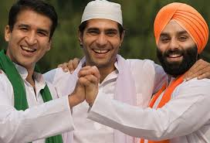
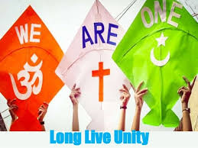
Look at the pictures again and talk about them
Here in first picture three persons from from different religions put together their hands.
Again different colours of flags are shown in second picture.
In this way staying together from different classes in a platform is called unity

Slide 5
So, today our topic is “Unity In Diversity”
Now, we shall learn about the topic

Slide 6
Learning Outcomes
After completing the class students will be able to :-
Students will be able to tell about “Unity” and “Diversity”
They will be able to cite the names of historical places
They will be able to tell about the country “India”

Slide 7
Vocabulary
Diversity = Varieties of something
Unity = staying together
Bordered = surrounded
Paradise = Heaven/ Peaceful place for ever

Slide 8
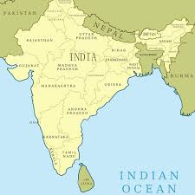
Look at the map of India
The land area of India is 3,287,596 square kilometers
India is the seventh largest country in the world

Slide 9
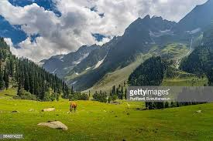
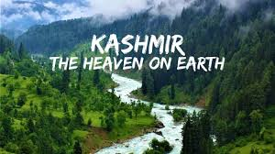
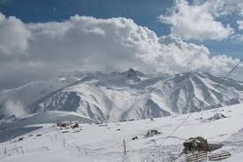
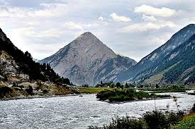
Here are some pictures of a beautiful place named “Kashmir”
Kashmir is called the “Heaven” or “Paradise” on earth

Slide 10
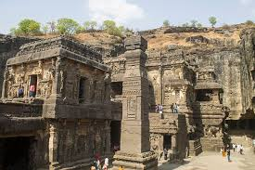
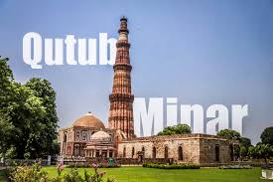
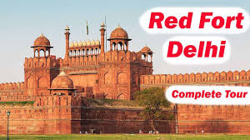
Ellora cave
Qutub Minar
Red Fort

Slide 11
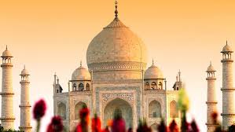
Taj Mahal

Slide 12
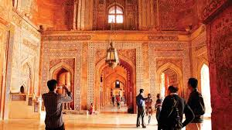
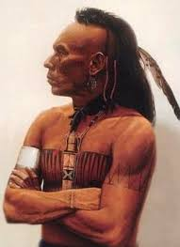
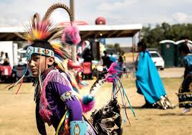
There are 29 provinces in India.
There are 17 major languages and 844 dialects
About 1.5 billion people live in India.

Slide 13
India is second most populous country after China.
India got its freedom in 1947.
India is the largest democratic country over the world.
People from all classes, religions and cast live together.

Slide 14
Reading Skill
Read the text for five minutes silently

Slide 15
Evaluation
Fill in the blanks with suitable word based on your reading.
India is a _______ delight. The Taj Mahal, ________ Sirki, The Qutb Minar and the Red _______ are a few of the many ________ which attract people from all _______ the world
Ans: tourists’ , Fatehpur, Fort, wonders, over

Slide 16
Home Work
Write a Paragraph about India in at least 15 sentences

Slide 17
Thank you for attending the class

