Slide 1
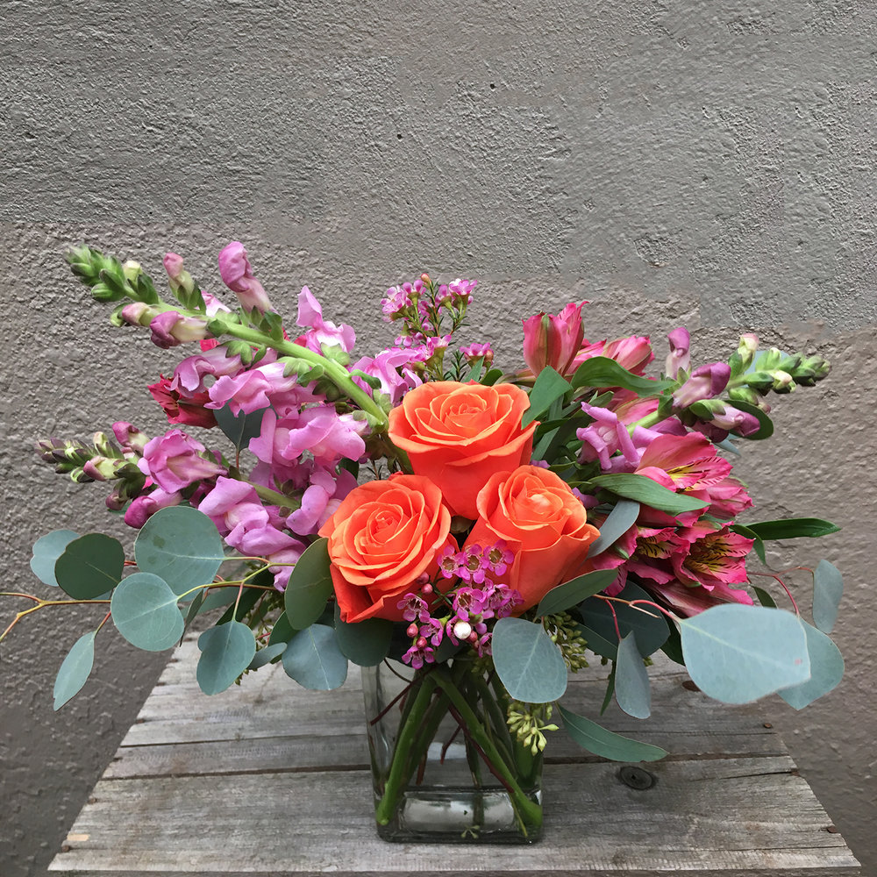
WELCOME

Slide 2
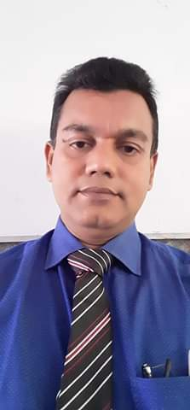
Introduction
Name: Nurul Amin Azad Assistant teacher: (English) Jahangirpur T,Amin Govt.
Pilot High School Madan,Netrakona
CLASS: Eight
SUBJECT: ENGLISH SECOND PAPER
UNIT: Two
LESSON: Seven
TOPIC : Suffixes

Slide 3
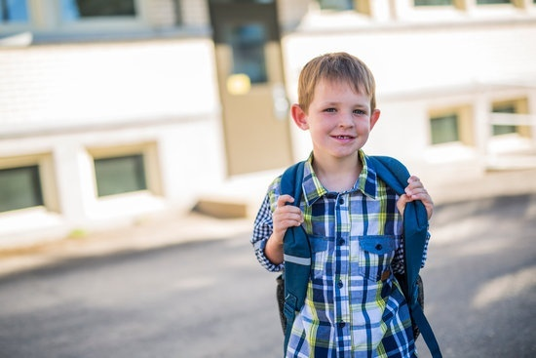
Jarif goes to school regularly. He is very careful to his study. He also maintains his time very nicely.
He is hopeful in his future life.

Slide 4
Today our topic is
Suffix

Slide 5
Learning outcomes
By the end of the lesson
the learners will be able to:
make sentences using suffixes.
use the correct form of words to fill in the blanks in the passage adding suffixes with them.

Slide 6
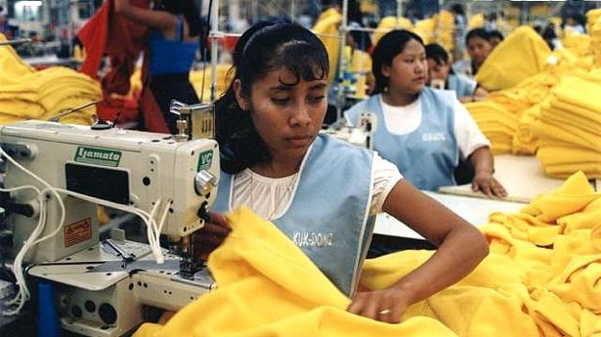
Without continuation of electricity supply the garment factory worker cannot ready their order timely.
prep
n
adv
Notes:
The learners will be asked read out the sentences loudly

Slide 7
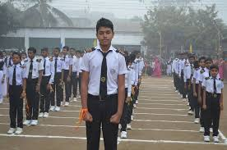
Comparatively low to high
adv
Notes:
The learners will be asked for making more sentences using the given word.

Slide 8
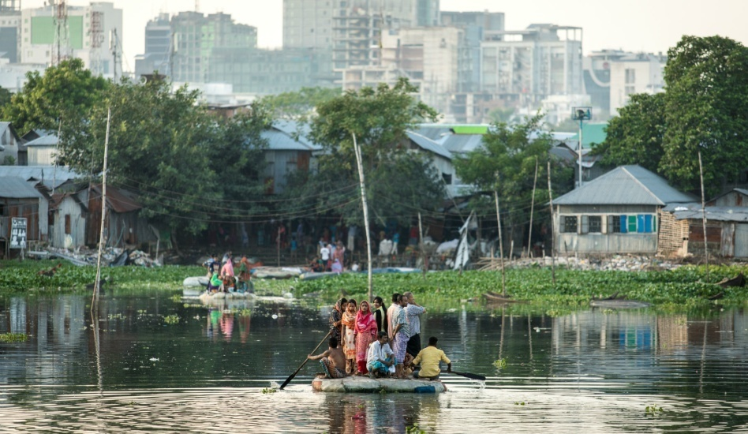
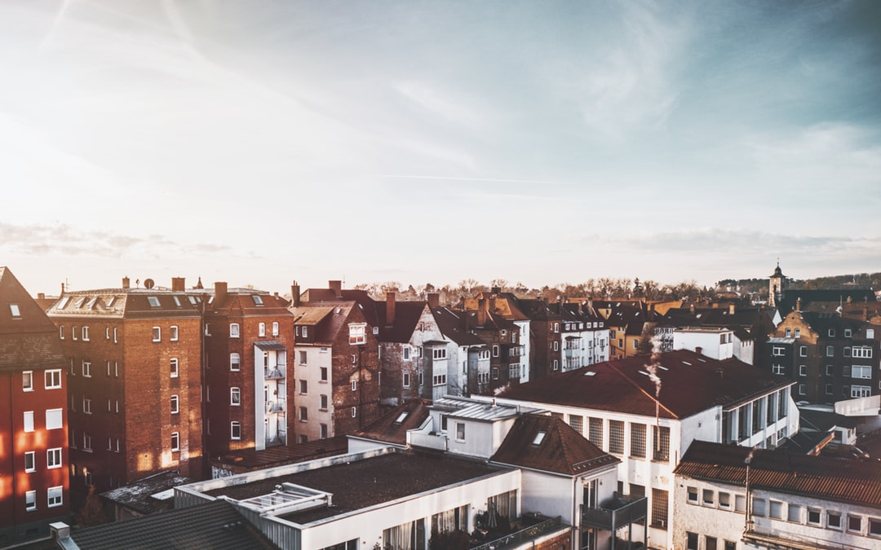
PAIR WORK
Discuss the pictures with your partner and think which words are needed to describe them . After that write down the words adding suffixes on your copy.
Notes:
When the learners will be doing the task in pairs, the teacher will monitor them. After they will have finished writing, he/she will check the copies

Slide 9
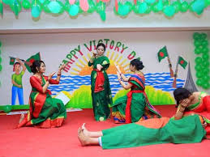
The school premise has been decorated nicely on the occasion of celebrating the national victory day on 16th december in 2019. coming 2020 is decleared as mojib’s years.
adj
Notes:
The learners will be asked for making new words and sentences adding ed, ly, ing and al with another words.

Slide 10
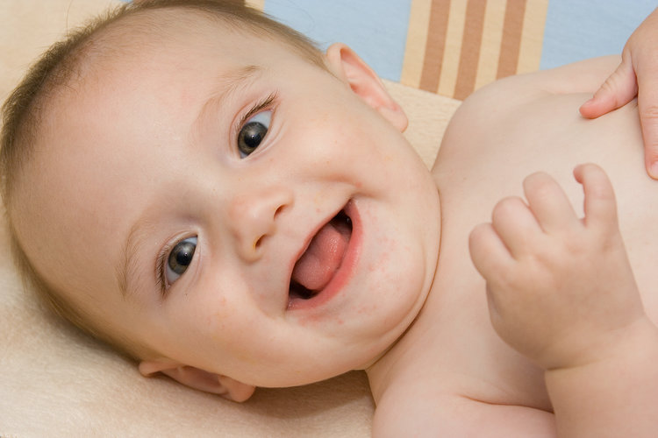
Happier, beauty
n
n
Notes:
The learners will be asked for making sentences with the given words adding suffixes with them.

Slide 11
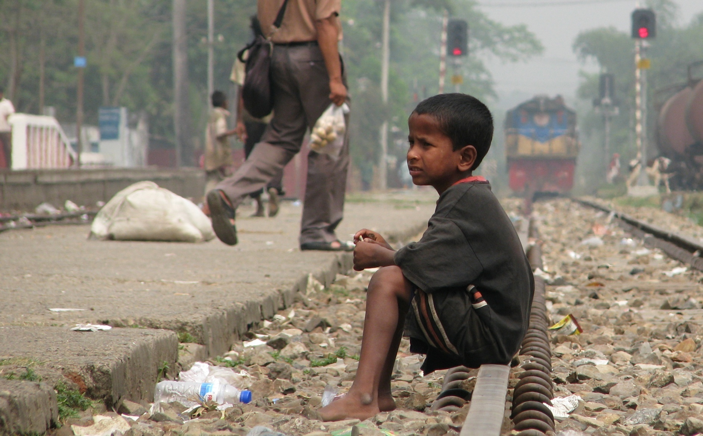
The boy is shelterless. He wants to survive himself like others. He dreams to go to school. By going to school he will receive education. Education give him chance to lead a happiness and peaceful life.
n
n
n
n
adj
Notes:
The learners will be asked foe making more words adding ment, tion, hood, ness and ful with another words and make sentences.

Slide 12
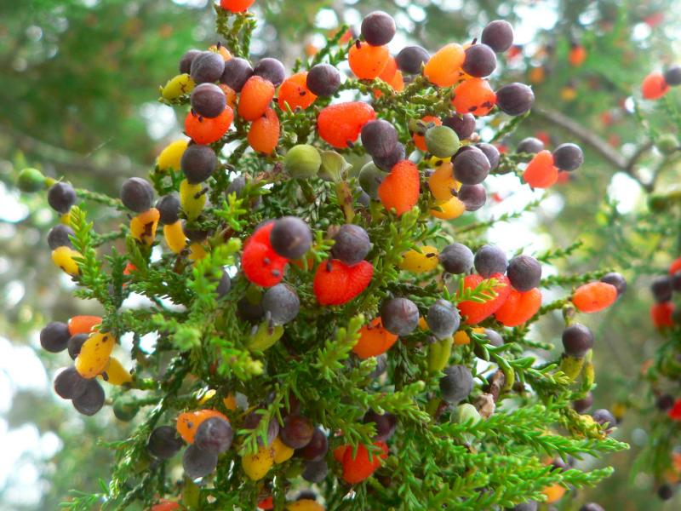
It is not predictable how many fruits will be yielded in the tree.
adj

Slide 13
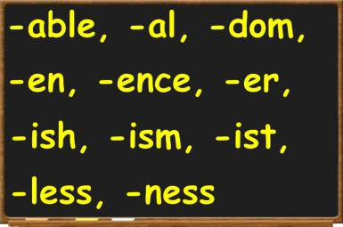
At a glance suffixes
A suffix is a letter or a group of letters attached to the end of a word to form a new word or to alter the grammatical function of the original word. For example, the verb read can be made into the noun reader by adding the suffix -er; read can be made into the adjective readable by adding the suffix -able.
Understanding the meanings of the common suffixes can help us deduce the meanings of new words hat we encounter. The table below defines and illustrates 26 common suffixes.
-ful, -ment, -ly,
-ing, -hood, -acy,
-ance, -ity, -tion,
-sion, -lize, -fy
,-ed,-ious, -ble
Notes:
This slide the teacher may not show to the learners in the classroom but the list from the slide may show them .
The learners will be taught the word class making the new word adding suffixes with them.

Slide 14
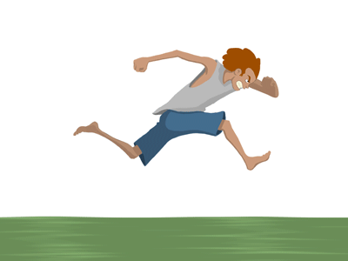
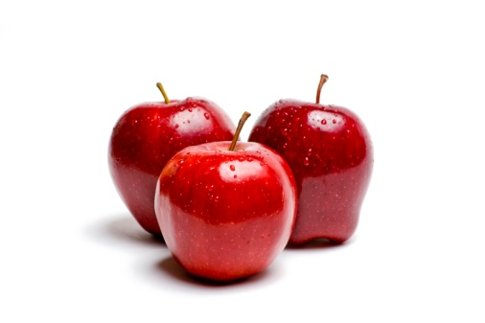
The boy runs quickly
Three apples
Change words class

Slide 15
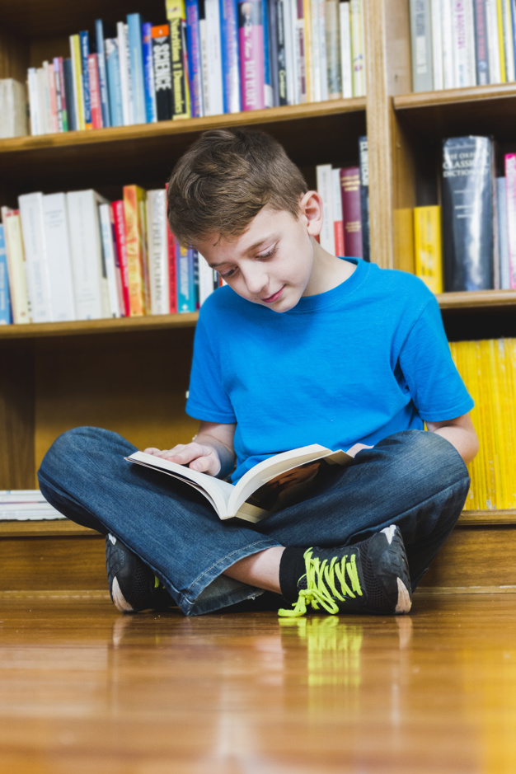
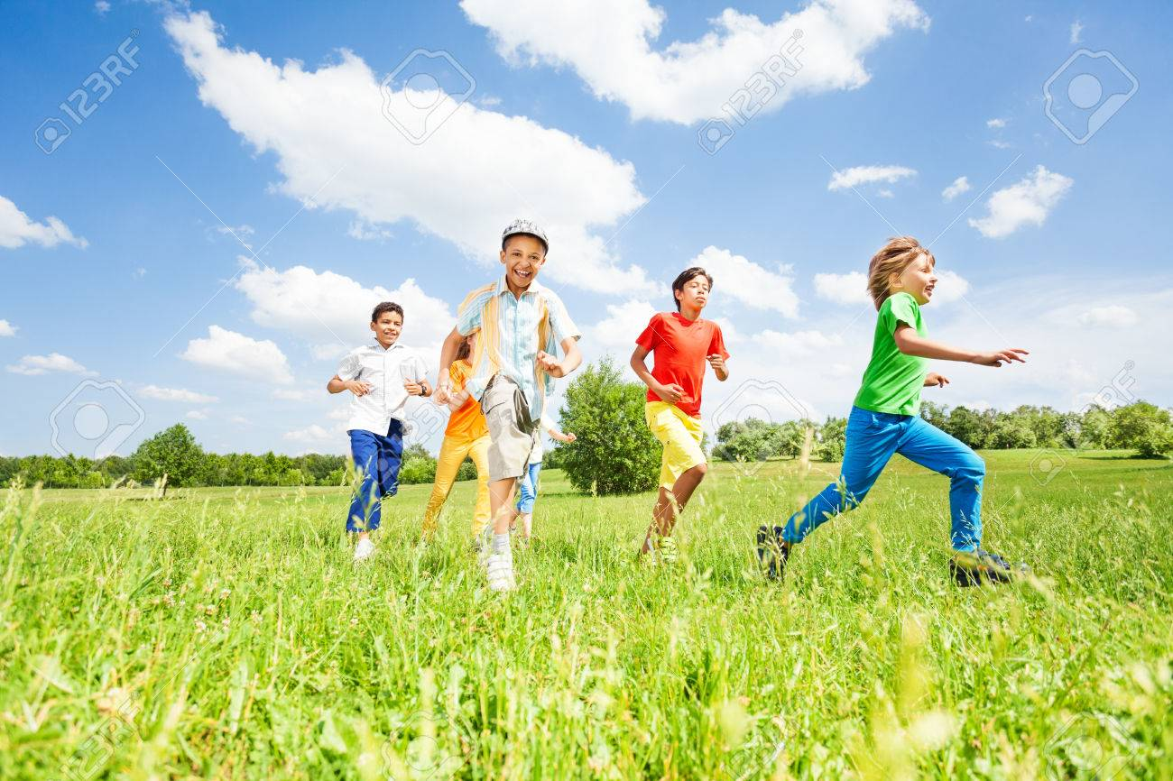
Group work
Look at the pictures. Discuss in groups about the pictures. Now each group make 10 sentences following the picture with words using suffixes .
Notes:
The teacher may give a pair work on this pictures.

Slide 16
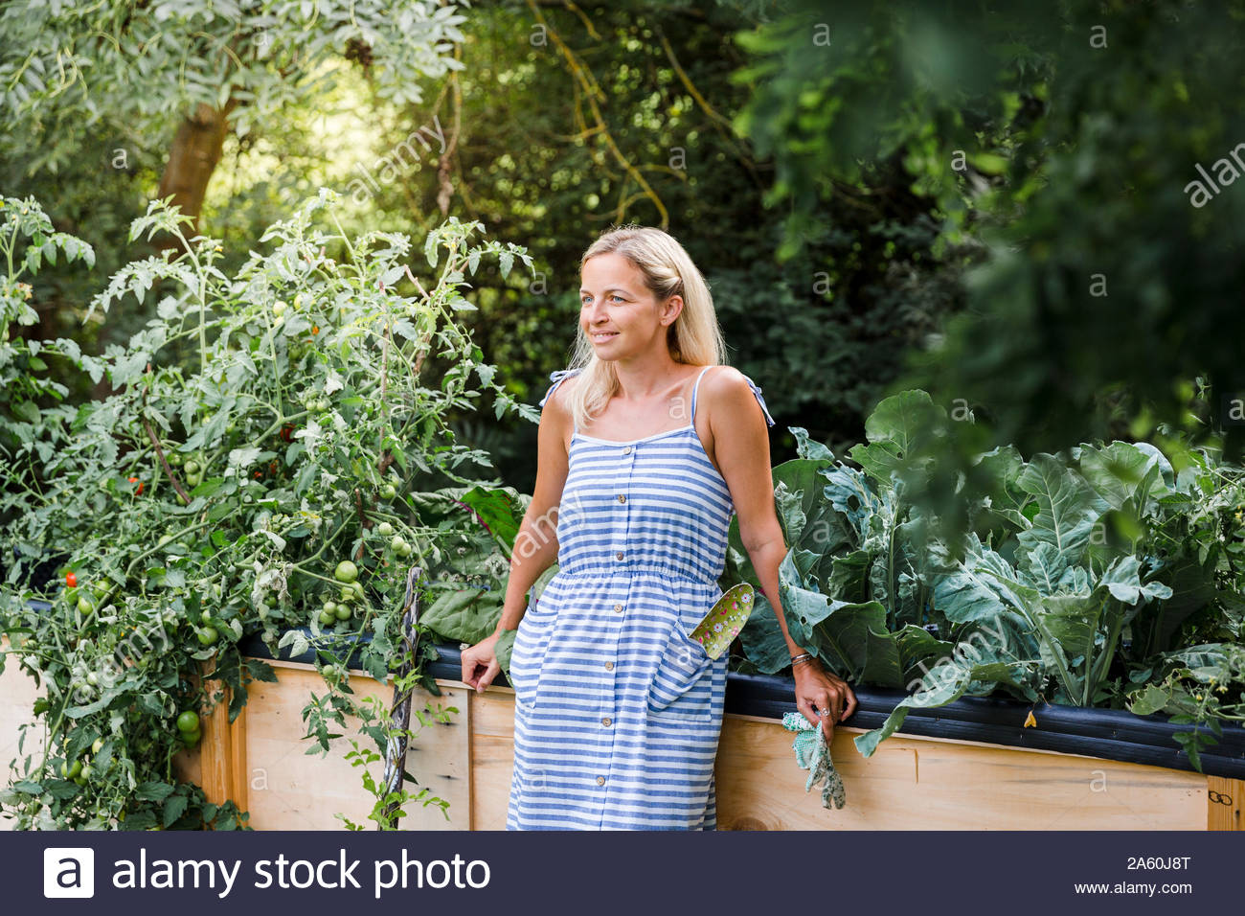
Fill in the blanks using suffixes:
Ms, Mohona is a-(beauty) woman. She looks very (cheer). Behind her, the large garden-(rich) her beauty more and more .The –(scene) is very much –(charm) .Seeing it, many people may feel home–(sick) for their …..(boy).
beautiful, cheerful, enriches, scenery, charming, sickness, boyhood
Notes:
The teacher may give the answer on the board later on.

Slide 17
HOME WORK
Make sentences with the following words adding suffixes with them:
Block , Predict ,Value , Comfort ,Use ,
Knowledge ,Need ,pay, punish, develop

Slide 18
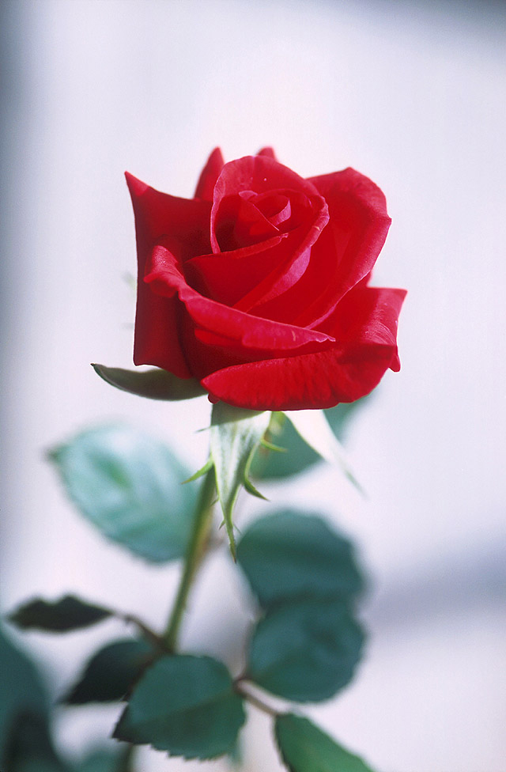
Thanks to all

