Slide 1
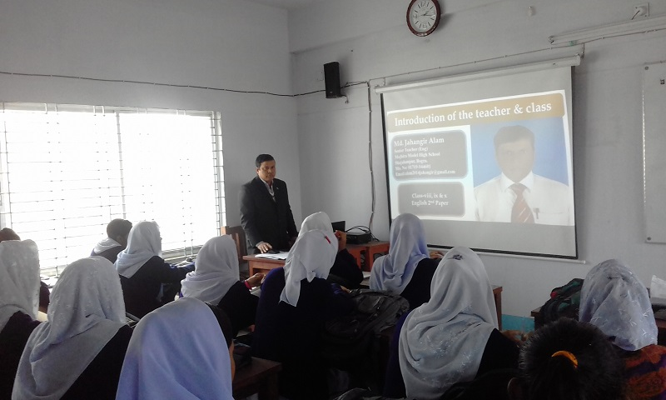
To Multimedia Class.

Slide 2
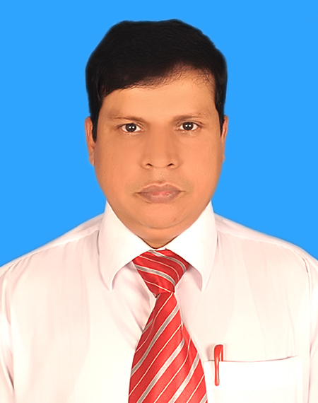
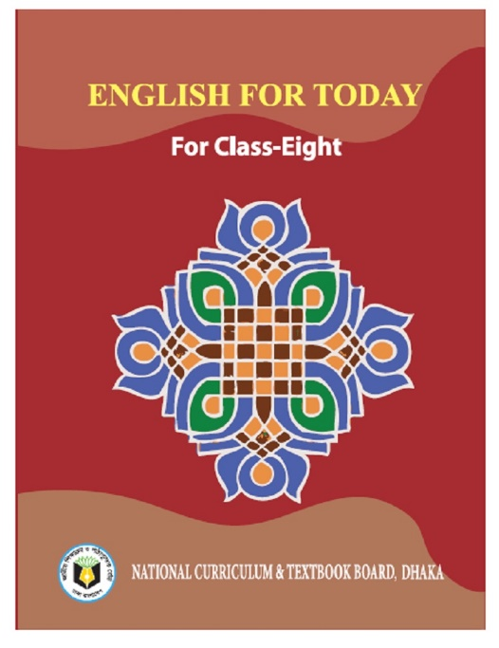
Identity
Md. Jahangir Alam
Senior teacher (Eng)
Majhira Model High School
Shajahanpur, Bogura.
Email: alam2014jahangir@gmail.com
Mobil: 01719-944601
Class: English 1st paper
Class: viii
Time: 50 minutes
Date: 19/01/2020

Slide 3
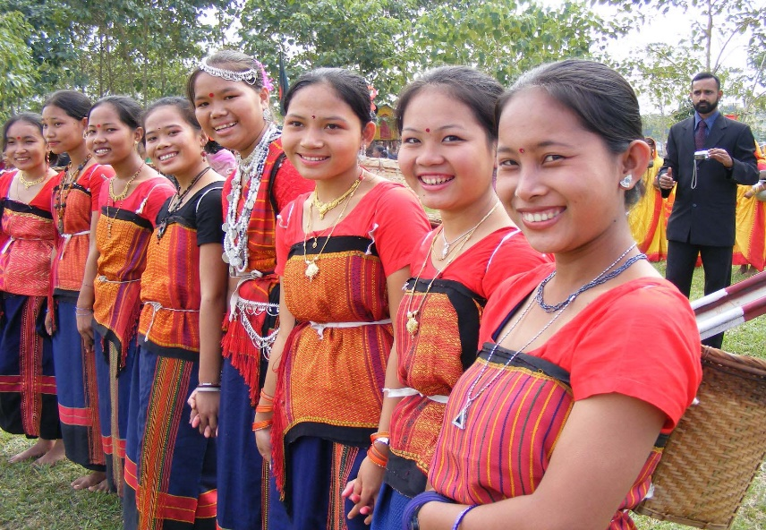
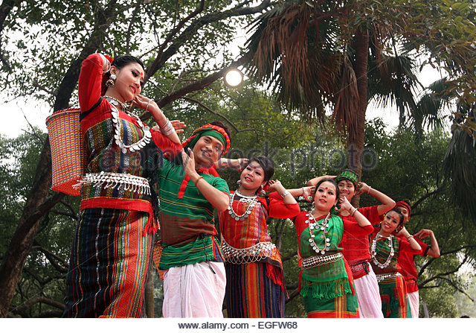
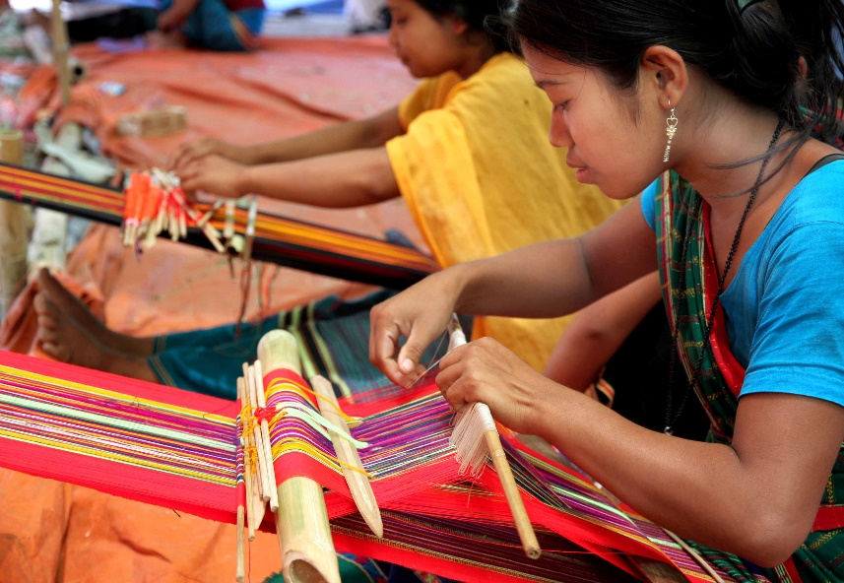
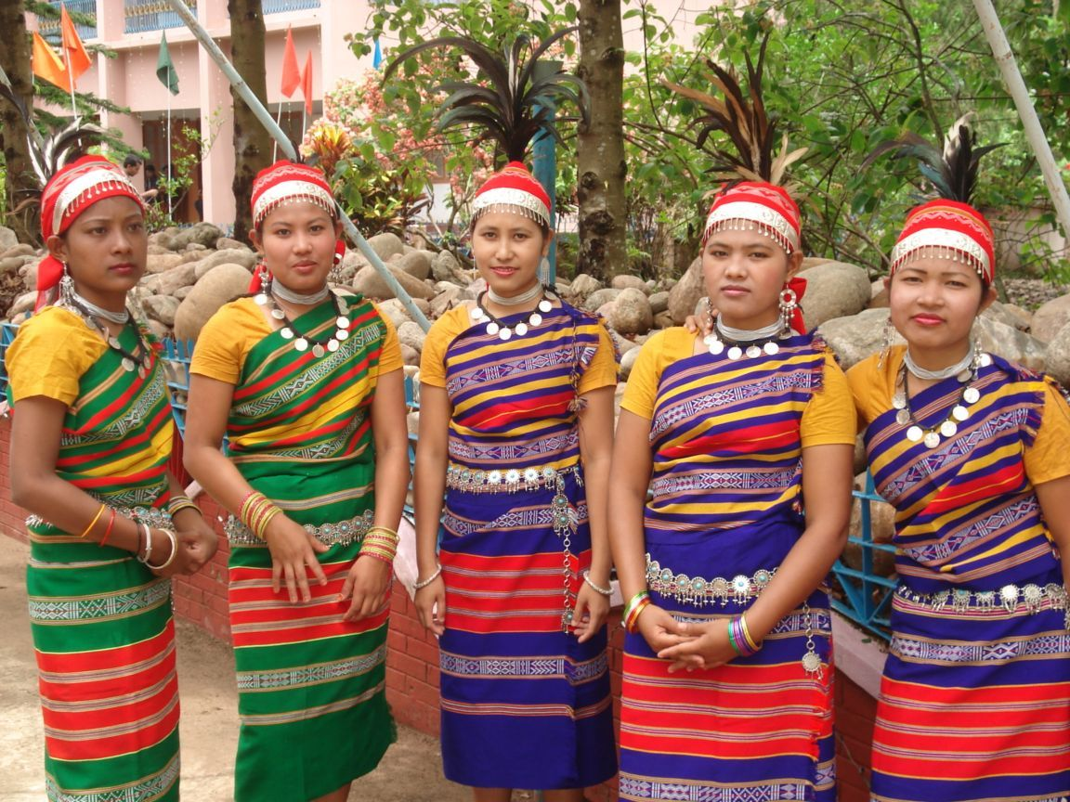
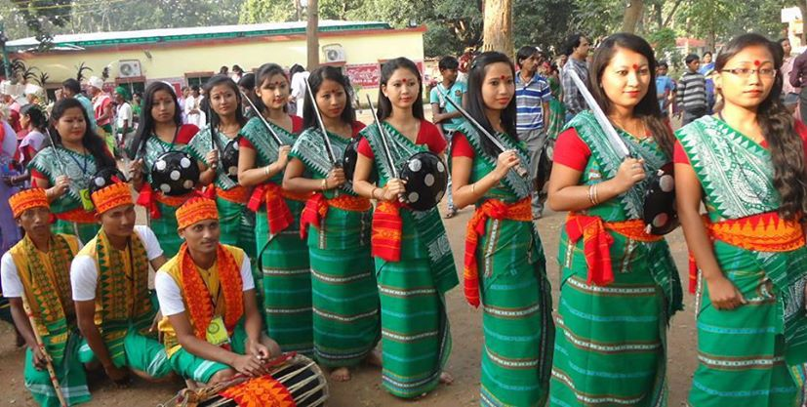
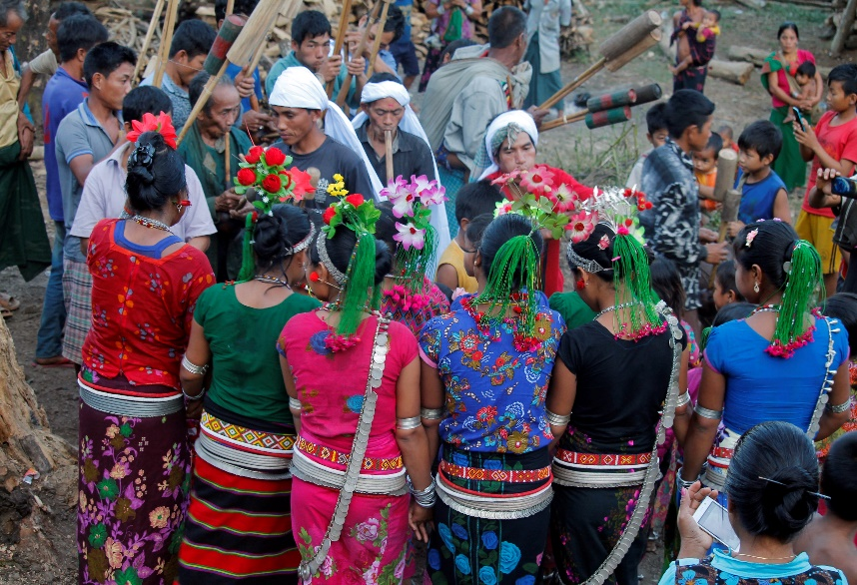
Chakma
Marma
Moorangs
Garo
Hajong
Mooges

Slide 4
Our today’s lesson is-
So
OUR ETHNIC FRIENDS
Unit-1, Lesson-3

Slide 5
Learning outcomes
At the end of the lesson, we will be able to-
tell about ethnic people.
tell about their living places.
describe their religions.
tell about the ethnic people lifestyle.

Slide 6
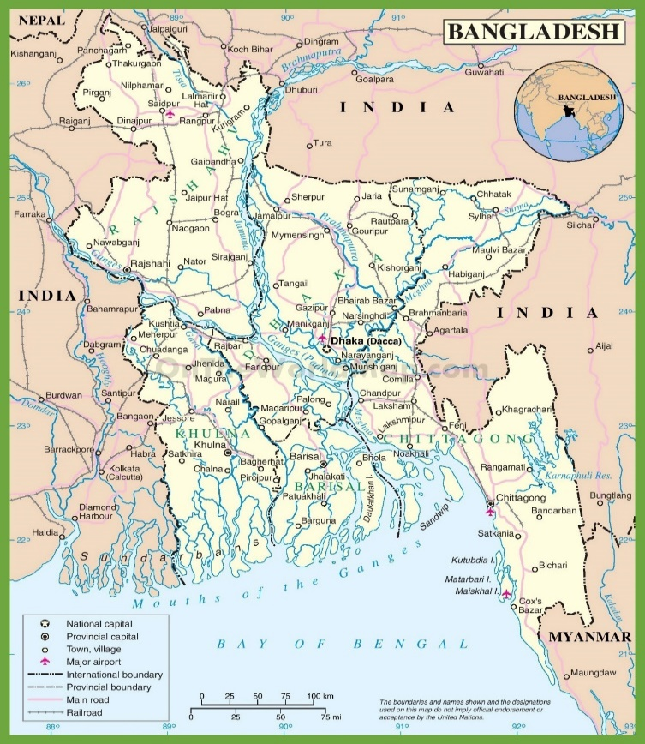
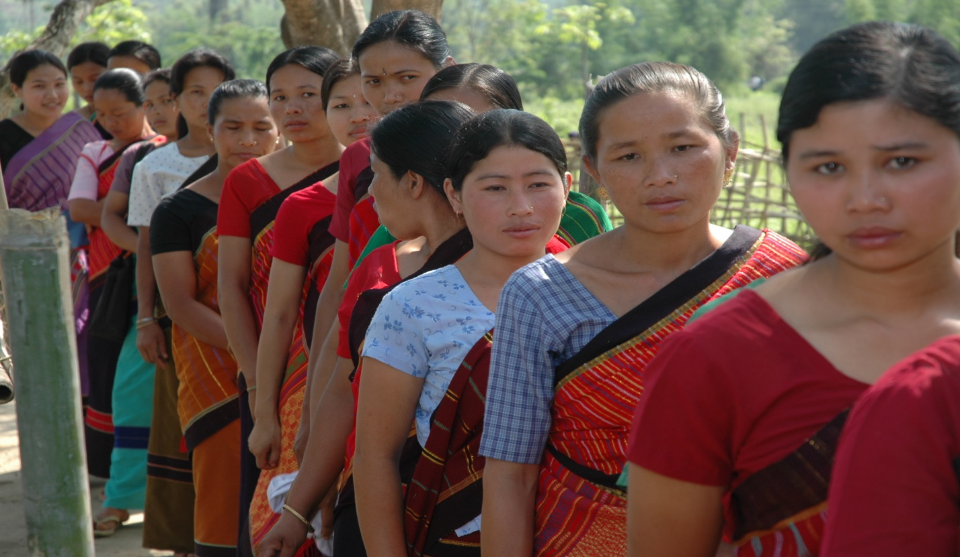
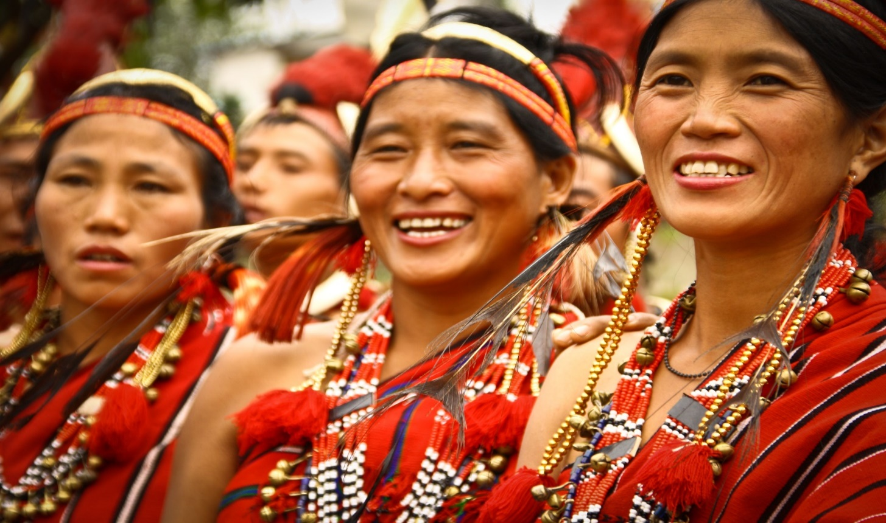
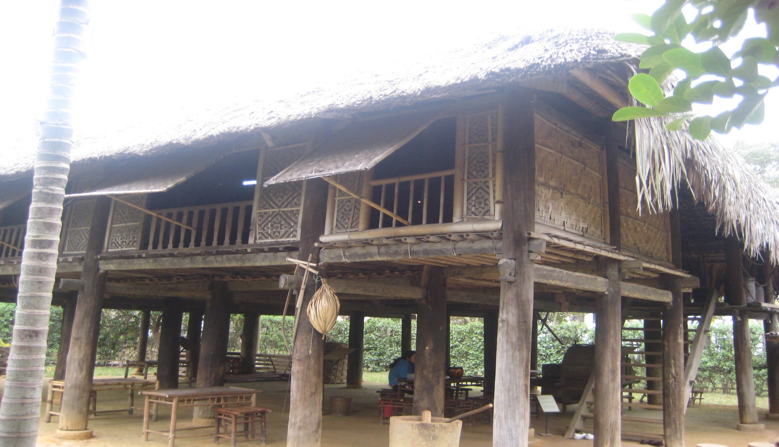
Let us introduce with some key words.
Word
Ethnic
Region
Majority
Shifting
meaning
A race of people who are all descending from the same ancestor
A part of a country or the world
Most of the populations
Living in a fixed place.
They are shifting in forest areas, in the hills and in rural areas.
The majority of these people live in the Chittagong Hill Tracts.
sentence
Ethnic people live in the regions of Chittagong Hill Tracts.
The ethnic people in Bangladesh hold a very important place in the culture of the country.

Slide 7
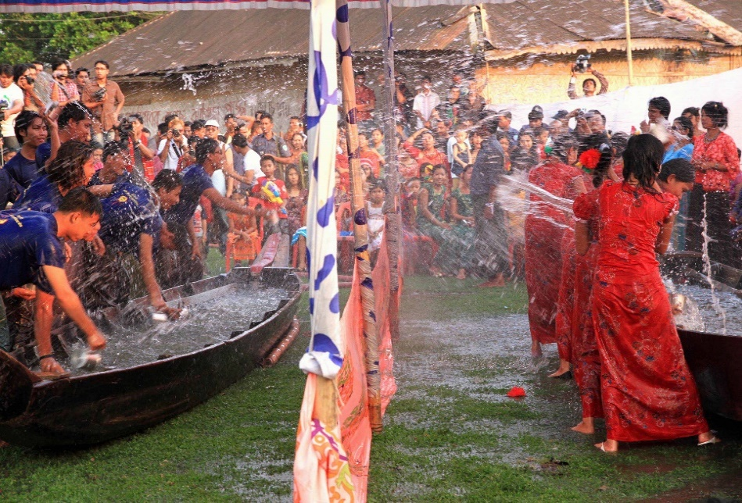
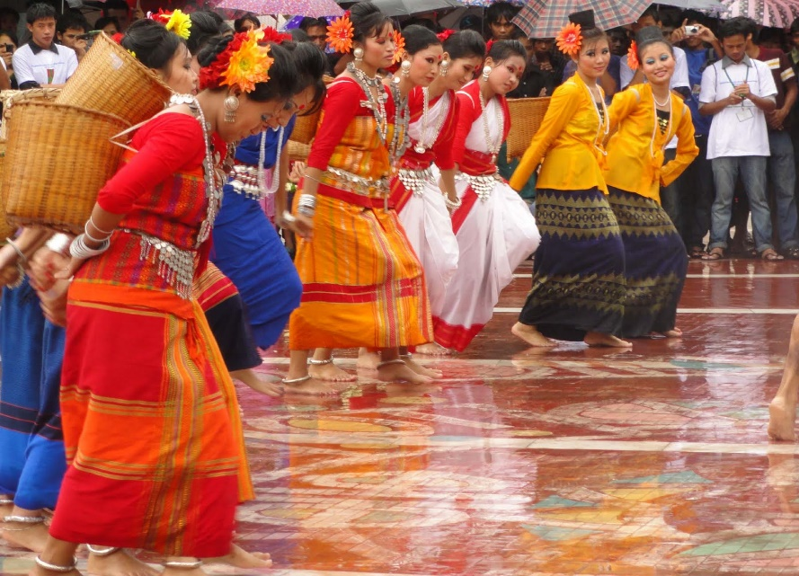
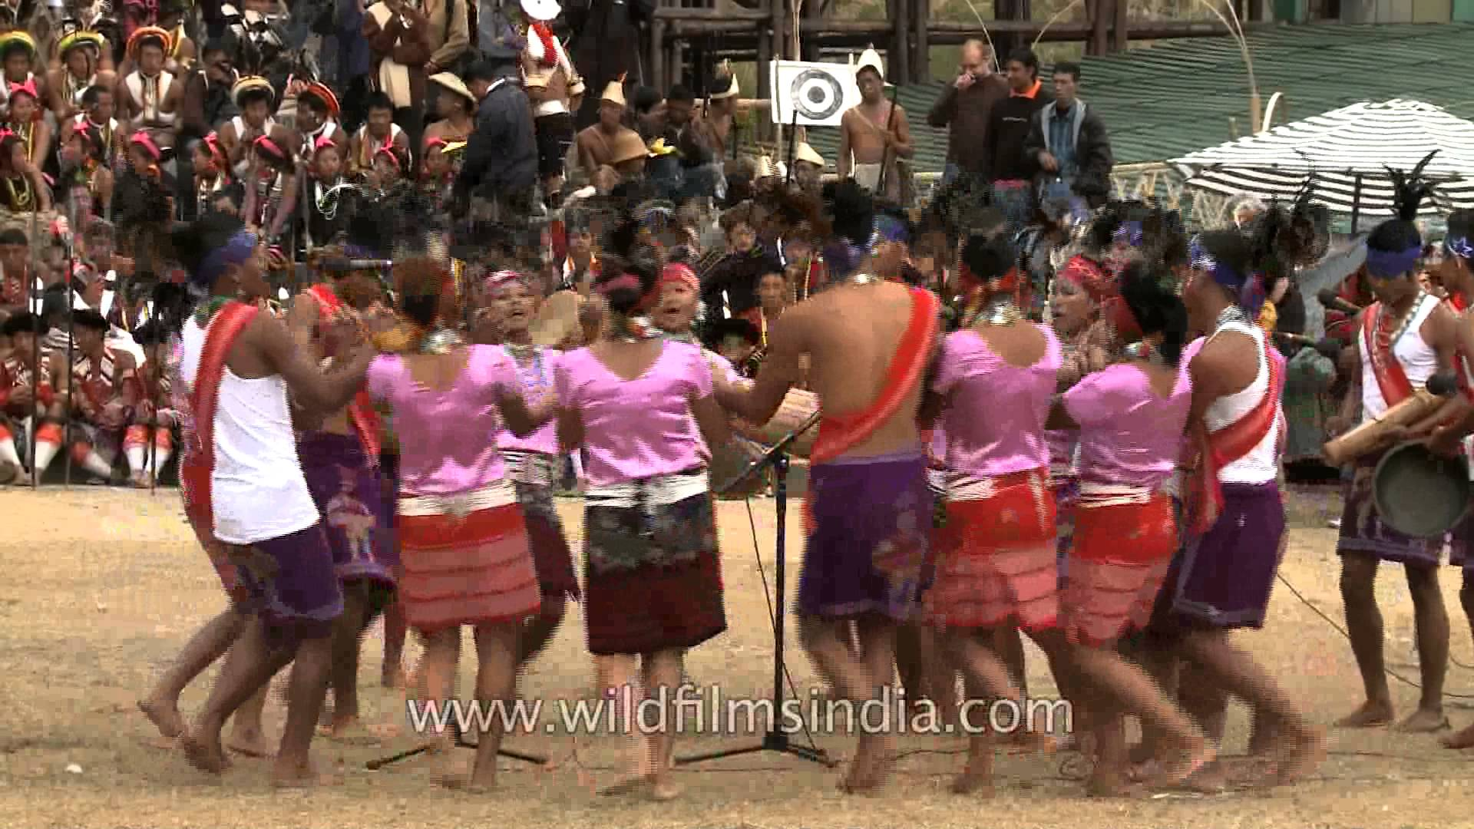
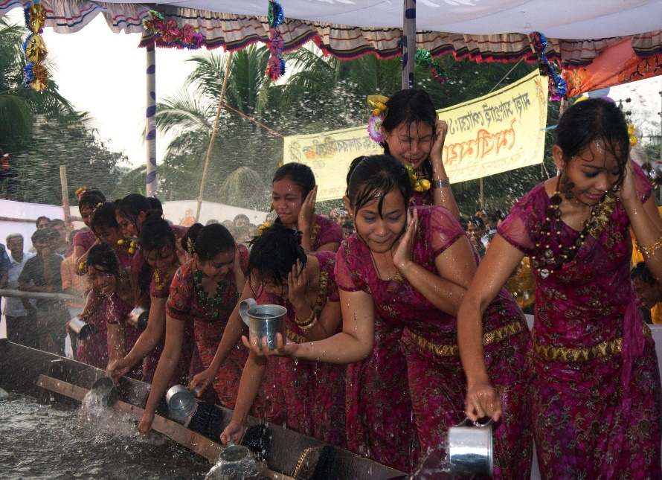
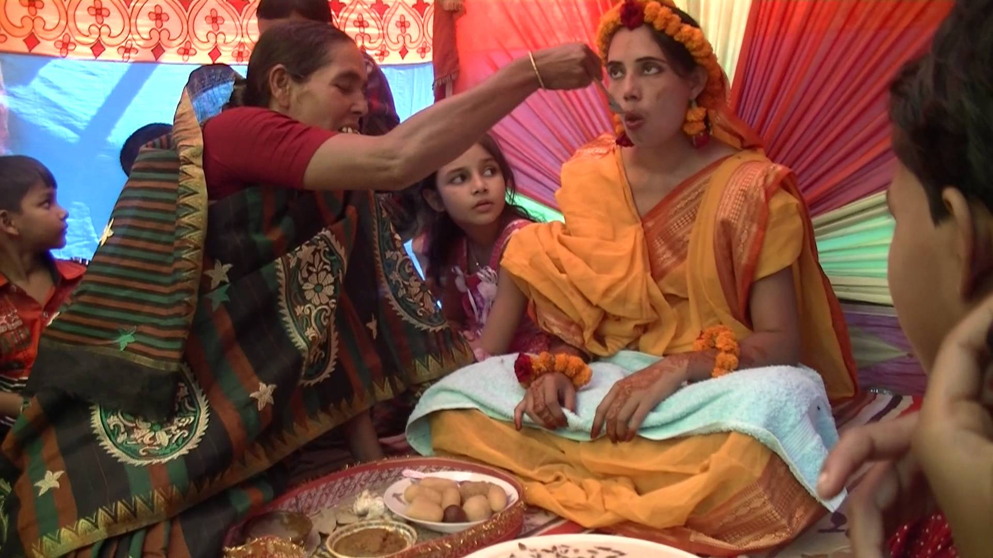
Chittagong Hill Tracts
Mymensingh
The ethnic people in Bangladesh hold a very important place in the culture of the country.
Rajshahi
Sylhet
Notes:
To identify area click on the district.

Slide 8
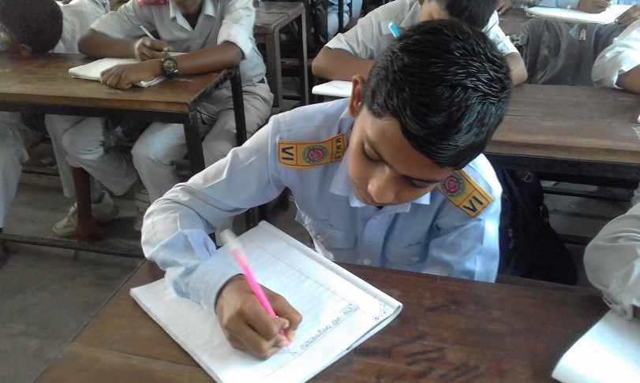
Answer the following questions:
Individual Work
1. Where do majority ethnic people live in Bangladesh ?
2. Where do the others ethnic people live in Bangladesh ?
Answers:
1. Majority ethnic people live in the Chittagong Hill Tracts in Bangladesh.
2. The others ethnic people live Mymensingh, Rajshahi and Sylhet in Bangladesh.

Slide 9
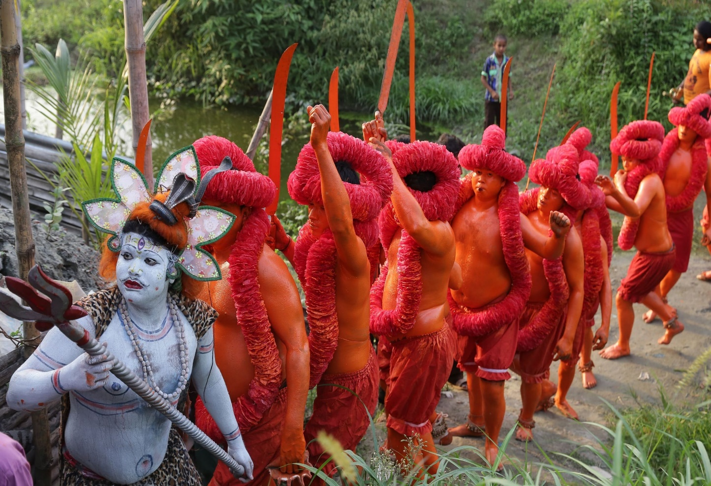
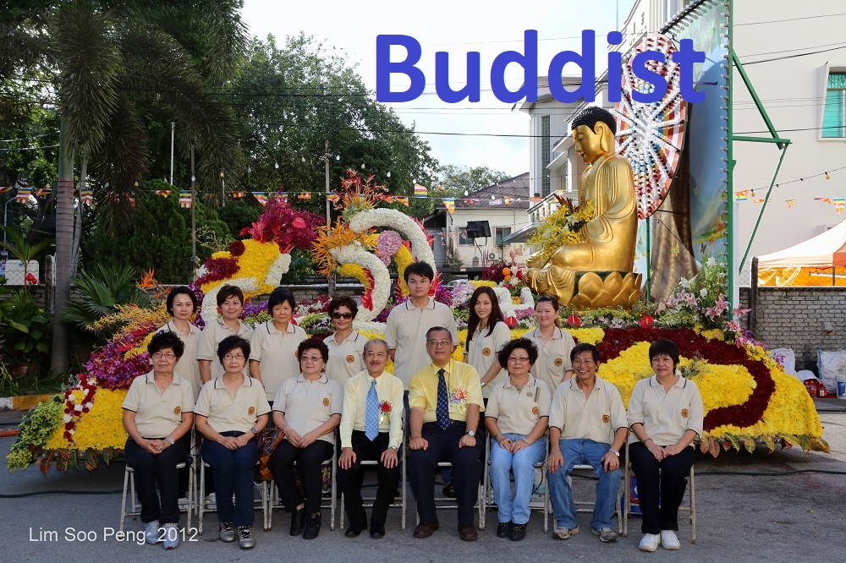
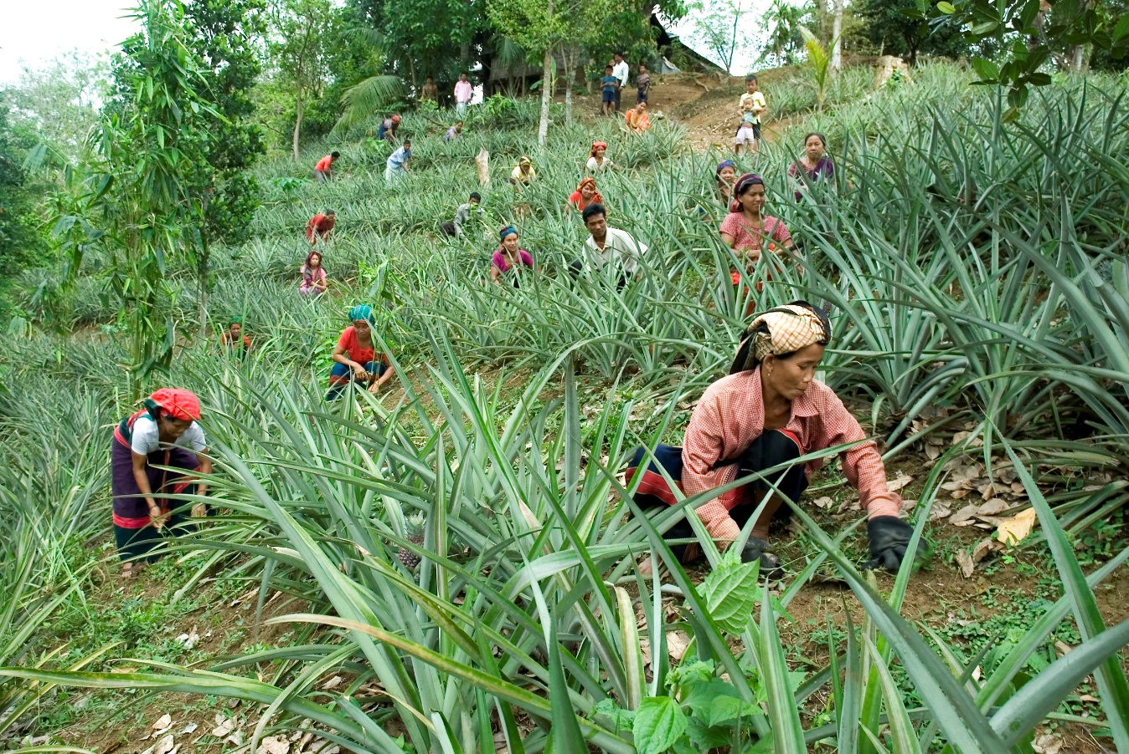
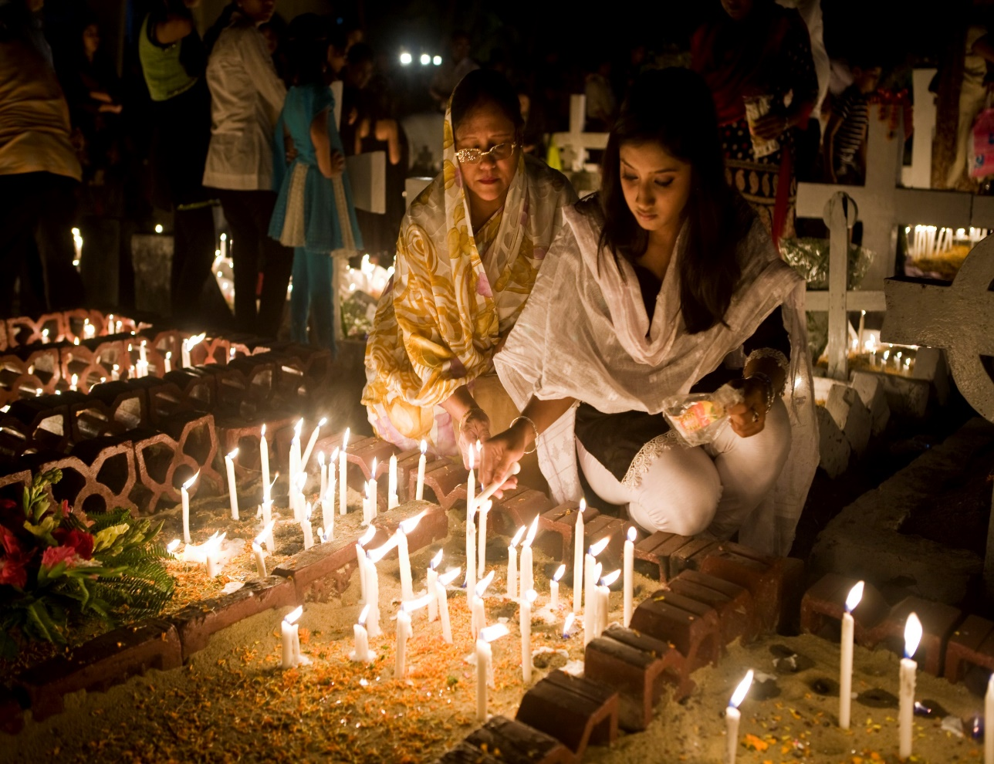
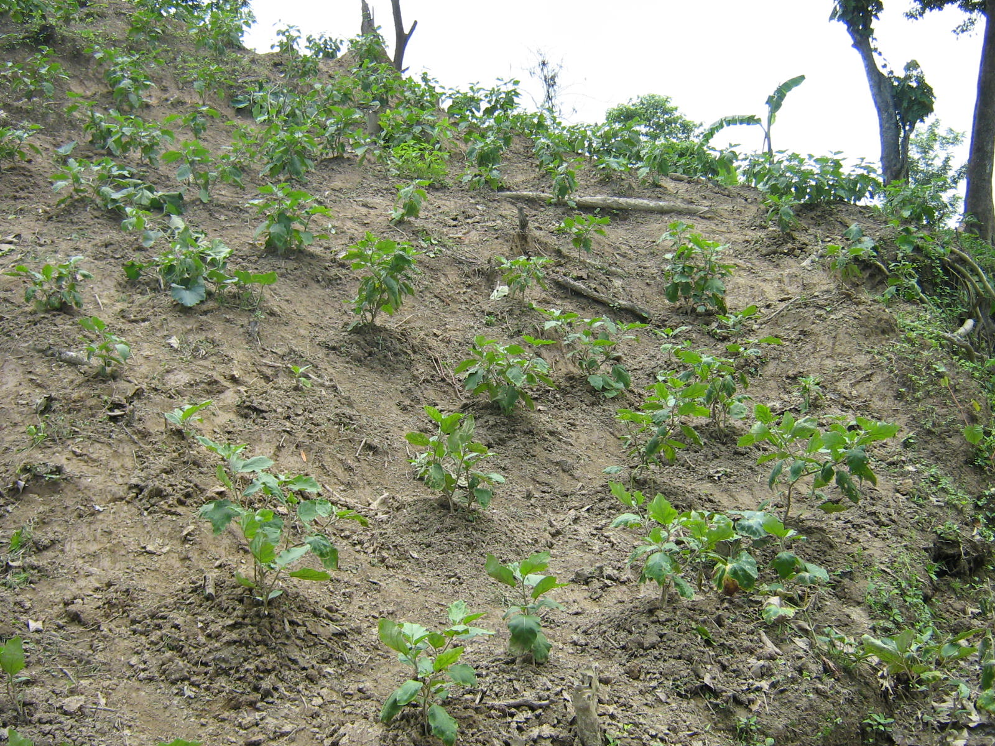
Hindus
Christians
They do Jhum cultivation. For this they clear a piece of land
in the forest, prepare it and sow seeds in it.
By religion they are Hindus, Christians or Buddhists.

Slide 10
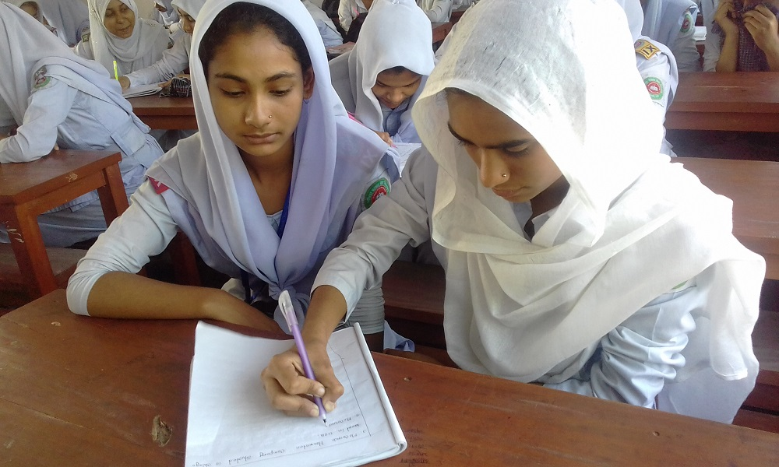
Answer the following questions.
1. Where and how they do the Jhum cultivation ?
Pair Work
2. Which religions do they hold?
Answers.
1. For Jhum cultivation they clear a piece of land in the forest, prepare it and sow seeds in it.
2. By religion they are Hindus, Christians or Buddhists.

Slide 11
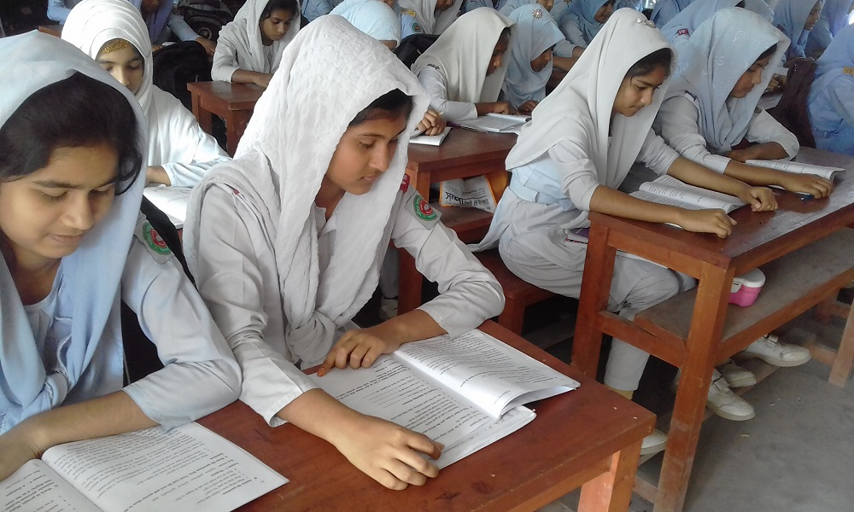
The ethnic people in Bangladesh hold a very important place in the culture of the country. The majority of these people live in the Chittagong Hill Tracts. The others live in the regions of Mymensingh, Rajshahi and Sylhet. They live in forest areas, in the hills and in rural areas. They do Jhum cultivation. For this they clear a piece of land in the forest, prepare it and sow seeds in it. They are mostly farmers. By religion they are Hindus, Christians or Buddhists. They speak their own mother tongues. Some of them are the Chakmas, the Marmans, the Tipperas and the Moorangs who live in the Hill Tracts. The Santals live in Rajshahi. The Khasias and the Monipuries live in Sylhet and the Hajangs and the Garos in Mymensingh.
The ethnic people in Bangladesh hold a very important place in the culture of the country. The majority of these people live in the Chittagong Hill Tracts. The others live in the regions of Mymensingh, Rajshahi and Sylhet. They live in forest areas, in the hills and in rural areas. They do Jhum cultivation. For this they clear a piece of land in the forest, prepare it and sow seeds in it. They are mostly farmers. By religion they are Hindus, Christians or Buddhists. They speak their own mother tongues. Some of them are the Chakmas, the Marmans, the Tipperas and the Moorangs who live in the Hill Tracts. The Santals live in Rajshahi. The Khasias and the Monipuries live in Sylhet and the Hajangs and the Garos in Mymensingh.
Silent Reading

Slide 12
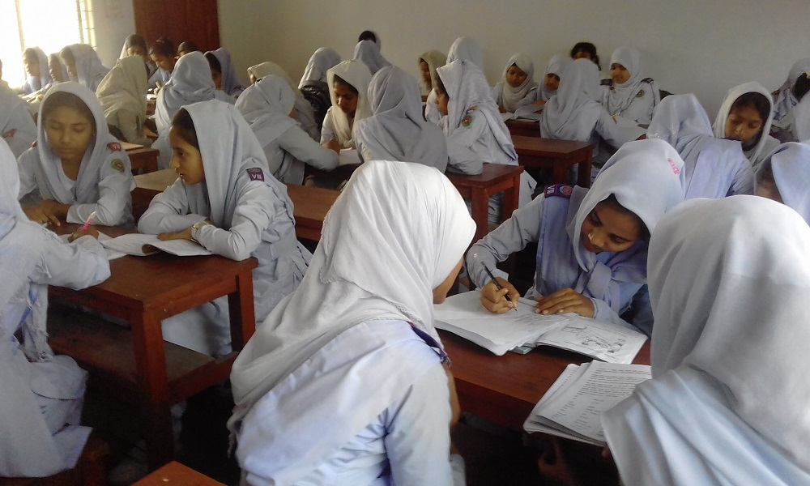
 Write whether the following statements are true or false. If false give the correct answer:
1. All the ethnic people of our country live in the Chittagong HillTracts.
Ans:
False: Majority of the ethnic people of our country live in the Chittagong HillTracts.
2. Most of them are farmers.
Ans:
True.
3. By religion all of them are Buddhists.
Ans:
False: By religion all of them are Hindus, Christains or Buddhists.
4. The Moorangs are an ethnic minority group.
Ans:
True.
Group Work
5. They practise jhum cultivation.
Ans:
True.
Notes:
For correct answer click on ‘Ans’.

Slide 13
Evaluation
Correct Answer
× Try again
Choose the best answer from the alternatives.
1. The eithnic people use -------- language.
(a) foreign
(b) global
(c) international
(d) native
2. The word “rural” means.
(a) pastoral
(b) urban
(c) village
(d) municipal
3. The ----------- live in Rajshahi.
(a) Garos
(b) Chakmas
(c) Santals
(d) Hajangs
Click on the potions.
Notes:
For correct answer click on the options.

Slide 14
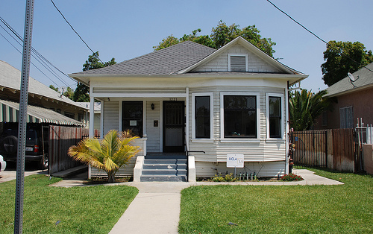
Home Work
 Write ten sentences about ethnic people in Bangladesh.

Slide 15
THANKS

