Slide 1
Welcome

Slide 2
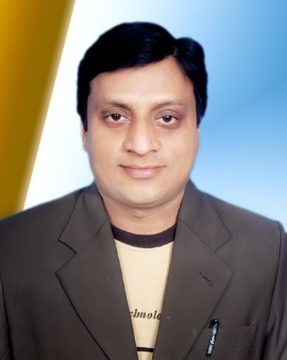
Teacher’s Identity
Md.Ali Hossain Pathan
Assistant Teacher
Chowra Nayabari Gps.
Kaligonj, Gazipur.

Slide 3
Learning outcomes
At the end of this lessons students will be able to:
Listening
1.3.1 recognize which words in a sentence are stressed.
3.4.1 understand statements made by teacher and students.
4.2.1 understand and enjoy simple stories
Speaking
1.1.1. say words, phrases and sentence with proper sounds and stress
6.2.1 talk about people , objects , events etc.
Reading
1.5.1. read words, phrase and sentences in the text with correct pronunciation, stress and intonation.
1.7.1 read paragraphs, dialogues ,stories,letters and other texts.

Slide 4
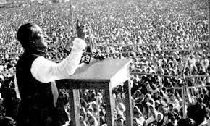
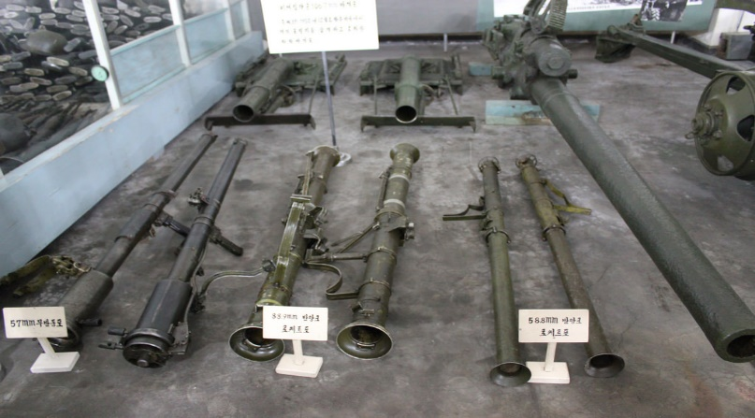
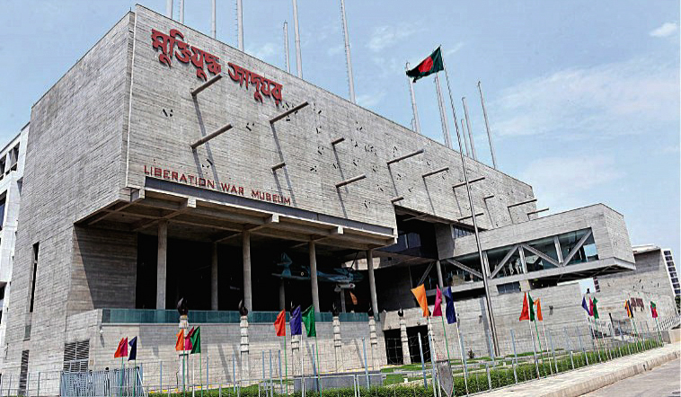
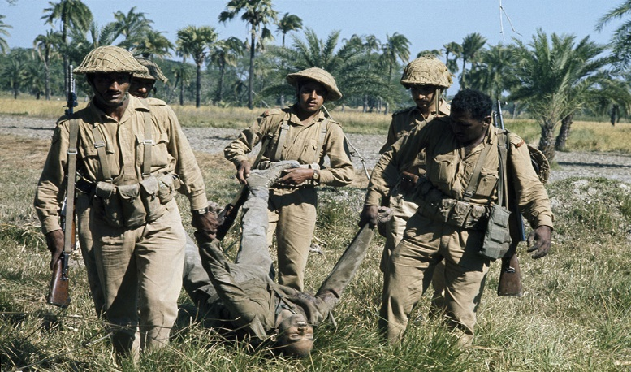
Look at the pictures ?

Slide 5
What type of picture have you seen ?
There are some pictures of our Liberation War.

Slide 6
Do you understand what may be our today’s lesson ?
The Liberation War Museum.
On 14 December…………………..of the museum.

Slide 7
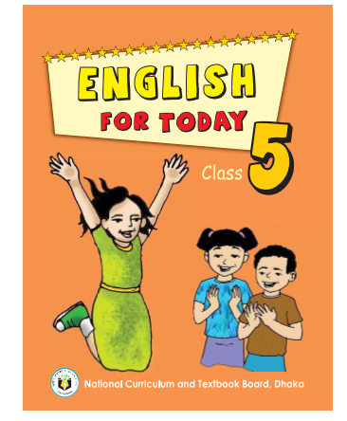
Title of the lesson:
Class: Five
Subject: English
Unit:19.
Lessons:1-2
Caption of the lessons: The Liberation War Museum.
Time:40 minutes.

Slide 8
Open
Your
English
Book
at page
74.

Slide 9
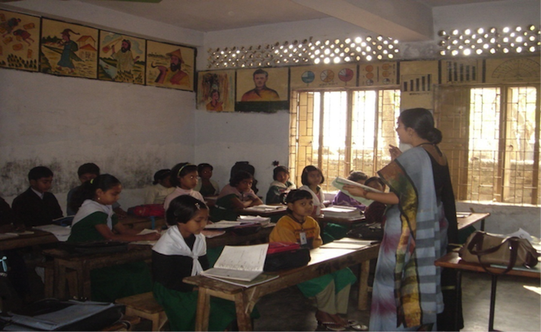
Teachers loud reading.

Slide 10
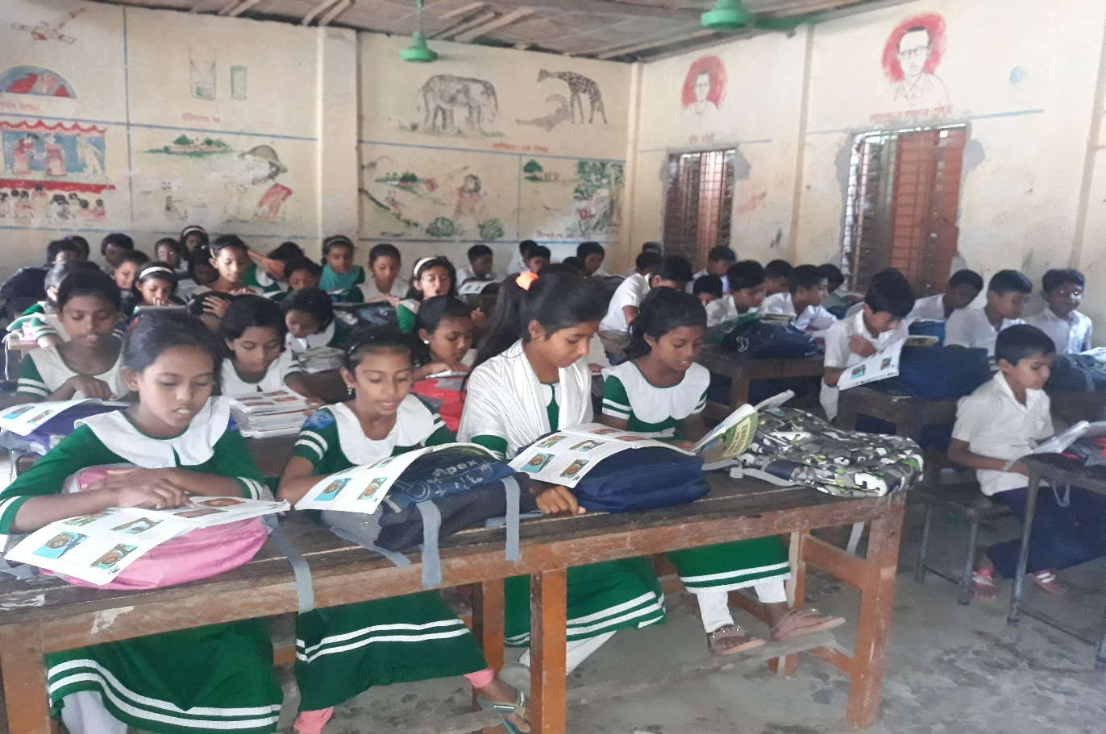
Students silent reading.

Slide 11
New Words meaning
WCW
Guide
পথ প্রদর্শক
A person who leades others.
Welcome
স্বাগতম
A kind of greeting or reception.
Warmly
আন্তরিকভাবে
With love,honour or affection.
Liberation
মুক্তি
The state of being free.

Slide 12
Write true or false.
PW
1.The students went to the Liberation War Museum.
2.A teacher was waiting for the students.
3.The Liberation War Museum at Agargaon.
4.The bus reached the museum at 11 a.m.
5.The students went to the field trip in the 9th month of the year.
true
false
true
false
false

Slide 13
Matching
GW
Match the words of column A with their meaning that is mentioned in column B.
Colum - A | Colum - B
1.Warmly | a)place where historical objects are shown.
2. Exhibit | b) a long journey.
3. Museum | c) a person who shows the way.
4. Guide | d) one kind of place where showing something.
5. Trip | e) to show ,make visible or apparent.
 | f)receive cordially

Slide 14
Evaluation
Fill in the blank.
waiting
10 a.m
field
museum
plannned
The students reached the museum at...................
2) The trip was a part of their………………..
3) Students entered into the……………
4) A guide was ………………..for us.
5) The students of class five went on a …………….trip.

Slide 15
Evaluation
IW
1)Where is the Liberation War Museum situated?
Ans:The Liberation War Museum is at Agargaon in Dhaka.
2)Why was the trip planned?
Ans:As a part of their Bangladesh and global studies.
3)What did the guide do for the students?
Ans:The guide welcomed the students and took them on quick tour of the differents galleries.
4)What did the students watch at first?
Ans:At first the students watched a video clip on our Liberation War and our independence.

Slide 16
Home Task:
Write five sentences about the Liberation War Museum.

Slide 17
Thanks to all.

