Slide 1
WELCOME
WELCOME

Slide 2
Lesson Introuduce
Teacher’s Introuduce
Laily Akter
Assistant Teacher
Fulgaon Govt. Primary School
Laksam, Comilla.
Class:Five
Subject: English
Lesson:4-5
Unit: 6
Time: 45 minutes

Slide 3
Let’s watch a video.
https://www.youtube.com/watch?v=YZ11C-U7S8Ihttps://www.youtube.com/watch?v=YZ11C-U7S8I
What do you see in the video?

Slide 4
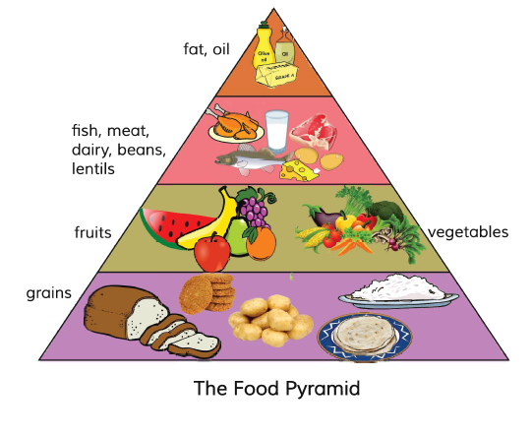
Look at the picture.
What do you see in the picture?

Slide 5
Lesson Declaration
Eat healthy
(What food is……good choices.)

Slide 6
Learning outcomes
Students will be able to:
Listening: 4.2.1 understand and enjoy simple stories.
Speaking: 3.1.1 ask and answer wh questions.
Reading: 5.1.1 read silently with understanding paragraph.
Writing: 10.2.1 write short and simple composition on familiar objects such as people place and events.

Slide 7
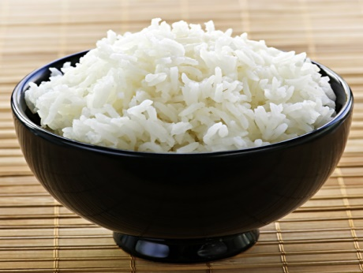
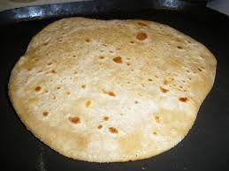
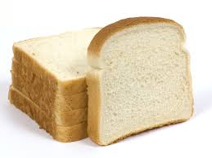
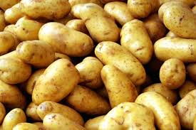
What kinds of these foods?
Rice
Ruti
Bread
Potatoes
Grains give us energy.
These are grains.

Slide 8
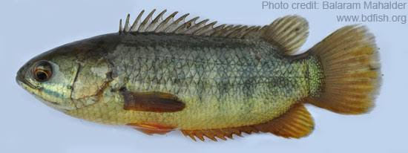
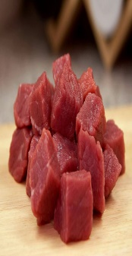
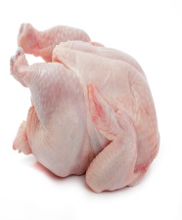
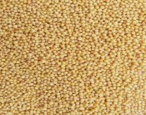
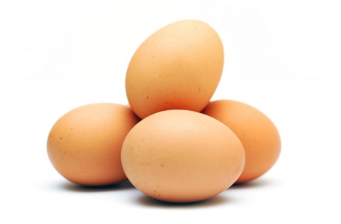
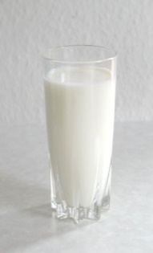
What have in these foods ?
Fish
Meat
Chicken
Lentils
Eggs
Milk
They have protein.

Slide 9
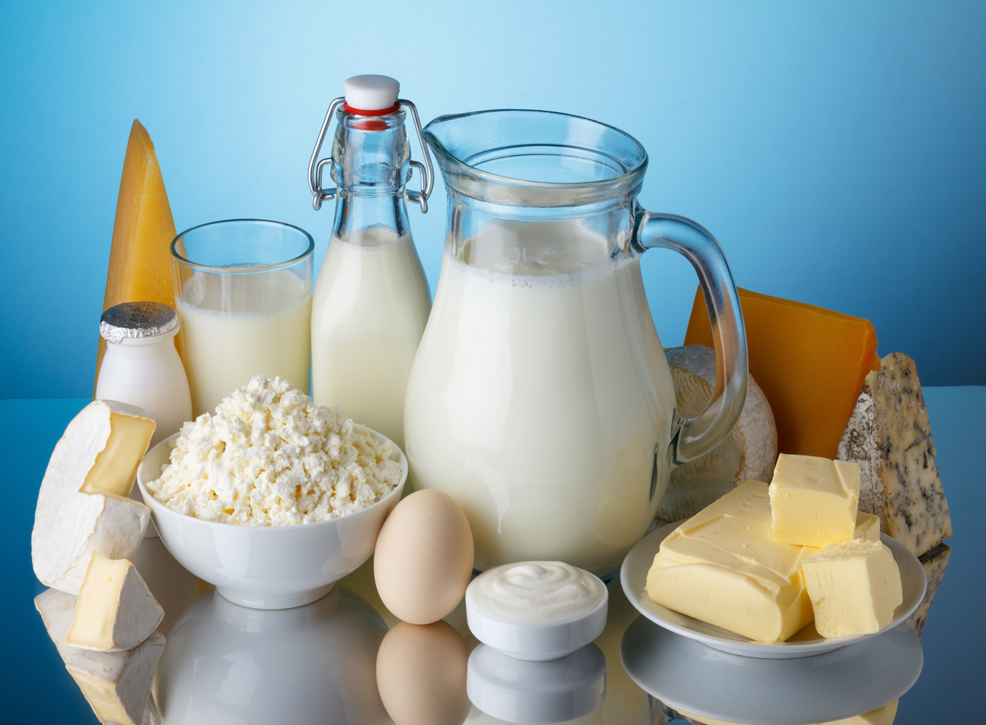
What is these?
Dairy products.
They help our teeth and bones.

Slide 10
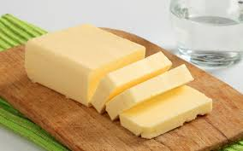
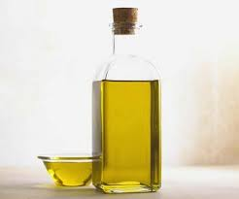
Which foods dose not need very much of our body ?
Fat/Butter
Oil
These make food delicious.

Slide 11
Food Pyramid
Fat and Oil
Dairy products
Vegetables
Bread, Patatoes
Rice, Ruti
Fruits
Fish, Meat
Lentils

Slide 12
There are 4 levels in the Food Pyramid.
Fat
and oil.
Fish, Meat, Dairy, Beans and lentils.
Fruits and vegetables.
Grains

Slide 13
Individual Work
Answer the following questions:
What is Food Pyramid?
How many levels are there in the Food Pyramid?

Slide 14
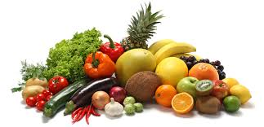
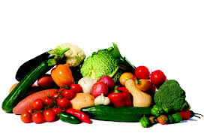
What have in these foods ?
Fruits
Vegetables
They have vitamins.

Slide 15
Pair Work
Answer the following questions:
What kind of foods are potatoes?
Write two sentences about fruits and vegetables?

Slide 16
New words
Different
Not the same
Bottom
Under
Similar
Same
Top
Above
Delicious
Taste
Grain
Corn

Slide 17
Now open your English book at page number 24. Listen to me attentively and put your finger under the line.
Read the text silently.

Slide 18
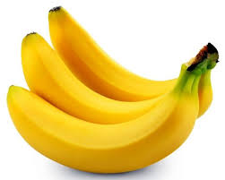
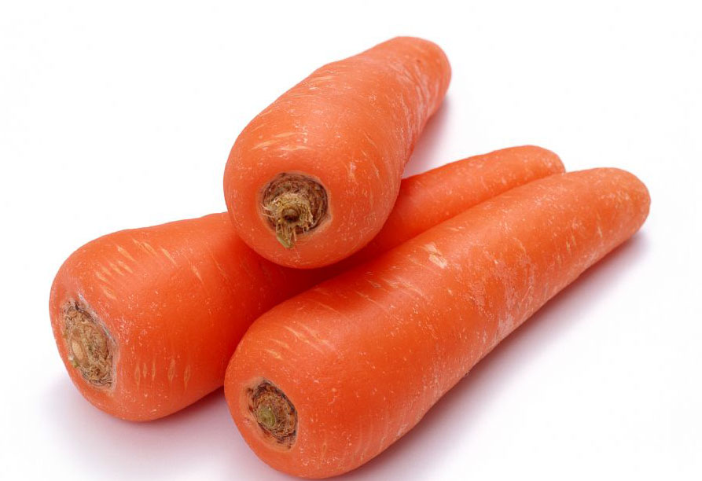
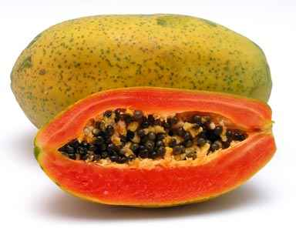
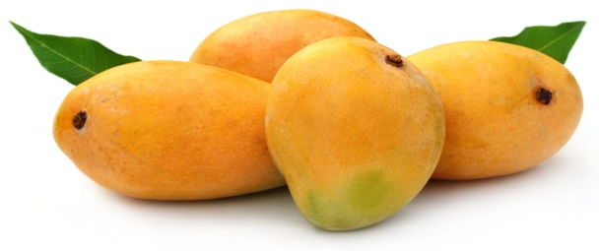
Everybody look at this pictures
Banana
Egg
Carrot
Papaya
Milk
Mango
What kind of these foods ?
Healthy Foods

Slide 19
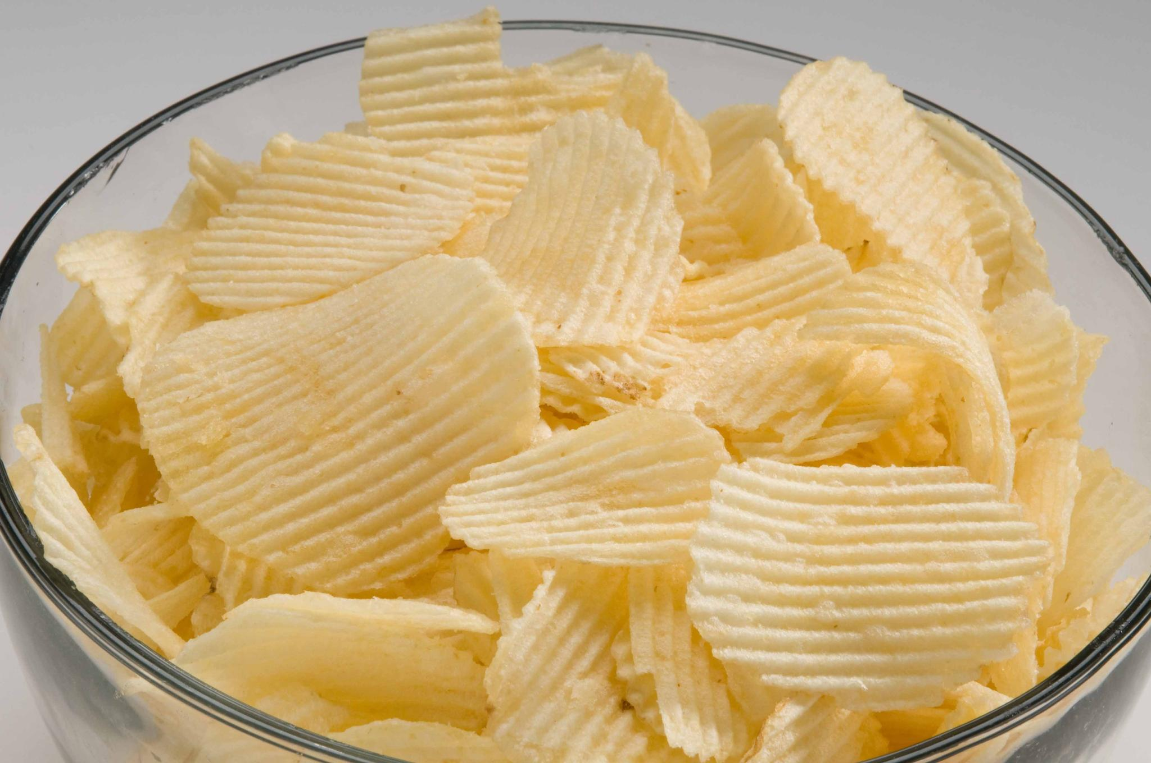
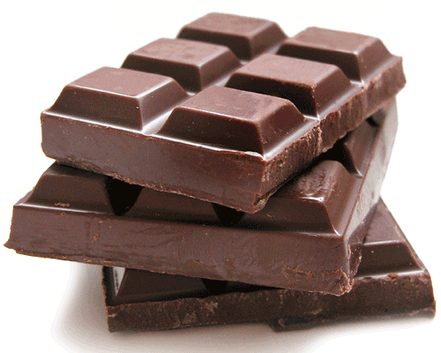
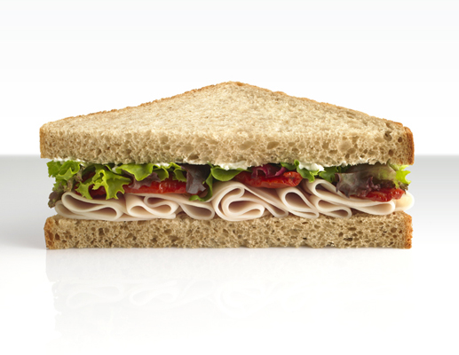
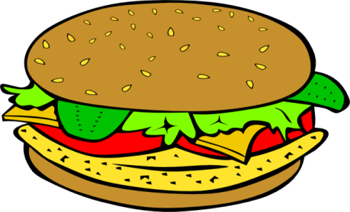
Look at these pictures
Ice-cream
Pija
Chips
Chocolate
Sandwich
Burger
What kind of these foods ?
Unhealthy Foods

Slide 20
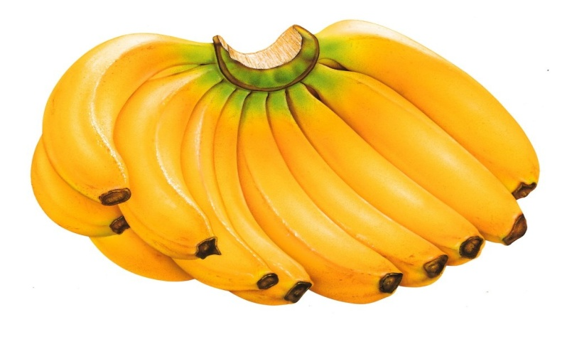
Group Work
Banana Group
Write names of five healthy food.
Carrot Group
Write names of five unhealthy food.

Slide 21
Evolation
Write a short composition on “The Food Pyramid” in at 5 sentences.

Slide 22
Lets play a bingo game
Write down any five of the following words in your notebook and follow my instructions.
Meat
Fish
Fruits
Fat
Oil

Slide 23
Home Work
What does the Food Pyramid tell us?
Which foods have protein? What does protein do?

Slide 24
Thanks everybody, Goodbye.

