Slide 2
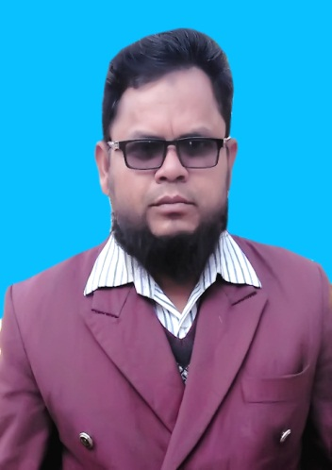
Md. Mominul Islam
Head Teacher
Ishanpur GPS.
Kaharol. Dinajpur
01717977443
mominict9@gmail.com

Slide 3
Class: Five
Subject: English
Unit: 24
Lesson: 2-3,
Cyclone Aila
Babul………in the sky.

Slide 4
Learning outcomes:
After finishing the lesson students will be able to……..
3.4.1- understand statements made by the teacher and students.
1.1.2- say sentences with proper intonation.
1.7.1- read paragraphs,dialoges stories,letters and other texts.
9.1.1-write short and simple paragraphs.

Slide 5
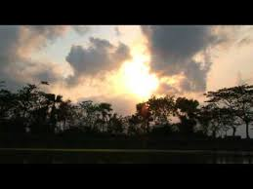
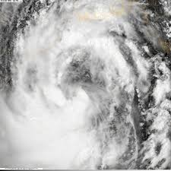
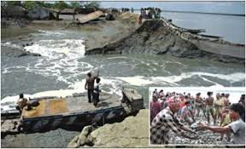
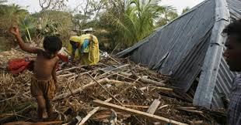
Pay your attention to the picture and think alone.

Slide 6
Watch the video

Slide 7
Today’s lesson:
Cyclone Aila

Slide 8
Open your text
book at page 95

Slide 9
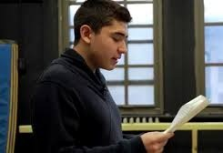
Teacher’s loudly reading.

Slide 10
New words
A shop selling foodstuff and other household necessities.
Grocery shop
Dark
Having no or very little light.
A small land surrounded by water.
Island
A protective covering of the top of a house.
Roof

Slide 11
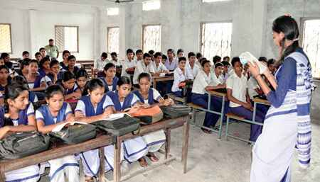
Student’s loud reading.

Slide 12
Student’s silent reading.

Slide 13
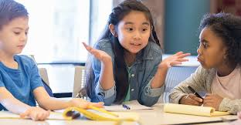
Group Work
Dublar char is an-----.
Babul’s family had-----members.
The sky was------on that evening.

Slide 14
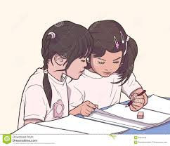
Pair work
Write True or False:
Nipa was seven years old.
Babul’s family lives on an island.
Babul’s parents checked the emergency kit.

Slide 15
Evaluation:
1. Where does Babul and his family live?
2. What was Babul’s father?
3. Why was everyone afraid?

Slide 16
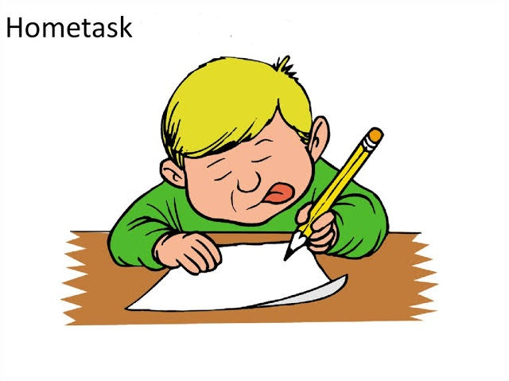
Write five sentence about Cyclone Aila.

