Slide 1
WELCOME

Slide 2
Introduction
Md.Ahsan Habib
Assistant teacher
33 no decreer char gps
Sadarpur,faridpur
ahsanhabib5183@gmail.com
Class:One
Subject:English
Unit:4
Lesson:1-3
Time:40 mins

Slide 3
Learning outcome
Students will be able to-
2.1.1 recognize and read the cardinal number upto 2 .
2.1.1 write the cardinal numbers upto 2 in figures

Slide 4
Let`s see the video

Slide 5
What do we see the vedio?
Number
(1,2)

Slide 6
Lesson Declaration
Number
(1,2)

Slide 7
Look,listen and say
What`s this?
How many balls?
1
ball

Slide 8
1
Look,listen and say

Slide 9
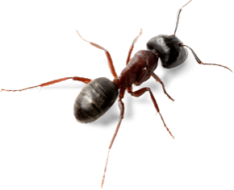
Look,listen and say
What is this?
2
How many ants?
ants

Slide 10
2
Look,listen and say

Slide 11
Say and read.Trace and write
1
1
1
2
2
2

Slide 12
Say and read.Trace and write

Slide 13
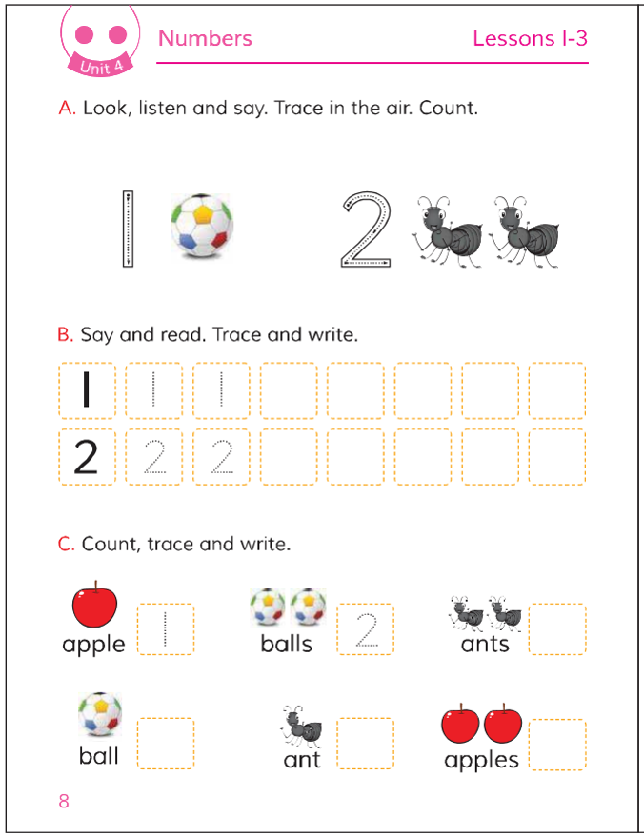
Open at page 8

Slide 14
Loud reading by the teacher

Slide 15
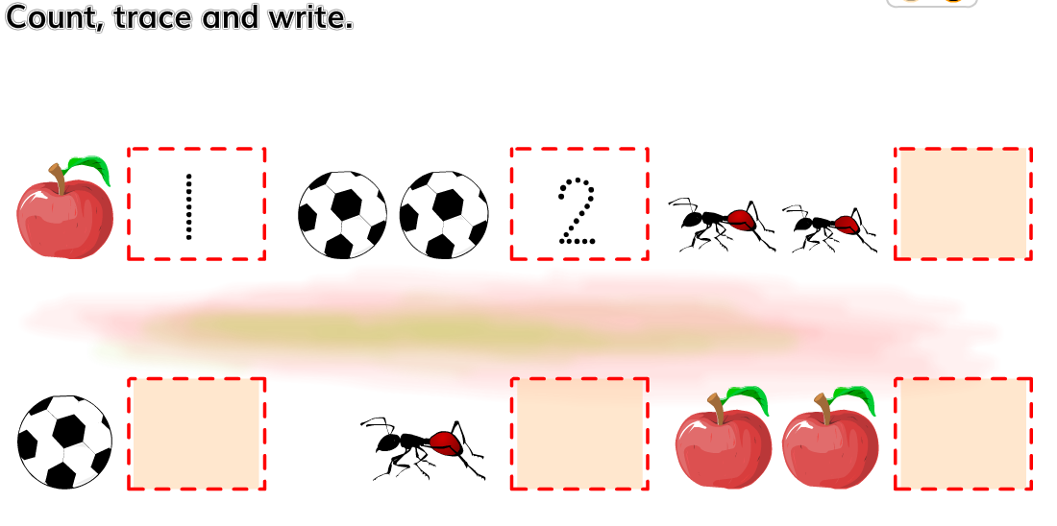
Individual work

Slide 16
Evaluation
Write number 1,2

Slide 17
GOODBYEE

