Slide 1
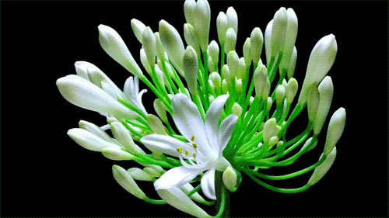
Welcome to English class

Slide 2
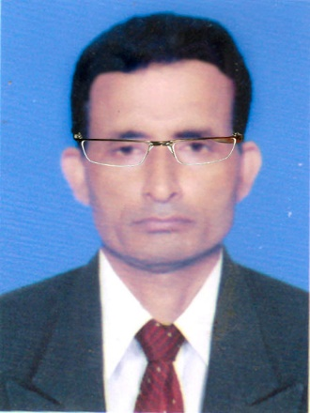
Identity
Manik Chandra Majumder
Senior Teacher (English)
Gazirhat High School
Senbag, Noakhali.
Mobile No: 01717155169
Email: manikmajumder01@gmail.com
Class : Nine-Ten
Subject : English 1st paper
Time : 50 Minutes
Date : 00/00/2018

Slide 3
Read &
Think
Knowledge = To know something about a
particular topic
Skills = Ability to do something practically
Attitudes = Bring about behavioural change

Slide 4
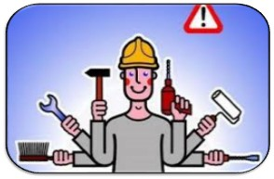
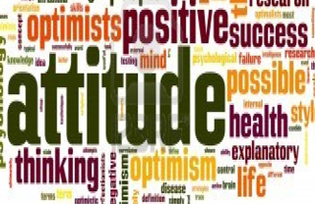
Knowledge
Skills
Attitudes
Behavioural change
Good character

Slide 5
Our today’s topic is-------
Good character
Honesty
Sincerity
Modesty
Dutifulness
Morality
Responsibility
Patriotism
Unit - 1
Lesson - 3

Slide 6
Learning Outcomes
After we have studied this lesson, we will be able to-------
ask and answer questions,
listen and understand others,
take part in conversation,
describe something in writing.

Slide 7
Work in pair
What do you understand by character?
Character is the combination of some good qualities such as----------------
A person of good character usually behaves well with other, doesnot-------
What does a person of good character usually do to others?

Slide 8
Listen the Audio
Good citizens are important in a society. How can be a good citizen? Generally it is believed that knowledge, manner, etiquette, behavior are some essentials qualities of a good citizen. Besides, positive attitudes to life and a good character are equally important to be a good citizen. Let us think about character. It is like to be a rooster crest. As the crest differentiates a rooster from a other hens, so do the characteristic features of a human being. These features differentiate a person from others. These traits or qualities cannot be earned automatically. Nor they just God given. They are to be learned and practiced.

Slide 9
Individual work-1

Slide 10
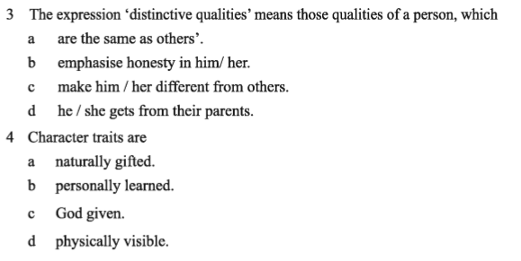

Slide 11
Fill in the gaps taking suitable words from the box.
Individual work-2
harmonious
allow
behaviour
respect
good
doing
family
class
sense
qualities
personally
believe
others
Citizens having good character live a life of virtue. They may belong to any social -----. upper or lower. Their thoughts and -------------show high moral values. That is they have a strong---------of right and wrong. So what they do------- for themselves as well as for other in the --------and in the society. In fact they cannot even think of -------- any wrong to others. One of the most positives---------- of these people is tolerance towards ---------. Suppose a group of people in your community --------- or practice something which you do not like------------------. But as a good citizen you should -----------them to perform their activities. Thus tolerance can generate------------the people of other religions and cultures. Tolerance and respect together can make life--------------- and peaceful.

Slide 12
Group work
Group-A
Make a list of some human qualities of a good citizen.
Group-B
What is meant by behavioural change.

Slide 13
Evaluation
Choose the best answer from the alternatives.
a) People with moral values-----------.
i. can do any thing wrong to others.
Ans :
Ans :
ii. cannot do any thing wrong to others.
ii. cannot do any thing wrong to others.
iii. do good only for themselves.
iv. belong to upper social class.
b) Skill is the --------- thing to be a good citizen.
i. second
ii. first
Ans :
i. second
iii. third
iv. fourth
Ans :

Slide 14
c) Tolerance means---------------.
i. Having disagreements with others
ii. a quality that every citizen has
Ans :
Ans :
iii. allowing others to say and do as they like.
iii. allowing others to say and do as they like
vi. quality of Buddhists
d) To do things one should apply his/her knowledge-----------------.
Ans :
Ans :
i. naturally
ii. normally
iv. practically
iii. artificially
iv. practically

Slide 15
e) What can make life harmonious in society ?
Ans :
i. performing religious rites.
ii. encouraging cultural values.
Ans :
iii. respecting others’ beliefs and opinion.
iii. respecting others’ beliefs and opinion.
vi. fulfilling religious obligation
f) -------------------changes one’s towards others.
Ans :
ii. working
Ans :
i. knowing
iv. knowing and doing other.
iii. doing pair work
iv. knowing and doing other.

Slide 16
Home Work
Write a paragraph about “Good character”.

