Slide 2
Introdructions
Md.Faruk Hossain
Assistant Teacher
Khalippur Dangi Govt:
Primary School.
Nawabgong,Dinajpur.
Class:Three
Unit 2
Lessons:1-3
Title of lesson:Introducing a teacher.
Time: 40 minutes
Date:22-01-2020

Slide 3
Learning outcomes:
Listening:
3.1.1 understand simple questions about student, family and friends.
3.3.1 understand statements
Reading: read simple sentences with proper pronounciation and stress.
5.1.3 read text.
Students will be able:

Slide 4
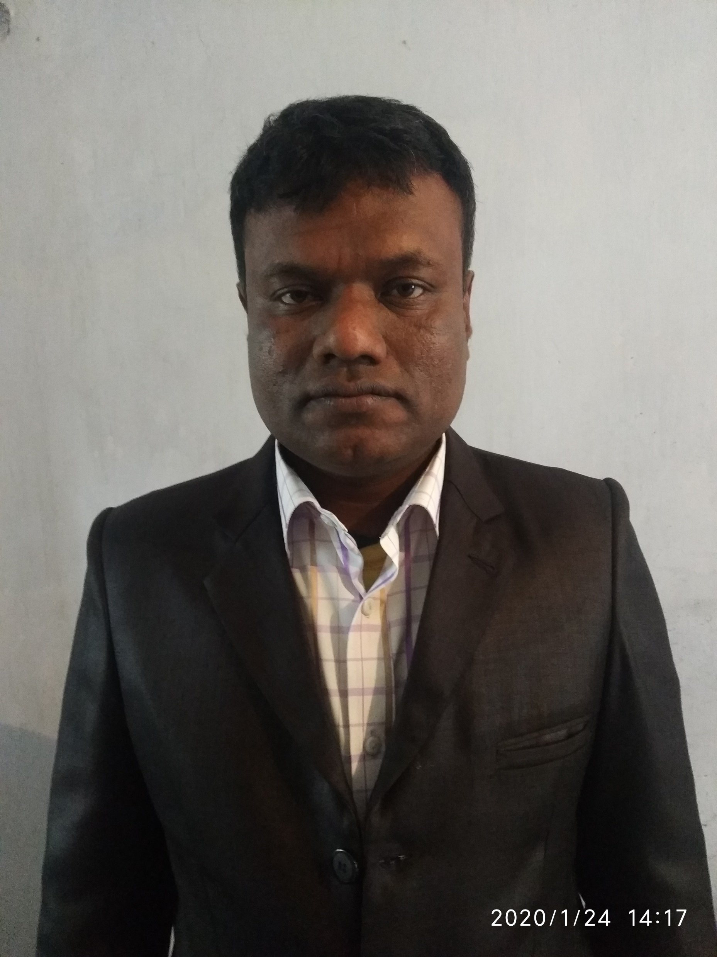
Who is he?

Slide 5
Introduce A teacher

Slide 6
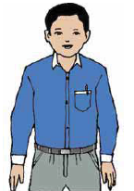
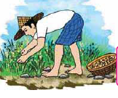
What do you see?
Teacher
Who teaches
Master
Work
To do something
Act

Slide 7
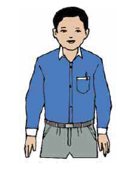
This is Mahbub Alam. He is 30 years old.

Slide 8
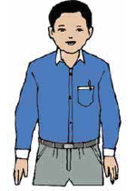
He is an English teacher. He works in a primary school in Narail.

Slide 9
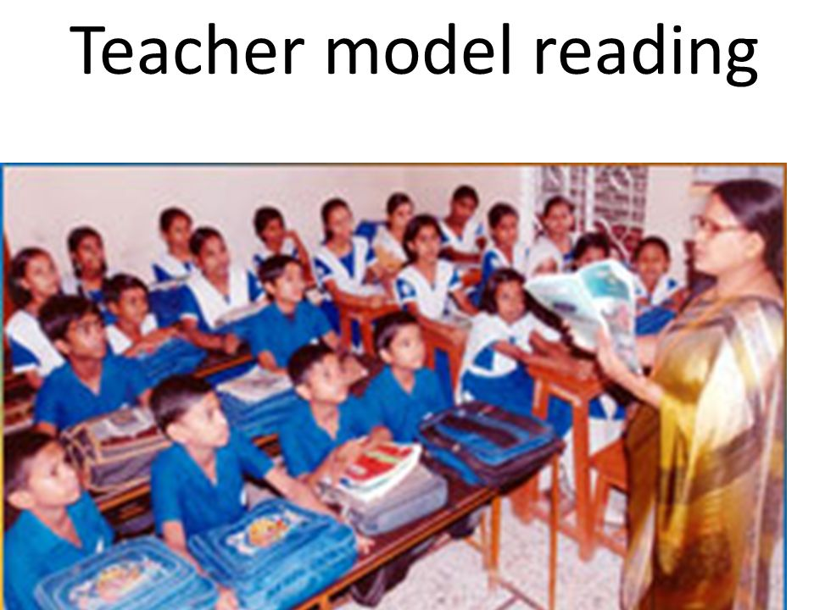
Teacher will read the text loudly and student will listen.

Slide 10
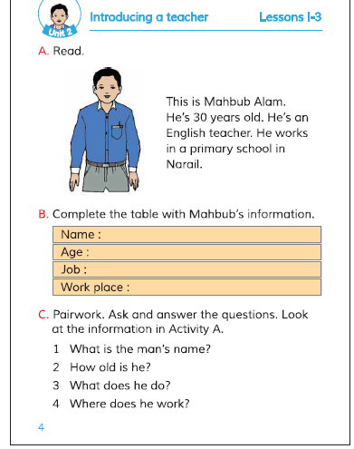
Students, open at page 4

Slide 11
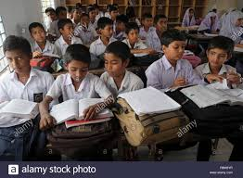
Student model reading
Student will read loudly and silently.

Slide 12
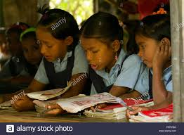
Group A will ask B will answer and C will ask and D will answer.

Slide 13
Let’s play Bingo Game
Write down any four words in your own exercise book and follow my instructions.
Old
Year
School
Teacher
Work
Primary

Slide 14
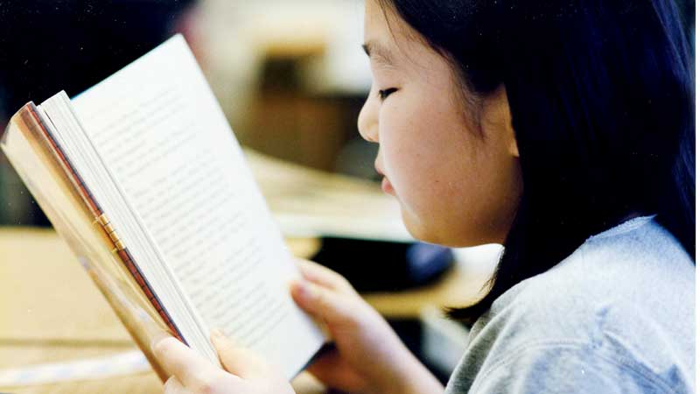
Students individual reading
Student will be able to read the text individually

Slide 15
Answer the following questions.
What is the man’s name?
How old is he?
What does he do?

