Slide 2
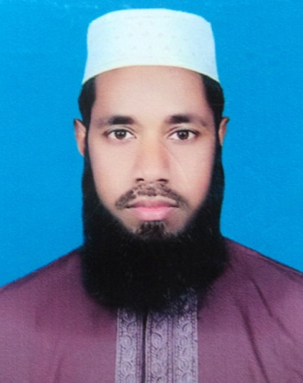
Teacher’s Identity
Anamul Haque
Assistant Moulavi
Talora S A Kamil Madrasah
Dupchanchia, Bogura
Email: anamultalora@gmail.com
Mobile: 01721-463748

Slide 3
Lesson’s introduction
Class : Eight
Subject : English 1st Part.
Unit : One
Class Duration : 50 minutes
Date: 30.03.2019

Slide 4
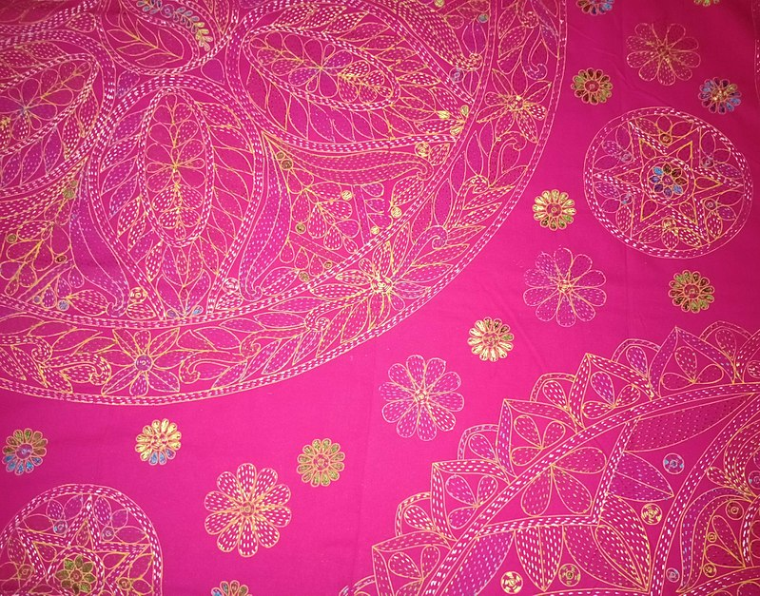
What do you see in the picture?
What is it called?

Slide 5
Today’s Lesson
Nakshi Kantha

Slide 6
Learning outcomes:
At the end of the of the lesson, learners will be able to……..
fill in the blanks
ask & answer questions
write a short paragraph

Slide 7
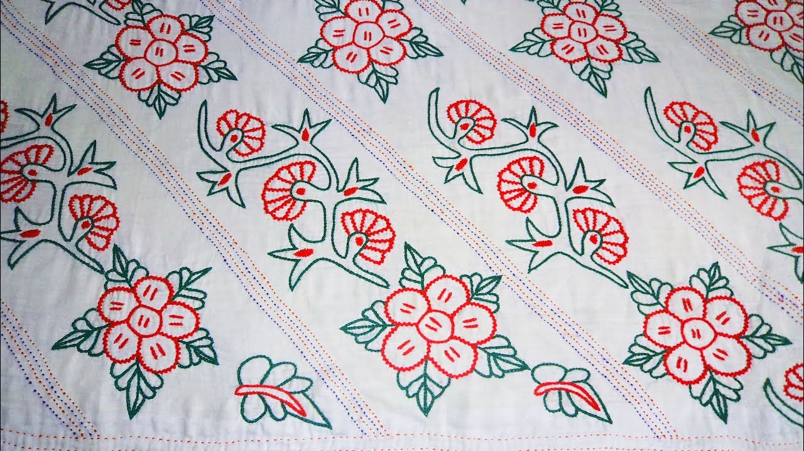
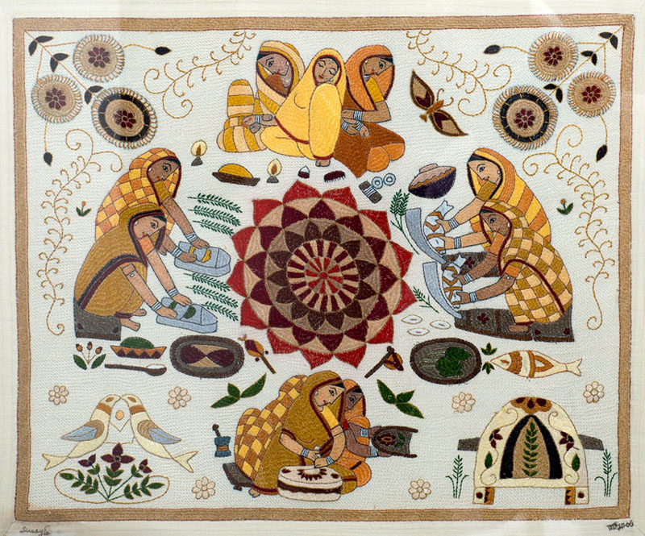
New words presentation:
Artistic
Traditional
Having or revealing creating style.
Attached to old custom

Slide 8
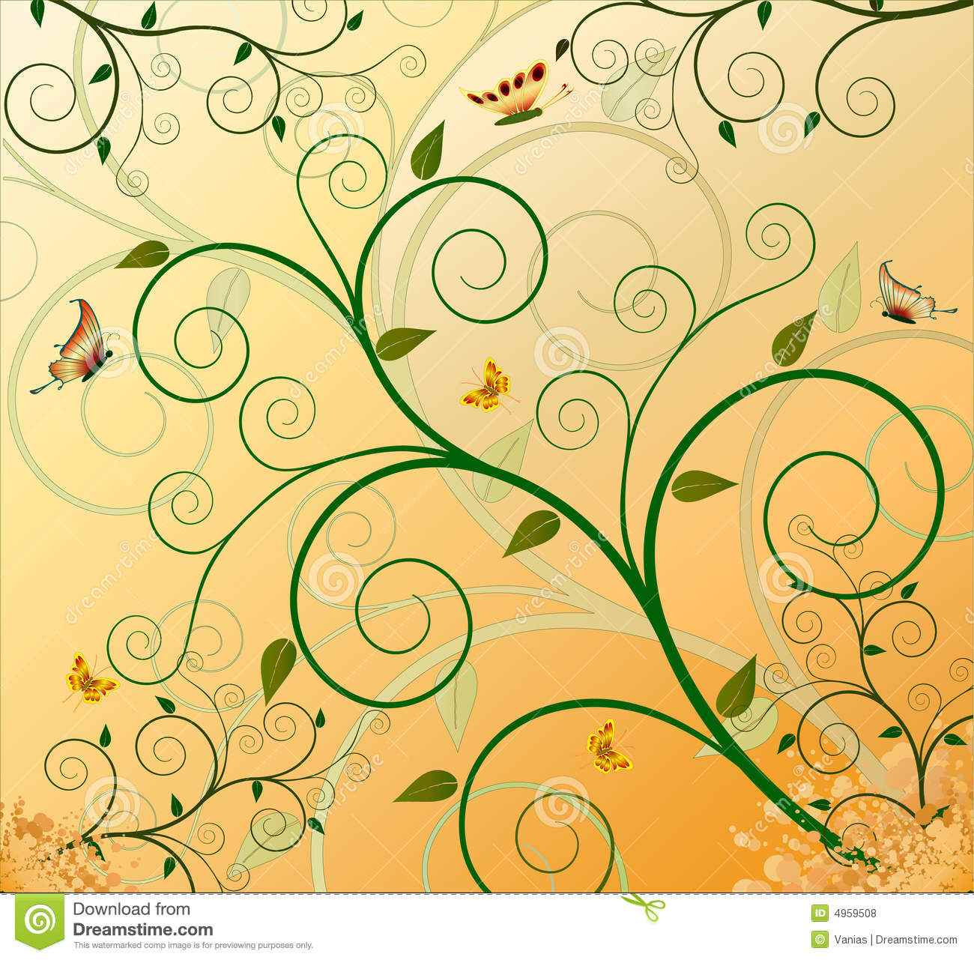
Pattern
Decorative arrangement

Slide 9
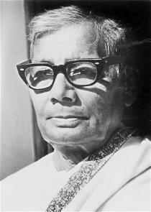
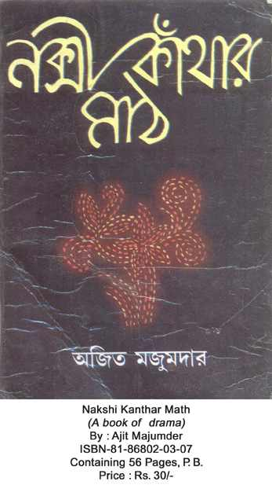
Jasimuddin
The name Nakshi kantha became famous after the poet Jasimuddin’s poem Nakshi kanthar Math was published in 1929.

Slide 10
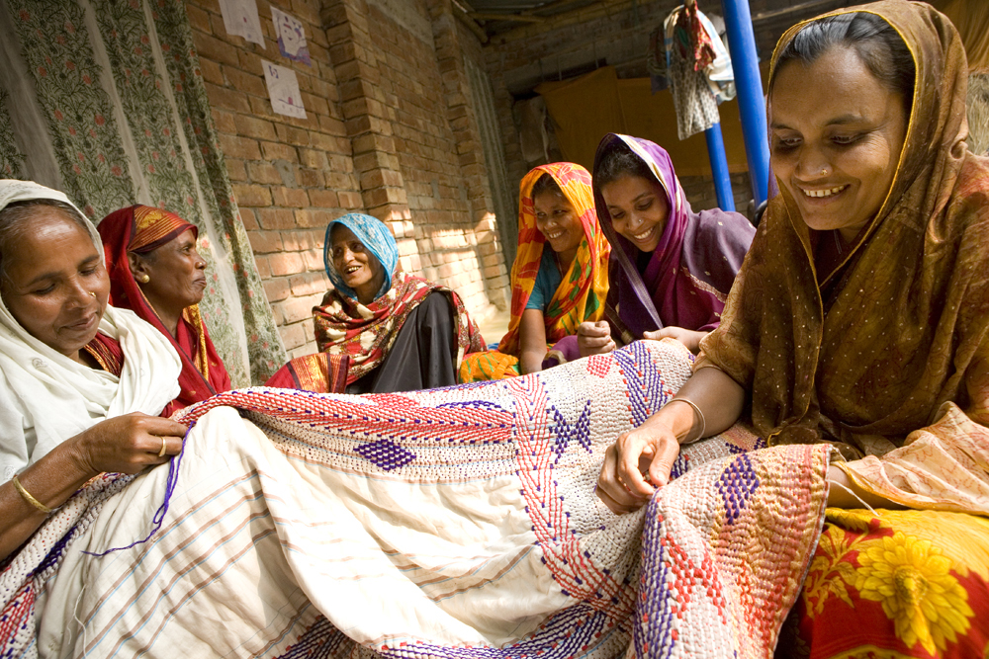
Traditional Kanthas are made for family use. Old or new clothes and thread are used to make these quilts. Mymensing, Jamalpur, Rajshahi, Faridpuir, Bogura and Jessore are most famous for this craft.

Slide 11
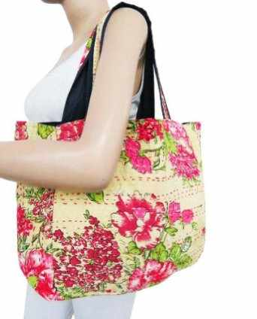
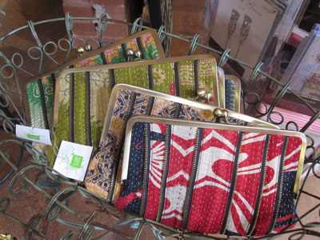
Now, it is produced commercially. We find them in many expensive handicraft shops in cities. The quilts are now in great demand because of the colourful pattern & designs.

Slide 12
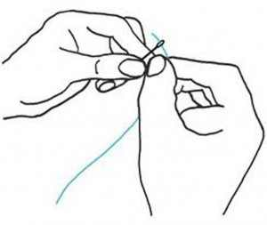
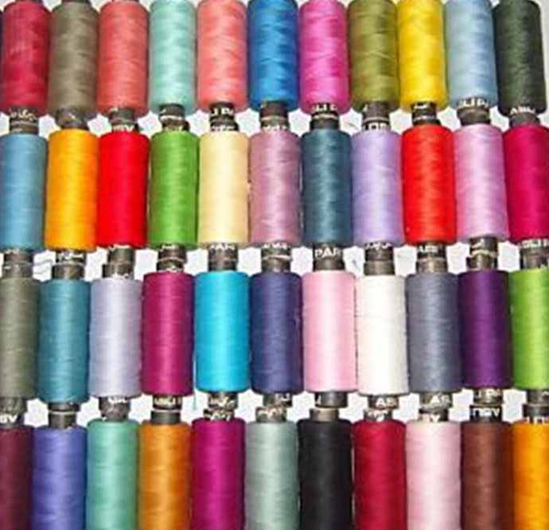
What are needed to make a nakshi kantha?
To make a nakshi kantha we need
Needle
Colorful thread

Slide 13
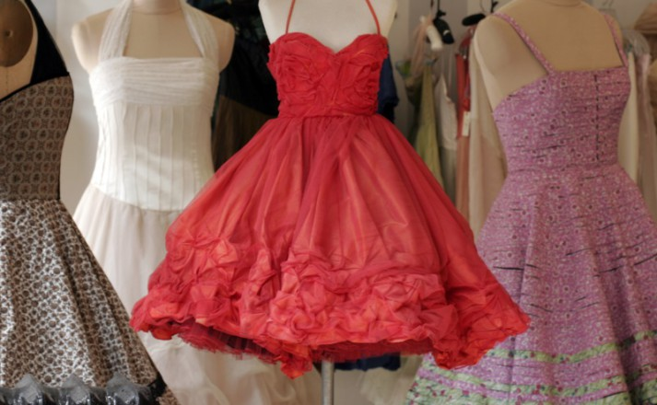
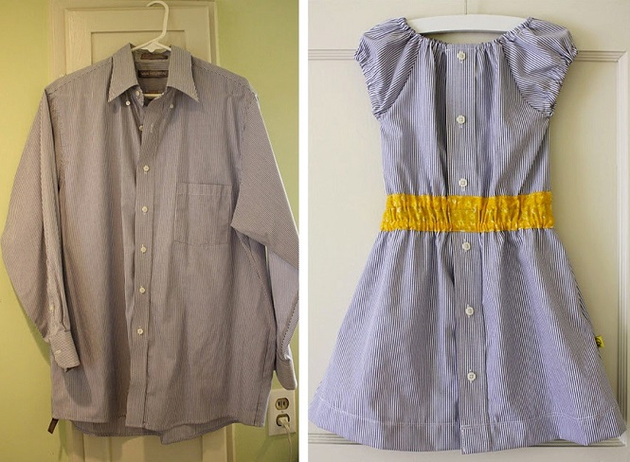
New cloth
Old cloth

Slide 14
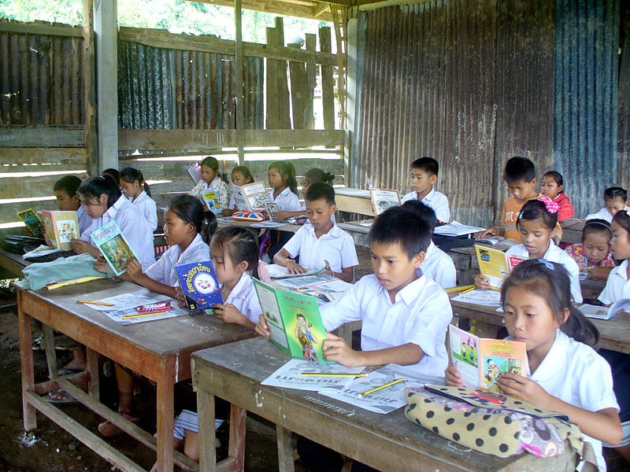
Now, read the passage silently.

Slide 15
Now, read the text silently and complete the sentences individually with clues given below: (Individual work) 05 minutes
Bengali, embroidered, luxurious, west, design, noksha…..
Naksha means artistic …………..
The name was taken from a ………… word……..…
The art has been practised in………….Bengal.
Nakshi kanthas are now sold in ………………..shops.
Nakshi kanthas are a kind of ………………….quilt.
design
Bengali
noksha
west
luxurious
embroidered

Slide 16
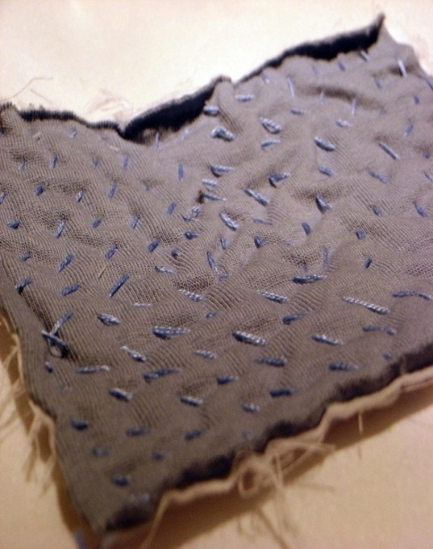
Now, read the text silently again and discuss in pair and tell about the pictures (Pair Work)
Jasim Uddin
Nakshi Kantha

Slide 17
Answer the following questions:
10 minutes
1. Who was Jasim Uddin ?
2. Who usually make these kanthas ?
3. Why is Nakshi Kantha popular ?

Slide 18
Solutions
1. Jasim Uddin is a famous Bengali Poet.
2. Women in the rural areas usually make these kanthas.
3.Nakshi Kantha is popular because of it’s attractive color and design.

Slide 19
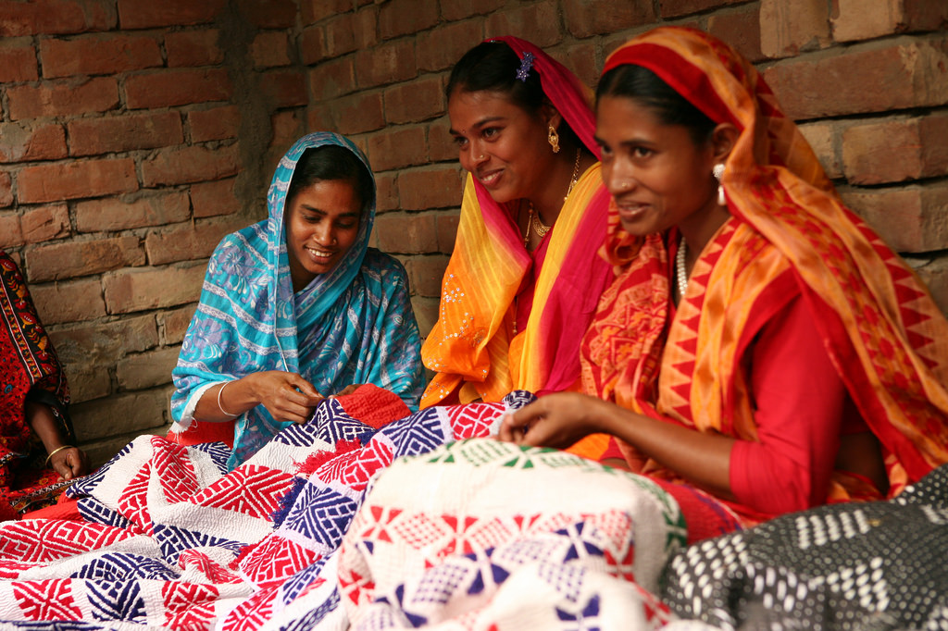
Look at the following picture:
(Group work)
Women are making nakshi kanthas

Slide 20
Answer the following questions:
10 minutes
Group-1. Where has the art been
practised?
Group-2. Do you like Nakshi Kantha
and why?
Group- 3. Why are Nakshi Kanthas in
great demands?

Slide 21
Solutions
The art has been practised in rural
areas of Bangladesh.
2. Yes, We like Nakshi Kantha for having
artistic pattern.
3. Nakshi Kanthas are in great demands
because of their different color and
designs.

Slide 22
Evaluation
1. What is Nakshi Kantha ?
2. Who wrote ‘Nakshi Kanthar Math’ ?
3. Where was the name taken from?
4. When was ‘Nakshi Kathar Math’
publised ?

Slide 23
Solutions
Nakshi Kantha is a kind of embroidered quilt.
2. Jasimuddin
3. The name was taken from naksha.
4. ‘Nakshi Kanthar Math’ was published
in 1929.

Slide 24
Home Work
Write a short paragraph on ‘Our Traditional Craft’ in your own words.

Slide 25
Bye Bye

