Slide 2
Welcome to my ICT Class

Slide 3
Identification
Md. Abu Abdur Rahman Siddiquee
(M. A, B. Ed)
Senior Assistant Teacher (English)
Jagarani M. L Girls’ High School
Newashi, Nageswari, Kurigram.
Master Trainer, UITRCE, BANBEIS.
E-mail: siddiquee1211@gmail.com
Contact No. 01743943113
Information and communication Technology
Class : 10
Total Ss: 53
Present Ss: 48
Duration: 50 Minutes
Date: 20/01/2020

Slide 4
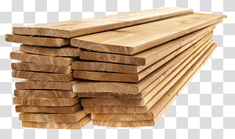
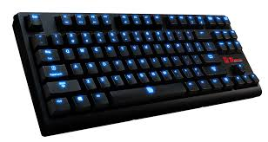
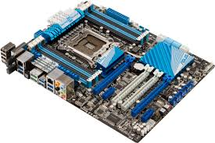
Look at the pictures
What is the main important part of a computer?

Slide 5
MOTHERBOARD

Slide 6
LEARNING OUTCOMES
After completing the lesson, students will be able to…
say about motherboard;
identify the major parts of motherboard;
define the parts of the motherboard;

Slide 7
Mother Board/Main Board
The motherboard is the most important part of a computer and is the main circuit board. Everything connects directly or indirectly to it.

Slide 8
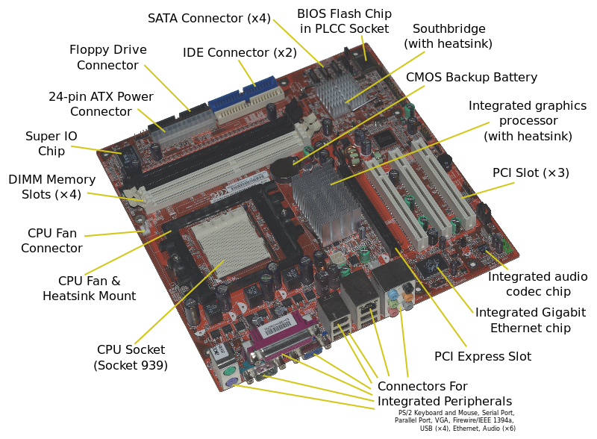
The important components of an ATX Motherboard are given below:

Slide 9
Form Factor
The form factor refers to a motherboard's dimensions and layout of its components.
The primary standard today is some type of ATX (Advanced Technology Extended) form factor, developed from the obsolete AT. ATX and micro ATX (mATX) are still the most popular.
Form Factor | Size
ATX (Standard) | 9.6" x 12"
Micro ATX | 9.6" x 9.6"
Extended ATX | 13" x 12"
Mini ATX | 8.2" x 11.2"
Mini ITX | 6.7" x 6.7"

Slide 10
Individual Work
Answer the following questions:
What is the main part of a computer?
What is called motherboard?

Slide 11
BIOS(Basic Input Output System) Chip
Every motherboard has a BIOS. This chip contains a small amount of code that is responsible for booting up your system.
It reads the CMOS settings, performs the POST (Power On Self Test), checks for devices, and then reads the master boot record on the hard drive so the operating system can load.

Slide 12
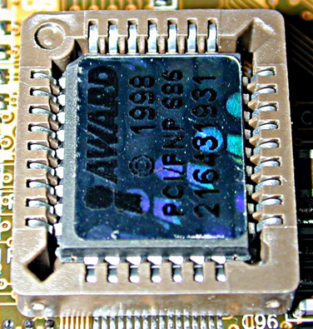
BIOS:
BIOS combination
BIOS program
CMOS stores BIOS program
BIOS parameter
BIOS hardware components
BIOS ROM
PC startup program (POST)
BIOS CMOS memory
house the configuration information of individual PC

Slide 13
BIOS vs. CMOS:
BIOS | CMOS
Non-volatile (stays same after power off) | Volatile (kept alive with battery)
Typically 64 K of programs | Typically 128 K of data
Programs | Data

Slide 14
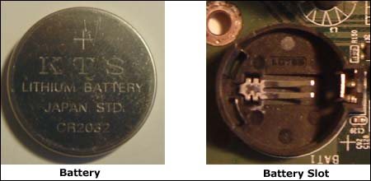
Battery:
Every motherboard has a battery to maintain the time and CMOS settings after the power is turned off. Most are small, round, flat and fit into a socket.

Slide 15
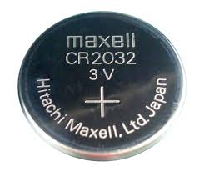
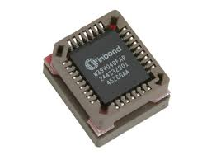
Pair Work
Identify BIOS and CMOS:
What are the differences between
BIOS & CMOS?

Slide 16
Chipset:
The chipset is either one chip or a pair of chips that allows communication between the CPU and other components.
If there are two chips one is called the north-bridge and the other south-bridge.

Slide 17
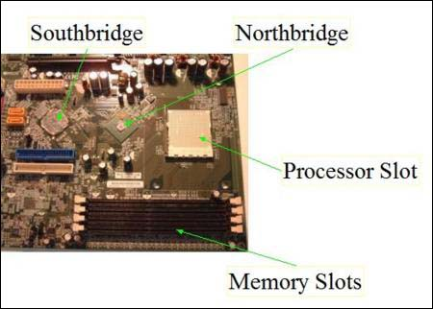
Chipset:
The northbridge connects directly to the processor through the front side bus and to the memory, AGP, and PCI Express controllers.

Slide 18
Chipset:
The south-bridge connects to the processor indirectly via the north-bridge and controls slower devices such as the hard drive, USB, audio, video, LAN, and PCI.
If there is one chip, then everything is controlled by that chip.
When a new processor is developed, a new chipset has to also be developed to accommodate its technology.
The two main manufacturers are nVIDIA and Intel.

Slide 19
Bus & Bus Speed:
In electronics, we can think of a bus as an electronic highway on which data travels.
With computers there has to be a communication highway between the CPU and other parts.
AMD motherboards use Hyper Transport technology for data transport.
Intel's Core i processor-based systems use Quick Path Interconnect. But before these there was/is the front side bus.

Slide 20
Bus & Bus Speed- Front side bus:
On current Intel computers not using the Core i processor, the front-side bus is still used as the data path that connects the processor to the north-bridge and other components.
"1333 MHz“ bus speed means the front side bus speed, also known as the motherboard speed.
This speed is obtained by using a quartz crystal on the motherboard. When current passes through it, it vibrates. These vibrations, or pulses, occur millions of times per second. This is what's known as the clock speed.

Slide 21
Bus & Bus Speed- Hyper Transport:
It eliminated the front side bus (FSB) and took the memory controller, which was previously on the chipset, and placed it on the processor.
The old front side bus used one data path from the CPU for memory and I/O (Input/Output). HTT implements two separate data paths for memory and I/O.
Also, unlike the FSB, data flow between the CPU and the chipset can be sent and received at the same time.

Slide 22
Bus & Bus Speed- Quick Path Interconnect (QPI):
It basically does the same thing as HTT but only uses DDR3 memory.

Slide 23
Central Processing Unit (CPU):
The Central Processing Unit (Normally called a processor or CPU) is the brain of the PC. It executes instructions, allowing a computer to perform all kinds of tasks.
Processors consist of two parts: The Arithmetic Unit, which performs math and logical operations, & the Control Unit, which decodes instructions.
AMD and Intel are the two primary manufacturers.

Slide 24
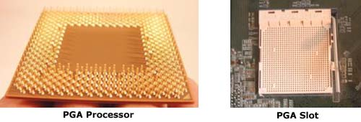
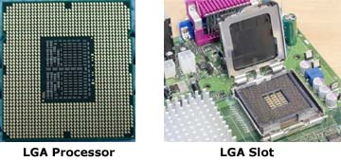
Central Processing Unit (CPU):
There are 2 types of Processor:
Pin Grid Array (PGA) Processor
--- Pin is located with the processor itself.
Land Grid Array (LGA). Processor
---- Pin is located in the slot.

Slide 25
Expansion Slots:
All computers now-a-days come with audio, video, and other features built right into the motherboard.
If you don't want to use these, expansion slots give you the flexibility to choose and have your own audio, video, or other card installed.

Slide 26
Internal Diagram of a main board:

Slide 27
Power supply plug in:
The Power supply, as its name implies, provides the necessary electrical power to make the pc operate.
The power supply takes standard 110-V AC power and converts into +/-12-Volt, +/-5-Volt, and 3.3-Volt DC power.
The power supply connector has 20-pins

Slide 28
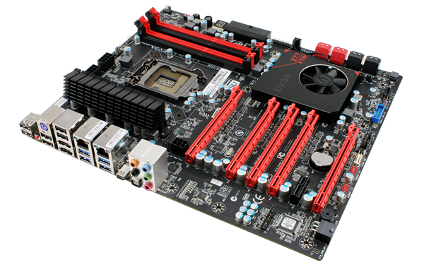
LEARNING ASSESSMENT
What is motherboard?
Write the difference between CMOS
and BIOS
Identify north-bridge and south-bridge

Slide 29
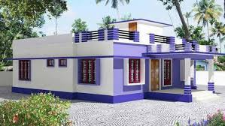
Write any six parts and define the parts of the motherboard.

