Slide 1

Welcome to the Multimedia Class

Slide 2

Introduction
Jahan ara
Assistant Headmaster
Nishat Jute Mills Adarsha Bidyalay
Tongi, Gazipur
Class-Eight
English 1st Paper

Slide 3
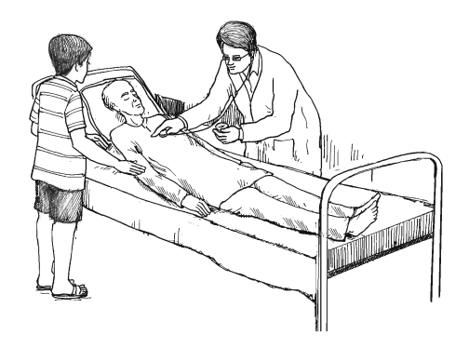
What about the picture?
Discuss with your partner then answer the following questions.
What do you see in the picture ?Who is the man in an apron?

Slide 4
So today we’ll discuss about
A dialogue
About Doctor & Patient

Slide 5
Learning outcomes
After completing this lesson, students will be able to-
Ask and answer the question.
Practice sounds.
Make the sentence with the word.
To write a dialogue.

Slide 6
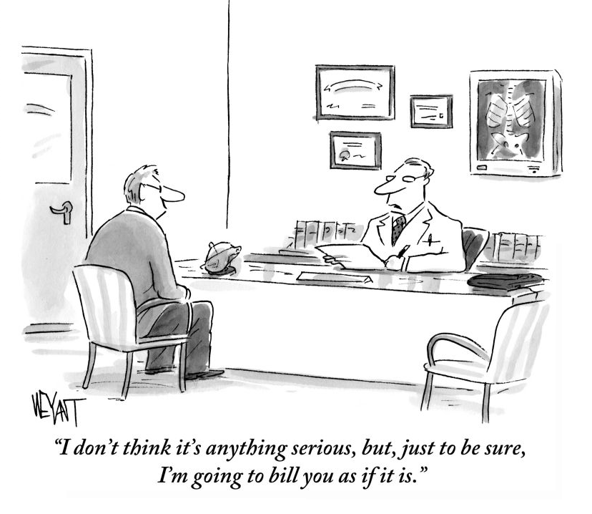
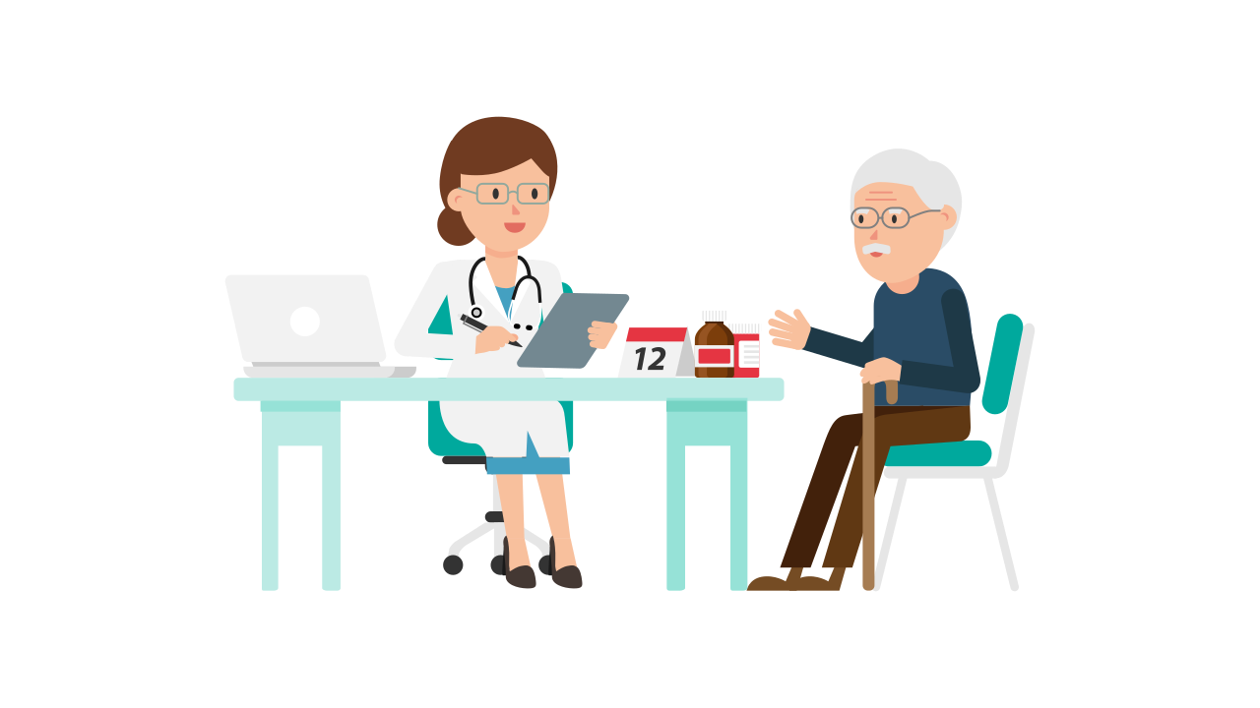
What can you see in the picture?

Slide 7
Patient
May I come in?
Doctor
Yes ,of course
Patient
May I have a seat please?
Doctor
Please.Tell me what is yourproblem?

Slide 8
Patient
I have been suffering from fever & bad cough for three days
Doctor
Did you take any medicine?
Patient
Yes, I have taken only napa .
Doctor
Ok. Let me check.

Slide 9
Patient
Is there any serious matter ?
I don’t think so.May be virus.Well ,I will give you some test.Please do it immediately & see the report soon
Doctor
Patient
Ok .sir.
Doctor
I also give you a medicine & take it three times per day.

Slide 10
Patient
Thank you sir.I will Meet You soon with my report
Doctor
Don’t worry. Get well soon
Patient
Thank you,sir
Doctor
Wel come

Slide 11

Group work
What do you do When do you feel sick?
What did you do to get well?
Notes:
Students will see the pictures, they can discusses it with their partner and will write minimum five sentences, teacher also can help them if necessary.

Slide 12

Home Work
A Dialogue
Suppose you visited a doctor for a stomach pain. Write an imaginary dialogue between you and the doctor.

Slide 13


THANK
YOU

