Slide 1


WELCOME

Slide 2
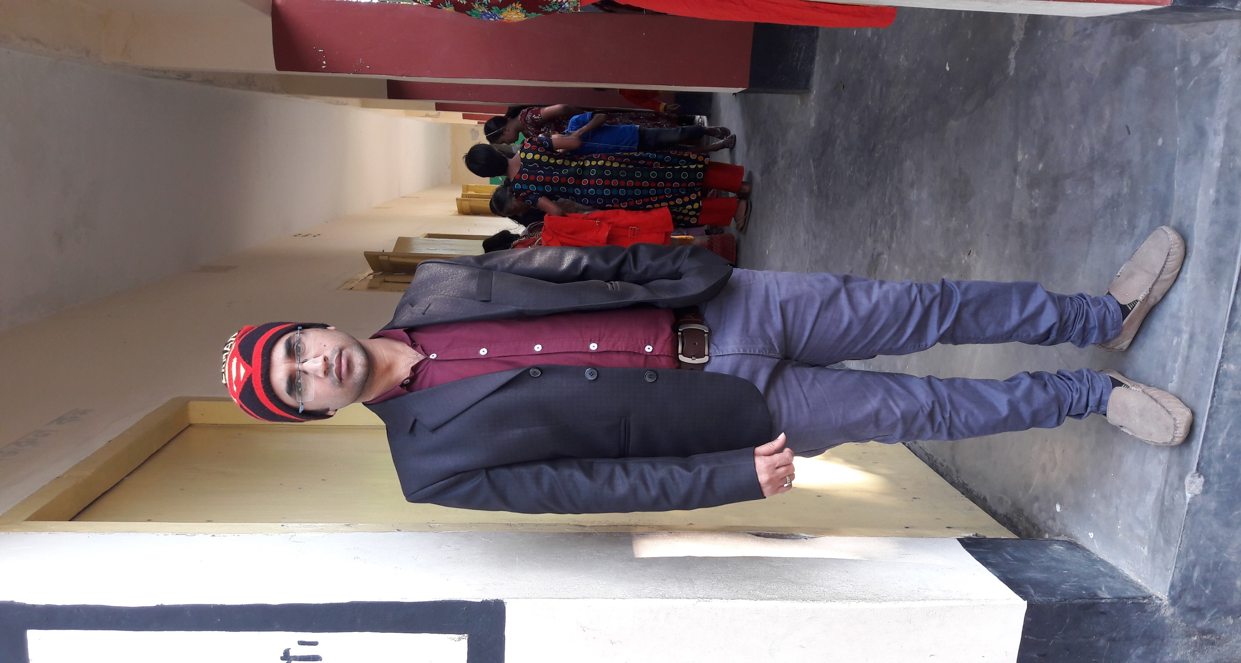
Presented by
Name : Prokash Chakravarty.
Assistant Teacher
7 No. Dighalia Govt. Primary School
Kotalipara, Gopalganj.
Email: prokash.ch@gmail.com

Slide 3

Introduction of the Lesson
Subject : English
Class : Two
Unit 1: Alphabet (Lesson 4)
Part of the lesson : A. Look, Listen Say [ A-E].
Page : 3
Time : 40 minutes
Date : 22nd January, 2020.

Slide 4
Learning outcomes
By the end of the lesson student will be able to –
Listening : 1.1.1 become familiar with English sounds by listening to common English words.
Speaking : 1.1.1 repeat after the teacher simple words and phrases.
1.1.2 say simple words and phrases with proper sounds and stress.
Reading : 1.2.1 recognize and read the alphabet both small and capital(non-cursive).
1.3.1 recognize and read the names of objects having the same initial and final sounds.

Slide 5

Creating safety environment
Let’s sing the greeting song

Slide 6

One Day one word
Read and say:
Bag [ব্যাগ]
– থলে
Spell out the word aloud

Slide 7
Diclaration of Lession
Today we will learn to make the words by the letters a , b, c, d & e.

Slide 8
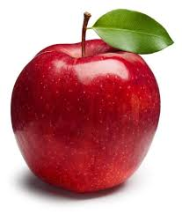
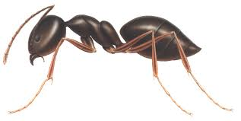

What is this?

Slide 9
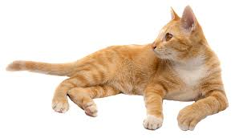

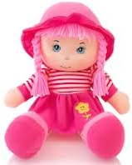

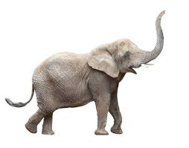
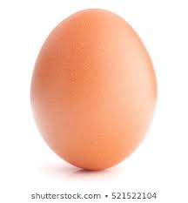

Slide 10
What can you see in the pictures? / What are these?
A
a
nt
What is the name of the letter?
Letter sound – /a//

Slide 11

B
b
at
C
c
at

Slide 12
D
d
oll
E
e
gg

Slide 13
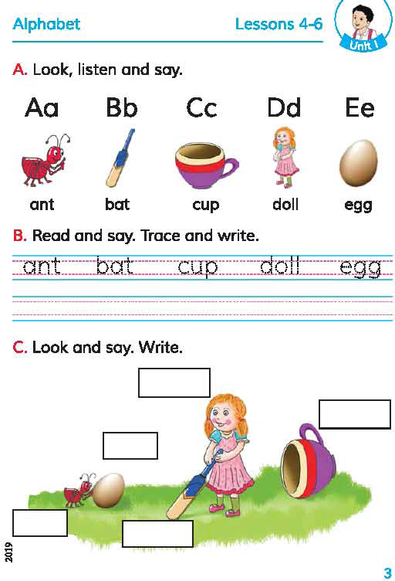
Students, open your book at page 3.

Slide 14
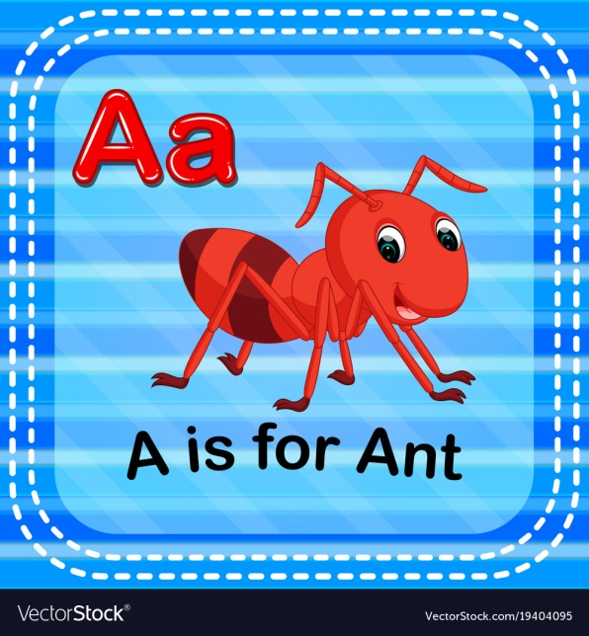
Read aloud with me

Slide 15

Bb
B is for Bat

Slide 16


Slide 17
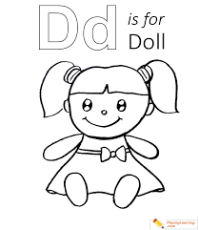

Slide 18


Slide 19
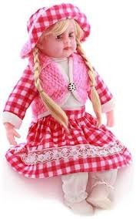

Do in pairs
One will show/point the pictures/letters, another will say the pictures/letters name:
ant
bat
doll
egg
cup
cup

Slide 20

Evaluation:
A
Match the letters
with the pictures:
(individual work)
B
C
D
E

Slide 21

A
B
C
D
E

Slide 22
Home work
Hand writing practicing:
A
a
B
b
Cc
Dd
Ee

Slide 23

Thank you, that’s all for today.
Playing “Goodbye” song from EIA.

