Slide 1
WELCOME

Slide 2
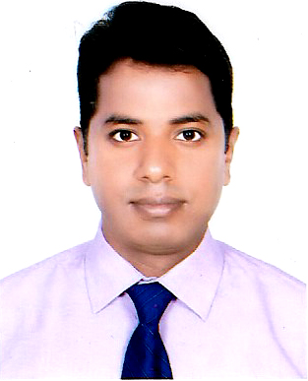

Introduction
MD. ANWAR PARVEZ
Assistant Teacher (English)
Rajar Bazar Govt. High School
Chunarughat, Habiganj
Mobile: 01737714340
E-mail: parvez.at@gmail.com
Class: IX-X
Subject: English 1st Paper

Slide 3
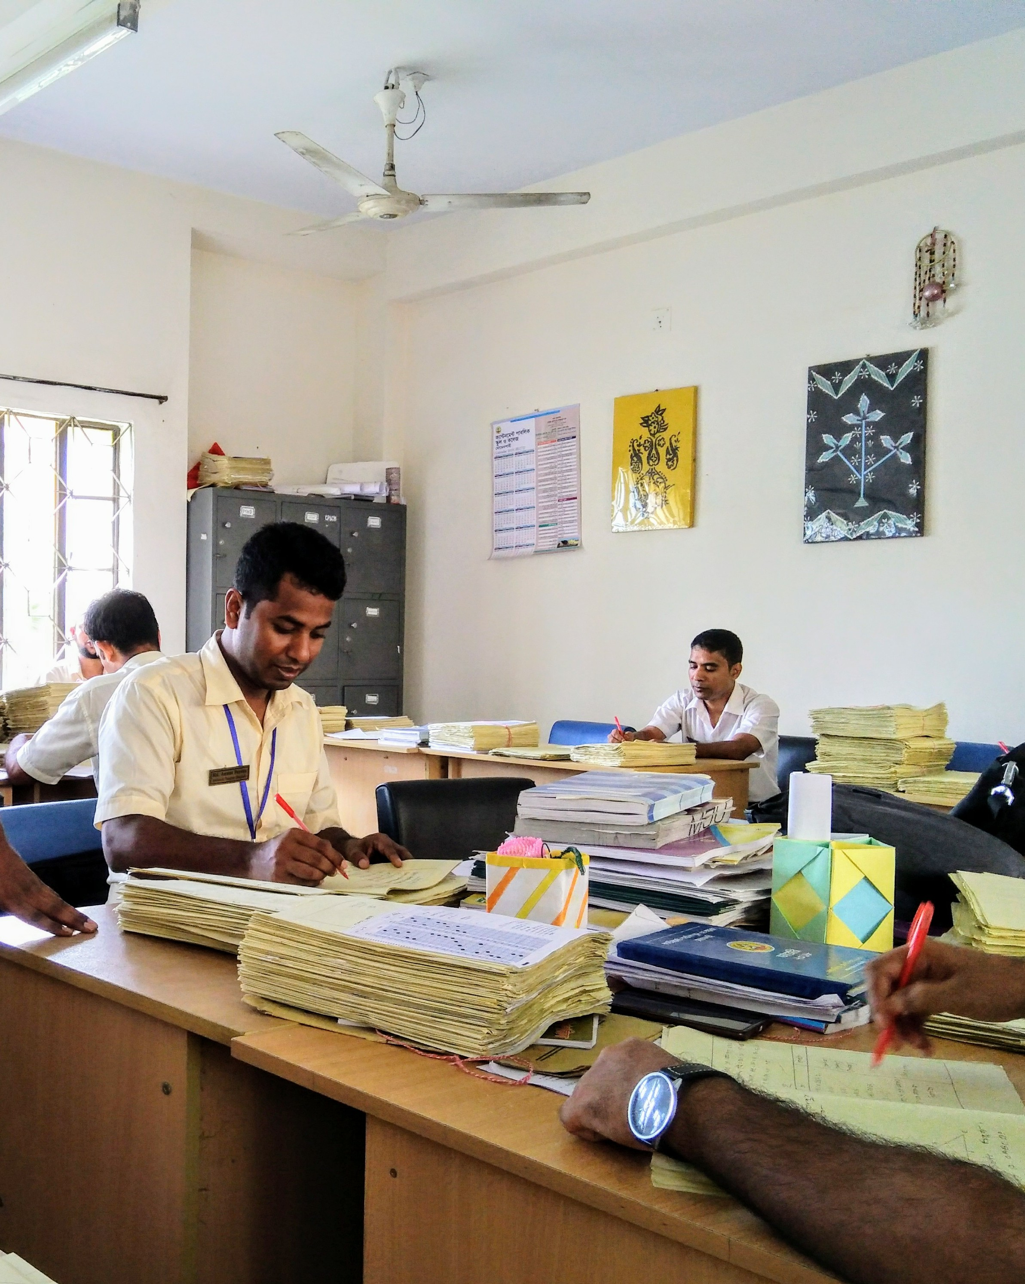
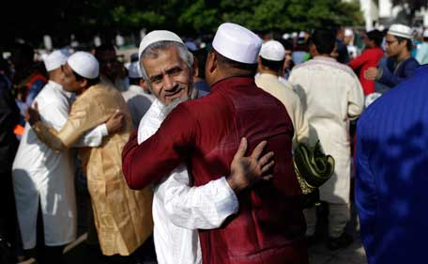
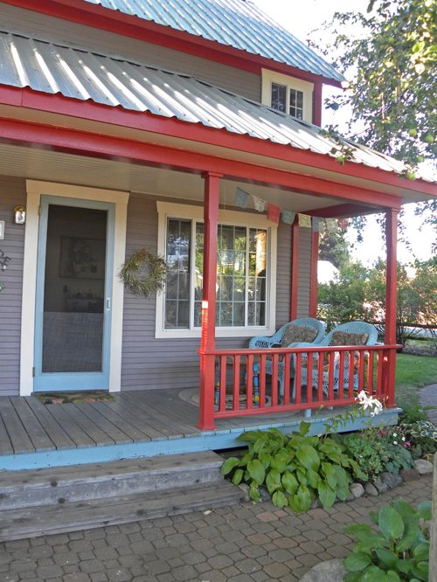

I work in a school in a city.
I go to my village to celebrate this occasion with them.
My parents live in a village.
Because this is my root.

Slide 4
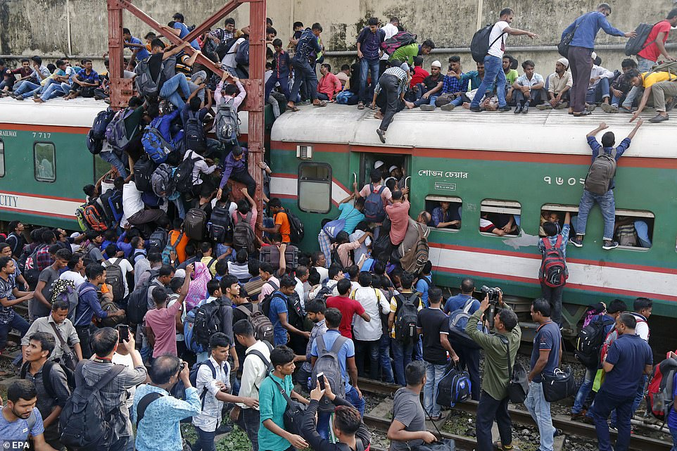
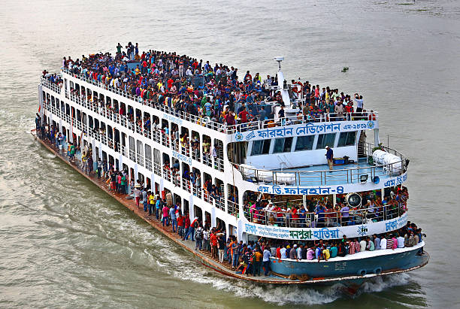
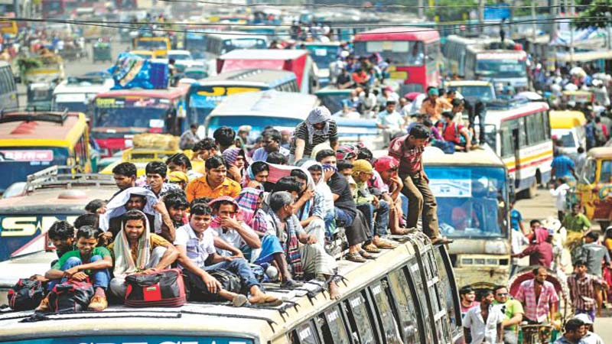
Look at these pictures

Slide 5
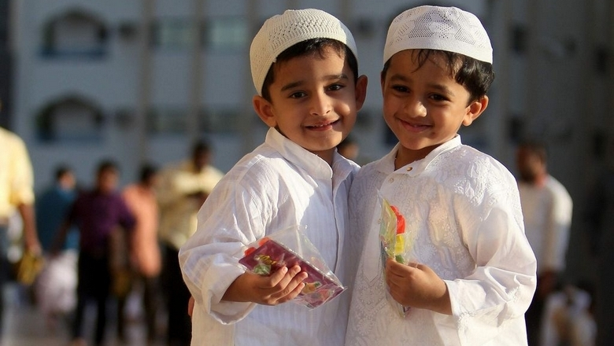
Can you tell what is our today’s topic?
My Roots
Unit-12
Lesson- 1

Slide 6
Learning Outcomes
After we have studied the unit, we will able to-
► participate in conversations.
► exchange personal information.
► understand the text through silent reading.
► present own ideas, give and ask for information.

Slide 7
Pair Work
Read the text in the speech bubbles. Make questions for them and then compare in pairs.
Eid means happiness
Eid is the main religious festival in Bangladesh.
It’s our roots that develop our identity making us what we are.

Slide 8
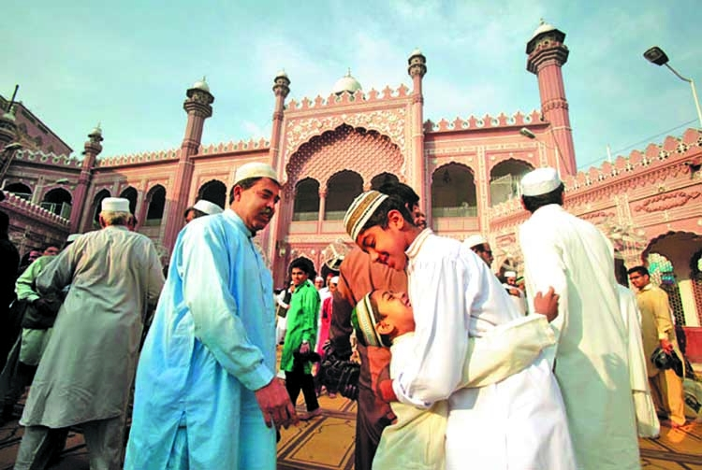

Let us know some key words of the text
Festival = a day or period of celebration, typically a religious commemoration:
Vacation =an extended period of leisure and recreation, especially one spent away from home or in traveling.

Slide 9

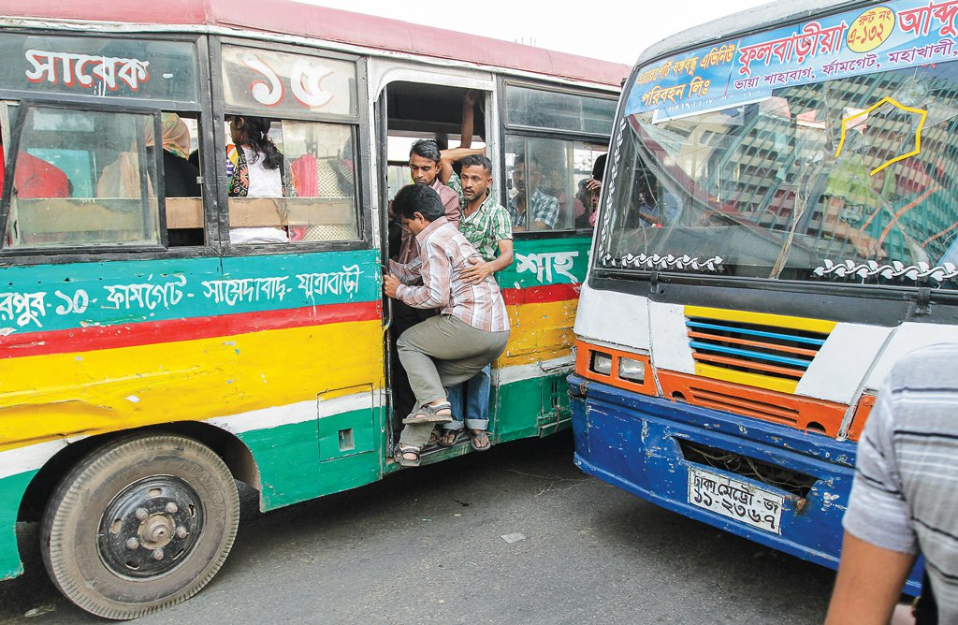
Rush = move with urgent haste
Hazard = a danger or risk.

Slide 10


Neighbour= a person living next door to or very near to the speaker or person referred to
Empty= containing nothing; not filled or occupied

Slide 11
Let’s read and understand the text.

Slide 12
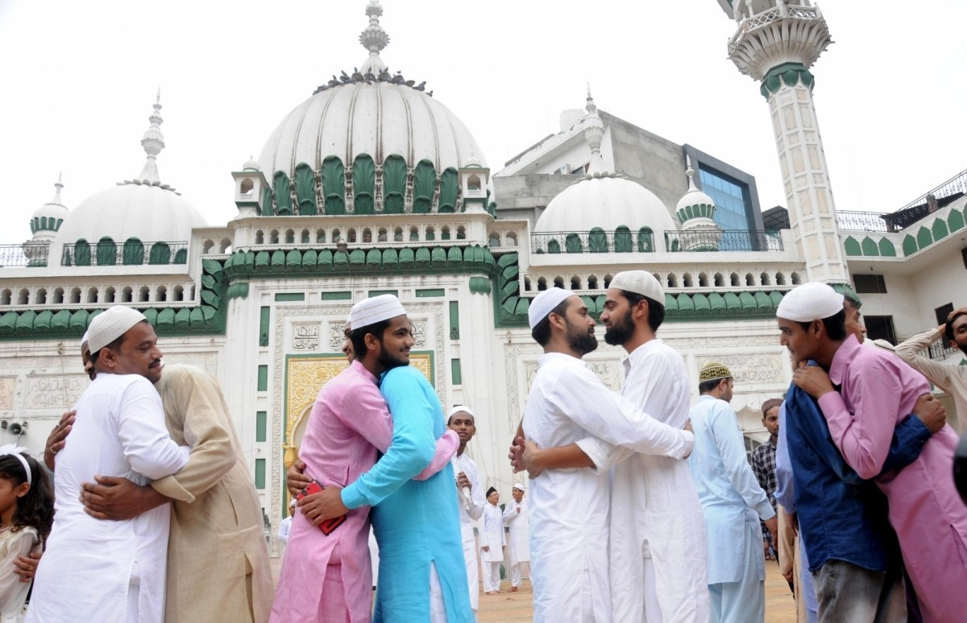
Eid is the main religious festival of the Muslims in Bangladeh. Eid means happiness. Eveyone wants to share this happiness with their near and dear ones.

Slide 13
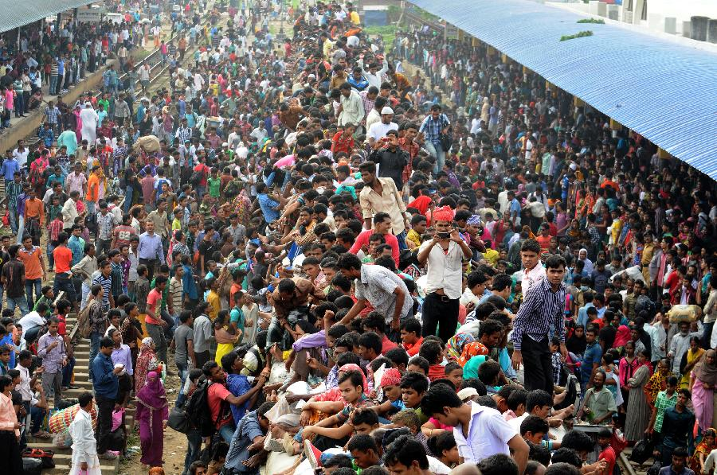
Where is the train?
So most of the people, who are living outside their home for different reasons have a strong desire to get back home during the Eid vacations. As a result, there is a mad rush in the buses, trains, or launches for the home-bound people

Slide 14
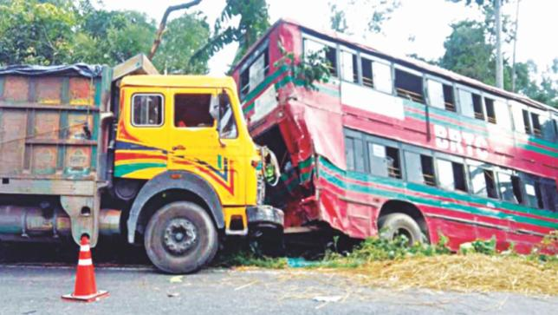
This often causes transport accidents that take away many lives. However, it cannot stop people’s desire to meet their family, in-laws, or friends.

Slide 15
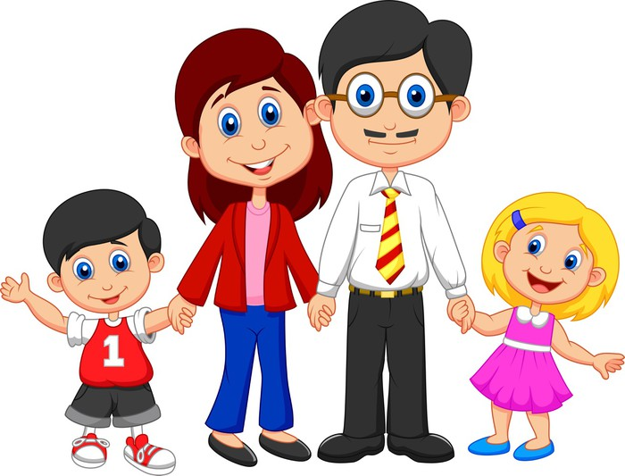
Do human beings have roots like the trees? The answer is ‘yes’ but unlike the roots of the trees they are invisible, they lie in our minds. It’s these roots that make a bond between us and family members, inlaws, friends, neighbours or even between us and the land where we were born and grew up.

Slide 16
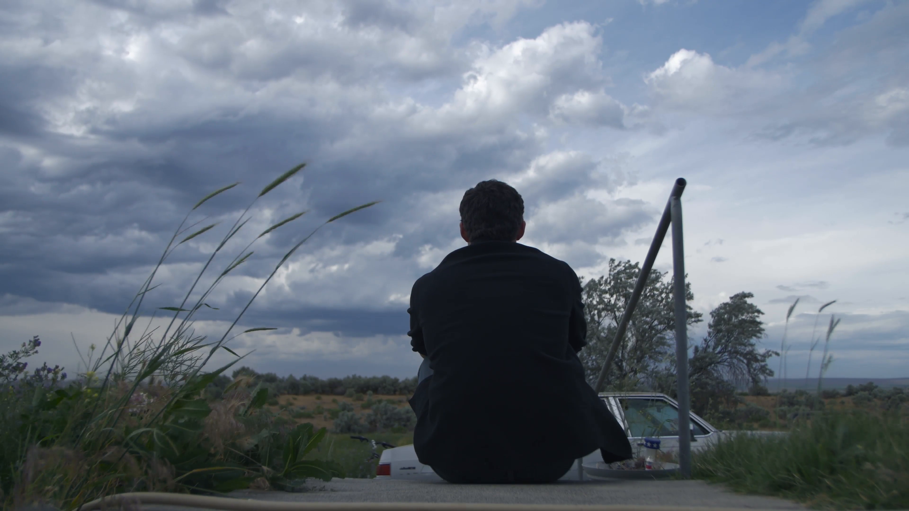
Human beings who do not have any root or contexts, are non entity. In other words, they do not have their own identity. Such persons are devoid of values, humanity, and social responsibilities. They don’t know where they are from, and/or where they are heading towards. This often makes them feel empty and lost.

Slide 17
Group Work
  Group A : Do you feel any attraction or pull of your roots?
  Group B : How do you nourish your roots?
Group C : What, according to you, are the reasons why people become rootless?

Slide 18
Evaluation
Why do people have strong desire to go home?
Why do the accidents happen on roads?
What makes people rush for their homes in spite of serious hazards?
Do human beings have roots like the trees?

Slide 19
Home Work
Make a classroom survey and present in a graph or chart the types of roots your classmates have.

Slide 20
Thank You

