Slide 1
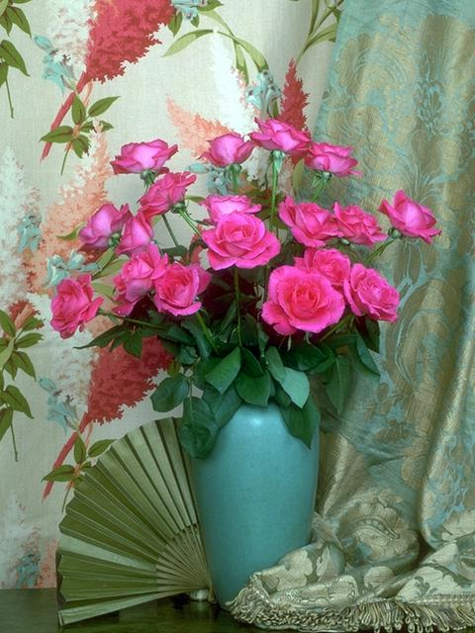
Welcome

Slide 2
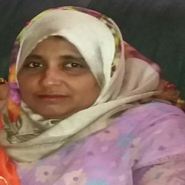
Identity
Molena Begum
Assistant teacher
Manullar char haji bari model high school
Pakundia Khishorgonj.
English For Today
Class : Six.
Lesson 8

Slide 3
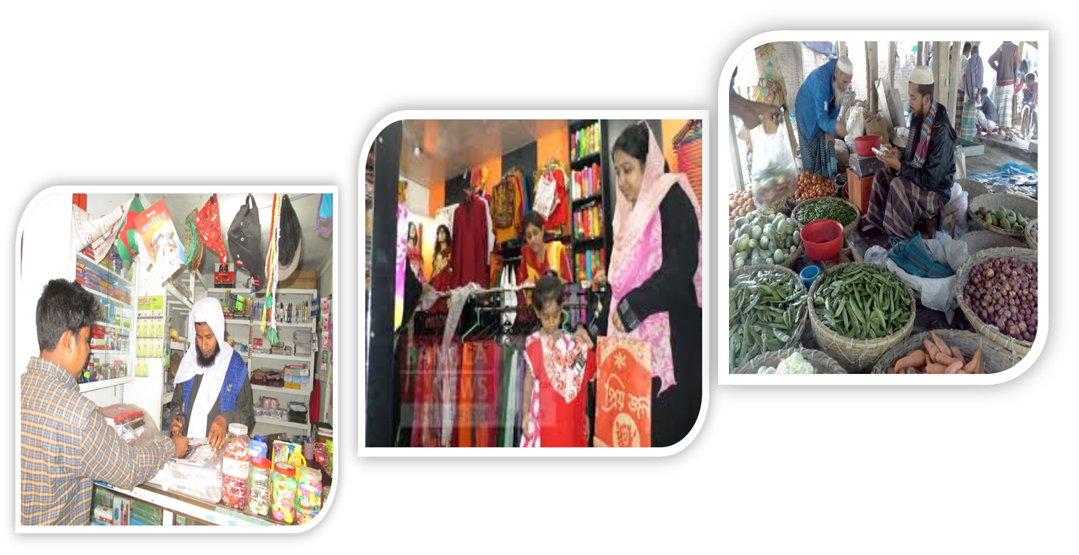
Look at the pictures and guess What they are doing.
They are shopping.

Slide 4
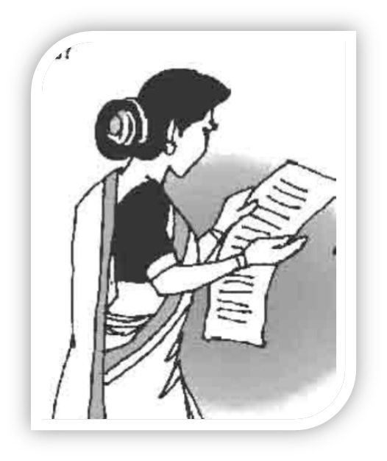
Today`s topic
Grocery Shopping
Lesson: 8(1)

Slide 5
Learning outcomes
After completing the lesson students will be able to…
use word stress on words in sentences
Participate in short dialogues and conversations on familiar topics
read and understand texts
ask and answer questions
use `some’ and `any’ in sentence.

Slide 6
Model Reading (Pair works)
Listen the conversation between Imran and his mother then practice it in pair.

Slide 7
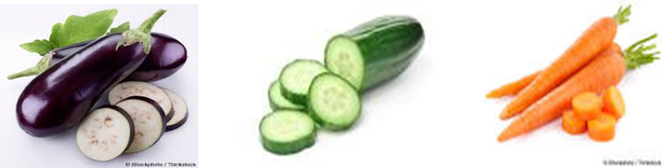
Look at the pictures of vegetables below and say theirs name.

Slide 8
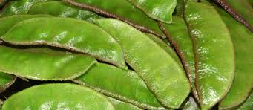
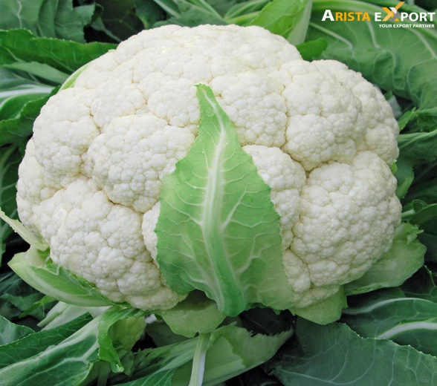
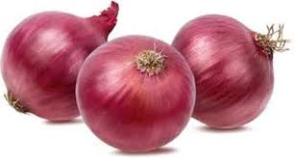
Look at the pictures of the vegetables below and say theirs name.
Bean
Onion
Cauliflower

Slide 9
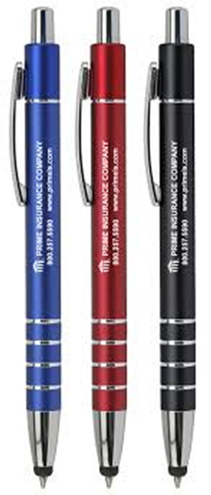
Imagine you are shopkeeper. What will you ask to your customers about below item`s quantity ? (using how much / how many.) one is done for you.
How many pen do you want ?

Slide 10
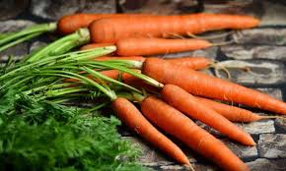
How much carrots do you want ?

Slide 11
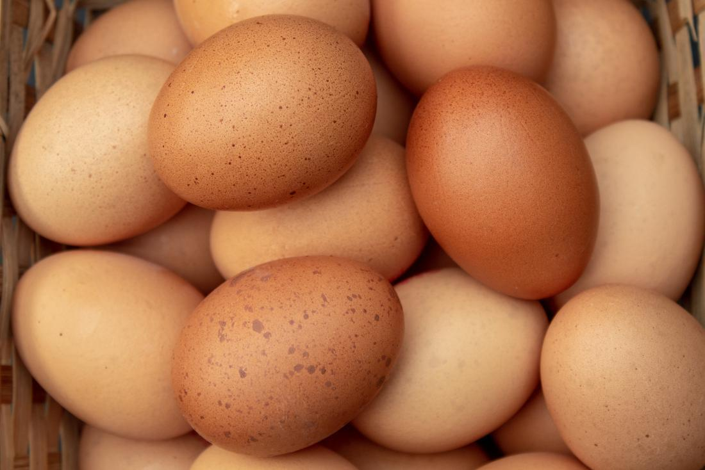
Make questions using how much / how many
How many eggs do you want?

Slide 12
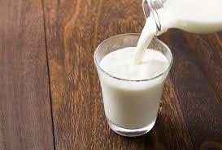
Make questions using how much / how many
How much milk do you want?

Slide 13

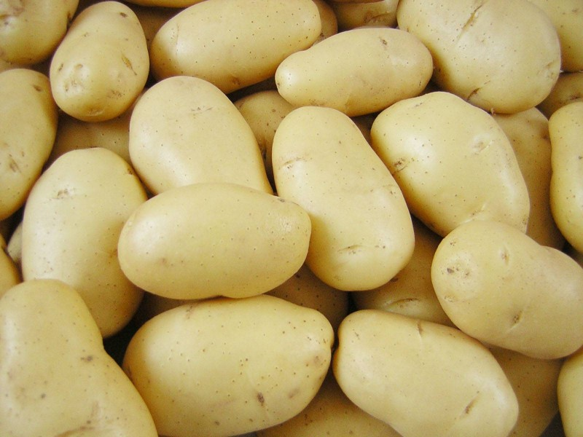
Make questions using how much / how many
How much potatoes do you want?

Slide 14
Use of ‘How much’
How much uses for uncountable noun :
Uncountable noun : That’s we can’t count : Such as – water, milk, sugar, oil, Gold etc.
Structure : How much + noun + auxiliary verb + subject + main verb + ext ?
How much sugar do you want ?

Slide 15
Use of ‘How many’
How many is used for countable noun :
Countable noun : That’s we can count : Such as – Pen, book, Egg, Chair, Table etc.
Structure : How many +noun + auxiliary verb + subject + main verb + ext ?
How many pen do you want ?

Slide 16
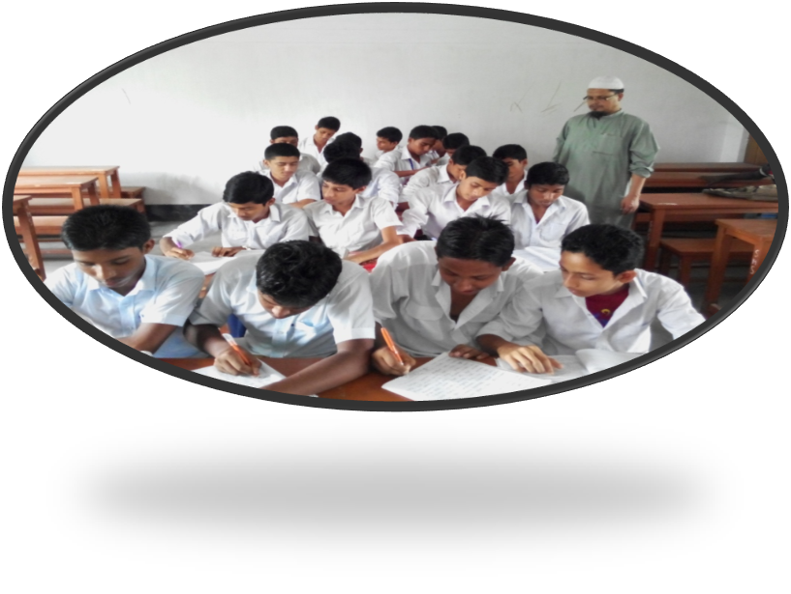
Silent reading (Pair work)
Go to section ‘B’ and read the dialogues then discuss the questions in pairs that have given in section ‘B1’.

Slide 17
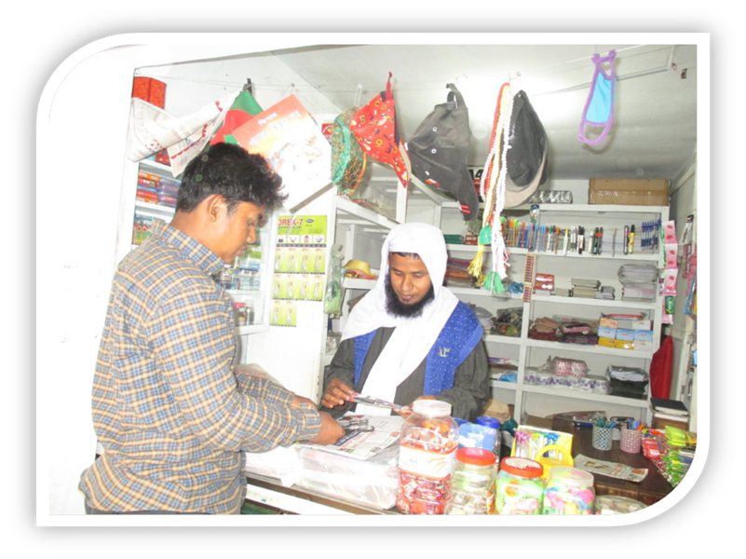
Make pair with your friend beside you and practice the conversation
A: Excuse me !
B: Yes, how can I help you ?
A: I want to buy a pen
B: Sure ! There you go.
A: How much is it ?
B: 1o taka only.
A:Here you are !
B: Thank you !

Slide 18
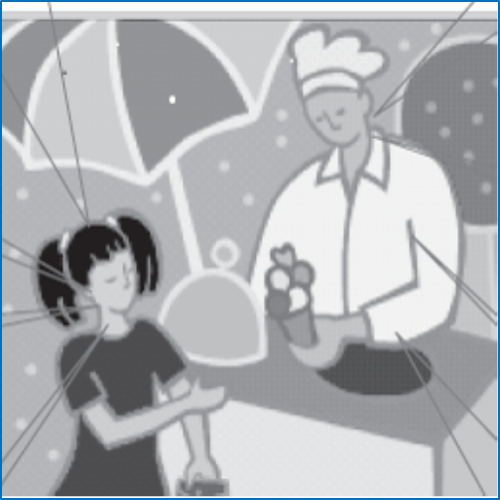
Compare with your answer.
The girl: Excuse me.
The salesman: Yes, how can I help you?
The girl: I want to buy an ice-cream.
The Salesman: Sure! There you go.
The girl: How much is it?
The salesman: 20 taka.
The girl: Here you are.
The salesman: Thank you.

Slide 19

Home works
Make a imaginary shopping list with quantity for grocer’s, baker’s and stationer`s.

Slide 20



