Slide 1

Well come

Slide 2
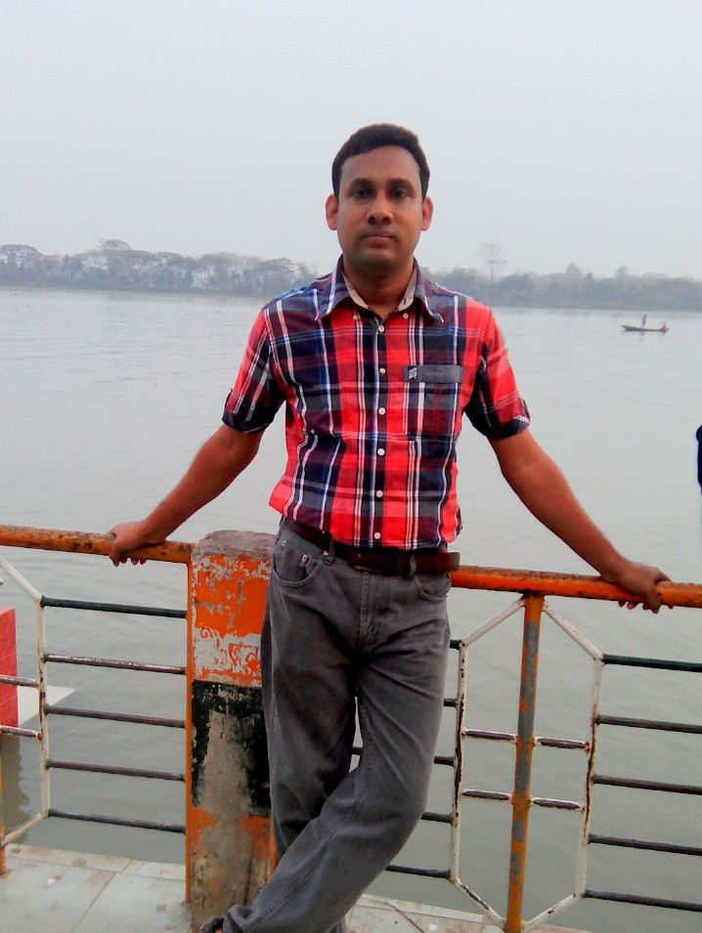
Md.Ibrahim
Ass:Teacher
Birkati Govt Primary School
Class:4
Sub:English
Unit:3
Lesson unit:1-2
Lesson:Family

Slide 3
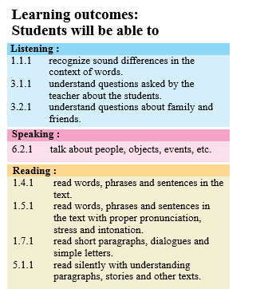

Slide 4
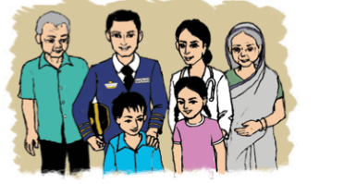
Look at the picture
Who can say about the picture

Slide 5
Our lesson is
Family

Slide 6
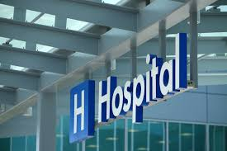
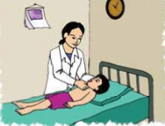
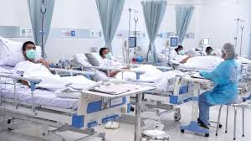
Now we are Learning new words
Hospital
হাসপাতাল
She works at hospital in kushtia
Doctor
ডাক্তার
She is a Doctor
patient
রোগী
She takes care of many patients everyday

Slide 7
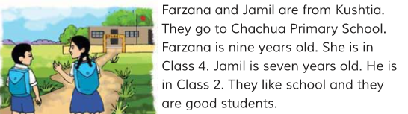
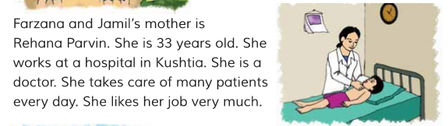
Teacher’s reading

Slide 8
Pair Works
A person who operaters an aircraft
A person who is under treatment.
A person who manages his own family
Children of one’s son or daughter
To go from one place to another
Patient
Pilot
Travel
Homemaker
Grandchildren

Slide 10
Group Works
True or False
a)Farzana and Jamil are from Dhaka
b)Jahanara Begum is a housewife
c)Farzana and Jamil read in Kushtia Zilla school
d)A doctor takes care of many patients
e)Farjana’s grandparents live in the village
f)Mr Altaf Uddin is 64 years old
False
True
False
True
False
True

Slide 11
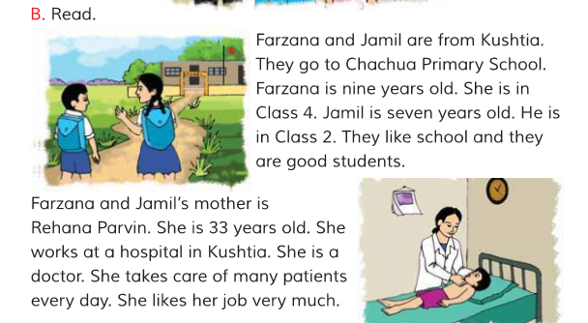
Student reading
I.W

Slide 12
Words Games
Cha hua
Gover ment
hospit l
c
n
a
Pat ents
i
Doc or
t

Slide 13
Answer to the Question
a)Where are come from Farzana and Jamil ?
b)How old is Farzana?
c)What class she?
d)How old is jamil?
e)What class he?
d) What’s like they?
e)What is Rehana Parvin?
f)How old is she?
g)Where does she works?

Slide 14
Home Works
Write five sentences about your family

Slide 15
Thanks Everybody

