Slide 1

welcome

Slide 2

Md.Kabir Hossain
Assistant teacher
Rupasdi Maddya Govt Primary School.
Bancharampur,Brahmanbaria.

Slide 3

Class:three
English
Unit:4
Lessons:1-3
Time:35 minuits
Date:24/01/2020

Slide 4
Learning outcomes:
By the end of the lessons the students will be able to
Speaking
1.1.1 repeat words,phrases and sentences after the teacher
with proper sounds and stress 1.1.2 say words,phrases and sentences with proper sound
and stress
Reading
2.1.1 Recognize and read cardial numbers up to 5.
Writing
2.1.1 write cardinal numbers up to 5 in figures.

Slide 5
Lets recite a rhyme…

Slide 6



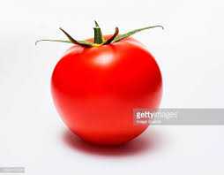


Slide 7
1

Slide 8
2

Slide 9
3

Slide 10
4

Slide 11
5

Slide 12
See pictures and read the numbers in pair.
1
2
3
4
5

Slide 13
Match the numbers with pictures in group.
4
5
1
2
3

Slide 14
Lets write the numbers
1 2 3 4 5

Slide 15
Write the numbers in the blanks

Slide 16


Thank You

