Slide 1

Welcome

Slide 2
Introduction
Teacher’s Identity
Lesson Identity
Tanjina Begum
Assistant Teacher
Uttar Samos Govt. Primary School
Sundargonj, Gaibandha.
Class-Three
Subject-English
Unit-34
Lesson-(1-3)
Headline-My Family
Part of the lesson-I’m Tisha……..years old.

Slide 3
Learning Outcomes:
Students will be able to-
Listening: 4.3.1 enjoy and understandsimple stories.
Speaking: 3.1.1 ask and answer Wh questions.
Reading: 5.1.1 read simple paragraphs.
Writing: 3.1.1 write words,phrases and sentences using non- cursive capital letters.
3.1.2 write words phrases and sentences using non cursive small letters.
8.1.1 write words from the textbook or model.
8.1.2 write phrases from the textbook or model.
10.1.1 write short and simple paragraphs by answering a set of questions.

Slide 4
Let’s play a
Bingo Game
with the words given below
Father,mother,sister,brother,grandfather,grandmother,uncle,aunt.

Slide 5
Let’s enjoy a video song
https://www.youtube.com/results?search_query=i+love+you+you+love+me+we+are+happy+family

Slide 6
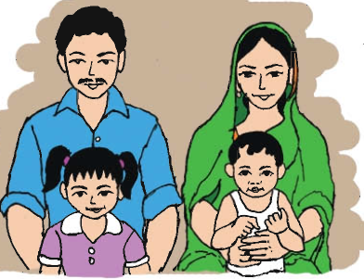
What do you see in the picture?
Father, mother, sister and brother.

Slide 7
Today’s lesson
My family

Slide 8
New words
Banker
Teacher
people
Student
Family

Slide 9
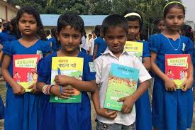
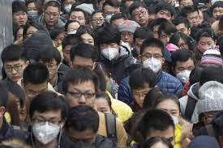
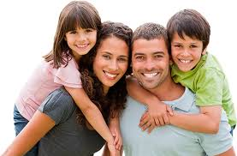
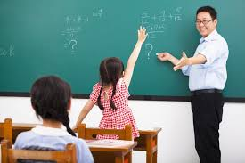
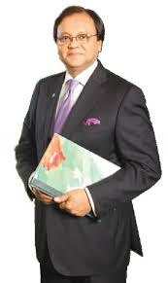
Word Meaning
Student-
Learner,who study in an institute.
People-
Crowd,men and women.
Root of a people,
Father,mother,sister and brother
Family-
Teacher-
Who teaches in an institution.
Banker-
Who works in a bank.

Slide 10

Teacher’s Reading

Slide 11
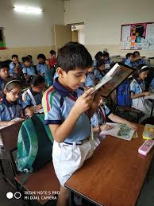
Student’s Individual Reading

Slide 12
Sentence making:
Student-
People-
Family-
Teacher-
Banker-
I’m a student.
There are four people in my family.
I live in a family.
My mother is a teacher.
My uncle is a banker.

Slide 13
Matching
Match column-A with column-B according it’s meaning.
Column-A
Column-B
1. People
2. Teacher
3. Banker
4. Family
5. Student
a)Who teaches his/her students.
b)Father,mother,sister and brother.
c)Who’s work is studying.
d)Who works in a bank.
e)Men and women.

Slide 14
Fill in the blanks:
a)Tisha reads in class…………..
b)Her mother is a………………
c)Her Father is a…………….
d)There are …………… members in her family.
e)Her brother is…………… years old.
three
teacher
banker
four
two

Slide 15
Rearrange:
1)family/there/four/are/people/in/my.
=
2)a/her/mother/teacher/is.
=
3)brother/my/is/ years/two/old.
=
4)three/he/in/is/claas.
=
5)do/her/father/what/does/?
=
There are four people in my family.
Her mother is a teacher.
My brother is two years old.
He is in class three.
What does her father do?

Slide 16
Wh-question:
1)Her name is Tisha.
=
2)There are four people in her family.
=
3)Her mother is a teacher.
=
4)Her father is a banker.
=
5)Her brother is two years old.
=
What is her name?
How many people are there in her family?
What does her mother do?
What does her father do?
How old is her brother?

Slide 17
Answer the following questions:
1)What is the girl’s name?What class is she in?
=
2)How many people are there in her family?
=
3)What does her mother do?
=
4)What does her father do?
=
5)How old is her brother?
=
The girl’s name is Tisha.She is in class three.
There are four people in her family.
Her mother is a teacher.
Her father is a banker.
Her brother is two years old.

Slide 18
Group work
Group no-1
Answer the following questions:
1)What is the girl’s name?What class is she in?
2)How many people are there in her family?
3)What does her mother do?
4)What does her father do?
5)How old is her brother?
Group no -2
Wh-question:
1)Her name is Tisha.
2)There are four people in her family.
3)Her mother is a teacher.
4)Her father is a banker.
5)Her brother is two years old.
Group no-3
Rearrange:
1)family/there/four/are/people/in/my.
2)a/her/mother/teacher/is.
3)brother/my/is/ years/two/old.
4)three/he/in/is/claas.
5)do/her/father/what/does/?
Group no -4
Fill in the blanks:
a)Tisha reads in class…………..
b)Her mother is a………………
c)Her Father is a…………….
d)There are …………… members in her family.
e)Her brother is…………… years old.

Slide 19
Write a paragraph with a title about your family answering the following questions (at least 5 sentences).
1)What is your name?
2)How many people are in your family?
3)What does your parents do?
4)Do you have brother or sister?
5)How old are your brother or sister?

Slide 20

Thanks

