Slide 1


WELCOME TO EVERY ONE

Slide 2
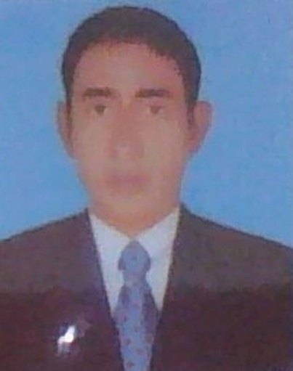


TEACHER IDENTITY
Md: Abdul Matin. Assistant Teacher(English)
Raghunathpur high School
Nawabganj,Dinajpur
E-mail: abmatin1977@gmail.com
Unit: 18
Lesson: 06
Class: SEVEN
GRAMMAR:
Topic: Traffic jam
Date:09- 01 2020

Slide 3

LEARNING OUTCOME
After completing this lesson students will be able to learn about
1.Studets asked and answered question.
2.Students talk about Traffic jam.
3.Students written a paragraph.

Slide 4
LESSON DICARATION
So today’ sour Lesson is ‘Traffic jam’

Slide 5

GROUP WORK
Group –B
1.How can we stop road accidents?
2.Why are roads becoming narrow now ?
Group-A
1.What are the main reasons of Traffic jam ?
2.When do you find Traffic jam most acute ?

Slide 6
INDIVIDUEL WORK
1. What are the main reasons of Traffic jam ?

Slide 7
PAIR WORK
1. Write three sentences about Traffic jam with your partner.

Slide 8


HOME WORK
Write a paragraph about ‘ My Birthday Party’

Slide 9

NO MORE TO DAY.

