Slide 1

WELCOME

Slide 2

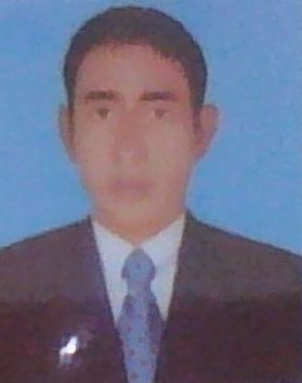

TEACHER IDNTITY
Md:Abdul Matin
Assistant Teacher (Eglish)
Raghunathpur High school
NawabgajDinajpur
E-mail: abmatin1977@gmail.com
Unit-1o
Lesson: 02
Grammar: Eight
Topic: MY FAVOURITE HOBBY
Date:10-01-2020

Slide 3


LESSON DICLARATION
So our today’s Topic is ‘MY FAVOURIT HOBBY’

Slide 4



LEARNING OUT COME
After completing this lesson students will be able to learn about.
1.Students are observe hobby.
2.Students are Identity her favourite hobby.
3.Students understand enjoyable hobby.

Slide 5


GROUP WORKS
Group -A
1.Whate is your hobby ?
2.Why do you enjoy your hobby?
Group – B
1.What do you exactly ?
2.How long has this been your hobby?

Slide 6
PAIR WORK
Write two sentences about your favorite hobby ?

Slide 7

INDIVIDUEL WORK
Write two sentences about your favourite hobby?

Slide 8
HOME WORK
Write five sentences about our school Library.

Slide 9

THANK

