Slide 1


WELCOE TO EVERY ONE

Slide 2
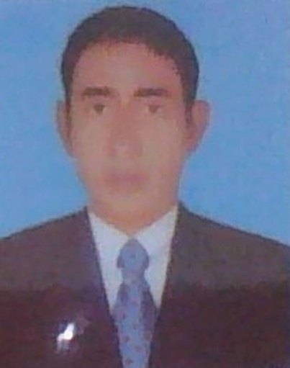


TEACHER IDENTITY
Md: Abdul Matin. Assistant Teacher(English)
Raghunathpur high School
Nawabganj,Dinajpur
E-mail: abmatin1977@gmail.com
CHAPTER: 01
Lesson: 07
E,F,T: 10
Topic: WINTERMORNING
Date: 11- 01 2020

Slide 3

LEARNING OUTCOME
After completing this lesson students will be able to learn about
1.Studets asked and answered question.
2.Students talk about winter morning.
3.Students written a paragraph.

Slide 4
LESSON DICARATION
So today’ sour Lesson is ‘WINTERMORNING’

Slide 5

GROUP WORK
Group –B
1.How do people feel in winter morning?
2.What do children and people do in a winter morning ?
Group-A
1.How is winter morning?
2.When do you get up ?

Slide 6

PAIR WORK
1. Write two sentences about winter morning with your partner.

Slide 7
INDIVIDUEL WORK
1. What kinds of food do people eat ?

Slide 8

HOME WORK
Write a paragraph about ‘ The Life of a Farmer’

Slide 9

THANK

