Slide 1
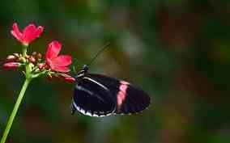
Welcome to all

Slide 2
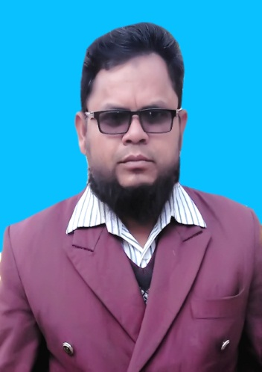
Md. Mominul Islam
Head Teacher
Ishanpur Govt. Primary
School
Kaharol. Dinajpur
017977443
mominict9@gmail.com

Slide 3
Class: three
Unit: 35
Lesson: 1-3
Time: 45 minutes

Slide 4
Learning Outcome
After finishing the lesson SS will be able to
Listening:
4.3.1 enjoy and understand simple stories.
Speaking:
3.1.1 ask and answer wh question
Reading:
5.1.1 read simple paragraphs.

Slide 5
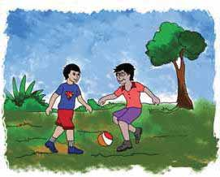
Look at the picture:

Slide 7
Today’s lesson:
My friend

Slide 8
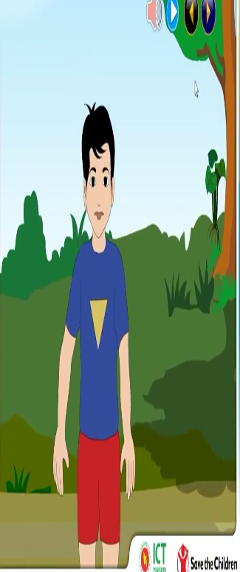
I’m Radif, I’m eight years old.

Slide 9
Anik is my best friend. He’s eight years old, too.

Slide 10
We go to Rajbari Primary School.

Slide 11
Anik sits next to me.

Slide 12
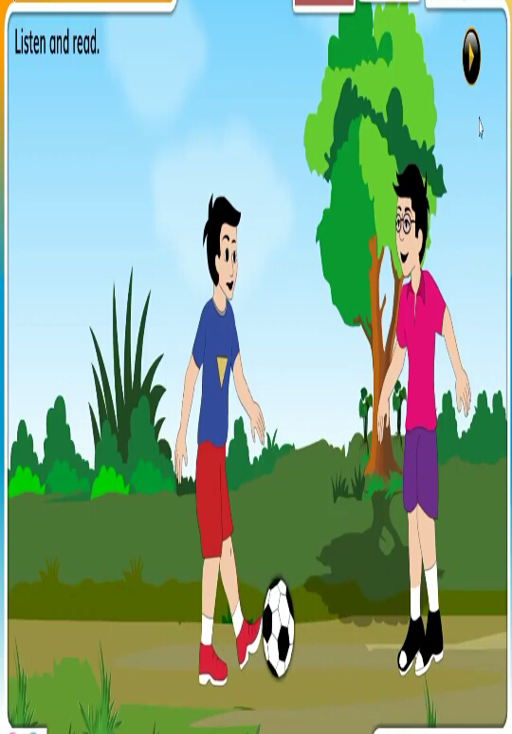
In the afternoon, we play football.

Slide 13
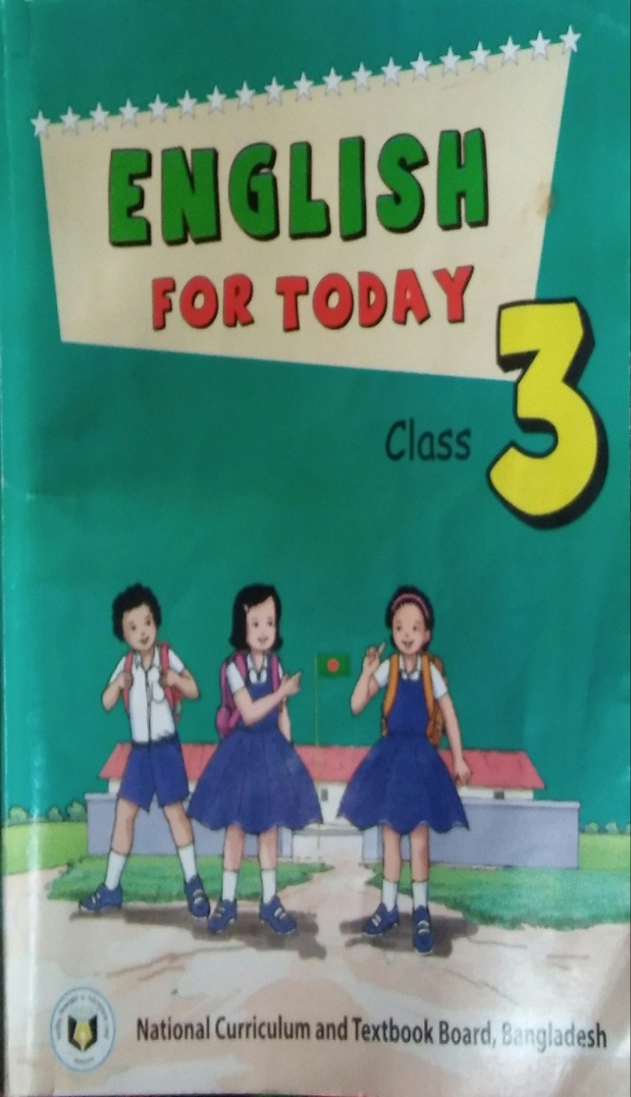
Open your English book at page 31.

Slide 14
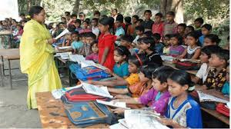
Teacher’s
reading.

Slide 15
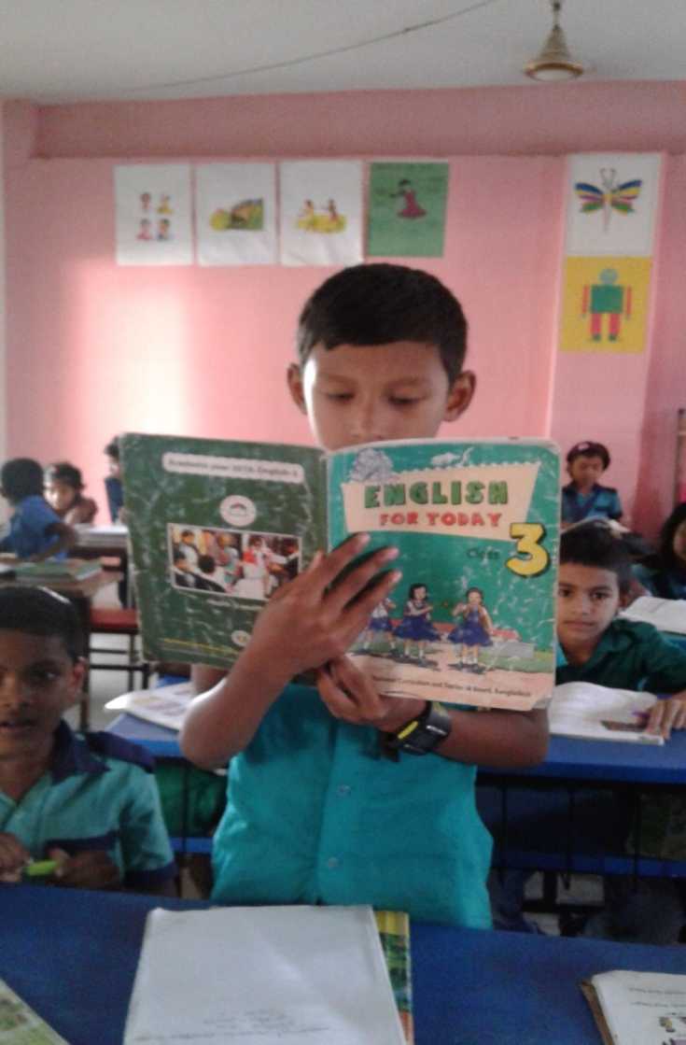
Student’s
reading.

Slide 16
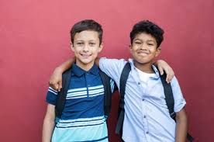
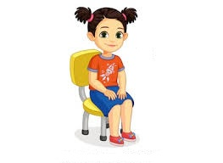
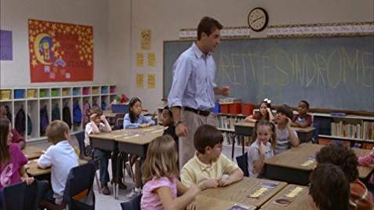
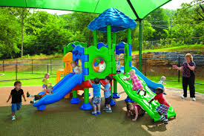
New words:
A person you
know and like.
Friend
Sit
To take a seat.
Those are taught together.
Class
To do thing
for pleasure
Play

Slide 17
Pair work. Read and match the words in of the column ‘A’ with their meaning in column ‘B’.
Column ‘A’ | Column ‘B’
a. old | i. a person you know well and like
b. friend | ii. to move from one place to another
c go | iii. of a particular age
d. primary | iv. to do things for pleasure
e. play | v. developing first
 | vi. men , women and children

Slide 18
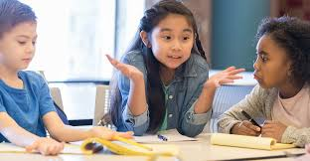
Group work.
Read and answer the following question.
Who is Radif’s friend?
How old is Radif?
Write about Radif and Anik?
Where does Anik sit?
How old is Anik?

Slide 19
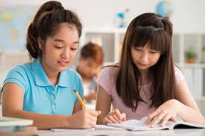
Pair work. Read and fill in the blanks.
1. They go to ________ Primary school.
2.Anik sits _______ to Radif.
3. They are in the _______ class.
Rajbari
next
same

Slide 20
Rearrange the sentences.
Radif, am, i.
a, student, am, i.
am, eight, i, years, old.
are, we, in, the, class, same.
football, play, we.

Slide 21
Write a five senteces
about “My friend”.

