Slide 1
Welcome to all

Slide 2
INTRODUCTION
Md.Soriful Islam
Assistant teacher
Chowrapara Fazil Madrasha
Niamotpur, Naogaon.
Mobile no: 01715637638
Email:soriful03@gmail.com
Class : Ten
Subject : English 1st paper
Unit : Thirteen
Lesson : 2
Time : 50 min.
Date : 17/01/2020

Slide 3
Look at the logo
Do you know what is the logo name?
Google
LinkedIn
Facebook
Twitter

Slide 4
Social network service
Facebook
Page no 168

Slide 5
Learning Outcomes
After studying the lesson we will be able to…
1. how to open facebook account;
2. learn about Utility of facebook ;
3. discribe the reason of popularity of facebook.

Slide 6
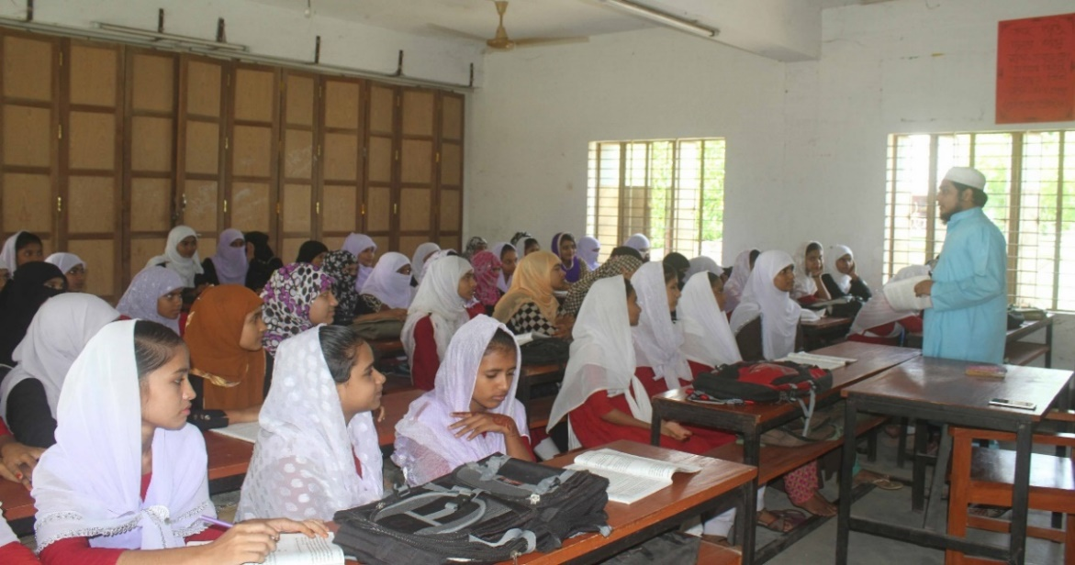
Proper learning

Slide 7
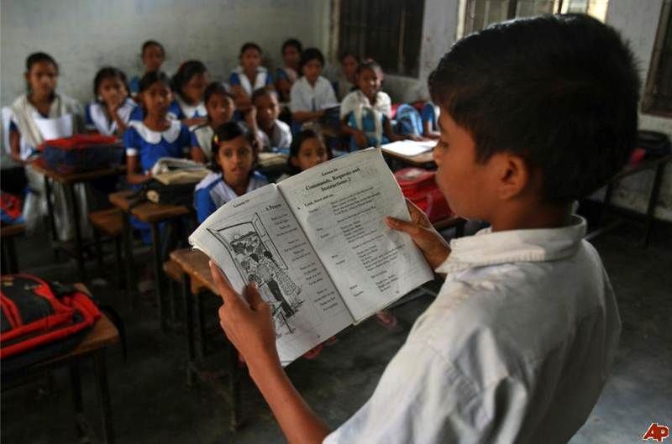
Loud reading
Open your English book page no 168 & read any one.

Slide 8
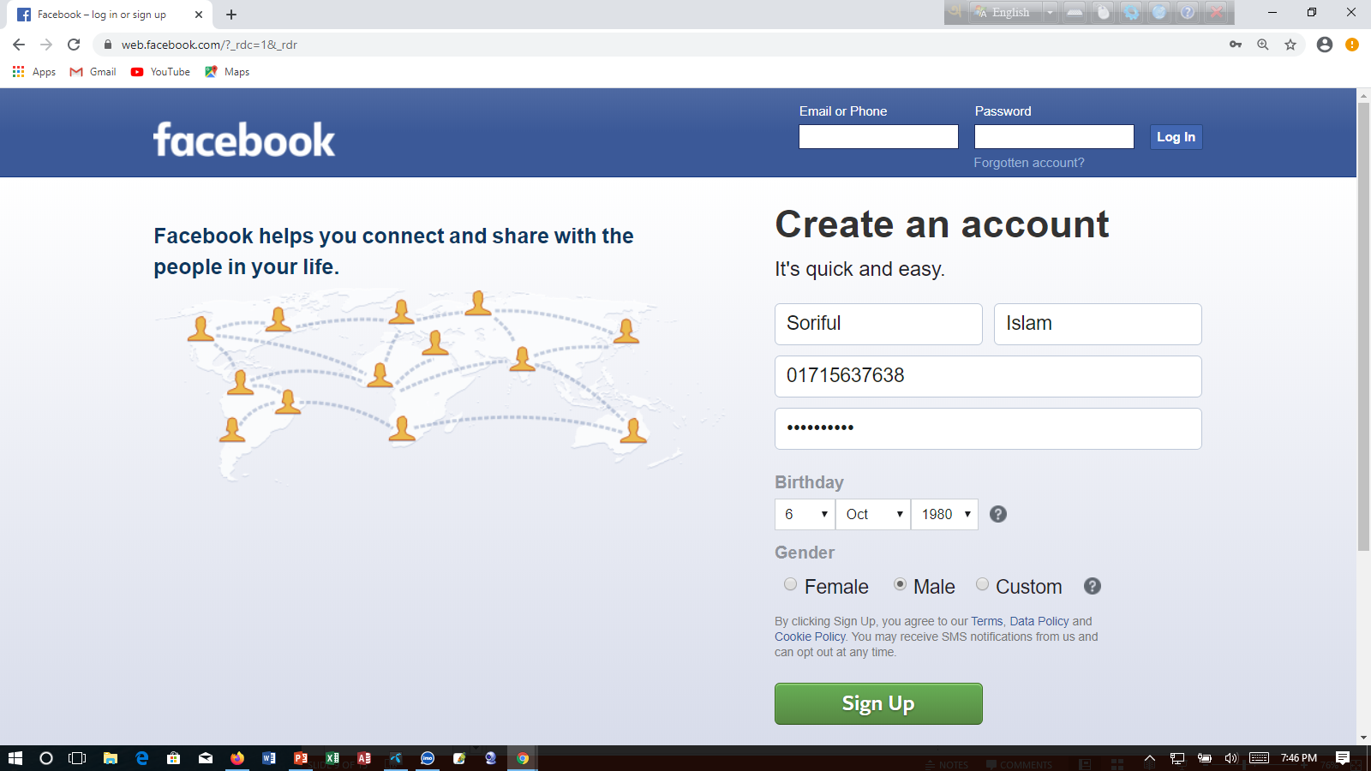
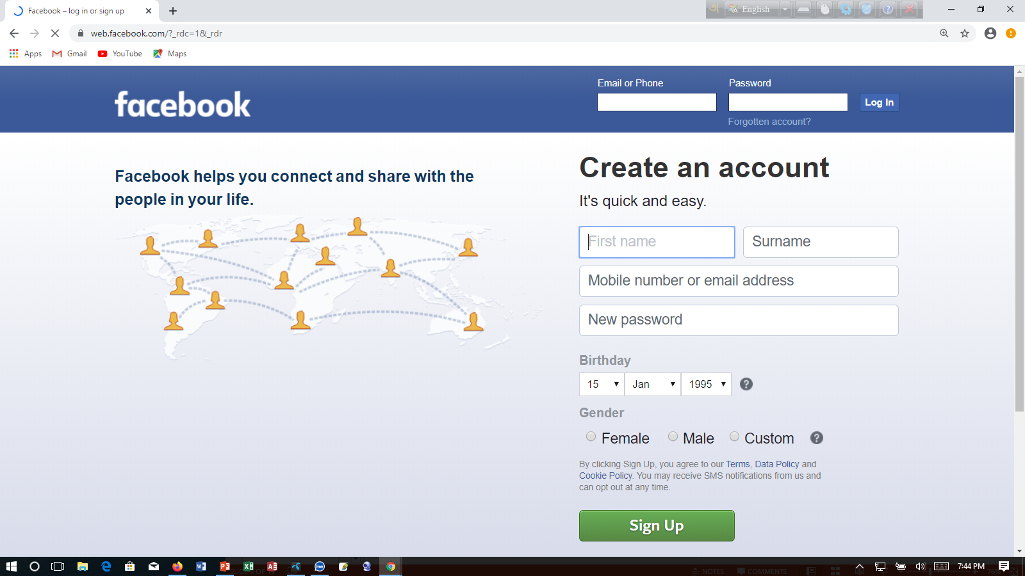
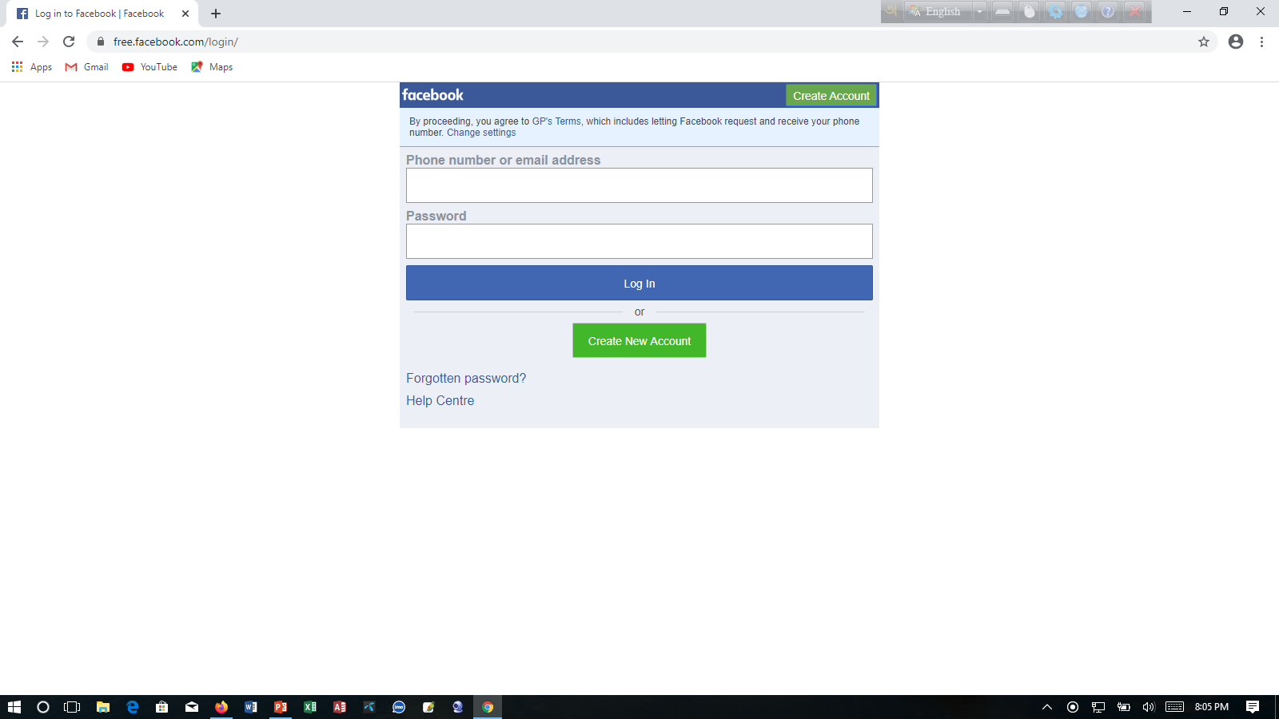
Look at the picture
soriful03@gmail.com
*********
You will fill up the Facebook account in this way.
Facebook account sign up page
Facebook login page
You will login the Facebook account in this way.

Slide 9
Individual work
What do you understand by social networks?
What are some uses of social networks?

Slide 10
Look at the following table adapted from Wikipedia.
It shows some data on worldwide use of social networks.
Social Networks | Induvidual users | Percentage(%) of popularity | Regions covered
Facebook | 792,999,000 | 55.1% | worldwide
Google+ | 250,000,000 | 17.7% | worldwide
Twitter | 167,903 | 11.7% | worldwide
LinkedIn | 94,823,000 | 6.6% | Asia & Europe
MySpace | 61,037,000 | 4.2% | USA & Canada
Others | 255,539,000 | 17.8%
Total | 1,438,877,000 | 100%

Slide 11
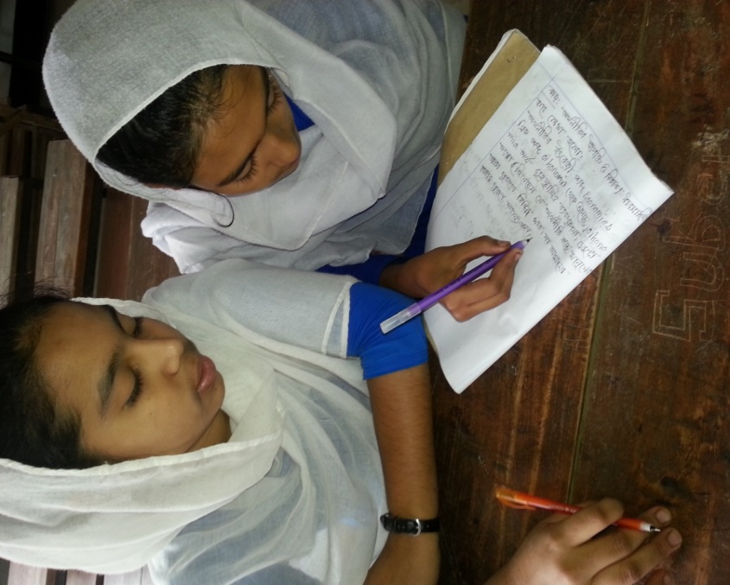
Pair work
Now complete the following dialogues about
facebook and provide your own questions and
answer on the rest of the social networks in the
table. Act out in pairs.
a. …………social network is the most popular?
b. …………individual users use Facebook?
c. …………part of the world is Facebook mostly used in?

Slide 12
Silent reading
Dear learner open your English book page no 168 & read attentively.

Slide 13
Group work
What is the reason of popularity of the facebook?

Slide 14
Evaluation
1. The ……….. Technology has helped social networking sites to emerge.
a Internet
b Google+
C LinkedIn
d Twitter
2. Users have to pay for.
a social networks.
b multimedia contents.
c ther online connections
d uploading pictures.
3. User accounts have ………protection measures.
a virus
b identtity
c network
d personal secrecy
4. User profiles have a section for
a outsideers’ editing.
b outsideers’uploading.
c outsideers’moderation
d others’ remarks.

Slide 15
Home Work
Write a paragraph about the Facebook within 15th sentences.

Slide 16
Thank’s to all

