Slide 2
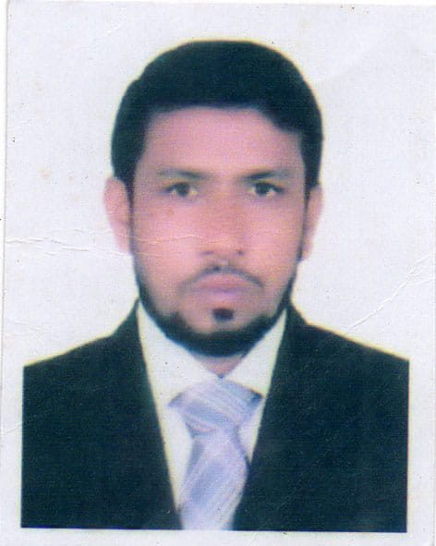
Introduction
Mizanur Rahman Talukdar
Assistant Teacher
Amria Alim Madrasha
South sunamganj
Sunamganj
English For Today
Class : 9 + 10

Slide 3
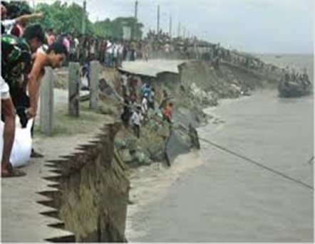
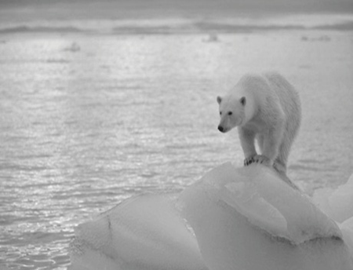
Look At the pictures and discuss with your friends what about the pictures.

Slide 4
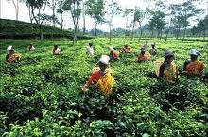
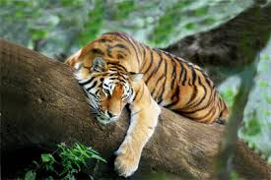
Look At the pictures and discuss with your friends what about the pictures.
These pictures are about our “Nature and Environment”.
Notes:
Teacher will say/discuss the definition of nature and environment.

Slide 5
Today’s Lesson is On Nature and environment (The greed of the roaring rivers)
Lesson Declaration

Slide 6
Learning outcomes
After completing this lesson students will be able….
1) to comprehend and summaries texts.
2) to ask and answer questions.
3) to say the meaning of key words.
4) to take part in debates on given topics.

Slide 7
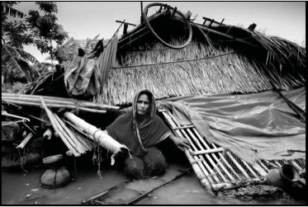
Model reading
Dear students listen the text attentively, then read the text individually and answer the questions that`s have given section B and C.
Notes:
First teacher will read the text, explain the text then ss will read the text loudly/silently later ss answer the ques orally/written.

Slide 8
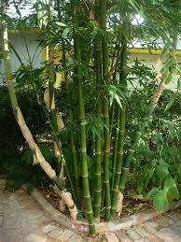
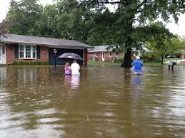
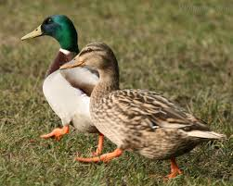
Look at the above pictures and discuss with your partner then write down about the previous life of Meherjan.
Notes:
Teacher can take it orally/written.

Slide 9
Key word
Look at the below word. Try to say the meaning of the word and make a sentence with them.
Erosion
Meherjan lost all her property due to river erosion.
Notes:
At first teacher will show the words then ask his/her students to tell the meaning and making sentences. If they fail teacher will show the picture again. For feedback click on meaning button.

Slide 10
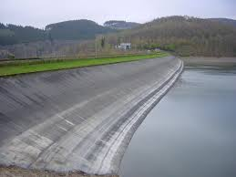
Key word
Look at the below word. Try to say the meaning of the word and make a sentence with them.
Embankment
A wall of stone or earth made to keep water back.
Meherjan lives in a slum on the Sirajgong Town Protection Embankment
Notes:
At first teacher will show the words then ask his/her students to tell the meaning and making sentences. If they fail teacher will show the picture again. For feedback click on meaning button.

Slide 11
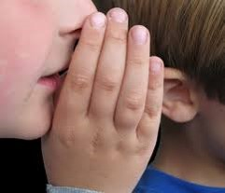
Key word
Look at the below word. Try to say the meaning of the word and make a sentence with them.
Whisper
To speak very quietly to somebody so that other people cannot hear what one is saying
The boy whispered me don`t believe a selfish friend.
Notes:
At first teacher will show the words then ask his/her students to tell the meaning and making sentences. If they fail teacher will show the picture again. For feedback click on meaning button.

Slide 12
Key word
Look at the below word. Try to say the meaning of the word and make a sentence with them.
Unsteady
A libel to fall or shake.
The flame of this candle is unsteady.
Notes:
At first teacher will show the words then ask his/her students to tell the meaning and making sentences. If they fail teacher will show the picture again. For feedback click on meaning button.

Slide 13
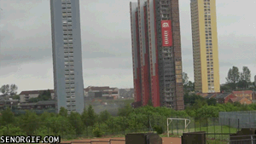
Key word
Look at the below word. Try to say the meaning of the word and make a sentence with them.
Demolish
To pull or knock down something.
The greedy Jamuna has demolished Meherjan`s all happiness.
Notes:
At first teacher will show the words then ask his/her students to tell the meaning and making sentences. If they fail teacher will show the picture again. For feedback click on meaning button.

Slide 14
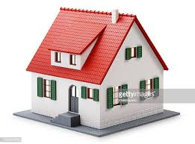
Home Works
Write ten sentences about merit and demerits of flood.

Slide 15
Good Bye

