Slide 1

WELCOME

Slide 2
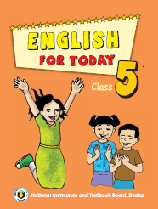

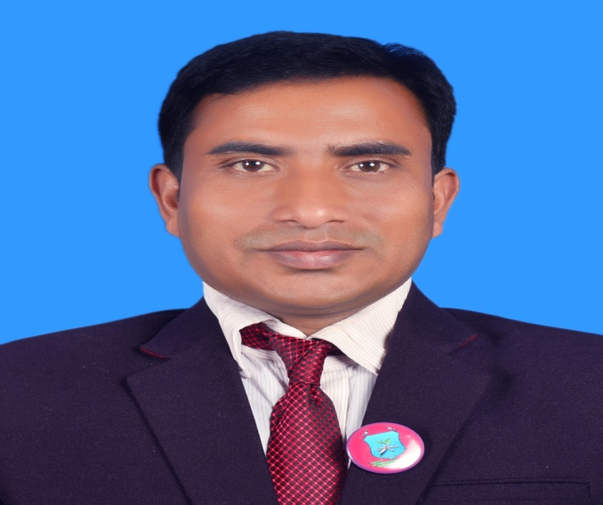
INTRODUCTION
Suranjit Talukder
( BA, B-Ed; MSS, M-Ed; C-in-Ed )
Assistant teacher
Voishber Govt. Primary School.
Sunamgonj Sadar, Sunamgonj
Class:Five
Subject:English
Unit:10
Lesson: 1-2
Time:40 Minutes
Date:

Slide 3
Good morning everybody.
How are you today?
Let’s sing the good morning song.

Slide 4
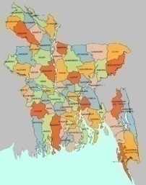
Please think about the picture.

Slide 5
What do you see in the picture?
Ans : It’s the map of Bangladesh.
What is the name of our country?
Ans : Bangladesh
What is called the town where we live?
Ans: My Home Town.

Slide 6
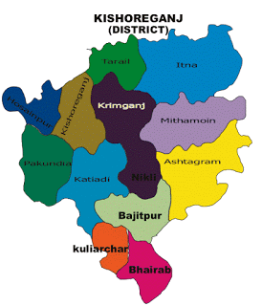
My Home Town.

Slide 7
LEARNING OUTCOMES
Students will be able to………
3.4.1: Understand statements made by the teacher and students.
1.1.1: Say words, phrases and sentences with proper sound and stress .
10.1 . Write a short composition about “ Your Home Town”.

Slide 8
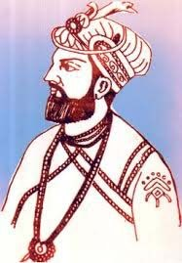
NEW WORDS MEANING
Landlord= Landowner, Zeminder .
Brojokishore Pramanik = An old landlord of ancient Kishoregonj
Ishah Khan=An important landlord of “Baro Bhuiya”
Ishah Khan

Slide 9
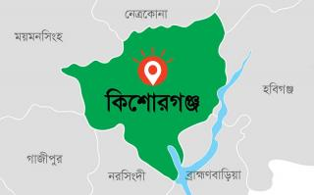
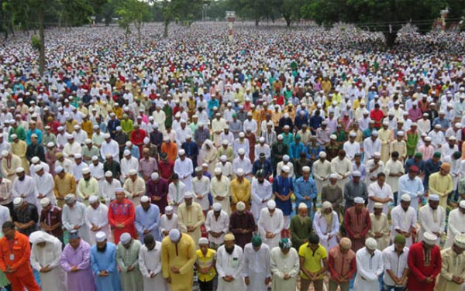
Kishoregonj =A district head quarter.
Solakia Eid Ground=The biggest Eid Ground.

Slide 10
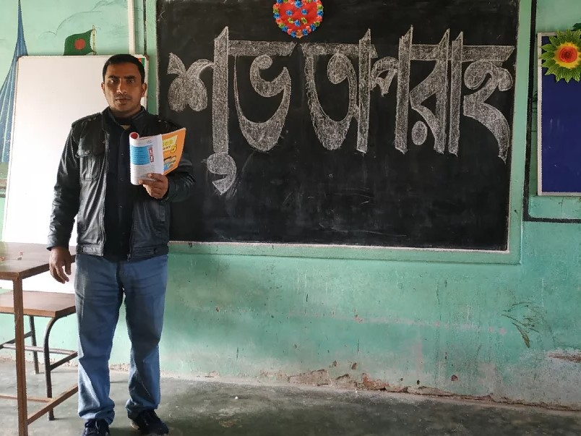
Listen to the text with me and put your finger under the line.

Slide 11
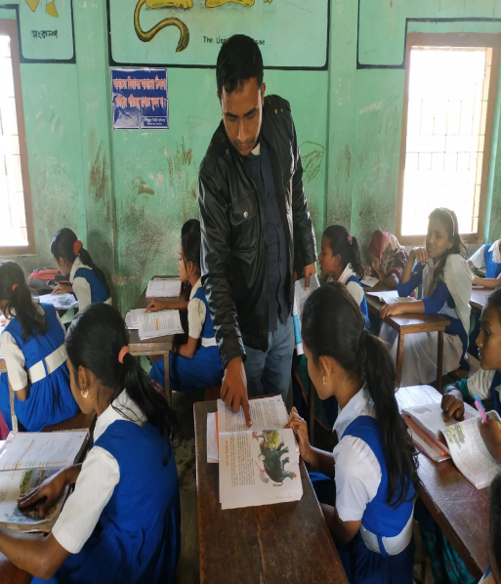

Slide 12
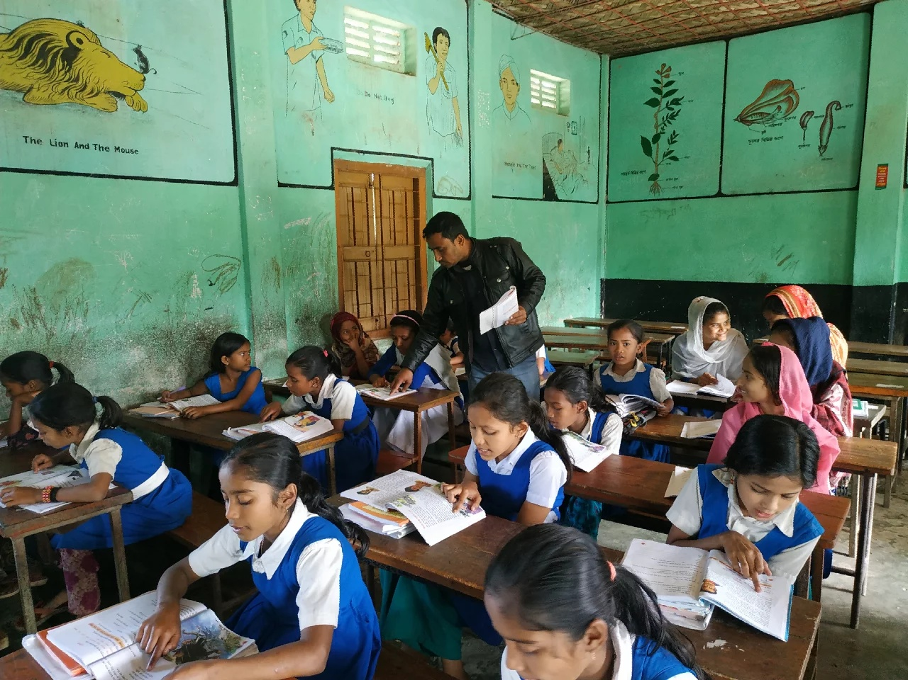
Read loudly after me…..

Slide 13
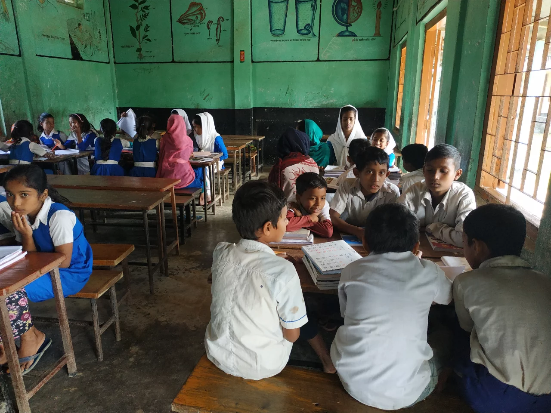
Read silently individually.

Slide 14
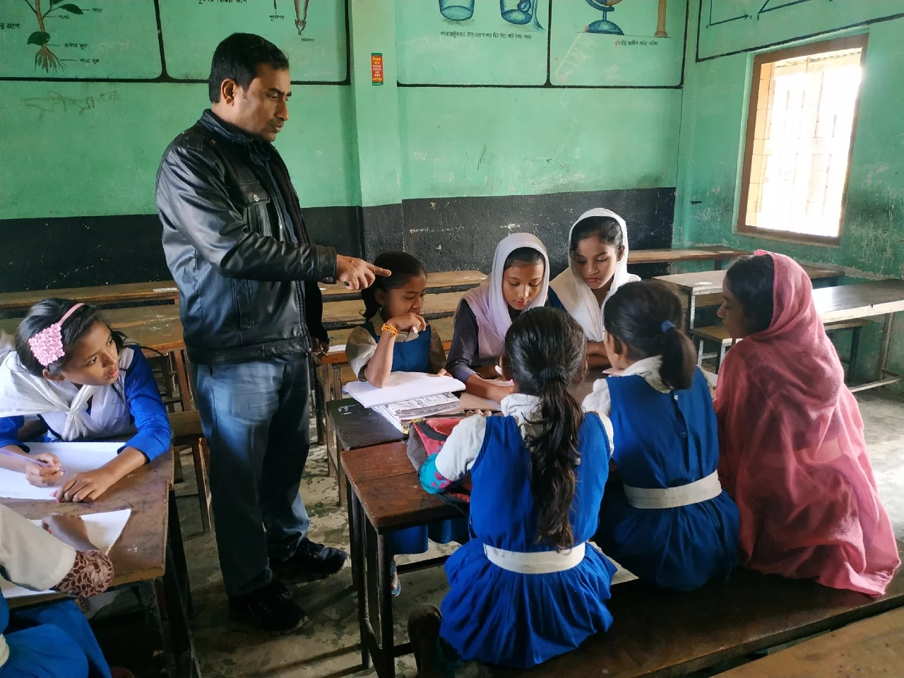
Now read in groups . A student should be selected from every group to read loudly
Groupwork

Slide 15
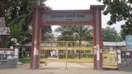
Let’s see the important places of Kishoregnj
Solakia Eid Ground=The biggest Eid Ground.
Government Gurudayal College

Slide 16
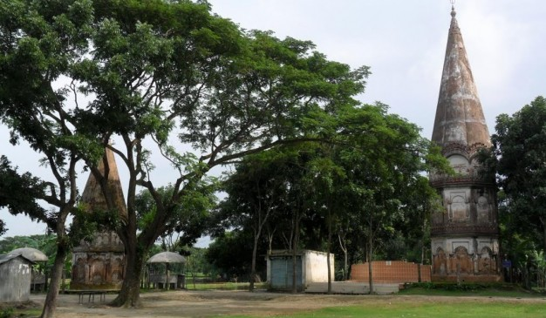
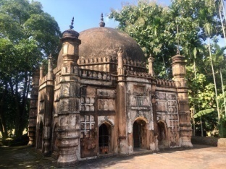
Shah Muhammad Mosque
Shiva Temple of Chandrabati

Slide 17
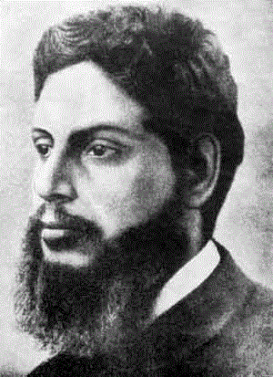
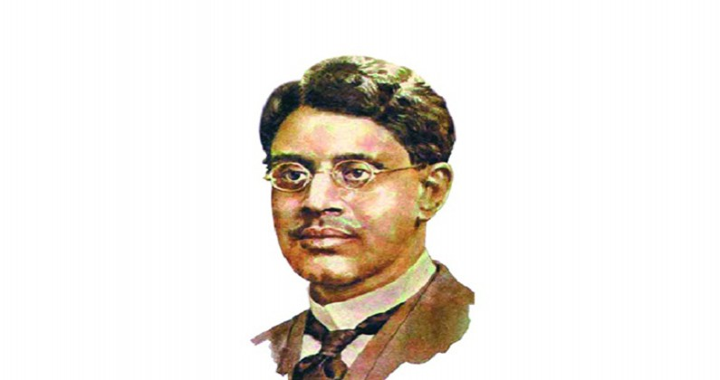
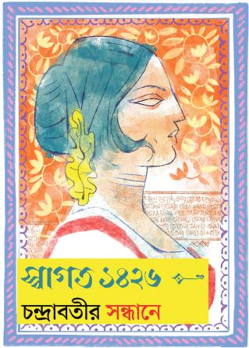
Some famous people of Kishoregonj
Upendrakishore Roy Chowdhury
(Writer of children’s Literature)
Sukumar Roy
( Writer of Children’s Literature)
Chandrabati
(The first woman poet of Bangla Literature)

Slide 18
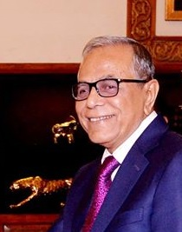
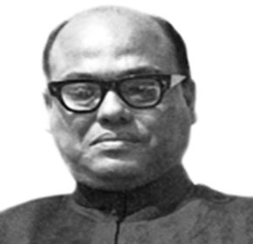
IMPORTANT PERSONALITIES
Syed Nazrul Islam
(The first Acting President of Bangladesh)
Abdul Hamid
President (Present)

Slide 19
Ask and answer the questions
Pair work
1.How far is Kishoregonj from Dhaka?
2.How did it get its name?
3.What is the name of the river in the town?
4.What are two things you can see in the town?
5.Who are two famous people from this town?

Slide 20
Let’s see the answer for the questions.
1.How far is Kishoregonj from Dhaka?
Ans : It is about 145 kilometres from Dhaka.
2.How did it get its name?
Ans : It got its name from the name of an old landlord known as Brojokishore Pramanik or Nandakishore Pramanik
3. What is the name of the river in the town in the town?
Ans : The name of the river is Narasunda .

Slide 21
4.What are two things you can see in the town?
Ans. The two things are :
1) Shah Mohammad Mosque
2) Government Gurudayal College.
5) Who are two famous people from this town?
Ans. The two famous people are:
1)Upendra Kishore Roy Chowdhury
2)Sukumar Roy.

Slide 22
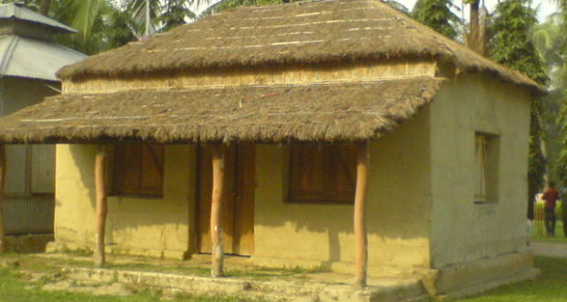
Homework
Write a short composition about “Your Hometown” at least five sentences

Slide 23

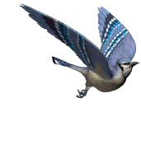
GOOD BYE

