Slide 1
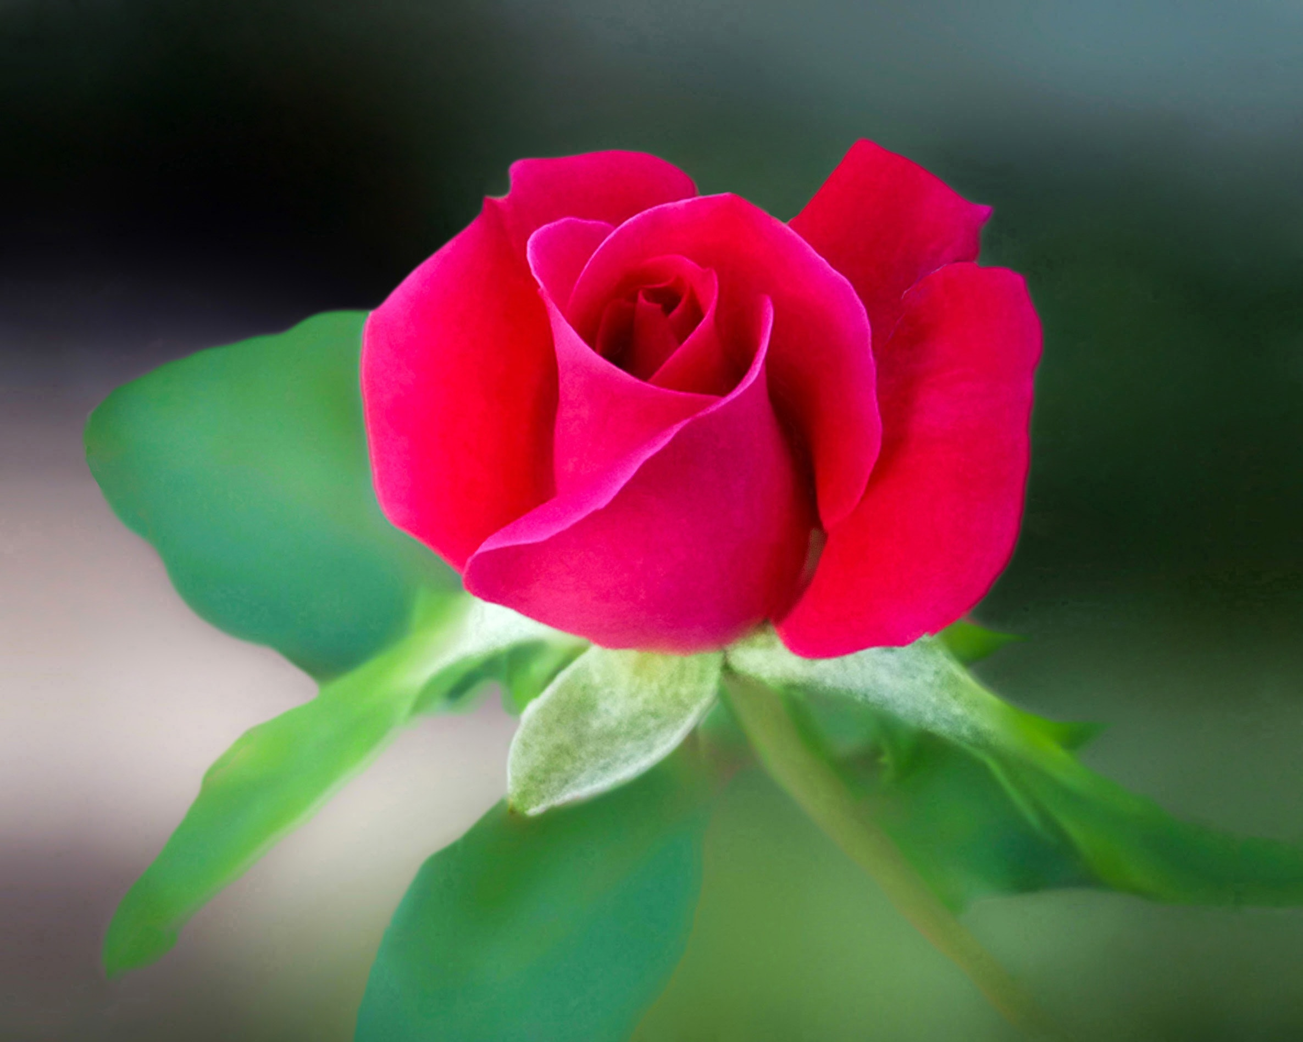
Good morning

Slide 2
Rokshana Aktar
Assistant teacher
Patdha Noyapara Govt. Primary School
Kishoreganj sadar

Slide 3
Class –one
Subject –English
Unit -25, Lessons 1-3
Rhyme
Time -40 minutes
22/01/2020

Slide 4
Students will be able to ……..
4.1.1 Enjoy the rhythm and music of simple rhymes.

Slide 5

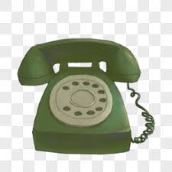
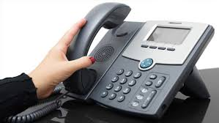
Do you like to see some picture?

Slide 6
Let’s see
Ring……. Ring…… it’s the phone!

Slide 7

Hello hello!
I am a rat on a mat.

Slide 8
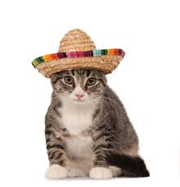
Is this the cat ?
I’m a cat in a hat.

Slide 9

But I’m not at home!

Slide 10

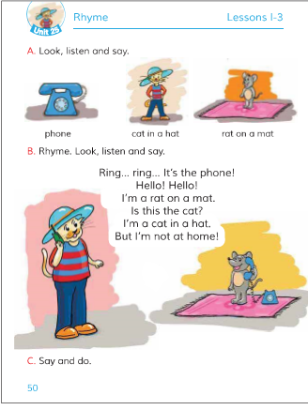
Open your book and look at the lesson
Page no-50 Lesson-1-3

Slide 11
New word
mat
Ring
phone
Hat
Rat
Cat

Slide 12
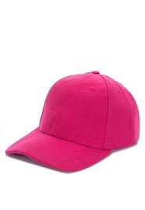
Group work
Think about the picture and tell the names of the pictures.
Group-A
Group-B

Slide 13
Do you want to listen the rhyme?
Keep quite and listen the rhyme.
Ring….ring…It’s the phone!
Hello ! Hello!
I’m a rat on a mat

Slide 14
Checking learning
Recite the rhyme with correct pronunciation.
Ring…ring…It’s the phone!
Hello! Hello!
I’m a rat on a mat.

Slide 15
Tasks
Say the next line.
Ring…ring…It’s the phone !
……………………………..!
I’m a rat on a mat.
……………………….?

Slide 16

Thanks to all

