Slide 1

WELCOME

Slide 2
Group Identity
Group’s Name: B (Rhyme)
Members Name:
Mostafa Kamal
Mashkura, Lakkhi, Sayed,

Slide 3
Lesson Identity
Class: Two
Subject: English for Today
Lesson Unit: 16
Lesson: 05 (Rhyme)

Slide 4
Learning Outcomes:
Students will be able to :
Listening :
1.1.1 become familiar with English sounds by listening to common English words.
4.1.1 enjoy the rhythm and music of simple rhymes.
Speaking :
1.1.1 repeat after the teacher simple words and phrases with proper sounds and stress.
1.1.2 say simple words and phrases with proper sounds and stress.
4.1.1 repeat rhymes after the teacher.
4.1.2 recite rhymes independently.
Reading :
1.4.1 read words and phrases with the help of visual clues (about 30 new words) and simple sentences.

Slide 5

Let’s See a video clip

Slide 6
Red
Orange
Yellow
Green
Blue
Indigo
Violet

Slide 7
Kims Game
Red
Orange
Indigo
Yellow
Green
Blue
Violet

Slide 8
Today we will learn
(A Rhyme)
Rainbow, rainbow,

Slide 9

Open Your Book At Page 33

Slide 10
Let’s Listen A Audio Clip

Slide 11

Rainbow, rainbow,

Slide 12
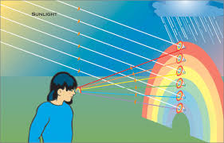
I see you!

Slide 13
Red and orange,

Slide 14
Yellow, green and blue,

Slide 15
Indigo and violet, too!

Slide 16

Teacher`s recitation

Slide 17
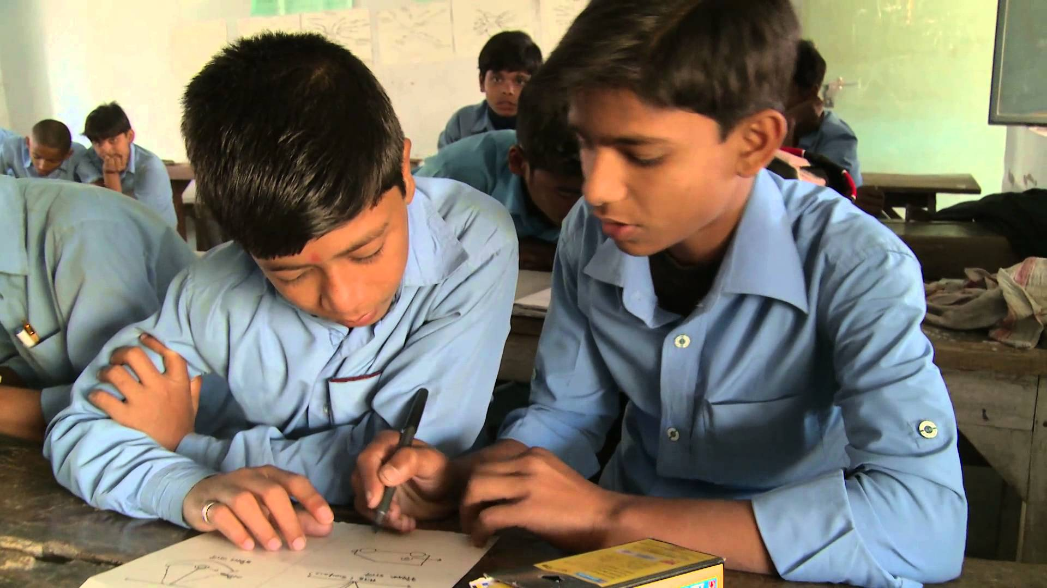
Pair work

Slide 18

Group work

Slide 19
Let’s Review
Rainbow, rainbow,
I see you!
Red and orange,
Yellow, green and blue,
Indigo and violet, too!

Slide 20

Evaluation
Individual recitation

Slide 21
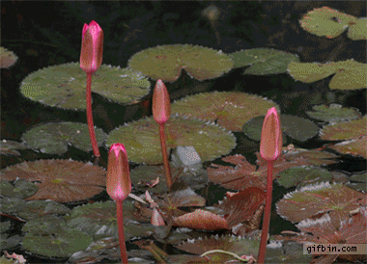
THANKS

