Slide 1
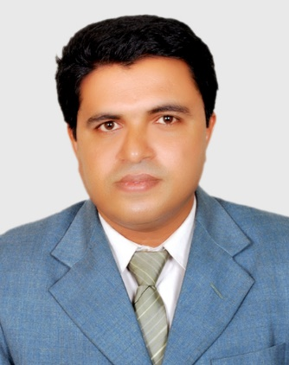
Teacher Identity
Biswajit Pariyal
Assistant Teacher
Kattali City Corporation Girls High School and College.
Mobile: 0199-1950549
Email :pariyal79@gmail.com
Website / Blog Address :biswajit –pariyal.blogspot.com.

Slide 2
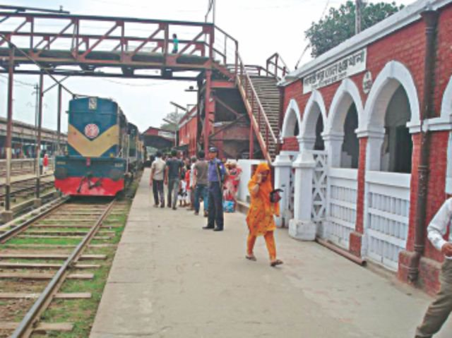
Look at the picture

Slide 3
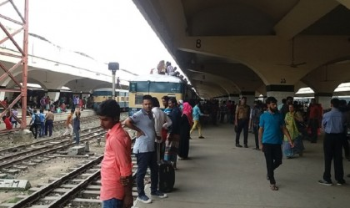
Today’s Topic
At a railway station

Slide 4
English For Today
Class - Six
Unit - 01
Lesson -3, Page No :8, 9
Time : 5O minutes.

Slide 5
Learning Outcomes
After finishing the lesson, Students will be able to know about --------
01. Participate in speaking, reading and writing skills.
02. Use vocabulary
03. Read and answer the question.
04 . Match opposite word and group work

Slide 6
Explain the words
Word | English Meaning | Bengali Meaning
‍Station | Place where vehicles' start from and stop at. | ট্রেন থামবার স্থান
Crowded | Mob, gathering | জনতা, জনতার ভীড়
Tightly | Firmly, compactly | শক্তভাবে বা দৃড়ভাবে
Couple | Husband and Wife, Pair | দম্পতি বা জোড়া
Suitcases | A rectangular case for carrying clothes. | সুটকেস
Whistled | Play the flute | বাঁশি বাজানো
Magazine | A periodical containing stories, articles etc. | সাময়িক পত্রিকা
Counter | Place of collecting tickets | টিকিট বিক্রির স্থান
Queue | Line | সারি বা লাইন
In front of | before | সামনে

Slide 7
Individual Work Silent reading the passage and answer the following question :
A) What place is it ?
B) Who is Sajjad ?
C) What can you see in the picture?
D) What was the young people doing?
E) Who was going to Dhaka?

Slide 8
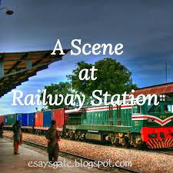
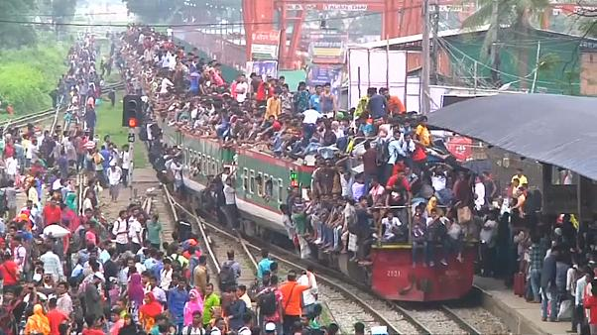
A Scene at Railway Station

Slide 9
Pair Work
To describe orally the scene at the railway station.
Or
Suppose your are name is Amir and Your friend name is Shiva. Now write a dialogue between two friends about the scene at railway station.

Slide 10
Look at the picture of below

Slide 11
Group Work
To ask group to orally discuss with in their groups what they can see in the above picture.
A) Where was Sajjad going?
B) Why did he come to the station?
C) What did you see in the ticket counter?

Slide 12
Video scene on railways station

Slide 13
Evaluations
1) Having Watched the above video scene on railway station, talk about what things you see.
2) How many passengers are there in the railway station?
3) How many stalls are there at the railway station ?
4) Where do you find newspapers at railway station?
5) Who carries the luggage of passenger at railway station?

Slide 14
Match a word from Column A with a word Column B that has an opposite meaning.
Column A | Column B
See off | light
long | busy
quite | receive
heavy | drop
pick up | short

Slide 15
Home Work
1) Write a paragraph about a railway Station.
2) Suppose you went to a bus station . Describe what you saw, what was happening and what you did there.

Slide 16
Thanks for watching

