Slide 1
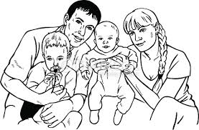

WELCOME

Slide 2
Presented By
Mostafa Kamal
Assistant teacher
Shikri Govt: Primary School

Slide 3
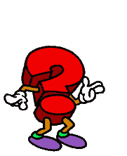



Todays Lesson
Class-Five
Lesson- 4
An Evening With Saiket’s Family
Part-A,A1

Slide 4
Learning outcomes
By the end of the lesson student will be able to
listen the lesson attentively.
Read the text with correct pronunciations.
answer lesson related questions.
Write five sentences about owns evening activities.

Slide 5
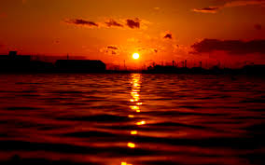
The sun is being set
Evening

Slide 6
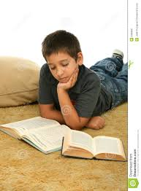
This is Saiket.
He is a student.
He reads English story book.

Slide 7
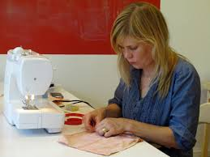
Saiket’s mother.
Maleka Begum
She loves sewing in her free time.

Slide 8
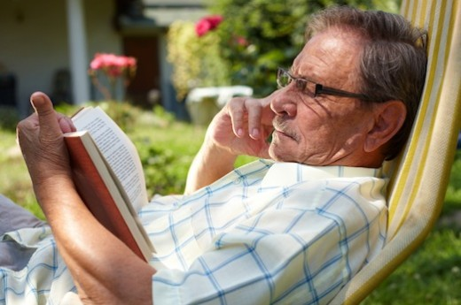
Saiket’s father.
Mr. Islam
He writes story.

Slide 9
Saiket’ Family.

Slide 10
Today we read
An Evening with Saiket’ Family.

Slide 11

NEW

Slide 12
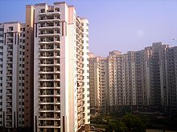
A building Where people generally live
Saikat lives with his parents in an apartment in Bogra.
Apartment

Slide 13
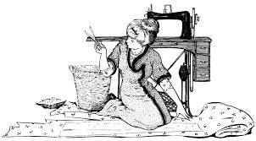
The activity of making thing with a needle and thread.
She loves sewing in her free time.
Sewing

Slide 14
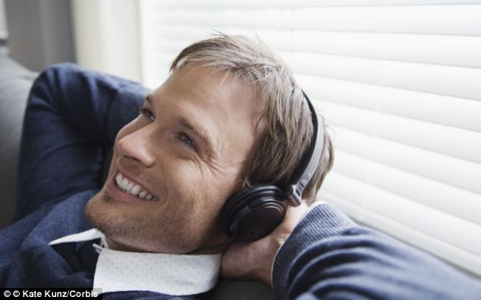
To give attention with the ear.
He loves listening to music of old times.
Listening

Slide 15
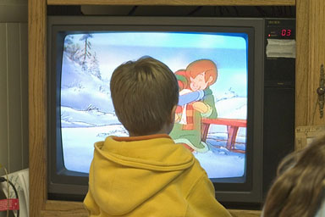
To be alertly on the lookout
He watches cartoons on TV
Watches

Slide 16

Make or became better.
He wants to improve his English.
Improve

Slide 17
Apartment =
A building Where people generally live
The activity of making thing with a needle and thread.
Sewing =
Listening=
To give attention with the ear.
Watches =
To be alertly on the lookout
Improve =
Make or became better.

Slide 18
Apartment
Sewing
Listening
Watches
Improve

Slide 19
Please open at page -15
Teacher’s Reading

Slide 20
Silent Reading
Pair reading

Slide 21
Answer the following MCQ
(a) Whom does Saikat live with?
(i) Teachers (ii) Friends
(iii) Parents (iv) Relatives
(b) Where does Saikat live?
(i) Magura (ii) Bogra
(iii) Borguna (iv) Barisal
(f) What kind of student is Saikat?
(i) Bad (ii) Good
(iii) Dull (iv) Ignorant

Slide 22
(i) What does Saikat watch on TV?
(i) Movies (ii) Drama
(iii) Cartoons (iv) Football
(j) What is the synonym of tale?
(i) Language (ii) Story
(iii) Word (iii) Book

Slide 23
Individual work
Write three sentences about your evening activities

Slide 24

THANKS

