Slide 2
Md. Mominul Islam
Head Teacher
Ishanpur GPS.
Kaharol. Dinajpur
017977443
mominict9@gmail.com

Slide 3
Subject : English
Class : Two
Unit : 5
Lesson : 4 (A)
Time : 45 minute

Slide 4
Dear learners, now we will
watch a video.

Slide 6
Today’s lesson : Alphabet
( Uu Vv Ww Xx Yy Zz )

Slide 7
Learning outcome:
After finishing the lesson students will be able to-
Listening:
1.1 become familiar with English sound by listening to common English words.
Speaking:
1.2 repeat after the teacher simple words and phrase

Slide 8
Students will repeat after the teacher.

Slide 9
Uu is for umbrella.

Slide 10
Vv is for vase.

Slide 11
Ww is for window.

Slide 12
Xx is for x-ray.

Slide 13
Yy is for yo-yo.

Slide 14
Zz is for zebra.

Slide 15
Look and say
U
Umbrella
Vase
V
W
Window
X-ray
X
Yo-yo
Y
Zebra
Z

Slide 16
Again students will repeat
after the teacher.

Slide 17
Uu
Umbrella
Vv
Vase

Slide 18
Ww
Window
Xx
X-ray

Slide 19
Yy
Yo-yo
Zz
Zebra

Slide 20
Open your Book at page 11

Slide 21
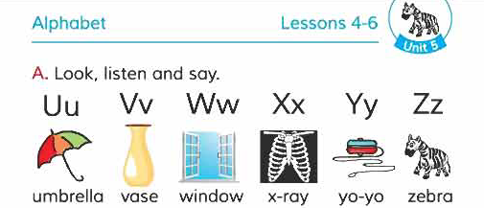

Slide 22
Look and say
Capital letter
Small letter
U u
V v
W w w w
X x
Y y
Z z

Slide 23
Look and say
U
V
W
X
Y
v
x
u
y
w

Slide 24
Whole class work:
(Matching)
Uu
Vv
Ww
Xx
Zz

Slide 25
Group work:
All students divided in to four groups of Red, Green, Black and White.

Slide 26
Group work
Each group has to re-arrange the letters.
Red
uvwxyz
Green
xyzvuw
wxyzvu
Black
vwxyzu
White

Slide 27
Thank you so much.

