Slide 2
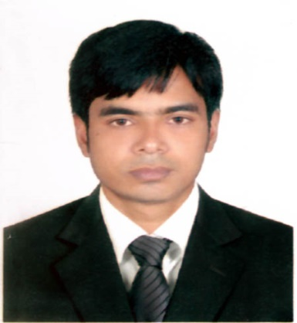
Identity
Emdadul haque milon
B.A(Hon’s)M.A.B.Ed.
Assit: Teacher in English
Sunapur SESDP Model High School, Dowarabazar,Sunamganj
English For Today
Class : Six.

Slide 3
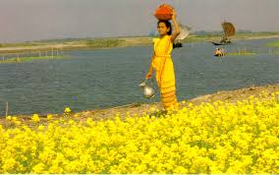
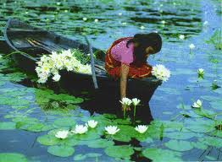
LOOK AT THE PICTURES
These are beauties of Bangladesh.
Do you know what about these pictures ?

Slide 4
Today`s topic
An unseen beauty of Bangladesh
Lesson : 13,

Slide 5
Learning outcomes
After completing the lesson students will be
able to –
# ask and answer the questions
# read and understand text
# write short paragraphs
# Describe the beauty of Bangladesh.

Slide 6
Let’s watch a video clip
Beauty of Bangladesh.
Now discuss with your partner about the video and write three sentences on it.
Notes:
Showing the video teacher can ask the question to the whole class. SS will raise their hands. Teacher can ask 5/6 students to narrate the video.

Slide 7
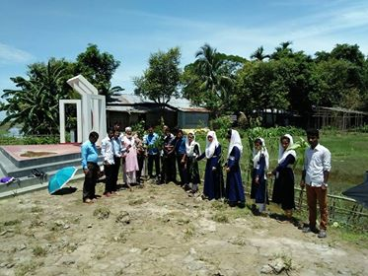
Go to section A and Follow the conversation then practice in pairs.
In the last winter vacation I went to Cox’s Bazar with my family. I enjoyed many things like watching sun rise and sun set, bathing on the beach, watching the natural beauty of St. Martin’s etc.
Have you ever visited any interesting tourist spot in Bangladesh ? If you have, what was that place. What special attractions did you see there ?
Notes:
Showing the conversation teacher can call pair by pair to practice it.

Slide 8
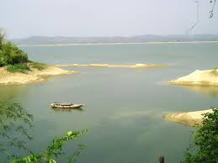
The main attraction of Durgapur in NETROKONA.
The Someshwari river.
Ceramic mountain-blue water.
There are many Ethnic groups in Netrokona.
Notes:
After shown the picture T. can ask to SS for narrate the picture, then he/she can give feedback.

Slide 9
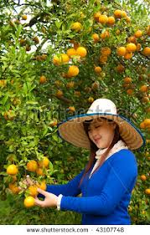
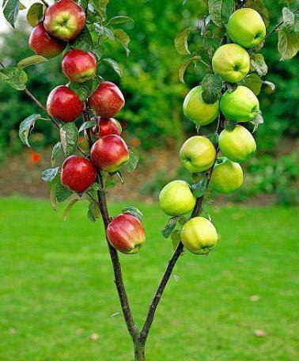
Orange Garden
Apple Tree
Locknathbaba Temple
Notes:
After shown the picture T. can ask to SS for narrate the picture, then he/she can give feedback.

Slide 12
Eye-catching destinations
Bangladesh is the true home of eye-catching natural beauty.
Places that draws one’s attentions.

Slide 13
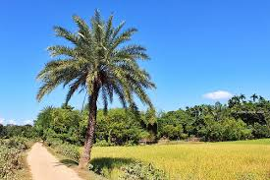
Green, remote countryside
How beautiful our green, remote countryside is !
A rural and distant place full of plants and trees.

Slide 14
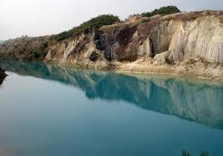
Crystal clear
The water of Someshwari river is crystal clear.
See-through.

Slide 15
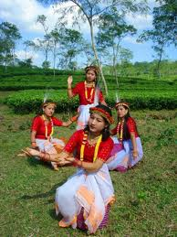
Vibrant tribal culture
Durgapur is also rich in vibrant tribal culture.

Slide 16
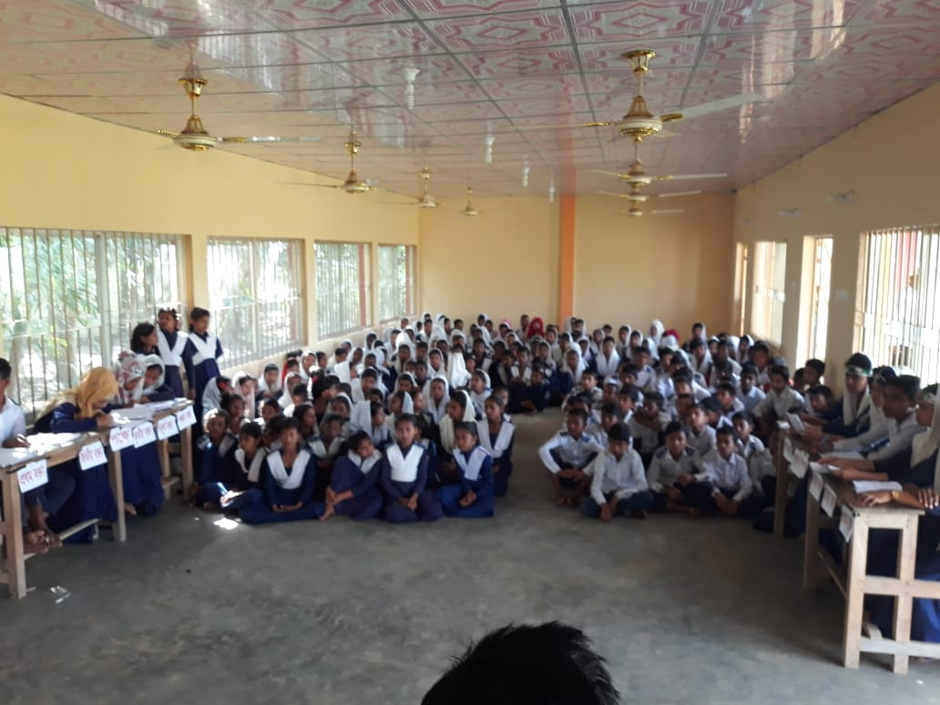
Pair works
Read the passage attentively , go to the section B2 then discuss the following questions in pairs.
Notes:
Teacher can evaluate it by orally or written from the SS.

Slide 17
HOME WORK
Write ten sentences about the beauty of your own area.

Slide 18
GOOD BYE….

