Slide 1
Notes for the teachers
Dear colleagues,
I like to request you to follow the instructions below the note options before going to the class so t hat the class may be effective to the students.
Notes:
Dear colleagues you can hide this slide. Start presentation by pressing F5.

Slide 2
Welcome
Notes:
This is welcome slide. This image is used here to make the student thoughtful about the lesson.

Slide 3
Introduction
Zakir Hossen
Lecturer in English
Bhulkara Islamia Alim Madrsah
Chouddagram, Cumilla
Mobile-01818-713909
Email-zakirhossen78@gmail.com
English for today
Class-XI-XII

Slide 4
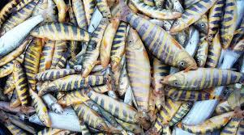
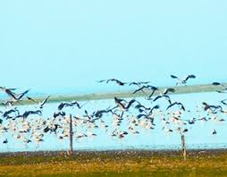
Where do we see this picture?
In Hakaloki Haor?
Notes:
Student will be discussed about the picture in pair. Then teacher will provide the correct answer and write it on the board.

Slide 5
Now watch the video and then discuss with your partner
https://www.youtube.com/watch?v=0HtUNdel7zc

Slide 6
Today’s topic is-
Hakaloki Haor

Slide 7
Learning outcomes
By the end of the lesson SS will be able to-
tell the kind of fish available in the Hakaluki Haor;
describe the economic importance of the Haor;
read and understand the text through silent reading.
Notes:
Learning outcomes should be read out by the students. Teacher can hide this slide, if he wants.

Slide 8
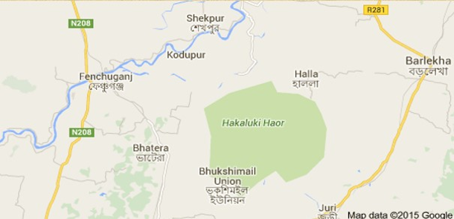
Location and surrounding areas of the Hakaluki Haor
The Map of The Hakaluki Haor
Notes:
Teacher will show the picture and try to find out the answer from the students. Then write down the students answer on the board and then show the correct answer.

Slide 9
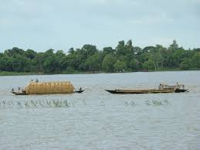
Hakaluki Haor is one of the major Wetlands of Bangladesh
It’s area is about 18,386 hectares. This haor is declared ecologically
critical Area in April 1999 by the Government of Bangladesh.
Notes:
Teacher will show the picture and try to find out the answer from the students. Then write down the students answer on the board and then show the correct answer.

Slide 10
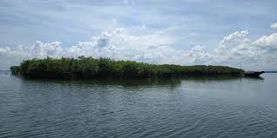
Hakaluki is complex ecosystem containing more
than 238 interconnecting beels and Jalmahals.
The most important beels are….
Chatla, 2. Pinlarkona, 3. Dulla, 4. Sakuna,
5. Barajilla,6. Balijhuri, 7. Lamba, 8. Tekonia etc.
Notes:
Teacher will show the picture and try to find out the answer from the students. Then write down the students answer on the board and then show the correct answer.

Slide 11
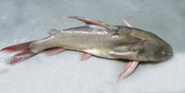
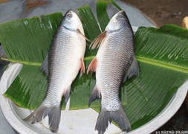
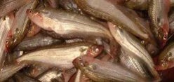
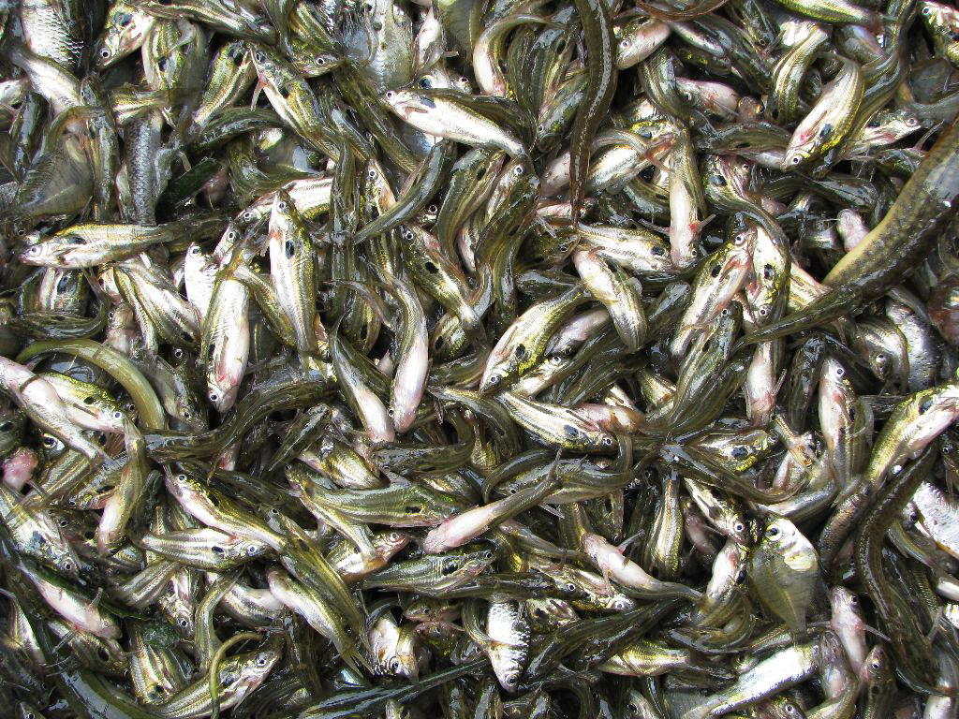
Hakaluki haor is an important source of fish source of fisheries resources for Bangladesh.
The main species found here are:
Ghagot fish
Rui fish
Pabda fish
Corbelling fish
Notes:
Teacher will show the image first and try to find out the answer from the students and write down the students answer on the board and then give caption.

Slide 12
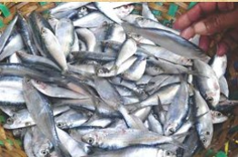
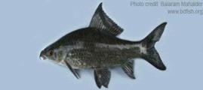
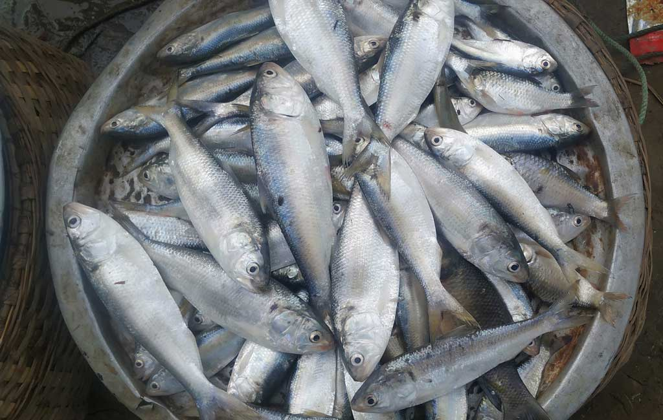
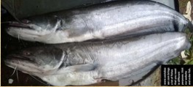
Chapila fish
Kalibaus fish
Hilsha fish
Boal fish
Notes:
Teacher will show the image first and try to find out the answer from the students and write down the students answer on the board and then give caption.

Slide 13
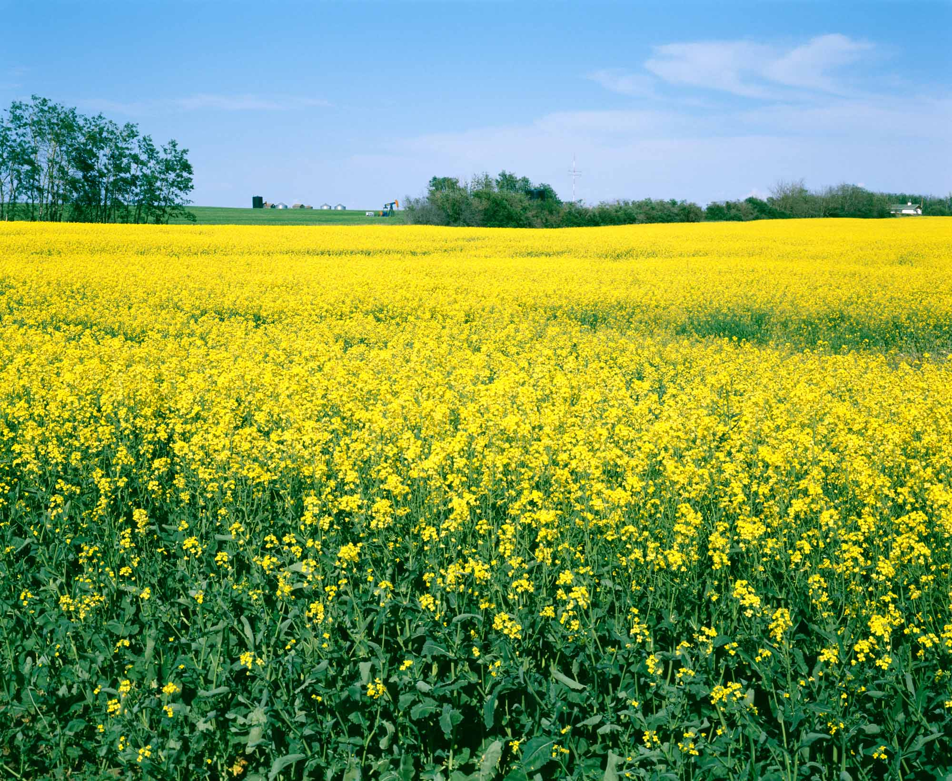
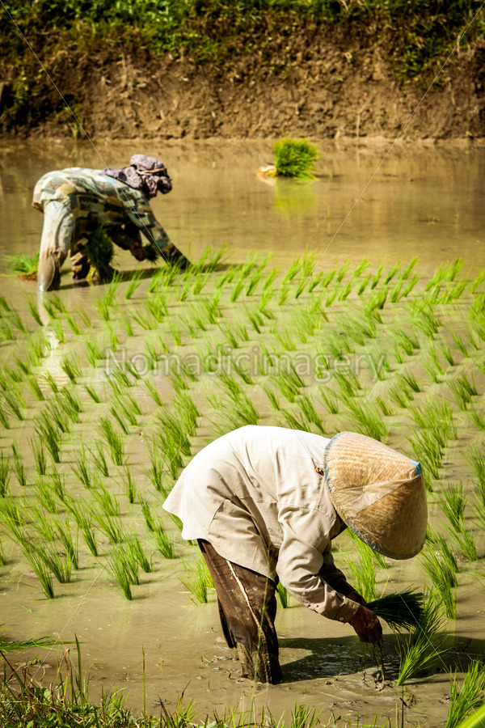
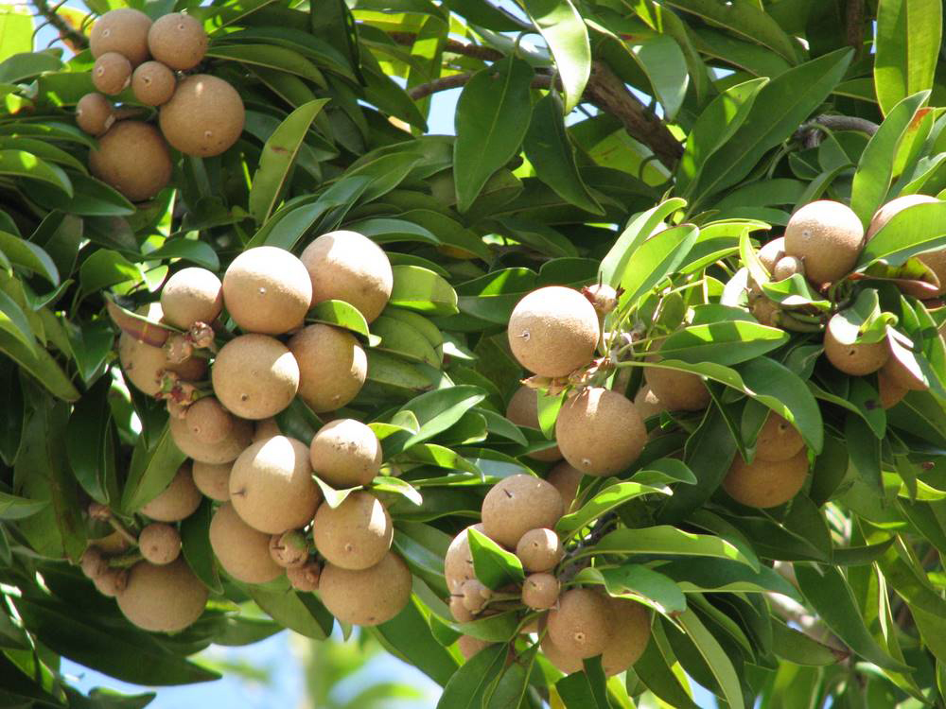
The haor system provides a wide range of economic and non-economic benefits
to the local people as well as to the people of Bangladesh.
Mustard seed
Peddy seed
Fruits
Notes:
Teacher will show the image first and try to find out the answer from the students and write down the students answer on the board and then give caption.

Slide 14
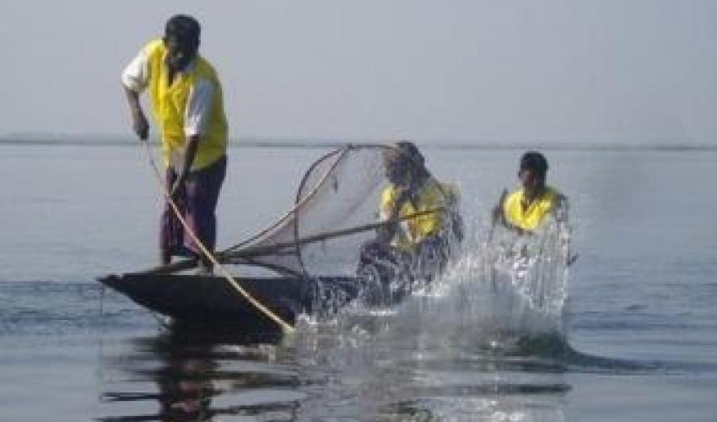
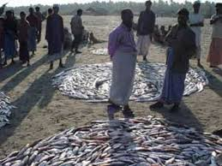
Fish production in Hakaluki Haor
Notes:
Teacher will show the image first and try to find out the answer from the students and write down the students answer on the board and then give caption.

Slide 15
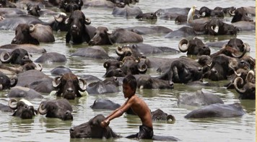
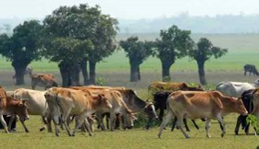
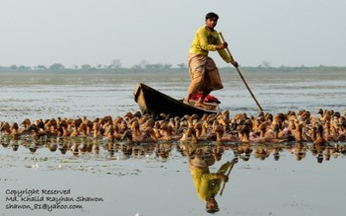
These are also economically important
Cattle rearing
Buffalo rearing
Duck rearing
Notes:
Teacher will show the image first and try to find out the answer from the students and write down the students answer on the board and then give caption.

Slide 16
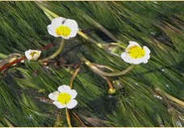
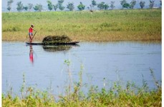
Collection of aquatic and other plants
Collection of reeds and grasses
Notes:
Teacher will provide the picture first and try to get the answer from the students and then give the caption.

Slide 17
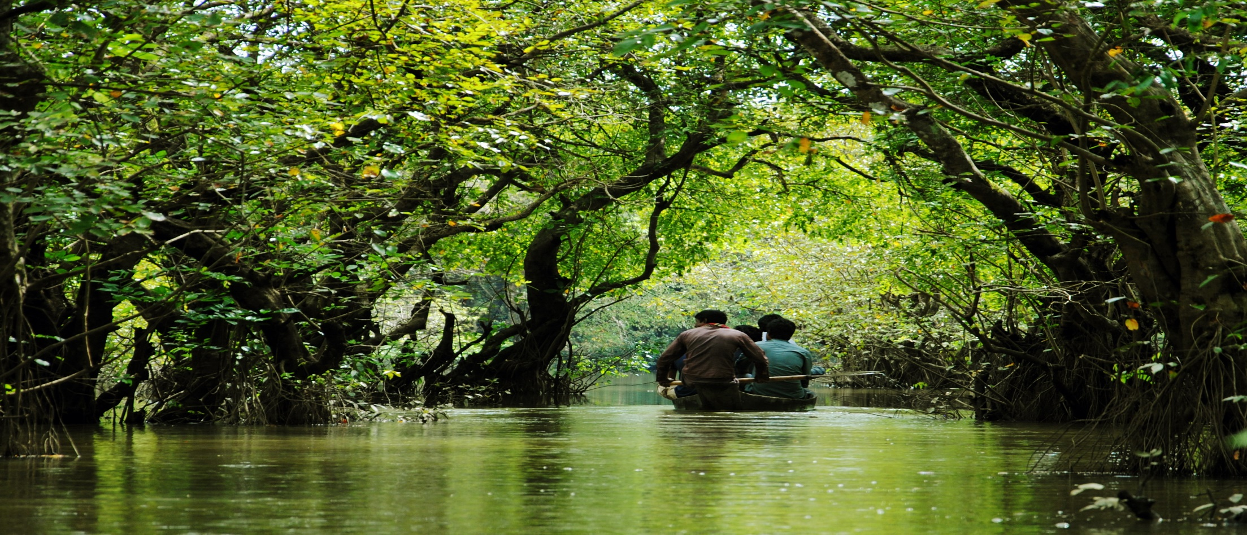
Swamp (Noun)
Meaning: (an area of) very wet, soft land
The Everglades are an area of swamp in southern Florida.

Slide 18
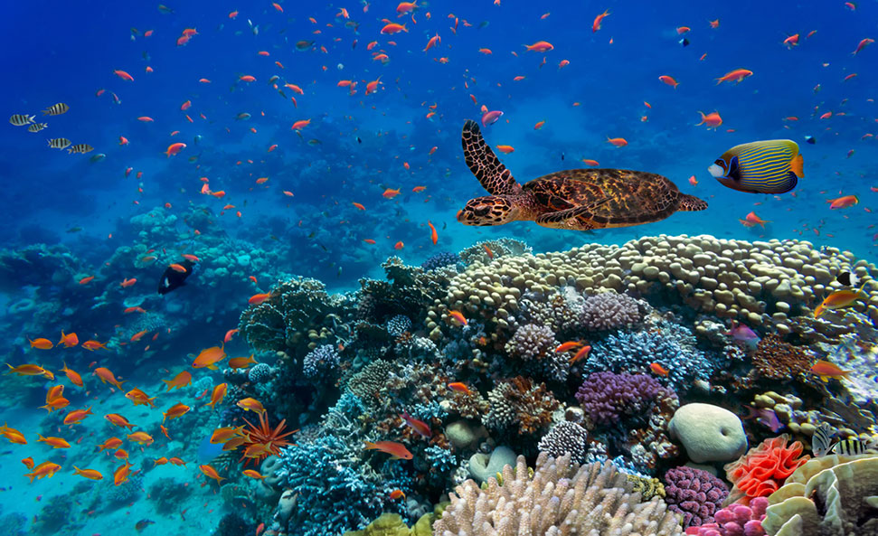
Biodiversity (Noun)
Meaning: the number and types of plants and animals that exist in a particular area or in the world generally
A new National Biological Survey to protect species habitat and biodiversity.

Slide 19
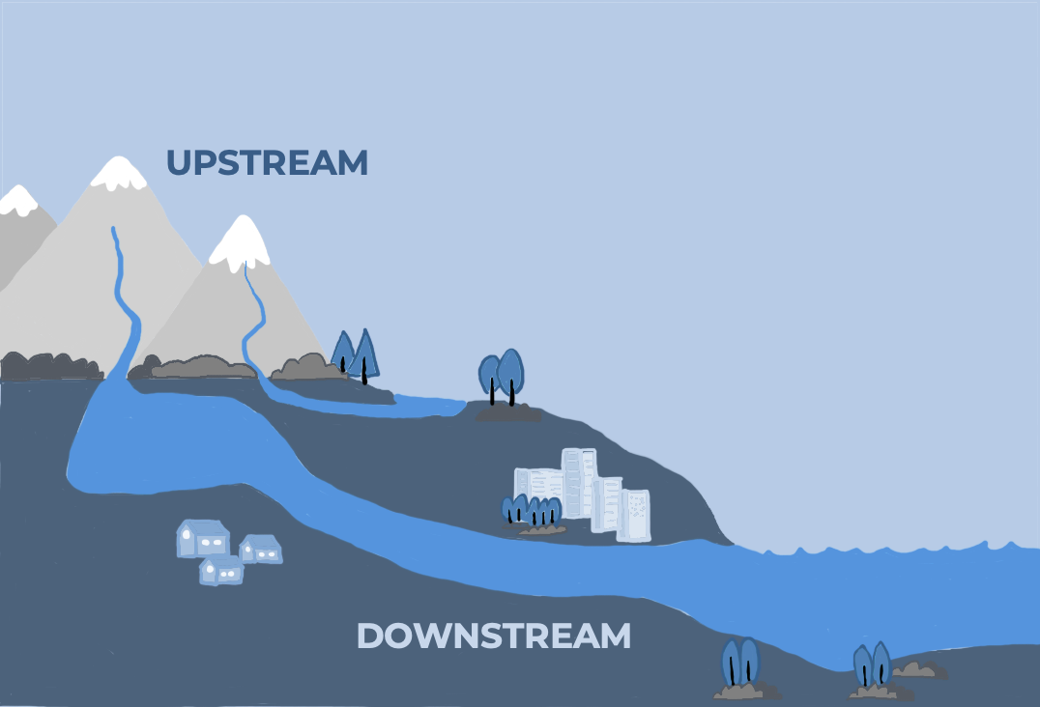
Upstream (Adverb/Adjective)
Meaning: (moving) on a river or stream towards its origin
Salmon swim upstream against very strong currents to reach their breeding areas.

Slide 20
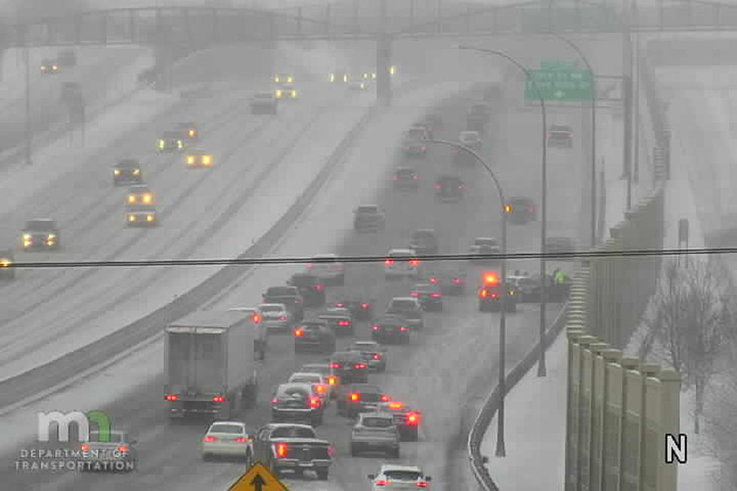
Numerous (Adjective)
Meaning: many
We have discussed these plans on numerous occasions.
Notes:
Caption will be given after the image

Slide 21
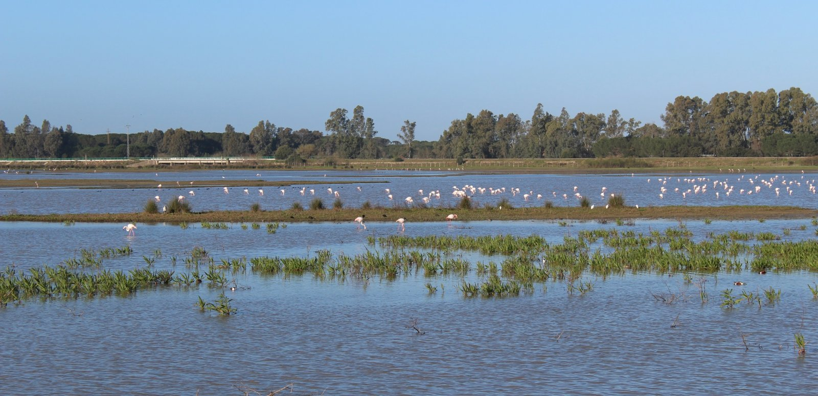
Wetland (Noun)
Meaning: a large area of land covered with swamp or marsh
These are words often used in combination with wetland.

Slide 22
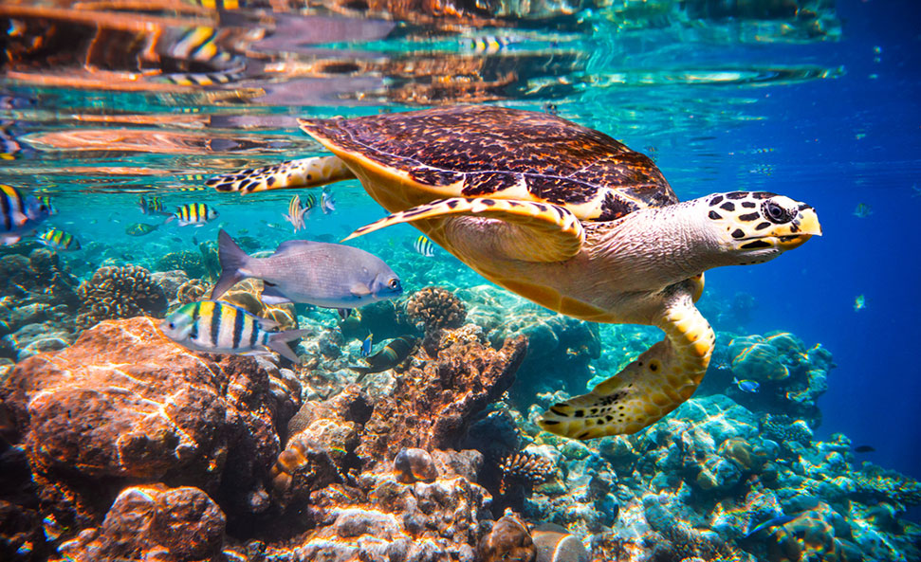
Ecosystem (Noun)
Meaning: all the living things in an area and the way they affect each other and the environment
Pollution can have disastrous effects on the delicately balanced ecosystem

Slide 23
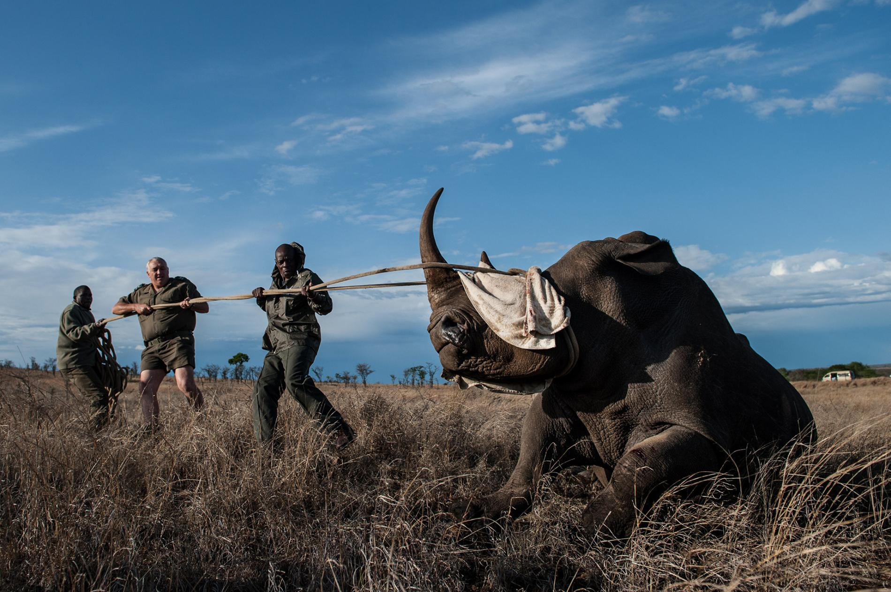
Poaching(Noun)
Meaning: Take possession of
Illegal poaching has been a threat to the waterfowl population in this vast wetland

Slide 24
Pre-reading
Dear students, you will read the first Para and
try to find out the answer of the question silently.
How is Bangladesh blessed with?
What is the land area of Hakaluki haor?
When was Hakaluki haor decleared an economically critical area?
Notes:
Students will read the passage individually and try to find this questions answer.

Slide 25
While reading
Dear students, Now read the whole passage and try to write down the answer the question given below..
How is the Hakaluki haor important?
What is the most interesting species?
What are the causes of destruction of swamp forest?
What are the still existing swamp forest?
Notes:
Students will do the work in pair and write down the answer in their notebook. Teacher will help them to find the answer of the questions.

Slide 26
Post reading
Read the following text again. Match the words in Column A with their meanings in Column B:
Column-A | Column-B
floodplains ii. Ecosystem iii. tributary iv. fry v. Aquatic vi. Waterfowls vii. swamp forests viii. Vegetation ix. Reed x. flash flood | water birds such as ducks and geese b. a stream or river that flows into a large river or a lake c. all the plants or plant life of a place, taken as a whole d. common name for several tall, grass-like plants of wetlands e. a sudden and rapid rise in river or lake water overflowing banks, typically due to heavy rain f. the young of various species of fish g. low, flat, periodically flooded lands adjacent to rivers, lakes etc. h. a community of living and non-living things that work together i. living or growing in, on, or near the water j. forests which are inundated with fresh water, either permanently or seasonally
Notes:
Students will do the work in group and try to solve the question from their understanding.
Teacher will play the role of a monitor.

Slide 27
Home work
Do you know any wetland (beel, jalmahal, haor etc.) in your area? Write a short article in
150 words about the wetland. Your article should contain some or all of the following points:
❑ the name, location and area of the wetland
❑ the kinds of fishes available
❑ the kinds of vegetation that grow in and around
❑ benefits it provides
❑ its natural beauty
Notes:
Teacher will tell the students to write this hints on their note book for writing short article.

Slide 28
Thank you
Notes:
This image is given here for remembering the students about the topic again.

