Slide 1
WELLCOME TO MY CLASS

Slide 2
Teacher identity
lesson identity
Nahid akhtar parvin.assistant Teacher.
jagodishpurGovt.
Primary school.
Email ID:nahidprimary@
gmail.com
Class : Five
Subject : English
Unit : 20
Lessons: 1-2(life is beautiful).
Maria is a lot …….was
born.
Page : 78
.

Slide 3
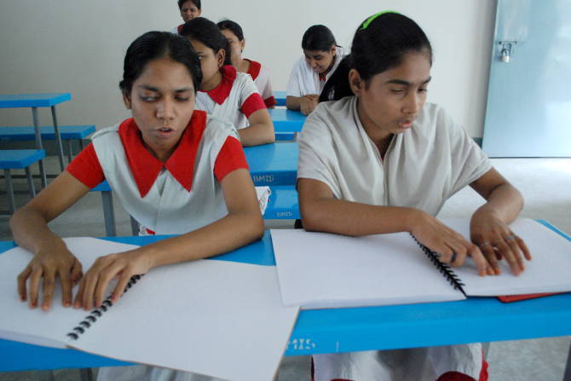
What do you see in this pictures?
They are reading the book
by using finger.
They are reading by see the book .
.

Slide 4
Today’s lesson
Life is Beautiful!

Slide 5
Learning outcomes
At the end of the lesson students will be able to-
Listening:
1.3.1 recognize which words in a sentence are stressed.
1.1.1 say words, phrases and sentences with proper sound and stress.
Speaking:
1.5.1 read words, phrases and sentences in the text with proper
pronunciation, stress and intonation.
Reading:
1.7.1 read paragraphs, dialogues stories, letters and other texts.

Slide 6
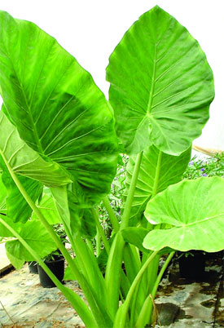
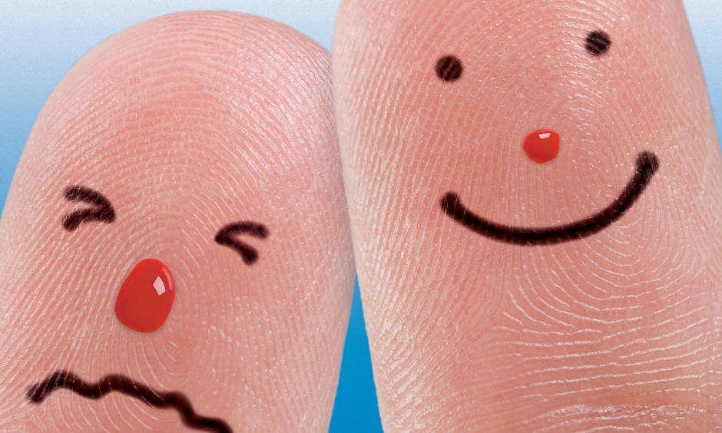
New Words
Meaning in English
One of the flat green
parts of a plant
leaf
visually
In eye sight

Slide 7
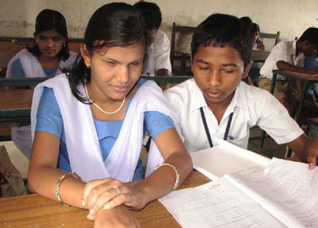
New Words
Meaning in English
damaged or not
working normally
impaired
unable to see
normally
Visually impaired

Slide 8
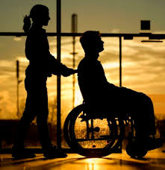
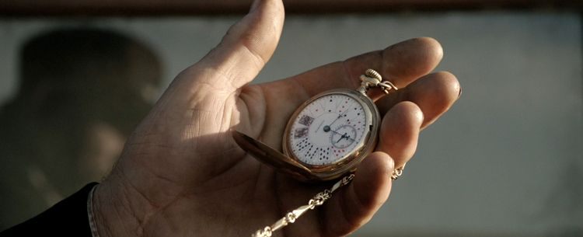
New Words
Meaning in English
not able to do something
unable
from a time in the past until
a later past time or until now.
since

Slide 9
Teachers model reading
Students silent reading

Slide 10
Pair work
Answer the following questions in sentence
a) What cannot Maria see?
Ans: Maria cannot see the flowers the blue sky, or the singing birds.
b) How is Maria different from others ?
Ans: Maria is visually impaired.
b) What is Maria’s problem ?
Ans: Maria’s problem is that she cannot see .

Slide 11
Indivisual work
Look at the table. Again see the words with English meaning.
Words | Meaning in English
student | someone who is studying at a school, college or university
neighbourhood | a small area of a town or the people who live there
leaf | One of the flat green parts of a plant
visually | In eye sight
impaired | damaged or not working normally
visually impaired | unable to see normally
unable | not able to do something
since | from a time in the past until a later past time or until now.
Notes:
Teacher explain the student this tropic with real object.

Slide 12
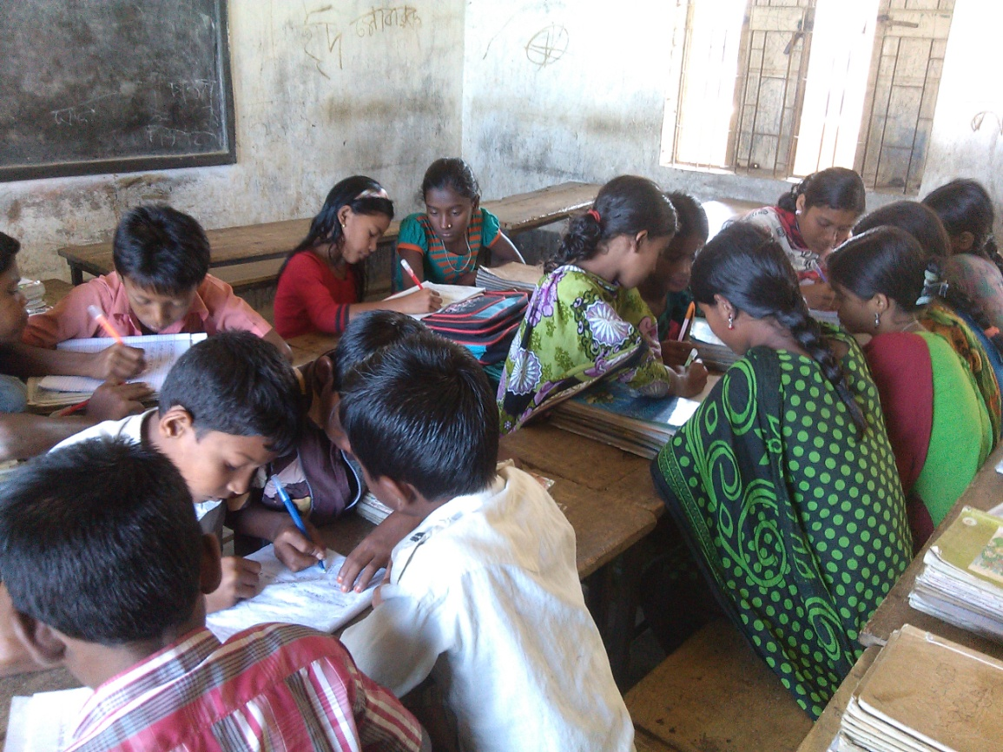
Group work--1
Choose the right answer
1. What smells sweet and fresh?
(a) the flowers (b) the birds
(c) the window (d) the spring
2. Maria is visually impaired.
Here the word “visually” is related to…………
(a) Leg (b) ear (c) brain (d) eye
3. Where will Maria go?
(a) to market (b) to school (c) to park (d) to her teacher
∙
∙
∙

Slide 13
Matching
Group --2
from a time in the past until a later
past time or until now.
visually
unable
one of the flat green parts of a plant
leaf
In a eye sight
since
not able to do something

Slide 14
Evaluation
Answers the following questions.
a) From when Maria is blind?
Ans) Maria has been blind since her birth.
b) Where are the flowers?
Ans) The flowers are outside her home.
c) Who cannot see the green leaves on the tree?
Ans) Maria cannot see the green leaves on the tree.

Slide 15
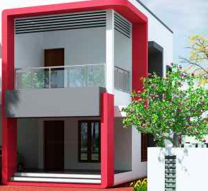
Home work
Write five sentences
about Maria.

Slide 16
n
ONE DAY ONE WORD
neighbourhood
প্রতিবেশী
They are my neighbourhood.
Thank you everybody.
See you again.
Bye Bye

