Slide 1
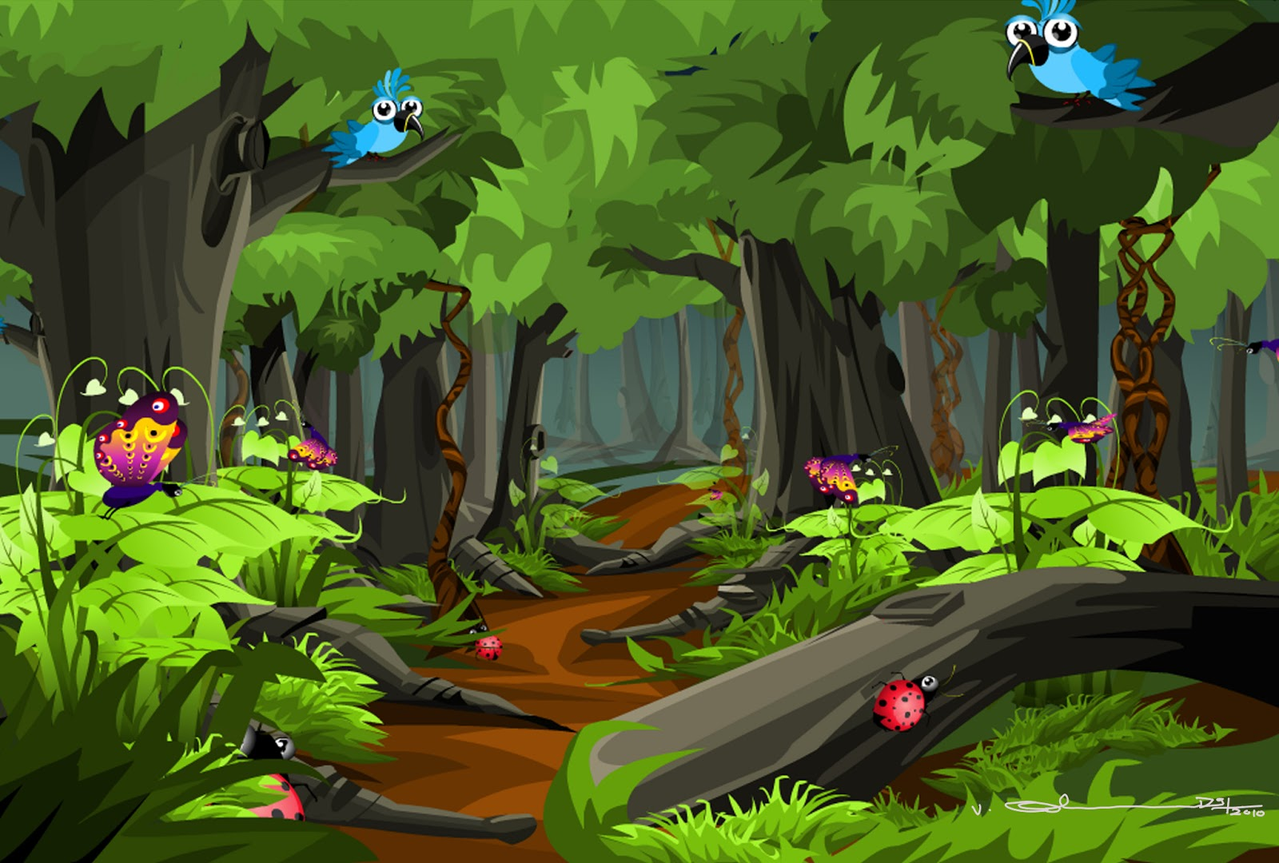
Welcome everyone
Welcome everybody

Slide 2
Identity
Nurul Aziz
Assistant Teacher
Krishnakumari City Corporation Girls’ High School,
Nandankanan, Chittagong
E mail : naziz23.na@gmail.com
English For Today
Class VI
Time : 45 Minutes
Date : 20/01/2020

Slide 3
Let’s watch a video clip

Slide 4
The Lion’s Mane
Lesson : 15 Page: 51 Period: 1st
Our today’s lesson is….

Slide 5
Objectives of the lesson
After the end of the lesson students will be able to…
use new vocabulary
talk about familiar objects
write short and simple sentences
ask and answer questions

Slide 6
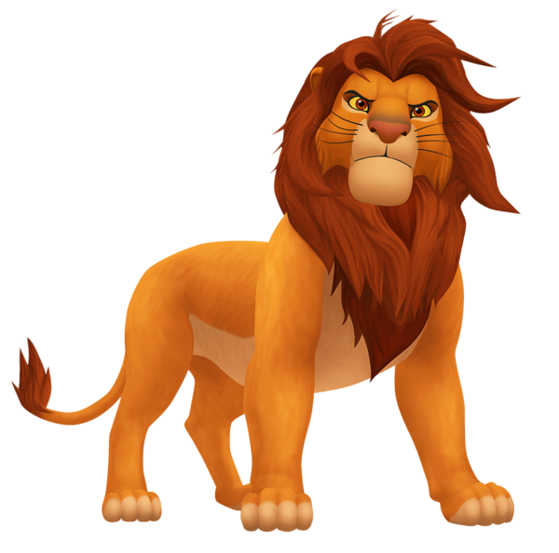
Vocabulary
Mane (noun)
Syn. Locks, Curls
The lion has mane but the lioness don’t.

Slide 7
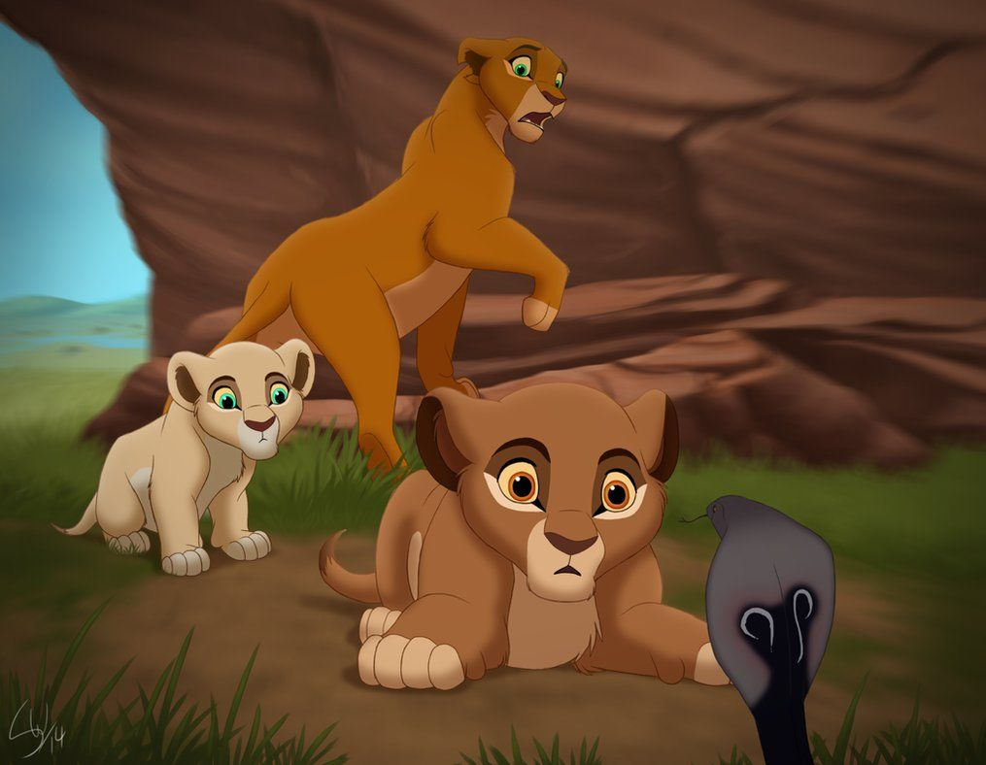
Vocabulary
Stare at (Phrase verb)
Look fixedly or vacantly at someone or something
Syn. Gaze, glare
The lion stared at the snake for long.

Slide 8
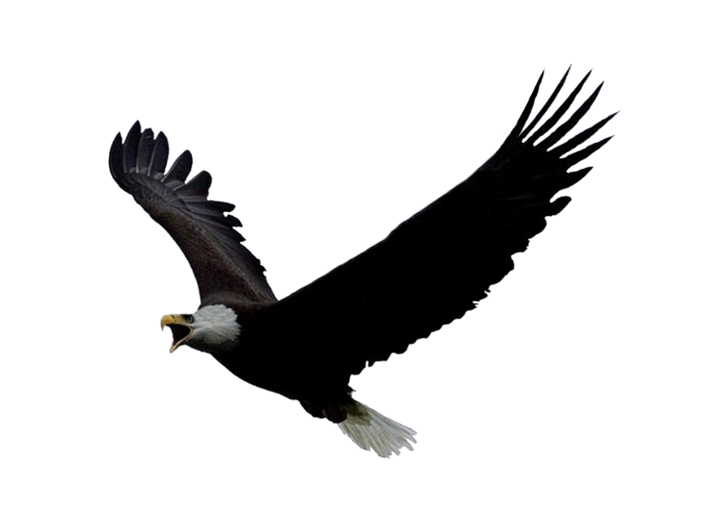
Vocabulary
Vulture (noun)
Syn. Predator, scavenger
Vulture is a predator bird.

Slide 9
Pair Work
Write the meaning of the following words given in the box.
raise
Lift or move upwards
Mane
The long hair on the neck of a horse or a lion
Roar
To make a very loud, deep sound
unruly
Difficult to control or manage
flap
Move quickly
moustache
A line of hair that some people have on their upper lip
Hissing sound
a sound like a long ‘s’s’

Slide 10
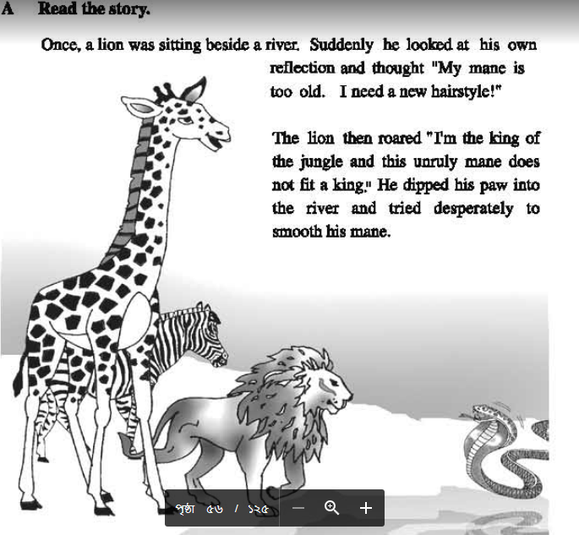
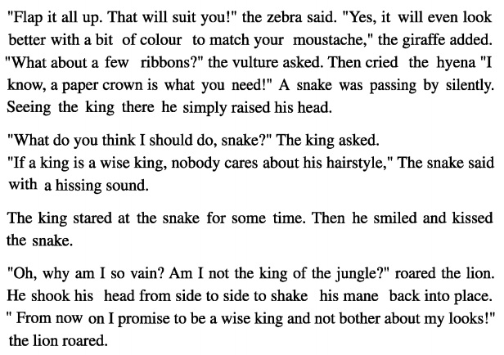
Silent Reading

Slide 11
Group Work
Answer the following questions.
(Match the answers in the next slide.)
1. Why did the lion want to change his hairstyle?
2. What was the giraffe’s suggestions?
3. Do you agree with the snake’s comment?

Slide 12
The
Group work
(Answers for matching)
1. The lion wanted to change his hairstyle because his mane grew old and he wanted to try a new one.
2. The giraffe suggested that a little bit color matching with his moustache would make him gorgeous.
3. Yes, I agree with the snake’s comment. It is because we should focus on gaining knowledge rather than giving importance to our outward looks.

Slide 13
The
Individual Work
Match the different marks of some animals
Lion
wool
Elephant
stripes
Zebra
trunk
Sheep
horns
Buffalo
Pony tail
Horse
Curved tail
Dog
scale
Fish
mane

Slide 14
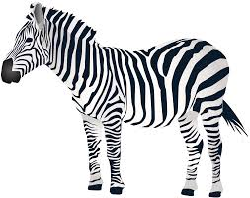
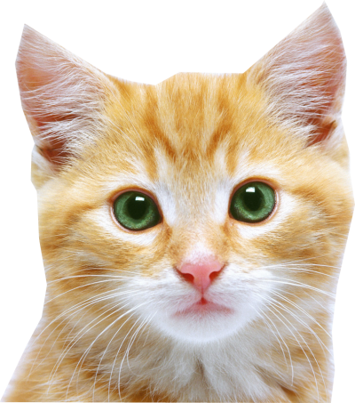
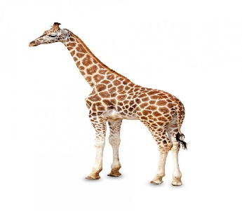
l
Evaluation
Puzzle : Answer the following questions.
1. Which baby is born with a moustache?
2. Which animal has the longest neck?
3. Which animal has black and white strife all over the body?

Slide 15
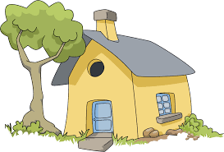
Home Work
Summarize the story in not more than five sentences.

Slide 16
Thank you.

