Slide 1
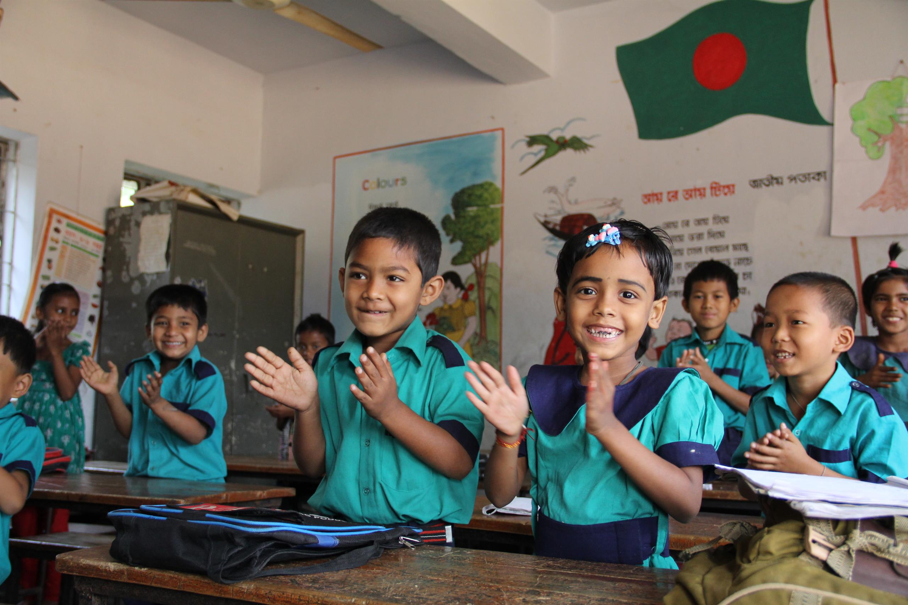
Welcome
to my dear students

Slide 2
Class: Two
Subject: English
Time: 40 Min.
Muhammad Abdul Muhaimin
Assistant Teacher
Chhakapan Govt. Primary School
Kulaura,Moulvibazar.

Slide 3
Let’s sing a song

Slide 4
Unit:11
Lesson: Head and Shoulder

Slide 5
Learning outcomes
Student will be able to:
Listening:
1.1.1-Become familiar with English sounds by listening to common English words.
Speaking :
1.1.1- Repeat after the teacher simple word and phrases with proper sound and stress.
1.1.2 - Say simple words and phrases with proper sounds and stress.

Slide 6
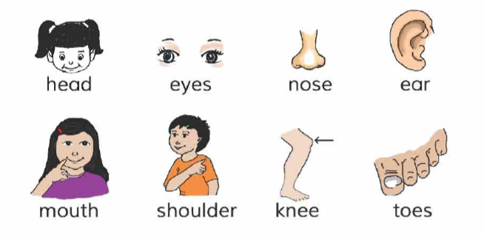
Open your book at page no. 22

Slide 7
Look, listen and say.
Head
Eyes
Nose
Ear

Slide 8
Individua Work
Touch your head.
Touch your ear.
Touch your nose.

Slide 9
Look, listen and say.
Mouth
shoulder
Knee
Toes

Slide 10
Pair Work
One show a picture and another say

Slide 11
Word Card
Head
Nose
Shoulder
Knee
Mouth
Ear
Eyes
Toes

Slide 12
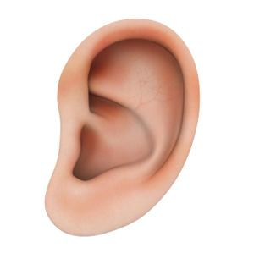
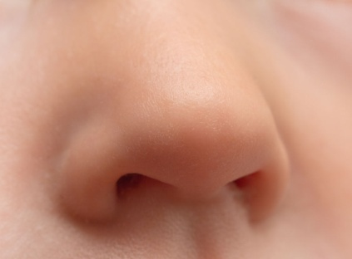
Matching Words
nose
toes
ear
head

Slide 13
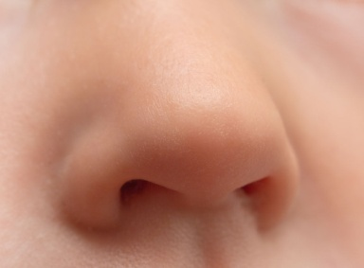
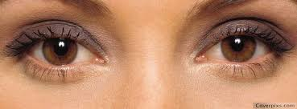
Let’s play
Toes
Head
Mouth
Ear
Nose
Knee
Eyes

