Slide 1


Slide 2

C
O
L
M
E
w
E
TO
EVERYBODY

Slide 3

Teacher`s Identity
Shadeb chandra Das
Assistant Teacher
Laskarhat Government
Primary School

Slide 4

Class:- Four
Subject:-English
Unit:- Three
Lesson:- 1-2 (Family)

Slide 5
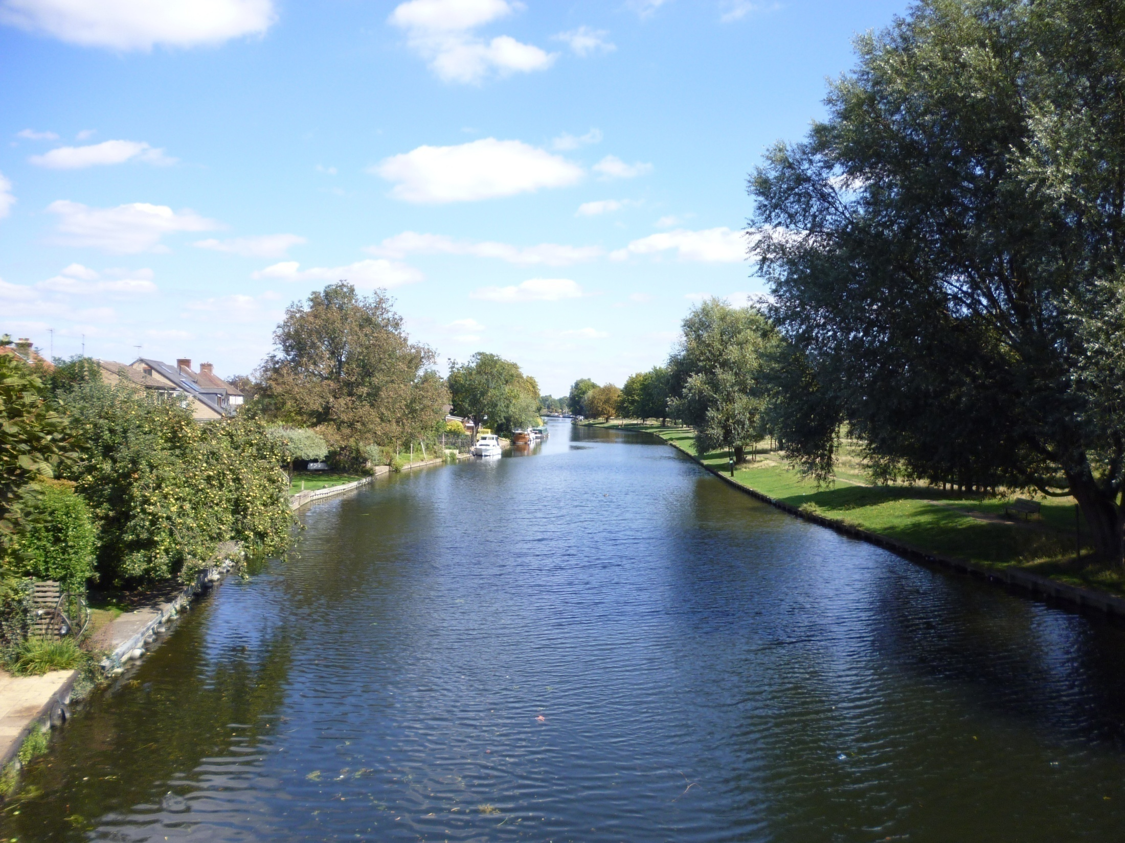
Learning Outcomes
3.3.1
  Understand questions about family and friends.
3.1.1
  Ask and answer Wh question.
1.4.1
  Read words, phrases and sentences in the text.
8.1.1
  Make senteces using words.

Slide 6
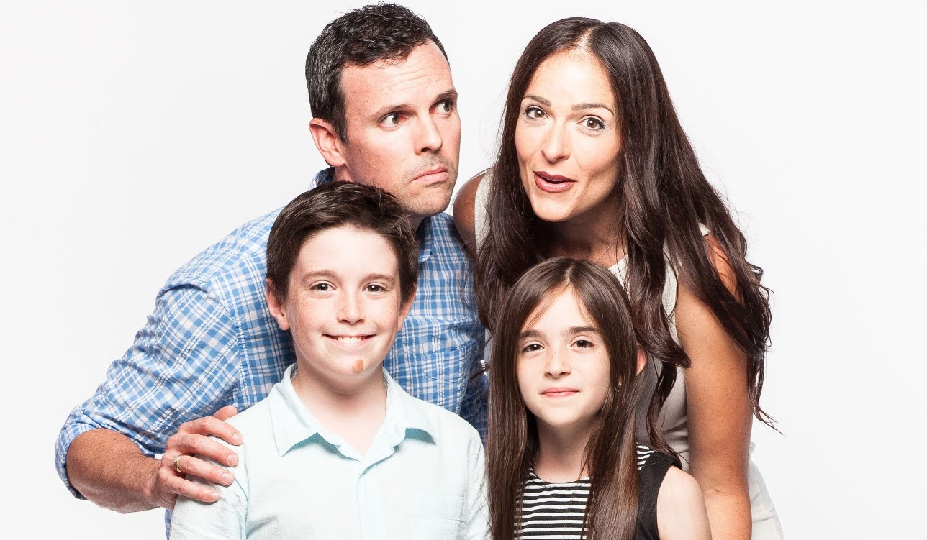
Please say somethings
about the picture.
What do you see in the picture?
Look at the picture.

Slide 7
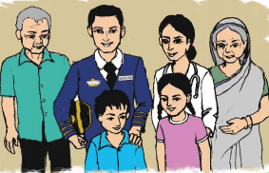

Slide 8
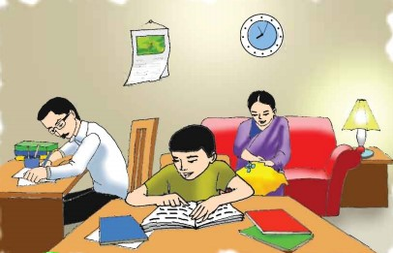
Lesson Title
Family

Slide 9

Teacher’s
Reading
Student’s Reading

Slide 10

Find out new words:-
Old, hospital,
patient,

Slide 11
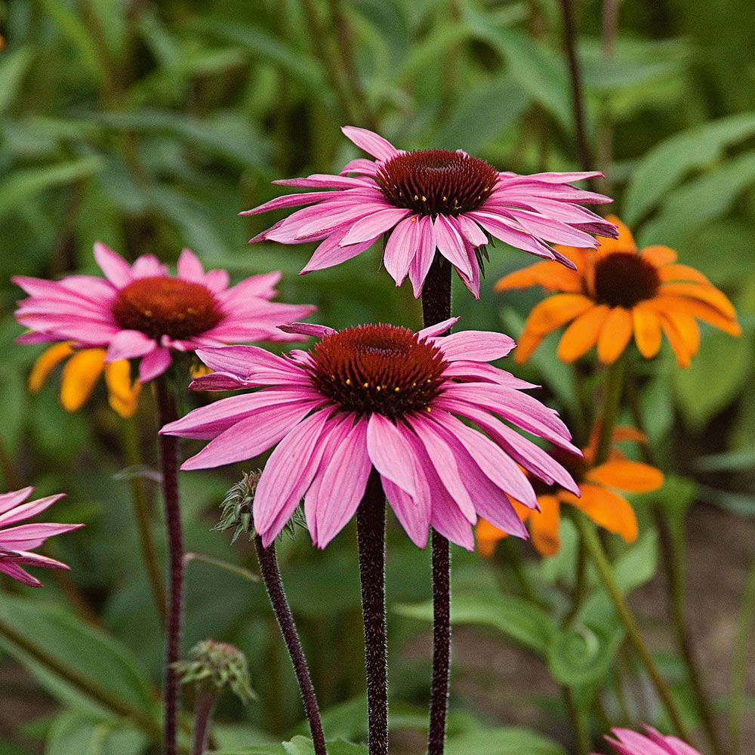
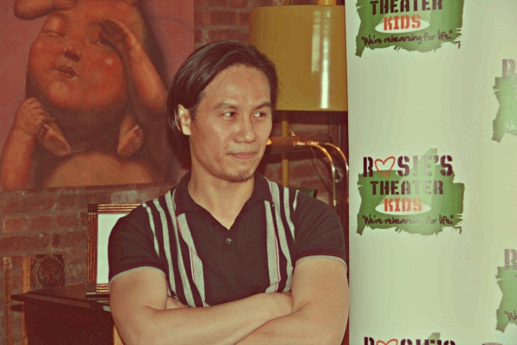
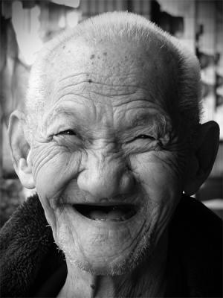
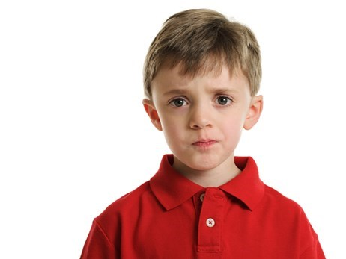
Old
38 years
.
8 years
88 years

Slide 12



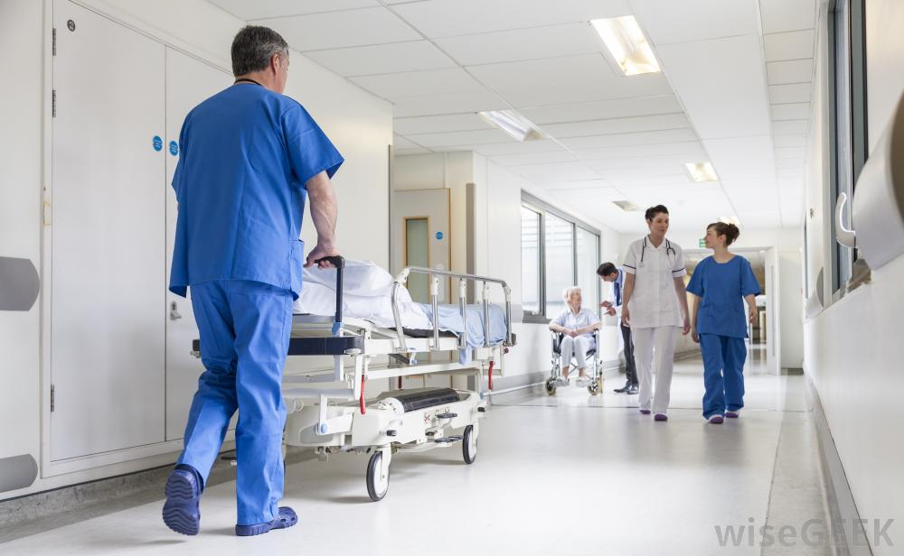
Hospital

Slide 13

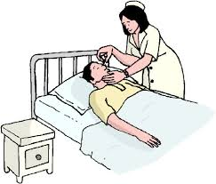

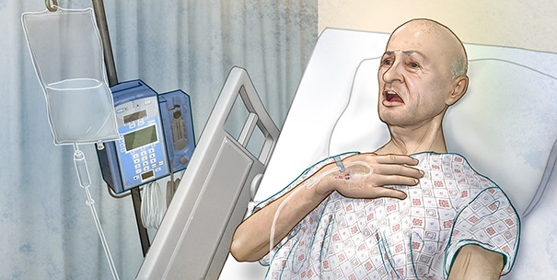
Patient

Slide 14
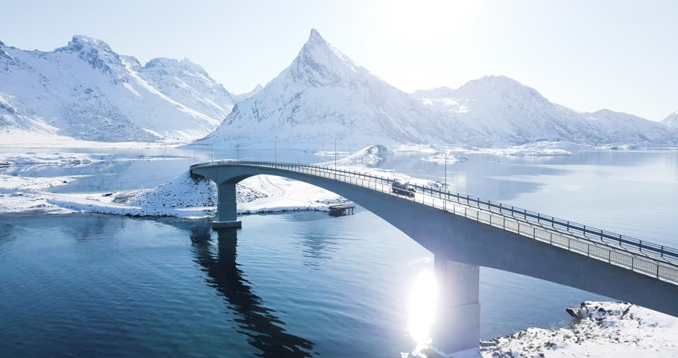


GROUP WORK:-
Fill in the blank:-
Farzana is …….... years old.
Jamil is ……….....years old.
Rehana Parvin ..……..a doctor.
nine
seven
is

Slide 15


Group Work
Give the correct answers:-
How old is Farzana?
How old is Jamil?
What is Rehana Parvin?

Slide 16
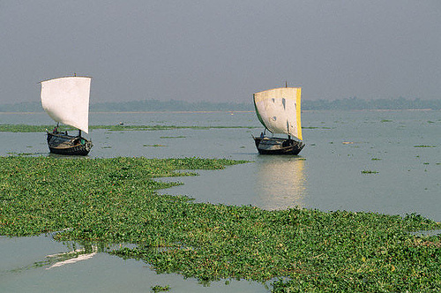

Make Sentece with the words:-
Old
Farjana is nine years old.
Hospital
She goes to hospital.
patient
Rehana Parvin takes care Patient.

Slide 17
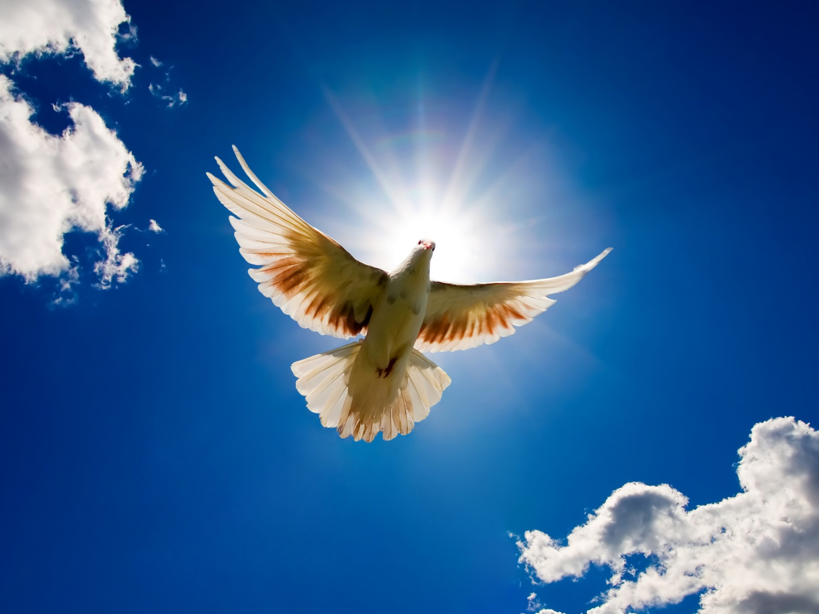
GOODBYE

