Slide 1
WELCOME

Slide 2
CONTACTS
Molena Begum
Assistant teacher
Manullar char haji bari model high school
Pakundia Khishorgonj.
molenaparvin@gmail.com
Class:Nine
Subject : English 1ST
paper
Text :Unit-3 ; Lesson-4.

Slide 3
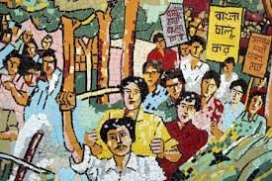
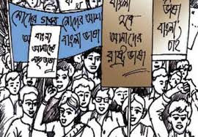
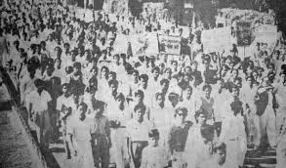
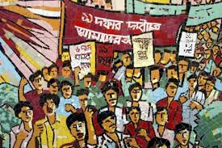

Slide 4
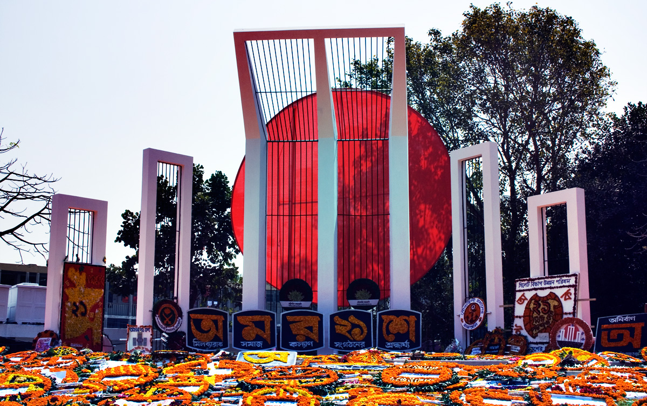

Slide 5
INTERNATIONAL MOTHER LANGUAGE DAY

Slide 6
LEARNING OUTCOMES
By the end of the lesson student will be able to say something………
Can tell about the martyrs’ day
Can do the abbreviation
Will be able to realize the importance of language movement

Slide 7
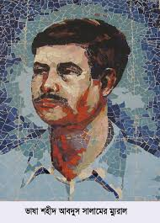
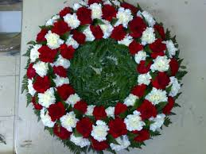
VOCABULARY
MARTYR
Killed Because of Their Belief
Flower in The Shape of a Circle
WREATH

Slide 8
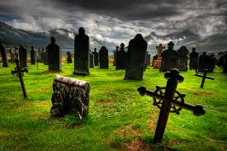
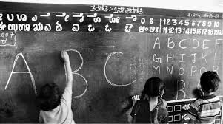
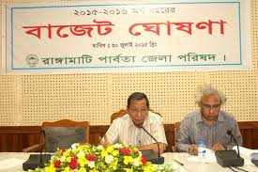
GRAVEYARD
CEMETERY
MULTILINGUALISM
PRACTICE of SEVERAL LANGUAGE
PROCLAIM
ANNOUNCE

Slide 10
Match the words/phrases in the table with their meanings.
In remberence of
declare
multilingualism
variety
garland
wreath
practice of using several languages
proclaim
diversity
in memory of

Slide 11
Read the Text again and answer these questions.
Why is 21 February called shaheed Dibosh ?
Why do people go to the Shaheed Minar ?
Why is 21 February now observed throughout the world every year ?

Slide 12
Group Work
(a) How to the Shaheed Minar ?
(b) Where the incident occurred in language movement ?

Slide 13
EVALUATION
(a) What do you mean by UNSCO ?
(b) Where is the cemetery of the martyrs ?

Slide 14
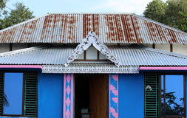
HOME WORK
Who and When declared Urdu would be the only official language of Pakistan ?

