Slide 1
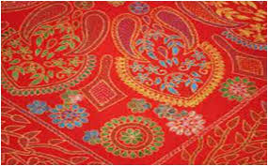
WELCOME TO MY ENGLISH CLASS

Slide 2
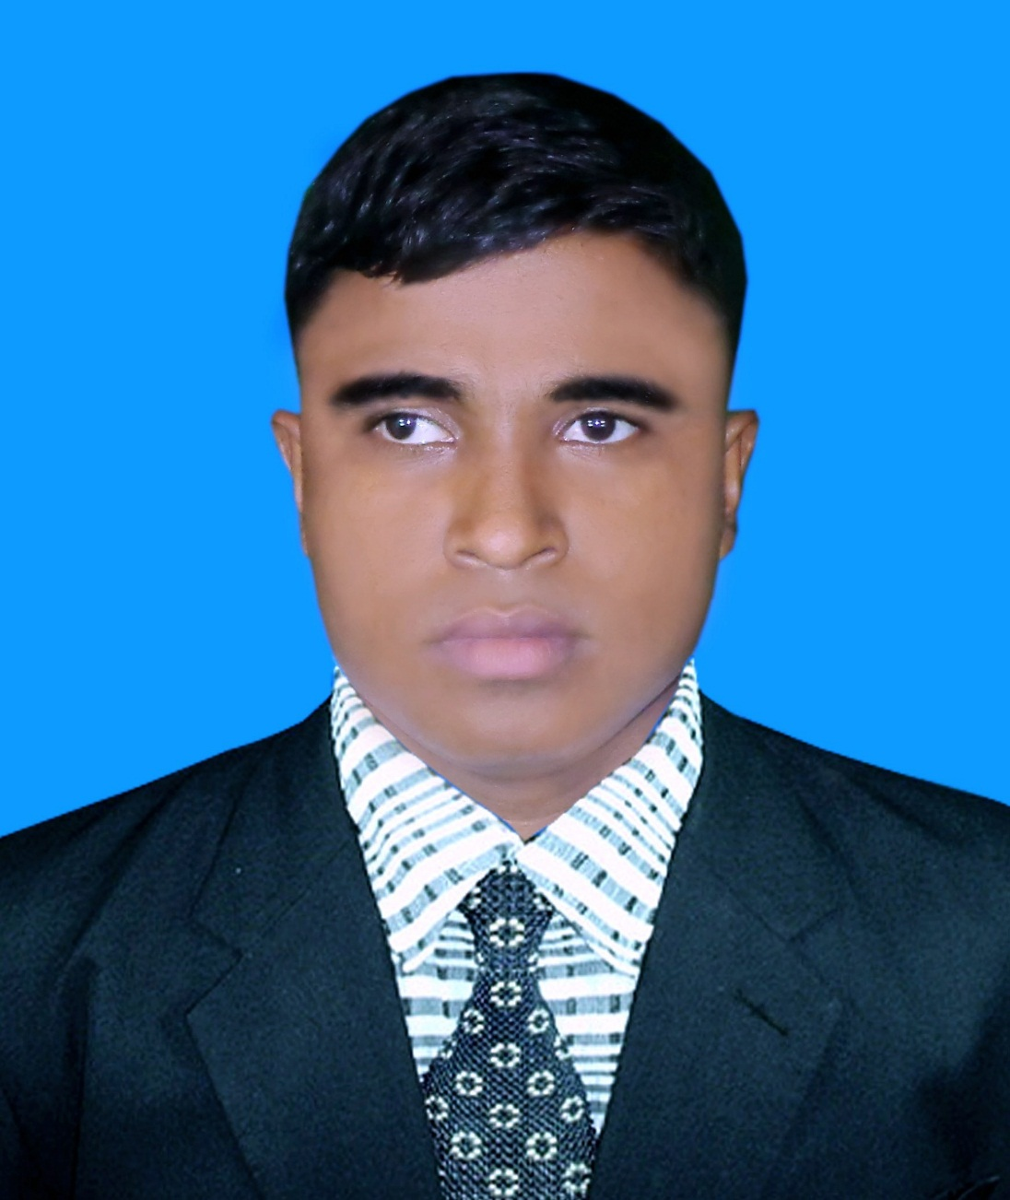
Teacher’s Identity A. Sukur Ali Khan B.A hons.M.A In English Assistant Teacher(English)
Naldha Secondary School
Naldha,Fakirhat,Bagerhat.
Email.sukur360720@gmail.com

Slide 3
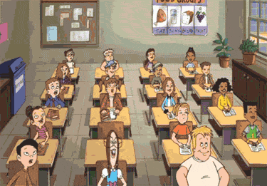
Class : Eight
Unit: 1
Lesson : 2
Date:05-01-2020

Slide 4
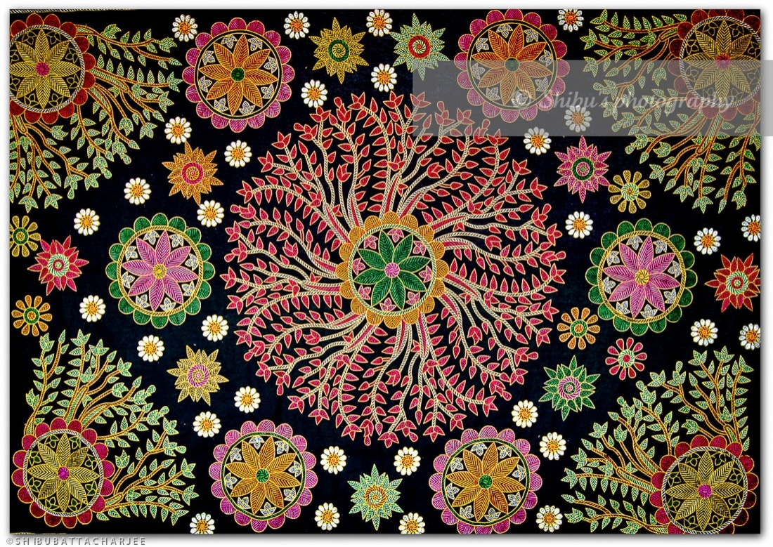
Guess the picture

Slide 5
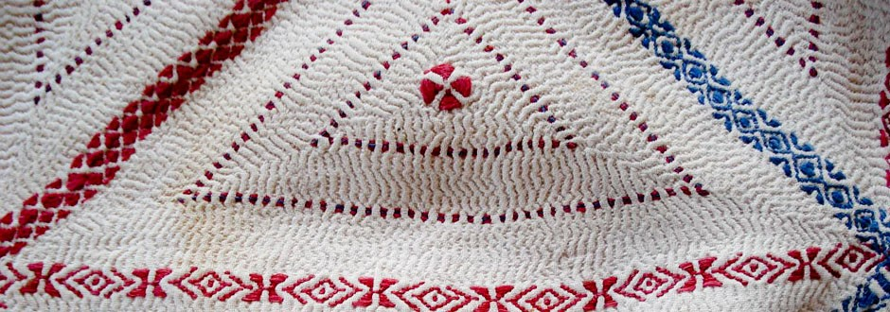

Slide 6
OUR TOPIC
NAKSHI KANTHA

Slide 7
Learning Outcomes
At the end of the lesson SS will be able to……
@ Tell about Naksi katha .
@Know the key words.
@ Describe about its root history .
@Ask and answer Questions.
@Explain about its uses.
@Write a paragraph aboutNaksi katha.

Slide 8
Let’s watch a Video

Slide 9
Read the text.

Slide 10
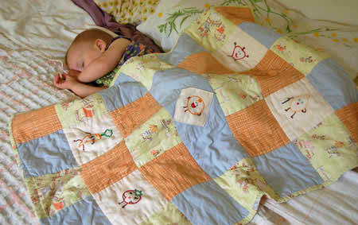
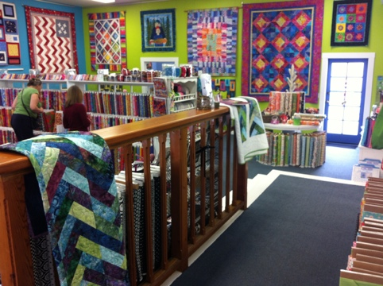
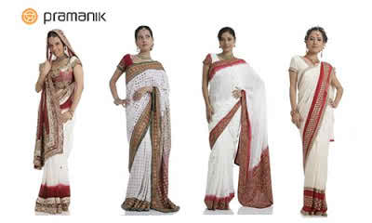
Key Words
Quilt
A thick coverlet
Artistic
Relating to art
Commercially
business
Traditional
manners

Slide 11
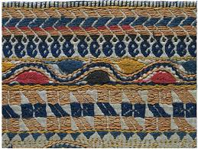
Look at the picture and answer the following question.
1. What do you see in the picture?
2. Have you seen it before?
3. What is the use of it?

Slide 12
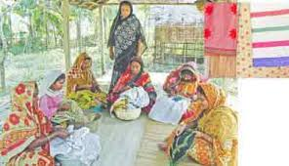
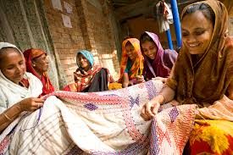
Practiced rural Bengal for centuries.

Slide 13
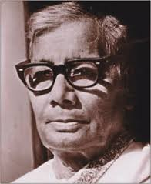
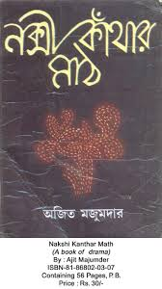
Rural poet Jasim Uddin
His famous work “Field of the Embrodried Quilt”

Slide 14
INDIVIDUAL WORK.
1. What is Nakshi Kantha?
2. What do you do with it?
3. When was first “NAKSI KATHAR MATH” published?

Slide 15
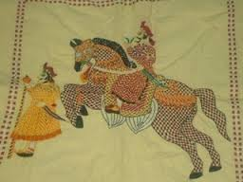

Slide 16
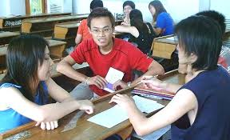
Pair works
Match the words in A column with the words of B column
Column A
Column b
Craft
Stylish
Native
Work on
Artistic
Indigenious

Slide 17
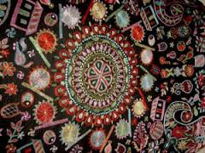

Slide 18
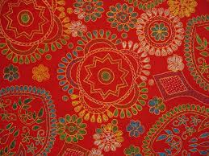
Group work
1. Do you like Nakshi Kantha or ordinary Kantha? Why ?

Slide 19
EVALUATION
1. Why do you like Nakshi Kantha?
2. Who was the poet of “NAKSHI KANTHAR MATH”?

Slide 20
SOLUTION
1. We like nakshi kantha as it is artistic and comfortable.
2. Jasim Uddin

Slide 21
HOME WORK
Write a Paragraph about nakshi kantha with 10 sentences.

Slide 22
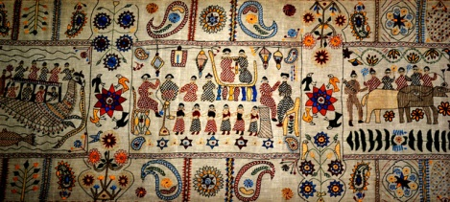
Thanks
To
All

