Slide 1
WEL COME TO ALL.

Slide 2
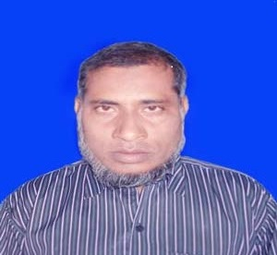
TEACHER IDENTITY
Lesson Identity
English 2nd Paper
Class: Six
Title :Article
Time: 45m
MD.NAZRUL ISLAM
ASSISTANT TEACHER
KATIPUR KALINAGAR HIGH SCHOOL ,PORSHA, NAOGAON.
Nazrul.kkhs@gmail.com

Slide 3
Read the following sentences
Karim is a student of class 8. He is a regular students. He is an honest boy. He respects the teachers. He is the first boy in the class.
What kind of parts of speech written in the red letters ?
Adjective
Rearrange the following letters and make a word.
RTAILEC
ARTICLE

Slide 4
Today our Topic is Article

Slide 5
Learning outcomes:
By the end of the lesson students will learn:
To describe what articles are and their kinds.
To say what parts of speech articles are.
how to use a or an before a given word.
to Identify the use of a, an and the before a given word.

Slide 6
ARTICLES ARE:
A
AN
THE

Slide 7
ARTICLES
INDEFINITE
DEFINATE
A & AN
THE

Slide 8
non-specific or
non-particular count nouns.
A/an +
specific or particular COUNT OR UNCOUNT nouns
The +

Slide 9
Use of the
The Padma/The world /The sun/The sky ,etc
The students / The boys /The birds, etc
The tallest boy/ The unique,etc
The water/The ant/The rich,etc
The cattle
The USA/The UK

Slide 10
1.The is used before the only one thing.
2.The is used before plural words.
3.The is used before common noun.
4.The is used before collective noun.
5.The is used before superlative degree.
6.The is used before USA&UK.

Slide 11
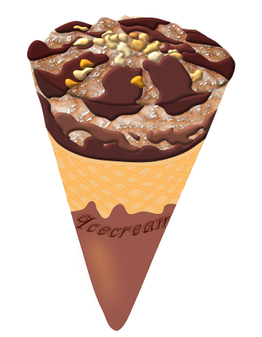
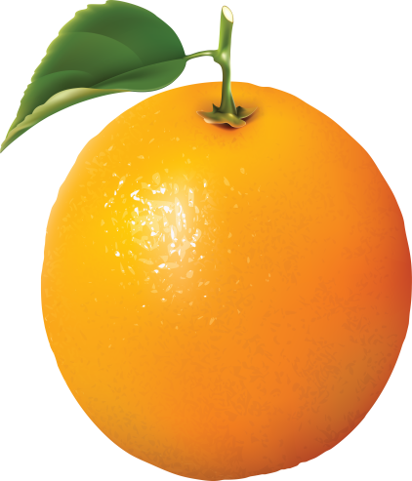
Use of an
An
-- ICE-CREAM
An
An
-- APPLE
--- EGG
All are
Count Noun
An
An
--- UMBRELLA
-- ORANGE
We use an before a word
1.Which starting with i
2.that’s starting sound is like অ/আ/এ

Slide 12
Use of ‘A’
A horse A house
A crow A bird
A book A toy
A student A teacher
Countable Noun
We use a before a word –
That‘s begins without i
That‘s starting sound is not like অ /আ /এ

Slide 13
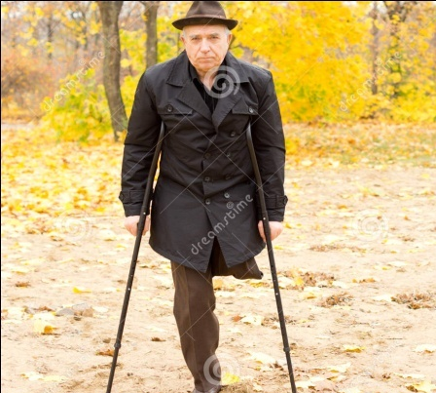
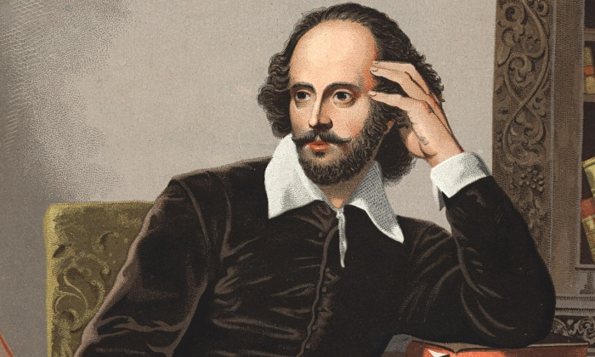
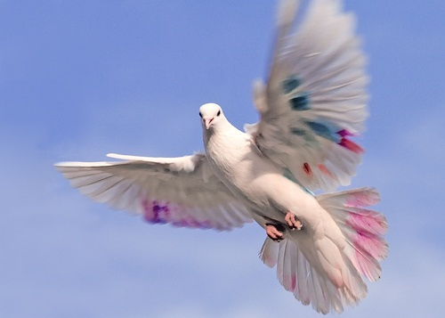
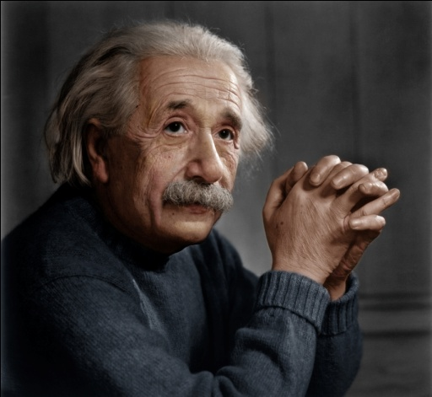
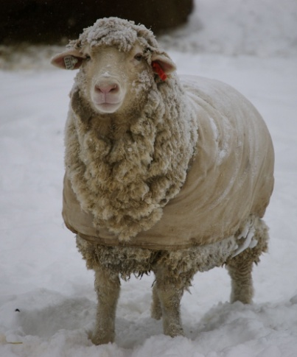
Fill in the gaps:
A
A
--- one leged man
---- university student
A
---- European
A
----- bird
An
---- honest man
A
A
---- ewe
--- house

Slide 14
Pair work
Fill in the gaps
an
an
Cricket is -----outdoor game.It is-----exciting game. People all over ------ world like to play& watch it.We need -----umpire to play -- -----game. --– players and ------ viewers enjoy it. Once football was -----popular game . But now it
Has taken -----place of football.
the
an
the
The
the
a
the

Slide 15
THANK YOU ALL

