Slide 1
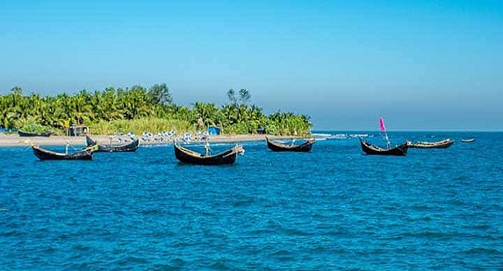
Welcome to everyone in my class.

Slide 2
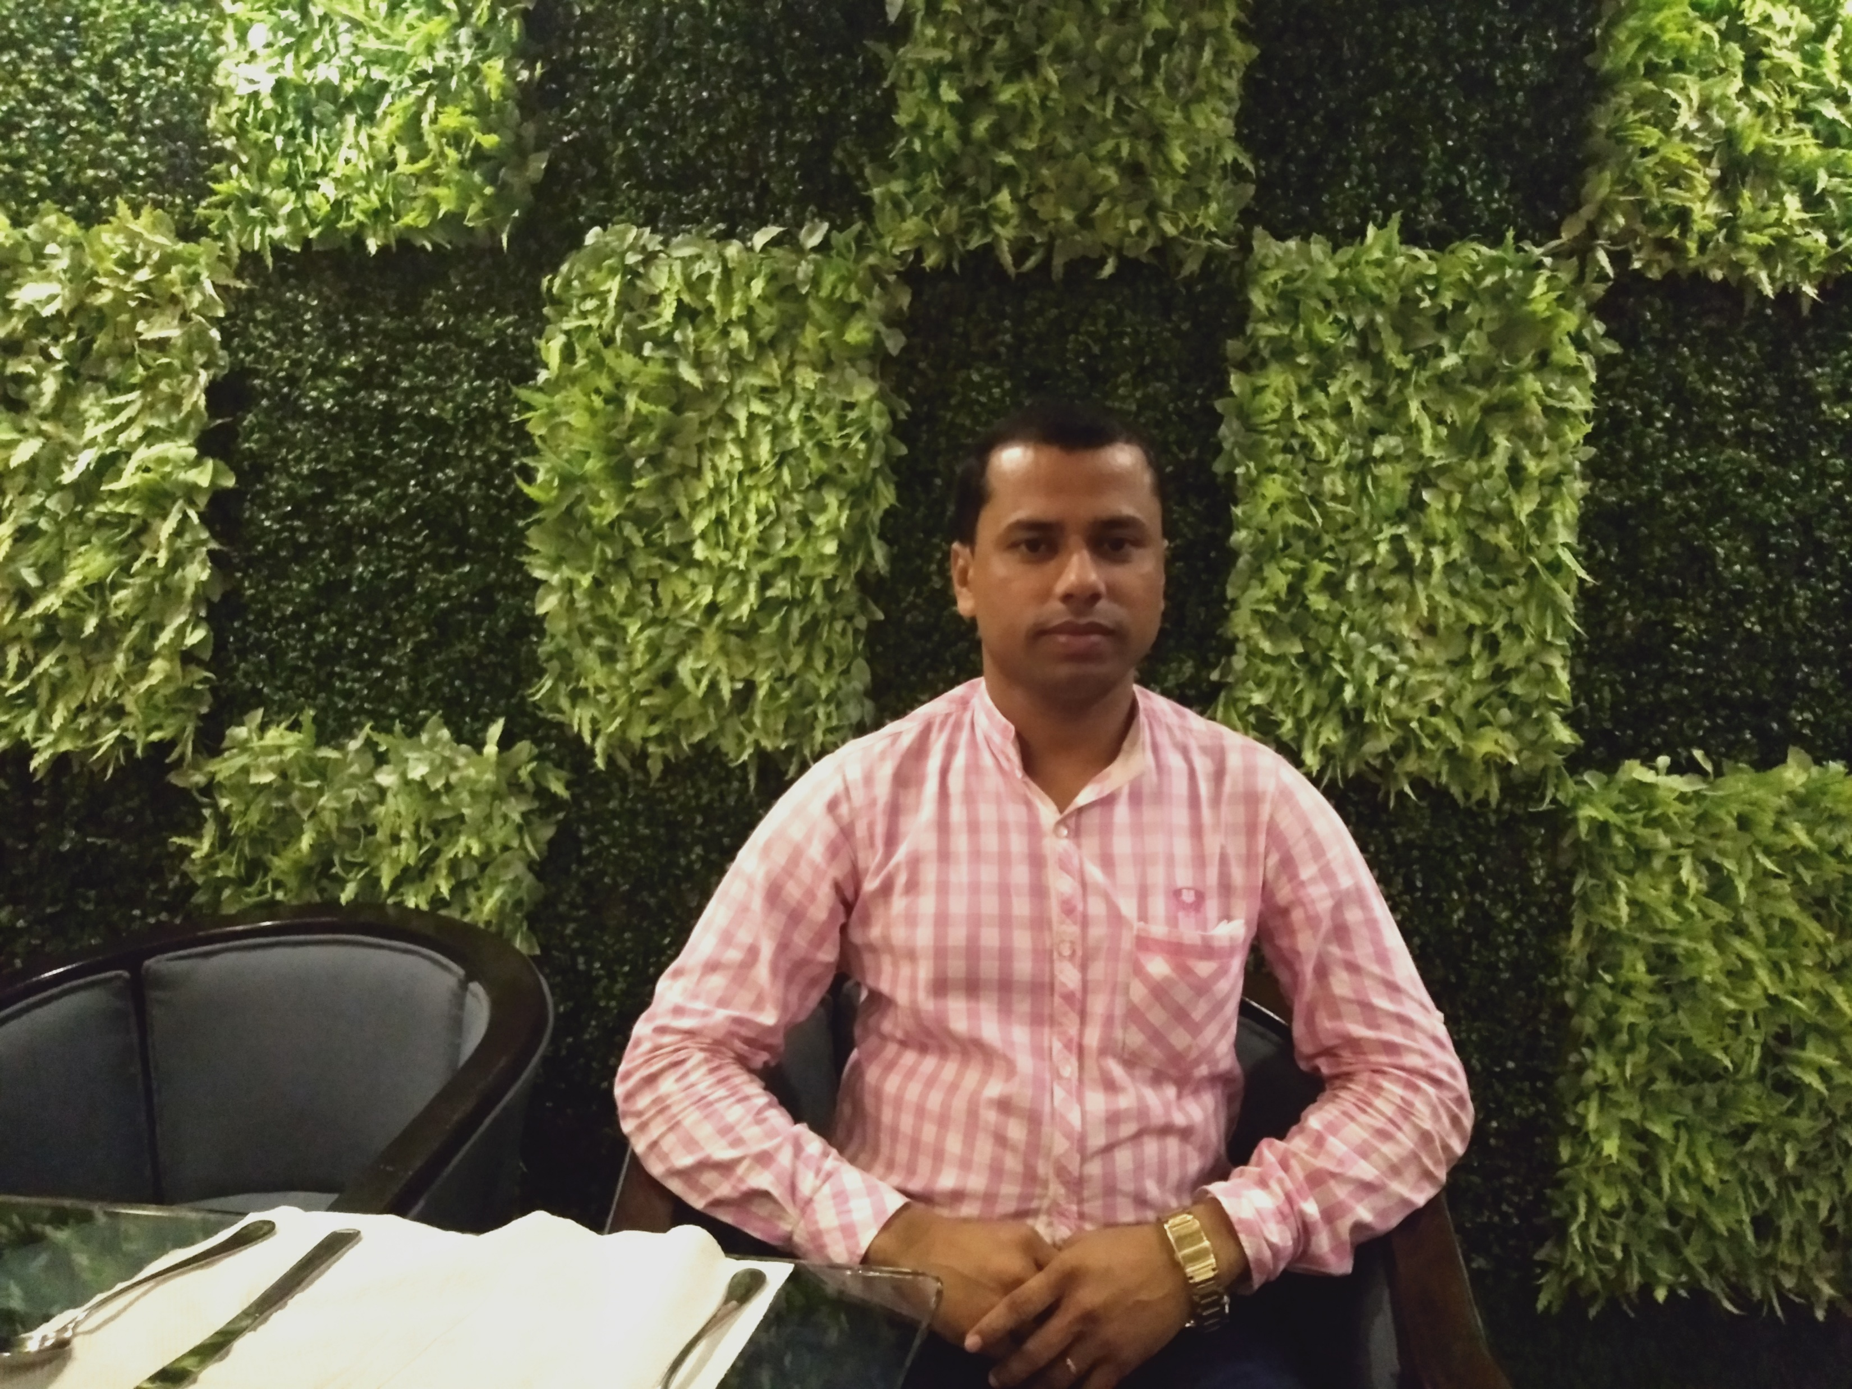
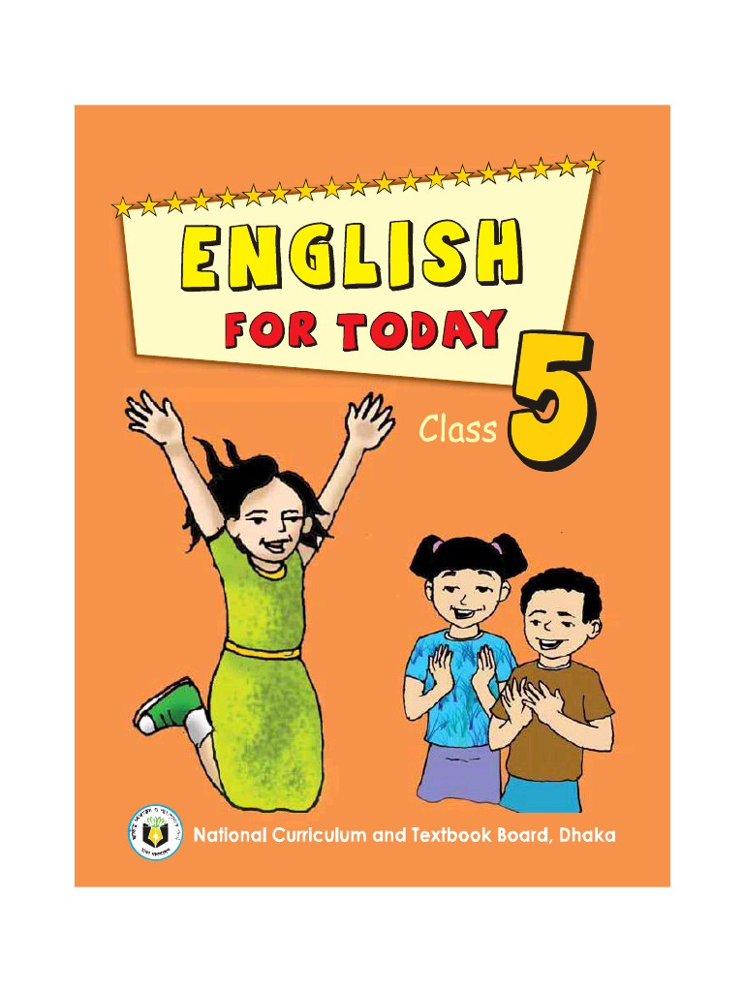
I D
E
N
T
I
T
Y
Khalidur Rahman Manik
Assistant teacher
Khasgaon G.P.S
Ambassador ICT4E
Chhatak,Sunamganj
01712-114197
Subject: English
Class: Five
Unit:12
Date:05/01/2020
Time: 40 Minutes.

Slide 3
Good morning students.
How are you today?
Let’s sing the good morning song.

Slide 4
What had we learnt from previous class?
Preposition
behind
in front of
next to
opposite
outside

Slide 5
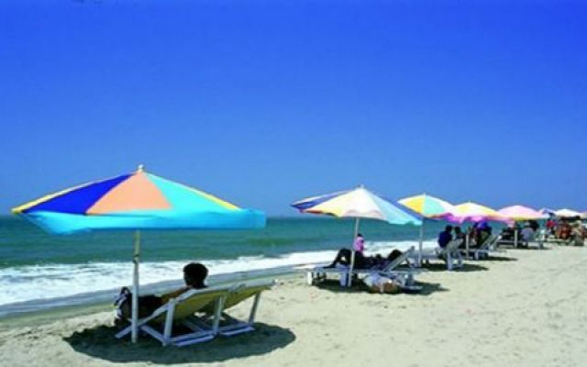
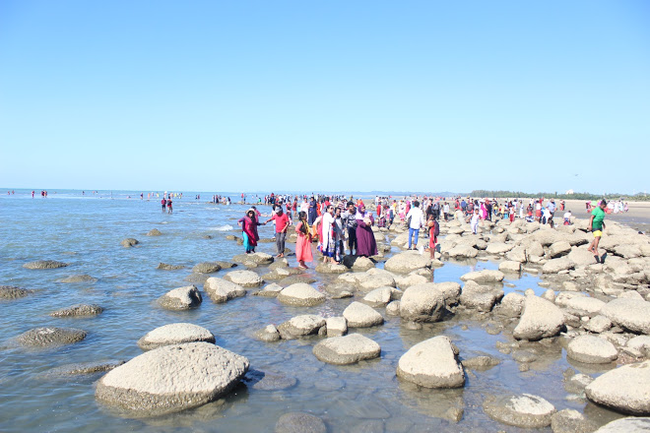
What can you see in the picture?
We can see the scenery of Cox’s Bazar Sea Beach
and Saint Martn’s Island in the picture.

Slide 6
Our today’s lesson is…
How far is Saint Martin’s?

Slide 7
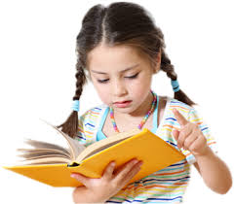
By the end of this lesson students will be able to…
Listening:- 3.4.1 understand statements made by the teacher and students
Speaking:- 1.1.2 say sentences with proper intonation.
Reading:- 1.5.1 read words, phrases and sentences in the text
with proper pronunciation, stress and intonation.
Writing:- 8.1.1 matching the words and phrases given in the textbook.

Slide 8
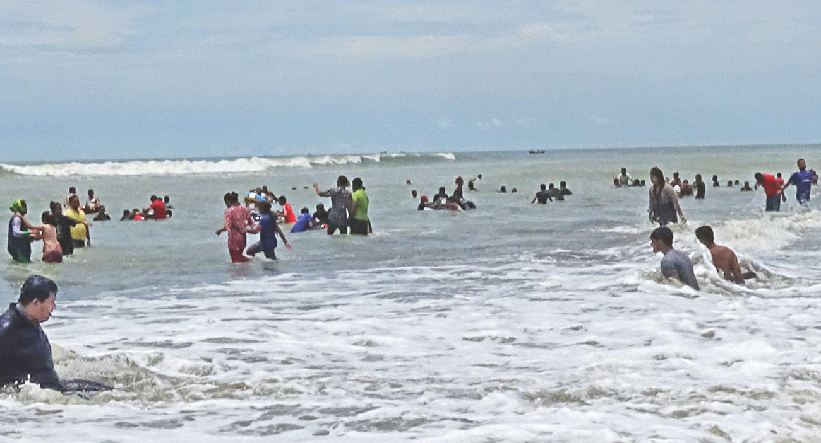
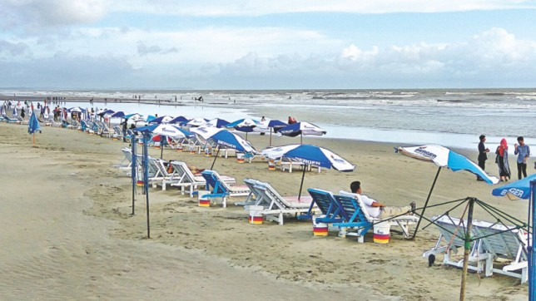
What can you see in the picture?
These are the pictures of Cox’s
Bazar Sea Beach.

Slide 9
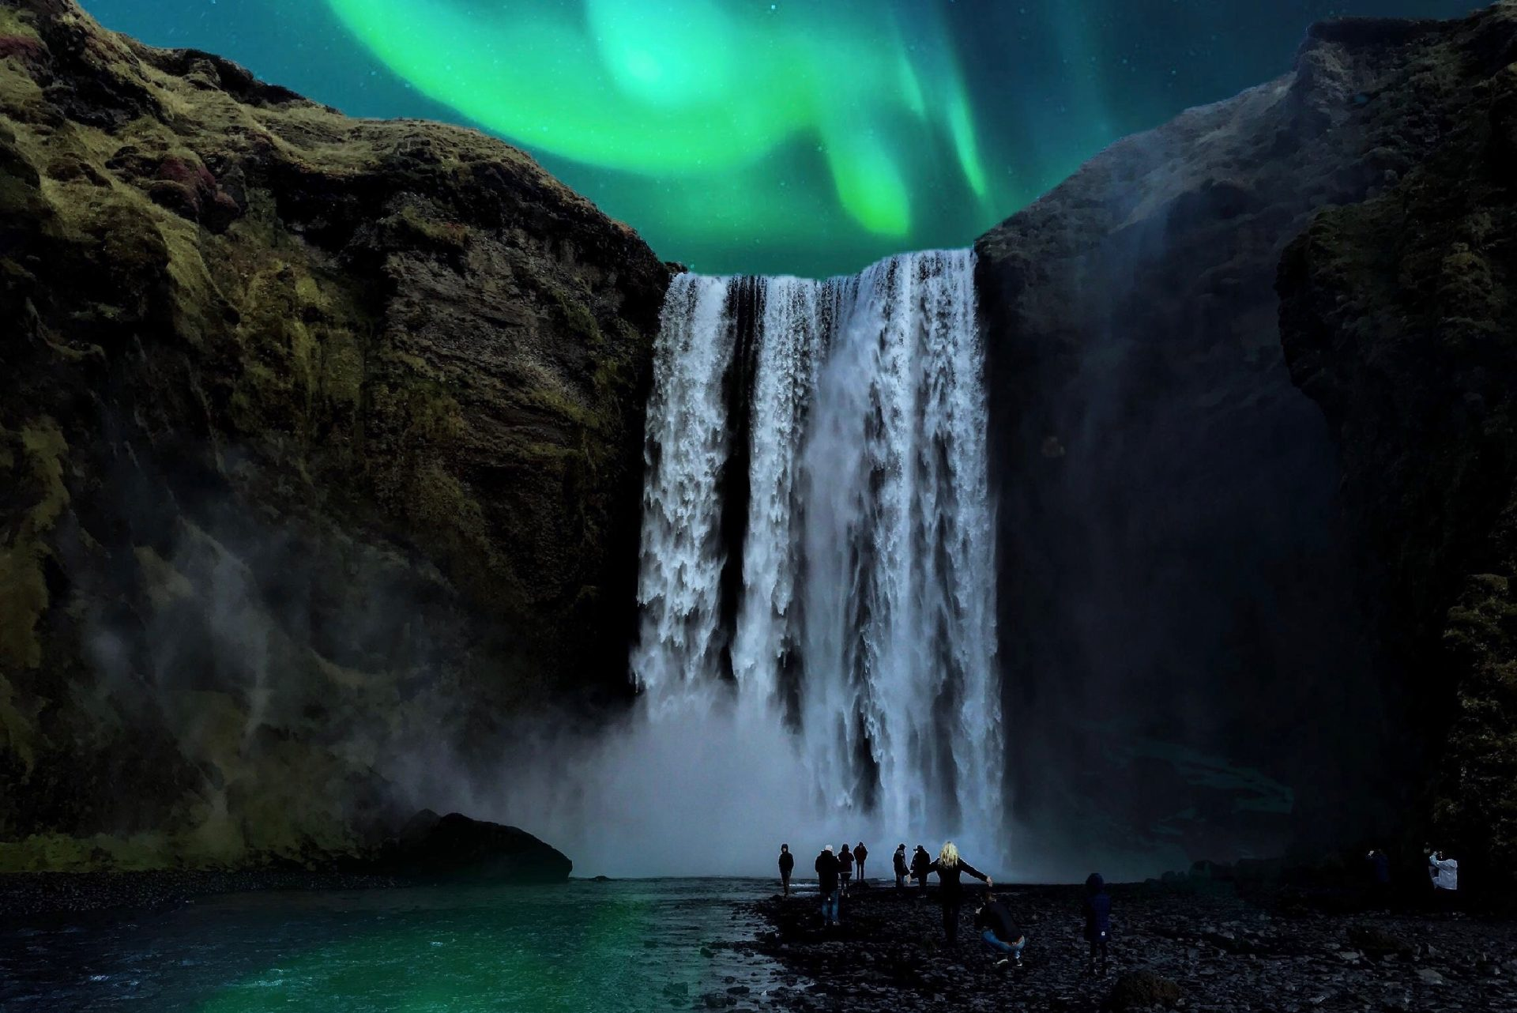
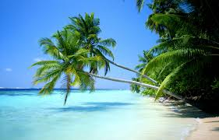
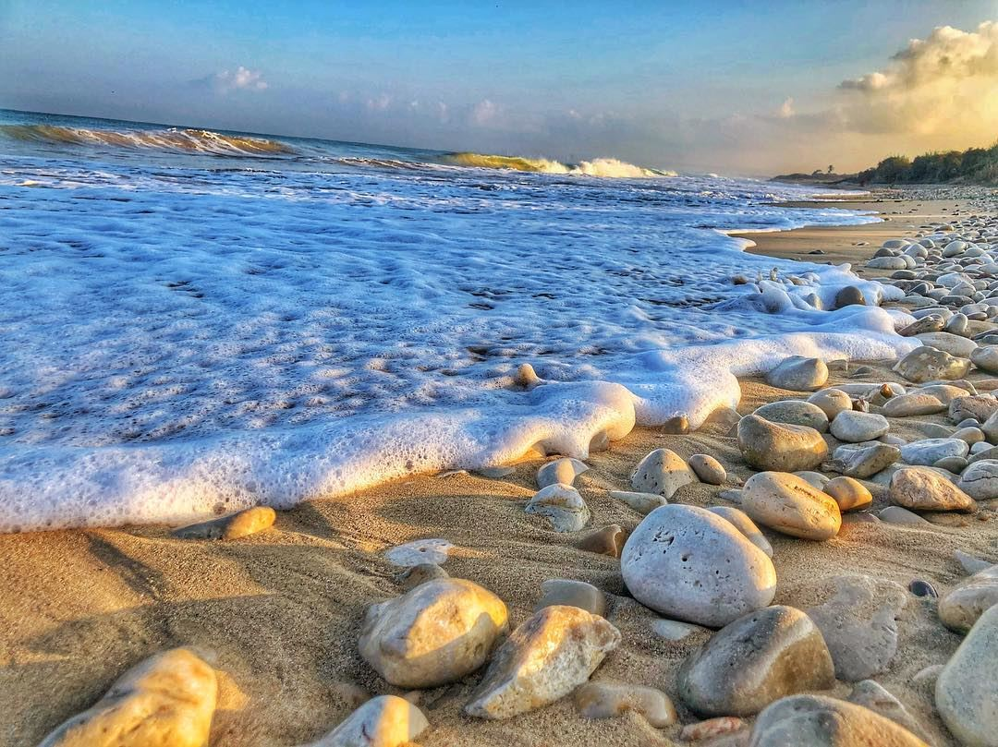
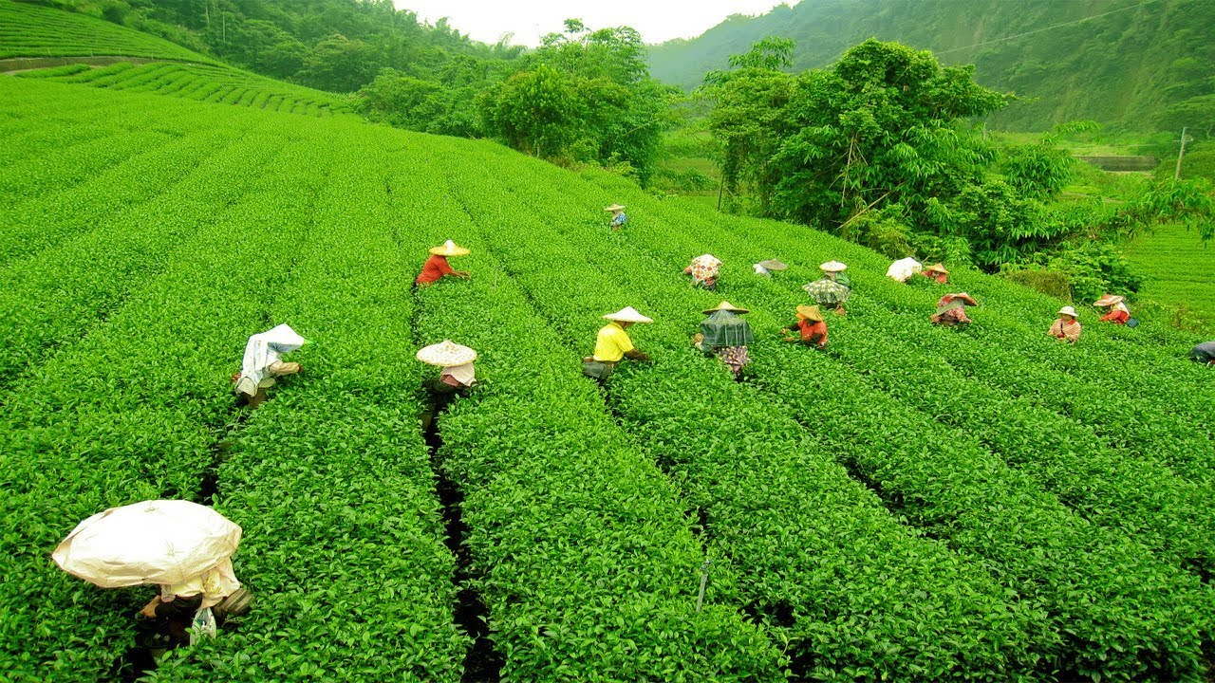
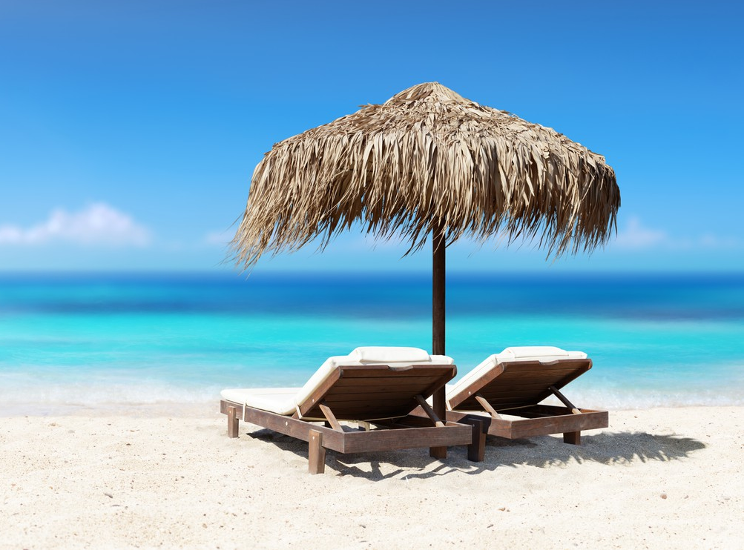
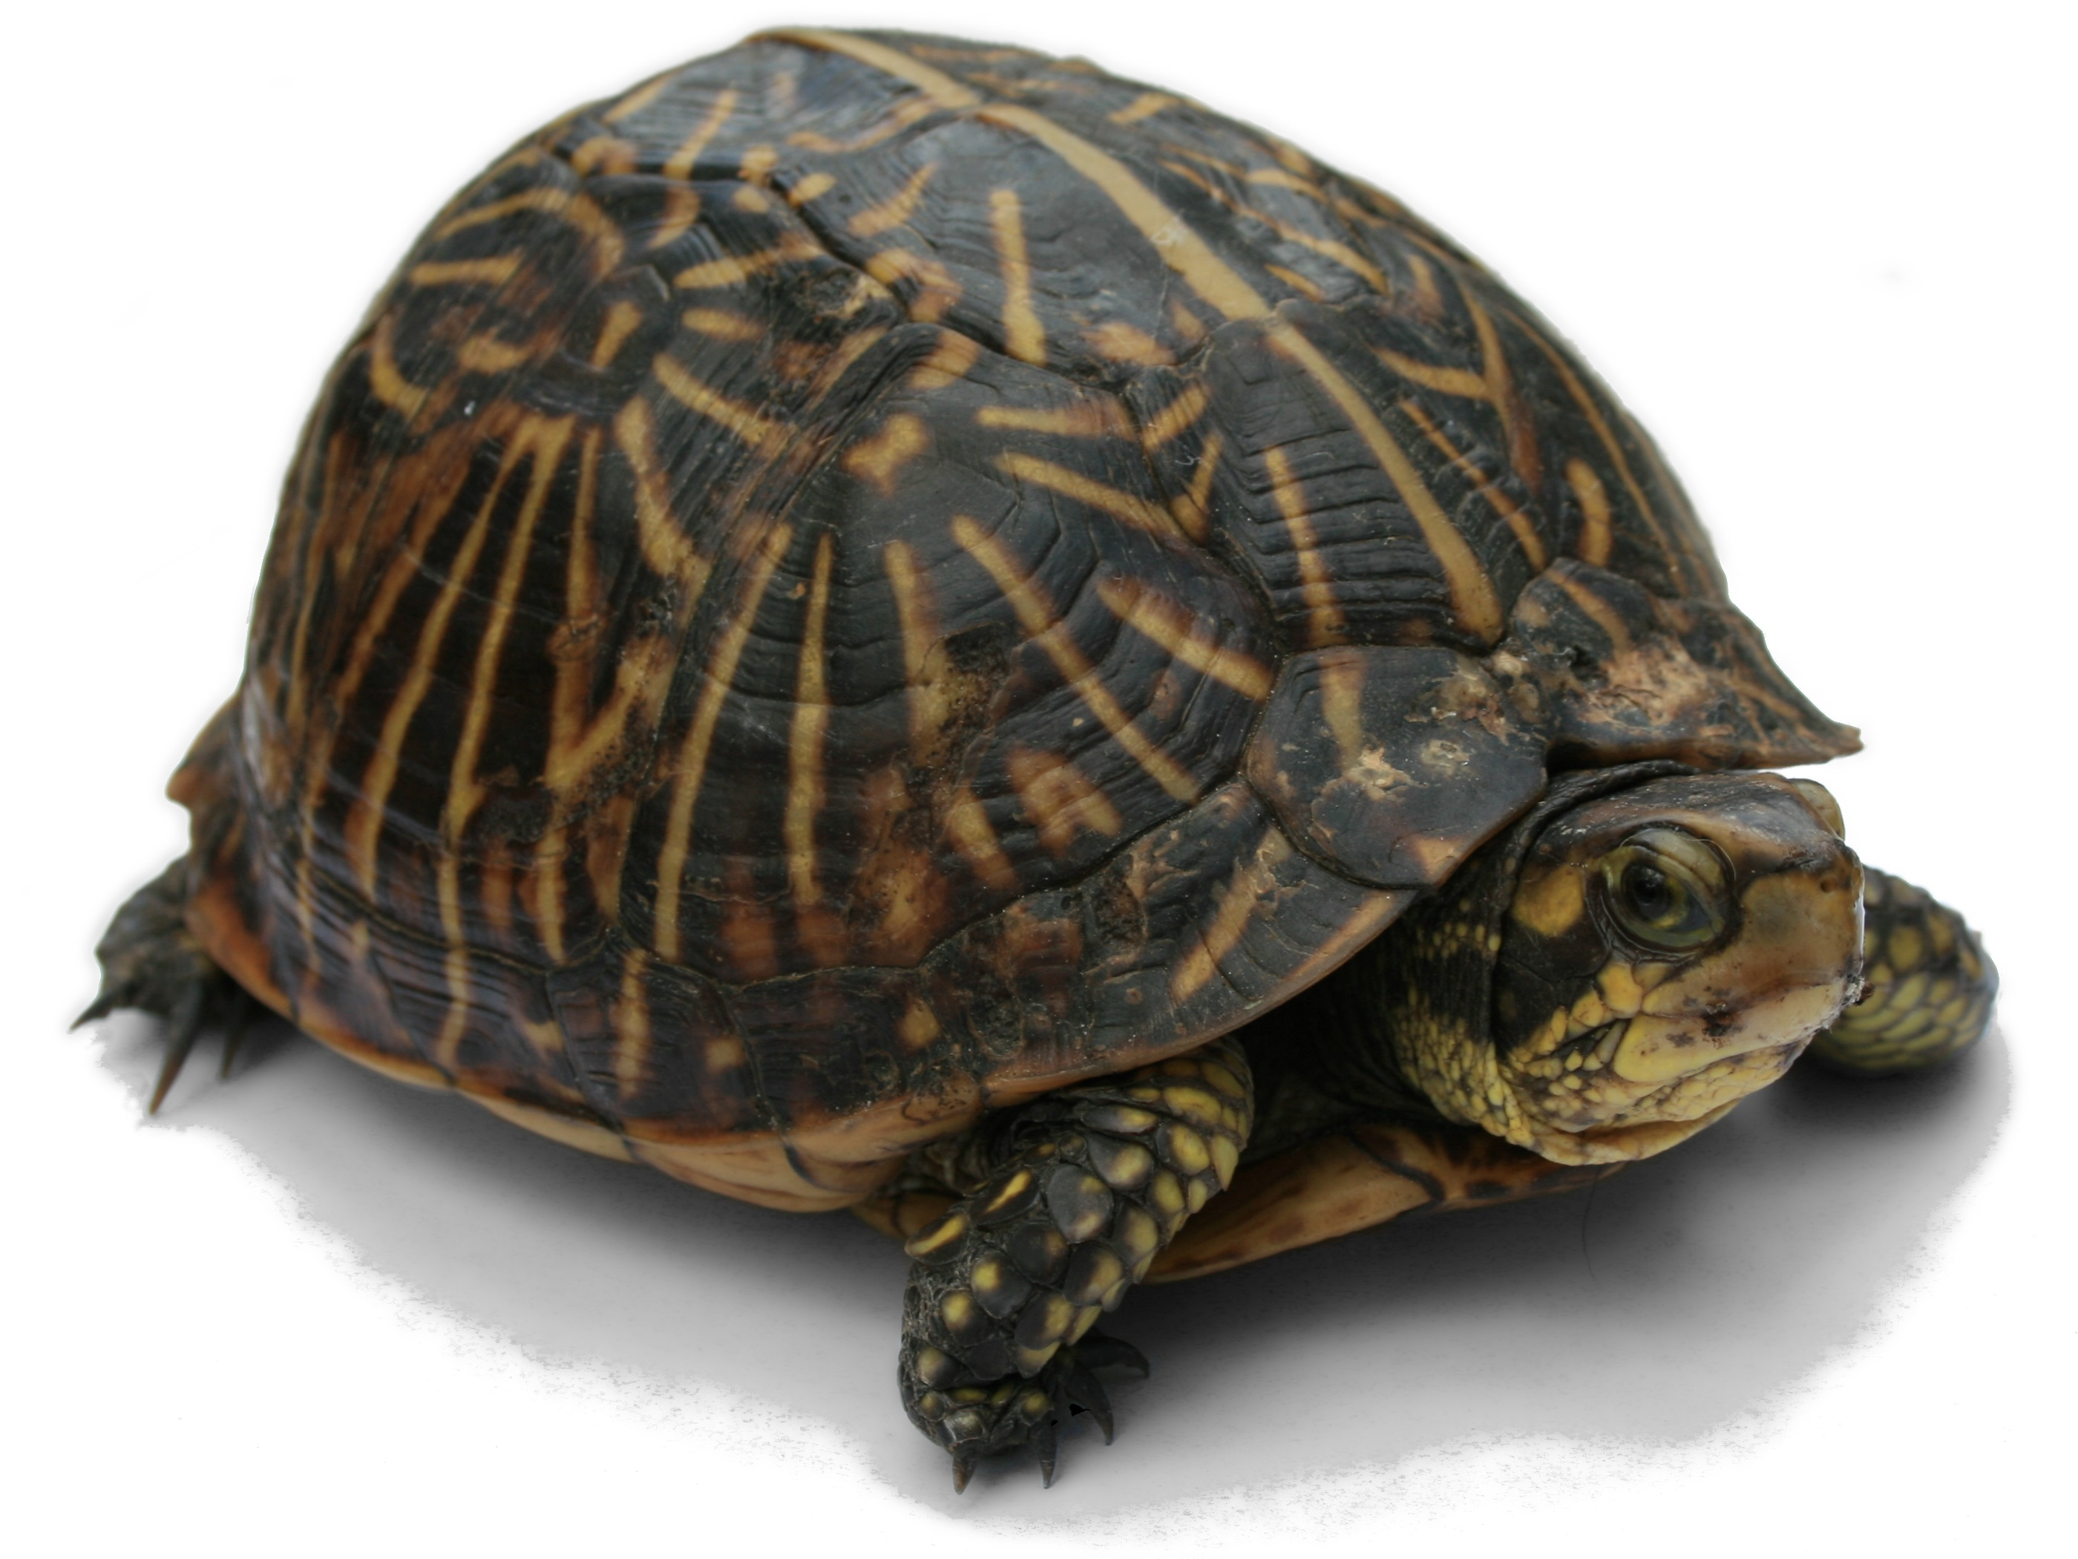
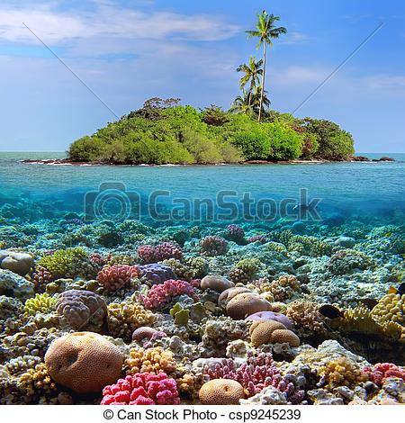
Let’s learn some new words
Waterfalls
Sea beach
Tea garden
Coral
Tourist spots
Turtle
Wooden boat
Island

Slide 10
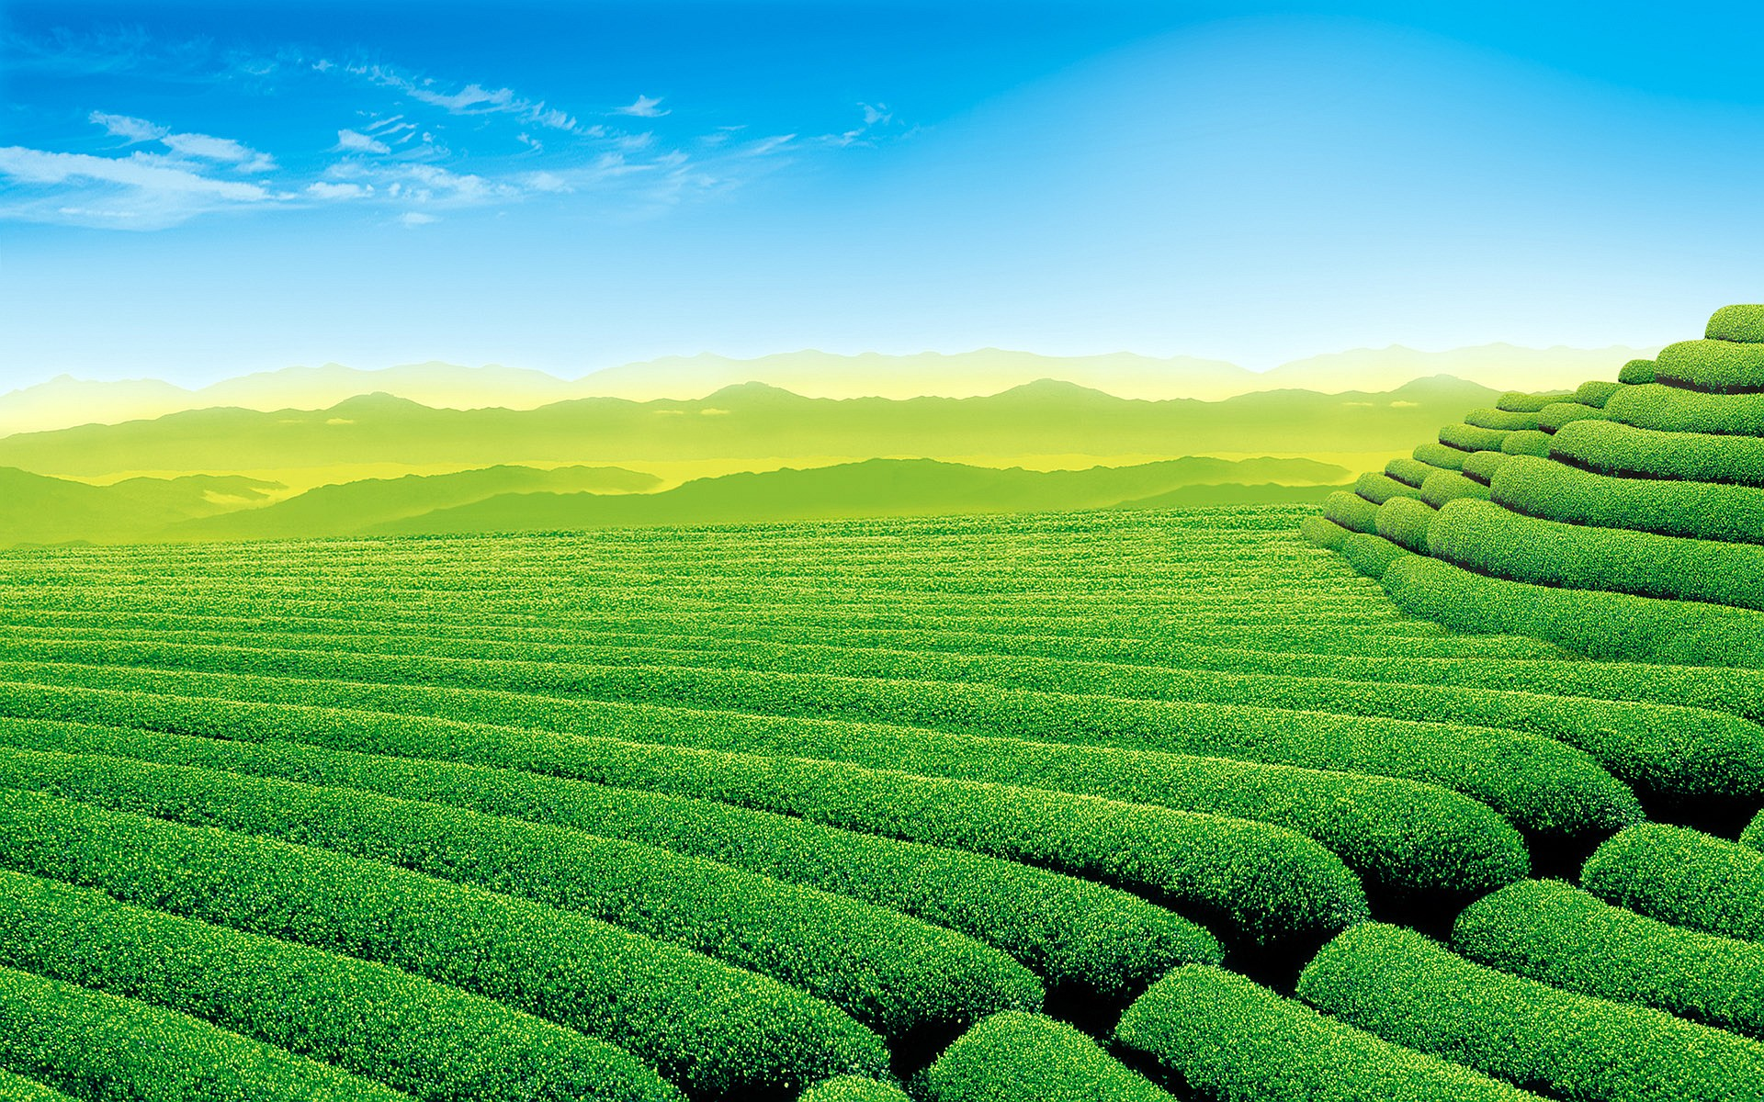
What’s the picture about?
Tea garden
Waterfalls

Slide 11
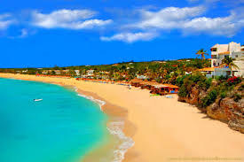
Coral and Island
Sea beach

Slide 12
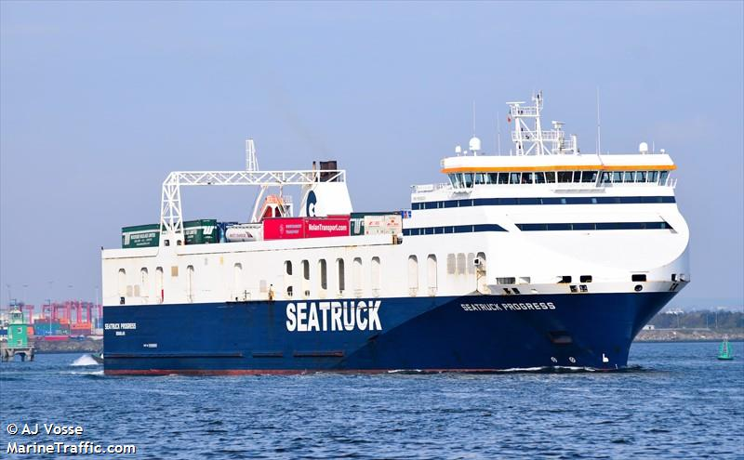
Wooden boat
Sea truck

Slide 13
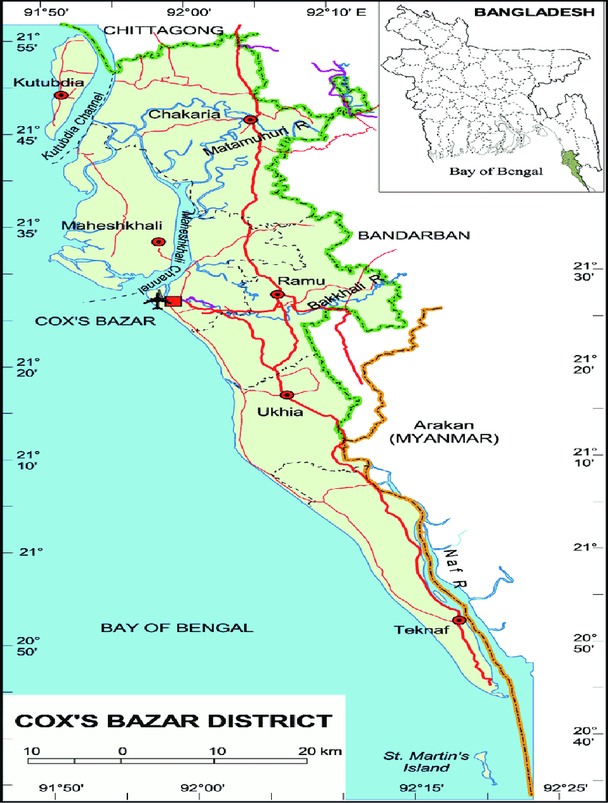
Cox’s Bazar map
Saint Martin’s
Click here

Slide 14
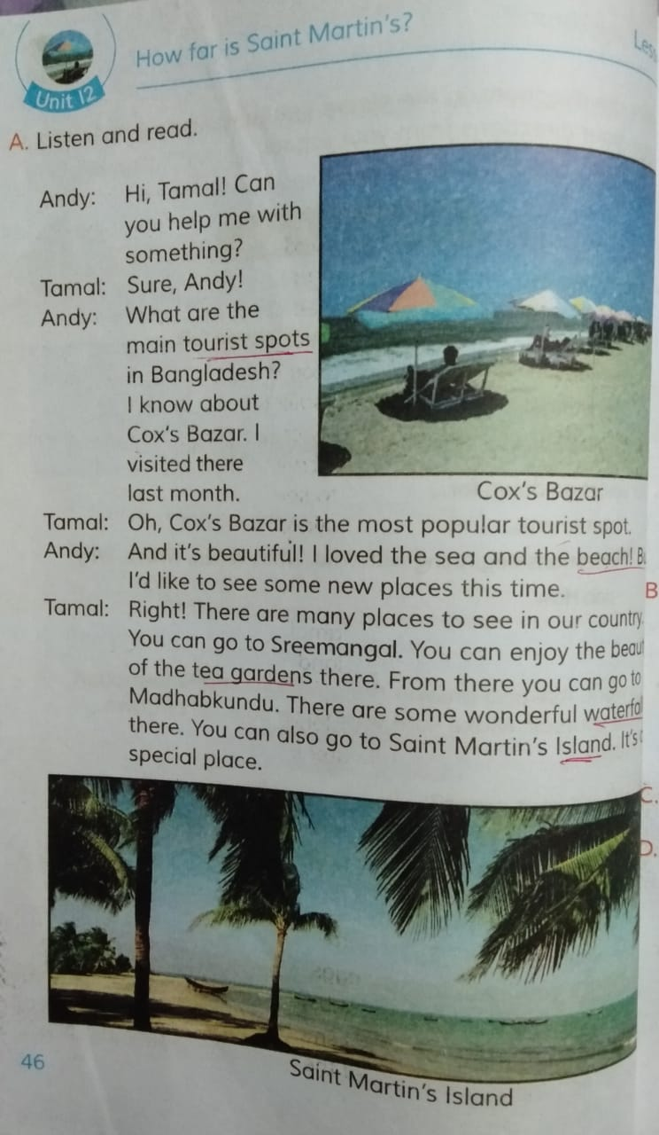
Open your book at page 46 and read the text silently.

Slide 15
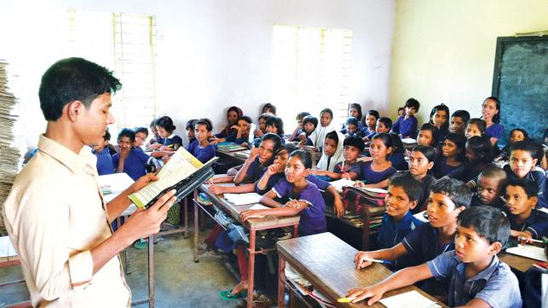
Teachers loud reading

Slide 16
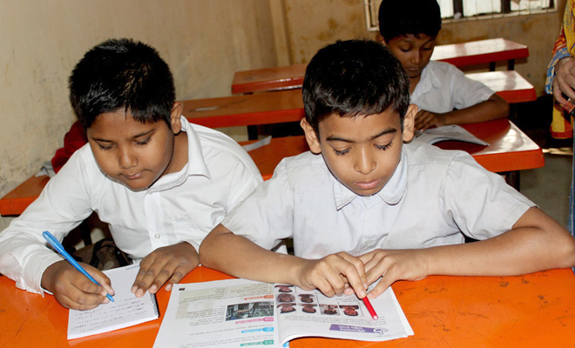
Students silent reading

Slide 17
Group Work
Time:5 minutes.
Answer the following questions-
What are the main tourist spots in Bangladesh?
Who is asking about main tourist spots in Bangladesh?
Why do people visit Cox’s Bazar?

Slide 18
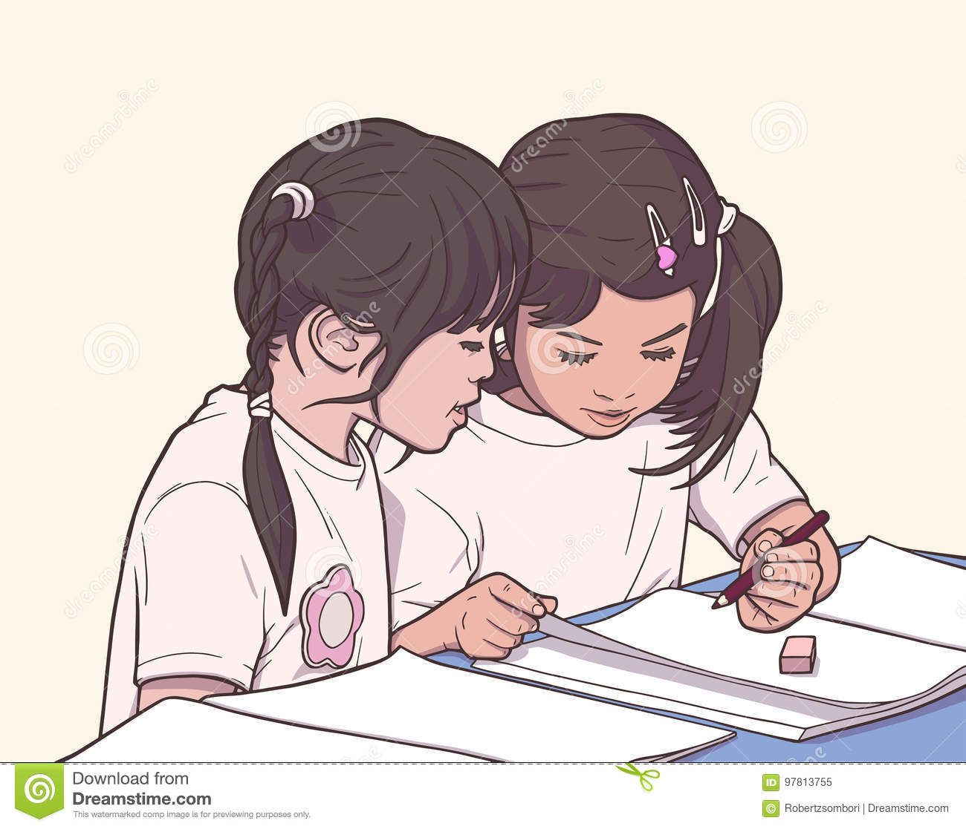
Pair Work
Come front and act out the dialogue in pairs.

Slide 19
I.W
Match the words in column A with their meaning in column B
Column: A | Column: B
(a) Turtle | (1) extremely good.
(b) Safe | (2) travelling on water.
(c) Sailing | (3) extraordinary.
(d) Special | (4) not good at all.
(e) Wonderful | (5) feeling bred.
 | (6) free from danger or risk.
 | (7) an amphibian animal.

Slide 20
Evaluation
Answer the following questions briefly.
What tourist places do Tamal and Andy talking about?
What is the name of the Island Tamal tells Andy about?
Where is the Island?

Slide 21
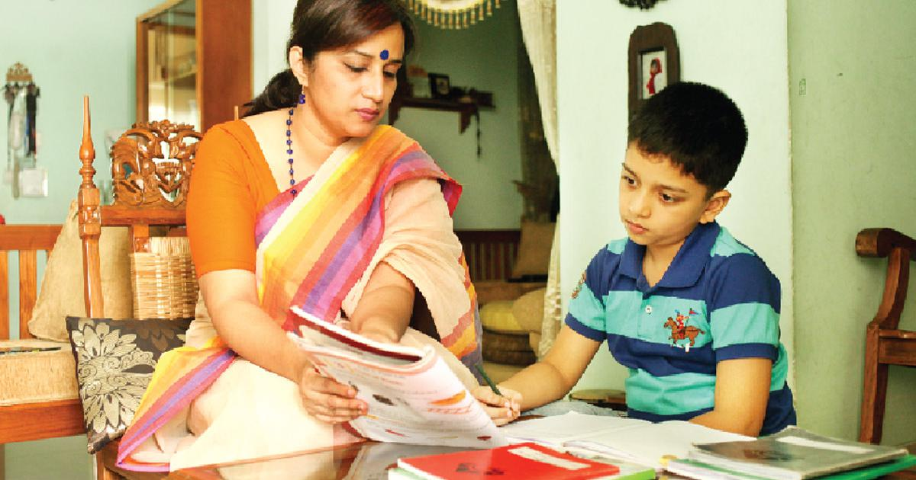
Homework
You will write a paragraph about Saint Martin’s Island.

