Slide 1
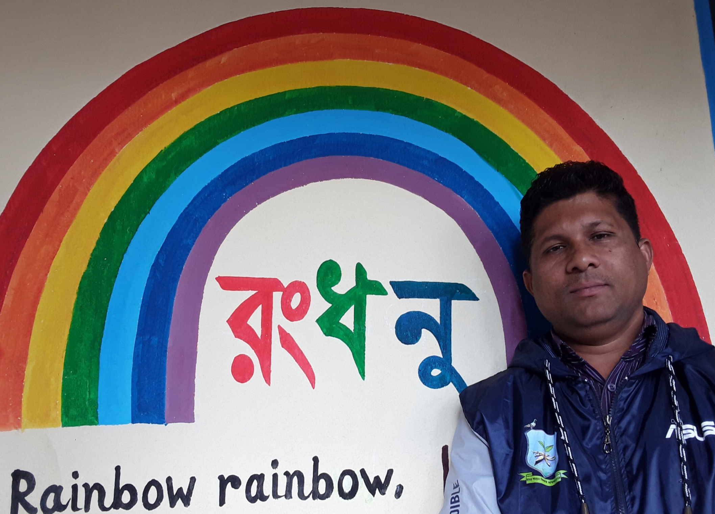
Good morning
Welcome to my class
Email: dhalder785@gmail.com

Slide 2
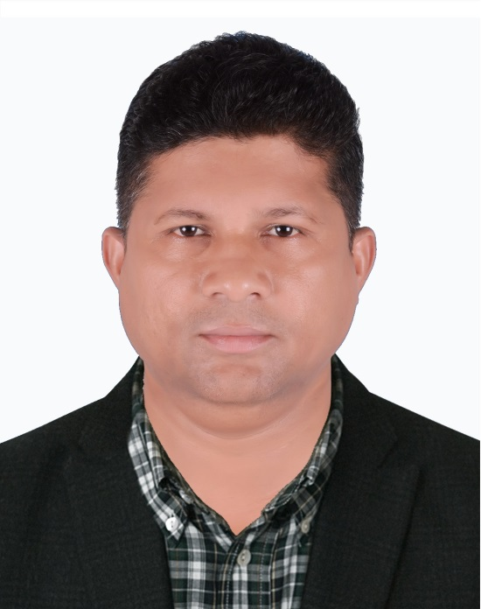
Presented by----------------------
Dulal Halder
Assistant Teacher
Kumna Govt.primary School
Chhatak, Sunamgonj
Mobile no: 01725725107
Email:dhalder785@gmail.com
Email: dhalder785@gmail.com

Slide 3
Lesson Introduce:
Class:Two
Subject:English ForToday
Unit: 16
Lesson:4--6
Heading: Colours
Part of lesson: Rhyme. look, listen and say.
Email: dhalder785@gmail.com

Slide 4
How are you?
Do you like song?
Lets sing a song.
Email: dhalder785@gmail.com

Slide 5
Learning Outcomes:
Students will be able to –
1.1.1- become familiar with English sound by listening to common English words.
1.1.2- say simple words and phrases with proper sound and stress.
4.1.2- recite rhymes independently.
1.4.1- read words and phrases with the help of visual clue and simple sentences.
Email: dhalder785@gmail.com

Slide 6
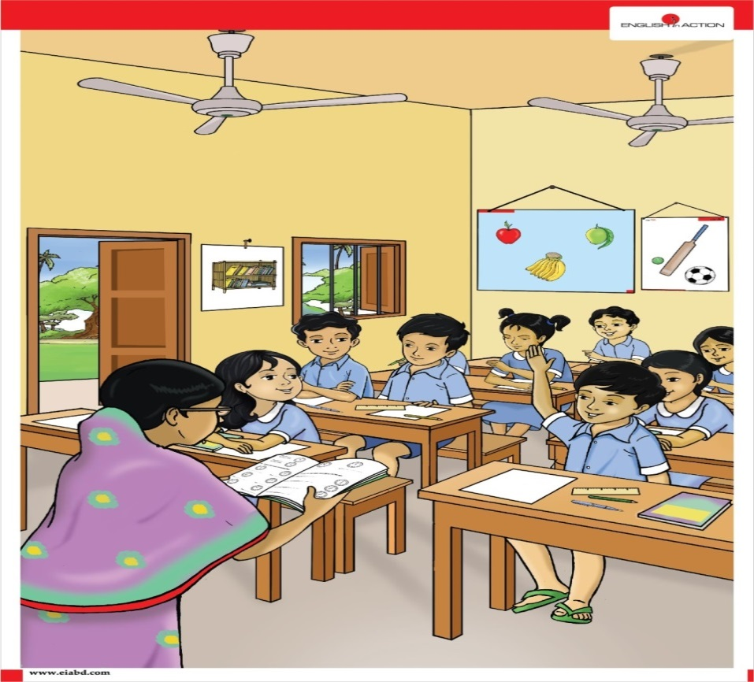
W.C.W-
Attentive to Activity A.
Lets see some cards. What is the colours of these cards? Raise your hand.
Email: dhalder785@gmail.com

Slide 7
Look and say
Red
Orange
Yellow
Email: dhalder785@gmail.com

Slide 8
Look and say
Green
Indigo
Blue
Email: dhalder785@gmail.com

Slide 9
Look and say
Violet
Email: dhalder785@gmail.com

Slide 10
What can we see sometimes after rain in the sky?
Rainbow Rainbow Rainbow
Email: dhalder785@gmail.com

Slide 11
Take your book and open at page 33
Today we will say the rhyme about Colours.
Would you like to say it with me?
Email: dhalder785@gmail.com

Slide 12
Colours

Slide 13
At first I’ll recite the rhyme.
You’ll listen to me.
Rainbow, Rainbow,
I see you!
Red and orange,
Yellow, green and blue,
Indigo and violet, too!
Email: dhalder785@gmail.com

Slide 14
I’ll recite the rhyme.
You’ll repeat after me.
Rainbow, rainbow,
I see you!
Red and orange,
Yellow, green and blue,
Indigo and violet, too!
Email: dhalder785@gmail.com

Slide 15
I’ll recite the rhyme again.
You’ll repeat after me.
Rainbow, rainbow,
I see you!
Red and orange,
Yellow, green and blue,
Indigo and violet, too!
Email: dhalder785@gmail.com

Slide 16
Everybody recite the rhyme independently.
Rainbow, Rainbow,
I see you!
Red and orange,
Yellow, green and blue,
Indigo and violet, too!
Email: dhalder785@gmail.com

Slide 17
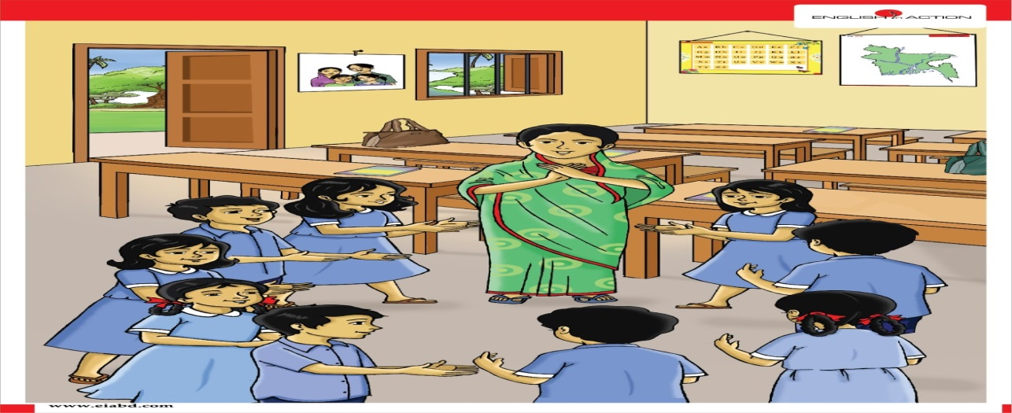
Group work.
Recite the rhyme in group with clapping.
Rainbow, rainbow,
I see you!
Red and orange,
Yellow, green and blue,
Indigo and violet, too!
Email: dhalder785@gmail.com

Slide 18
Pair work.
Recite the rhyme in pair.
Rainbow, rainbow,
I see you!
Red and orange,
Yellow, green and blue,
Indigo and violet, too!
Email: dhalder785@gmail.com

Slide 19
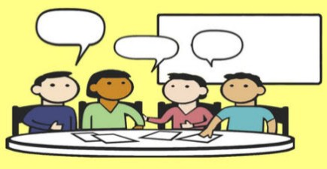
Evaluation?
Say the next line of the rhyme.
Rainbow, Rainbow,
----------------!
Red and orange,
--------------------------,
Indigo and violet, too!
Email: dhalder785@gmail.com

Slide 20
Home Task
# Recite the rhyme independntly
Email: dhalder785@gmail.com

Slide 21
Wish your colourful life and good bye
Email: dhalder785@gmail.com

