Slide 1
Journal Presentation
What have you learnt?
What was new to you?
How could you apply those in the classroom teaching?
What was not clear to you?
Which one did you find difficult?
Which one is not relevant to the contents of EfT books?
Write your comments on that day’s sessions?

Slide 2
Day 05
Session 01
Scaffolding learners to be communicative users of language
Activity-1: Warm up → I wish to visit…………..

Slide 3
What is Scaffolding?
Scaffolding is the support given during the learning process with the intention of helping the student achieve his/her learning goals (Sawyer, 2006).

Slide 4
How do you Scaffold?
resources
templates and guides
modeling a task
giving advice
Pair advance learners with developing ones
These supports are gradually temporary.

Slide 5
Activity 2: Eliciting more communicative activities out of EfT texts
Recall some communicative activities which have in our EfT books. Then make pairs and ask them to supply some interesting/ game like activities (SAs) which can help learners to develop their communication skills. Collect their ideas in plenary on poster paper or white board.

Slide 6
Activity 3: Conducting extra communicative activities beyond the EfT texts
Make 5 groups. Give Resource Paper-34 to the groups. Ask each group to choose 1 game like/ joyful communicative activity.
Ask each group to write the demonstration note of how to use game in class and also to identify the lesson in which they want to use it and when.

Slide 7
Resources Paper -34
Some supplementary activities:
Bingo game: The teacher asks students to write 3/4 words out of 7-10 in their exercise. Then teacher either tell or show words at random. If the students have written one of the words ask them to circle/cross it out. When a student’s has crossed off all his words, tell him/her to shout ‘’bingo’’ and he/ she will be the winner. It is suitable for revising for alphabet, number, short-long form, present-past tenses, vocabulary etc.
Preposition game: Vocabulary used: NOUNS table, pen, book, bag, window, floor, apple, wall, ball, bed, box, calendar, chair, cup, doll, door, fan, glass, picture, pillow, shelf, shoe, corner.
PREPOSITIONS: in, near, under, in front of, on, above, into, with.
The children look at the picture and ask each other, ‘’Where is the…………….?’’
One child look at the picture, the other says, ‘’I have lost my………….Is it/Are they in/on/near/etc. the……………….…?’’ The first child then says where the object can be found.
Hunt the pencil game: One child goes out of the room or covers his/her eyes. Another child places a pencil/…. somewhere in the room. The first child has to find the pencil by asking questions to the other children in the class. This is also a good game for practicing nouns and prepositions. Is it………..? Yes, it is. Or no, it is not.

Slide 8
Mime game: One child mimes an action. The other says or writes, ‘’ she/he is…….ing.’’ Can also be played in pairs or in groups.
Guessing game: A child thinks of an object in the room and says its initial letter. The other child or children guess what the object is by looking round for things beginning with that letter. A child thinks of a number and the other(s) ask yes/no questions. For example- ‘’ Is it an odd number? Is it an even number? Is it bigger than 20? Is it less than…..? ’’ to guess the number.
Information gap: A gap in information between two or more people which means they have to communicate with each other and asks questions to fill up the gap and to find out all the required information. For example- Student ‘A’ is given a part of the information and student ‘B’ is given the other part. They must not show each other their sheets, but must ask each other questions to find out the missing information to complete their sheet.e.g.

Slide 9
Student A: How many kites have you got?
Cat | 7
Kite
Mango | 4
Egg
Bat | 9
Student B: I have got 5.
Cat
Kite | 5
Mango
Egg | 8
Bat

Slide 10
Here is a sample demonstration of bingo game.
Materials: Words written on cards/ on the black board.
Method: Write 8-10 words on the black board or cards that you have taught now or would like to review. Tell the students to choose any 5-6 of them and write them down in their exercise books. Read out the words one by one and in any order. If the students have written down any of the words you have said, they cross it out. When they have crossed of all their 5-6 words they tell you by shouting ‘bingo’. Keep a record of what you say in order to be able to check that the students really have heard all their words the students who could cross out as per instruction win the game.
Kim’s game
Memory game
Noughts & crosses
Family game
Domino game
Cross word puzzle
Word square
10 questions game
Snap game

Slide 11
Supplementary activity
It is anything extra to what is in the text i.e. activities which are not in the lesson but closely related to the learning outcomes, that are easily achievable for the students either in pairs or groups and have potential for interesting activity based learning are called supplementary activities.
The importance of supplementary activity help students in language learning is---
To ensure learning by doing.
To extend thinking.
To increase eagerness to learn new things.
To build up vocabulary.
To grow confidence.
To develop creativity.
To arouse interest an involvement.
To make learning easy and enjoyable.
To make a bridge to reach the goal.
To construct new knowledge integrating with previous knowledge.

Slide 13
Day 05
Session 02
IPT Linked Lesson Planning
Activity 1: Identifying the basic components of IPT linked lesson plan:
Divide the participants into groups of 5 (5 participants in each group).
Cut a lesson plan (Worksheet-16) into 5 pieces

Slide 14
Please write the components of a lesson plan on your khata
The components of a lesson plan
Input activities
practice activities
Lesson title
Task/Checking learning activities.
learning outcomes

Slide 15
The Compnents of a lesson plan
learning outcomes
practice activities
Input activities
Task/Checking learning activities.
Lesson title

Slide 16
Activity 2: Writing learning outcomes of a lesson:
Learning outcomes are the core of a lesson. A teacher has to organize all activities in accordance with learning outcomes of a lesson. This time you are going to write the learning outcomes in groups.
Writing learning outcomes
Identifying learning outcomes is very important for planning a lesson because all activities are based on it. In the curriculum, terminal competencies, class-wise attainable competencies and learning outcomes of a lesson are written. To identify learning outcomes, teachers have to go through the lesson carefully and consider the new vocabulary, grammar points and skills. Remember, for each learning outcome it is must to provide at least one activity in your lesson.
According to Mager, the ideal learning outcome has 3 parts:
a measurable verb (for example ‘answer’);
the important condition (if any) under which the performance is to occur (‘verbally’ ‘simple questions about likes and dislikes’)
and the criterion of acceptable performance (‘using short sentences’),
Frequently you will not see the criterion or the condition specified if they are obvious. However, sometimes adding the condition(s) and/or the criterion give more clarity to a learning outcome.
The following verbs should not be used in writing learning outcomes as these are not measurable verbs: Believe, understand, know, appreciate, feel, enjoy, learn, think.
Learning outcomes describe the measurable skills, abilities, knowledge, or values that students should be able to do or demonstrate as a result of a completing a program of study, a course, or lesson.
Learning outcomes are student-centered rather than teacher-centered, in that they describe what the students will do, not what the instructor will teach. Learning outcomes are not standalone statements.

Slide 17
Learning outcomes need to be SMART:
Specific - The learning outcome should be well defined and clear. It states exactly what will be accomplished.
Measurable - The learning outcome should provide a benchmark or target so that the teacher can determine when the target has been reached, by how much it has been exceeded or by how much it has fallen short.
Achievable – The learning outcomes should be achievable by the learners within the given time and should be according to their cognitive level.
Realistic - Learning outcomes should be reasonable given the available resources. Learning outcomes should neither be easy nor impossible to attain, but somewhere in between.
Time-framed - A learning outcome should include a specific time or date by which it will be completed. It is important to allow enough time to successfully implement the steps needed to achieve the objective.

Slide 18
Before doing the task, explain some verbs (Believe, understand, know, appreciate, feel, learn, think) are not used to write the behavioural objectives of a lesson. Similarly the SMART rule should have to follow to write the learning outcomes.
Now ask the participants to work in the same group. Ask the participants to discuss and to write the learning outcomes of Class 3, unit 23, B, Read. Page: 46
After 10 minutes ask each group to tell one learning outcome that they have written (avoid repetition).

Slide 19
Activity 3: Writing and evaluating a lesson plan for English for Today (class 1-5)
Refer the participants to Activity 1 that a lesson plan has 5 components. Tell them that they have to write a lesson plan in group. Ask them to work in the same group as before. Give them 30 minutes to write the lesson plan. Tell them they have to write the lesson plan on the poster paper.
Distribute the group task in the following way.
Class | Group Name and class | Unit | Page:
5 | Dialogue | 1, G | 5
1 | Writing | 7, C | 15
4 | Vocabulary | 12, A | 24
3 | Story | 28, A | 56
4 | Reading | 12, A | 24

Slide 20
Ask them to assess others’ plans according to the following questions and make comments for improvement. Tell them to preserve it for the next day use.
Questions for assessing developed Lesson Plans
Are the learning outcomes relevant to the lesson? Are they written using the proper behavioral verbs and following the SMART rule?
Will the input activities help the learners to get information clearly?
Will the practice activities appropriate and enough to achieve the learning outcomes?
Are there any task or checking learning activity that ensure teacher if the learning outcomes achieved or not?
Are the classroom languages written against each activity?

Slide 21
Activity 3: Explaining the role of a lesson plan
Write the question` How does a lesson plan help teachers to present a lesson?’ in a circle on the board.
The role of a lesson plan
Each piece of work needs a plan to achieve its goal. Nothing can be achieved without a good plan. The plan could be written or well organised in the mind. The written one is preferable for the following reasons.
It’s a working document
It leads the teacher systematically through the stages of the lesson.
It focuses on teaching aids and supplementary activities.
Specific techniques and activities are mentioned in a lesson plan.
It gives opportunities to think about the possible problems of the lesson in advance.
It helps teachers to manage the class successfully
Clear stages for objectives, inputs, practice and task will help to achieve the learning outcomes.

Slide 22
Ask the participants to think about the question and give their ideas. Request a participant to collect the ideas around the circle.
At the end of the session, distribute Resource Paper-35 among the participants. Ask them to read the resource paper.

Slide 23
RESOURCE PAPER-35 : IPT linked lesson planning
The framework of an linked lesson plan Almost all lesson plan has 5 basic components namely: Lesson title, learning outcomes Input activities, practice activities, Task/Checking learning activities. The linked lesson planning has three different but clear stages : The first one is the input (or presentation) stage. In this stage the teacher provides the text, model language or vocabulary to the students. The second one is the practice stage. The students do different types of activities (controlled, guided, and free- (see unit 3 for detail) in this stage either with the help of their classmates or teachers for better understanding of the input. The third one is the ‘Task (Production)’ stage. In this stage students get the opportunity to do something which could be writing, discussion or making something (e.g. poster) in order to use their new knowledge and language they have learnt in the previous stages (input, practice) and also the previous lessons or classes . It helps them to build up confidence in using English and they start to become communicative users of English.

Slide 24
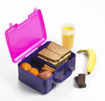

Slide 25
Day-5
Session-3
Developing MCQ and CRQ items according to Competency
Activity-1: Warm up
Activity-2: Identify the different types of test items.
Collect different types of Test items on the board that we use to assess students’ learning achievement.
Oral
written
i) Objectives- True-false, Fill in the gap, matching, write in a word, MCQ (multiple choice Question)
ii) CRQ- Constructed Response Question

Slide 26
Ask them which test item is not used in written exam (Oral and True-false)
Explain why True-false item is not used in the competency based test because by guessing 50% or more marks could be obtained. Clarify the different types of items with the help of Resource paper-36 if necessary.
Resource paper-36:
Types of test
Oral test: Teacher asks questions orally and the learners also answer orally.
Written test: Learners write the answer of the questions in the answer paper.
Written test are two types
Constructed Response Questions- short answer type, descriptive types
Objective types items: They are 5 types- answer in a word, MCQ, Matching, fill in the gaps, true-false.
Advantages of constructed response questions
can measure learner’s subject knowledge, understanding, analyzing, synthesizing and evaluating skills
learners can express opinions and attitude in their own style.
can measure learner’s literary knowledge, sentence construction ability and ability of writing style
can measure learner’s thinking and imagination power.
Learners acquire the skill of writing in an organized way
Disadvantages of constructed response questions
Marking is varied a lot by marker to marker.
can’t compare students intellectuality and achievement.

Slide 27
Activity-3: Describing the guidelines for constructing MCQ and CRQ

Slide 28
Form groups of 5 using a joyful technique. Give them the constructing guidelines of MCQ items (Resource Paper-37) and worksheet-17 (sample items) to identify which one is not constructed in accordance with the guidelines and rewrite them accordingly. Tell them they will get 10 minutes to do the group activity.

Slide 29
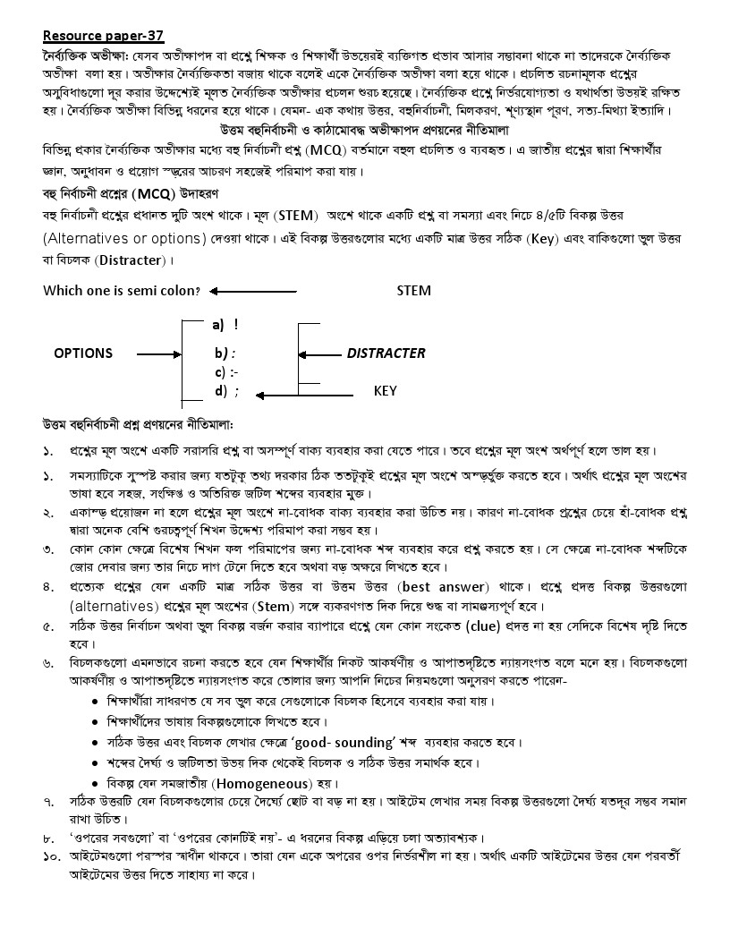

Slide 30
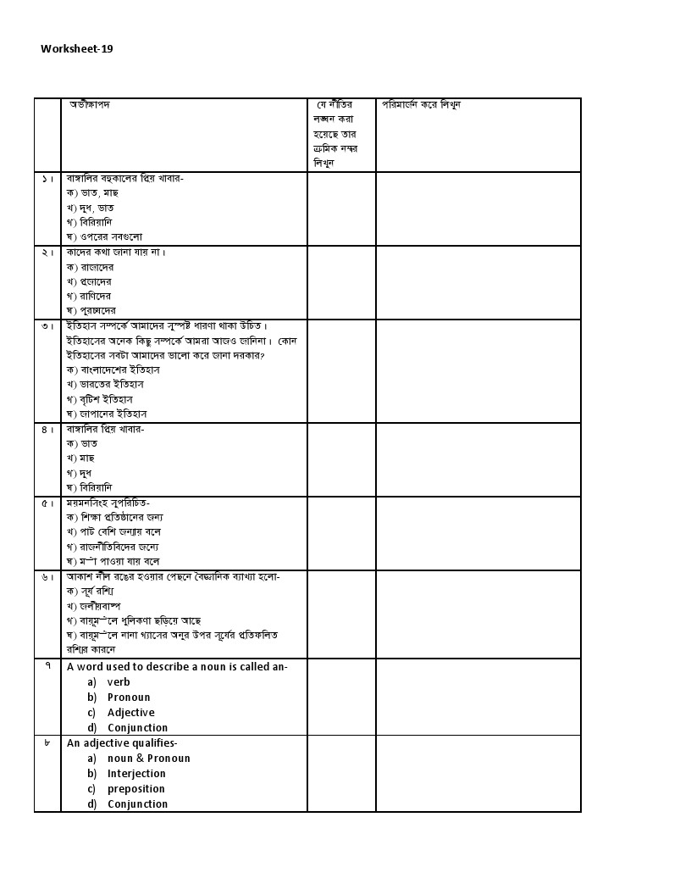
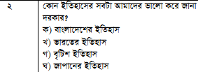
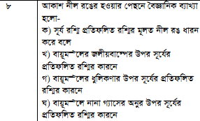
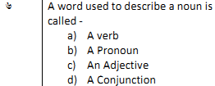

Slide 31
Now give them the constructing guidelines of CRQ items (Resource Paper-38) and worksheet-18 (sample items) to identify which one is not constructed in accordance with the guidelines and rewrite them accordingly. Tell them they will get 10 minutes to do the group activity.

Slide 32
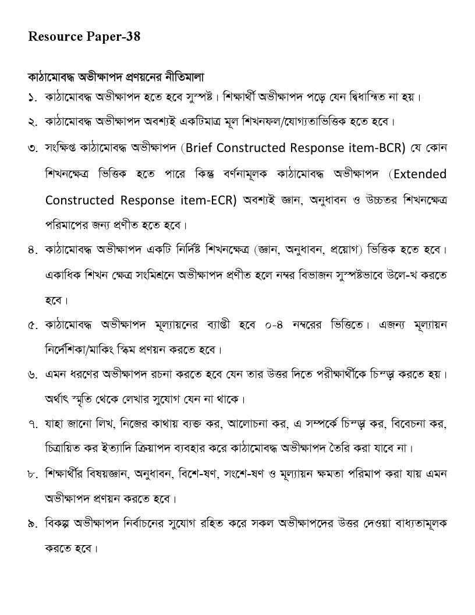

Slide 33
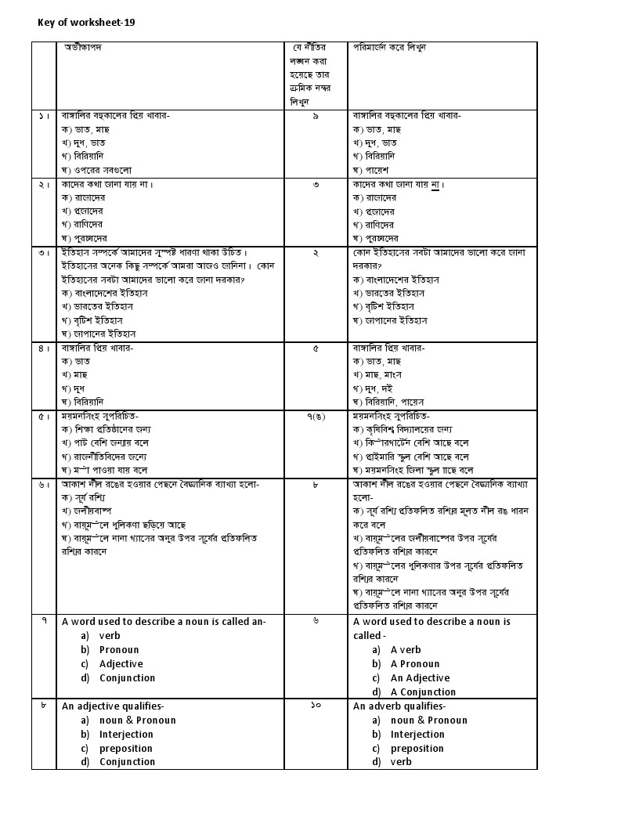

Slide 34
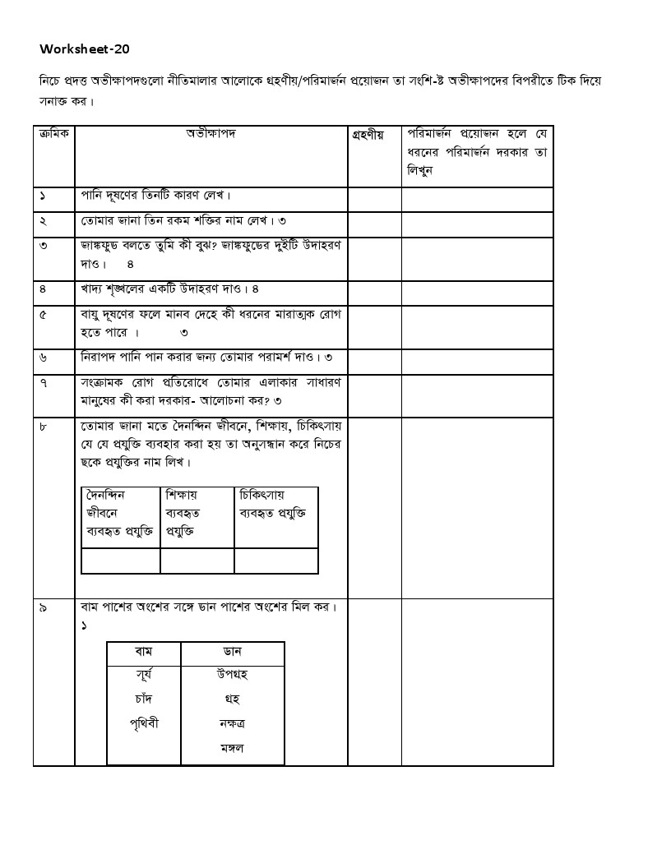
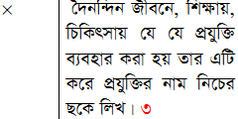

Slide 35
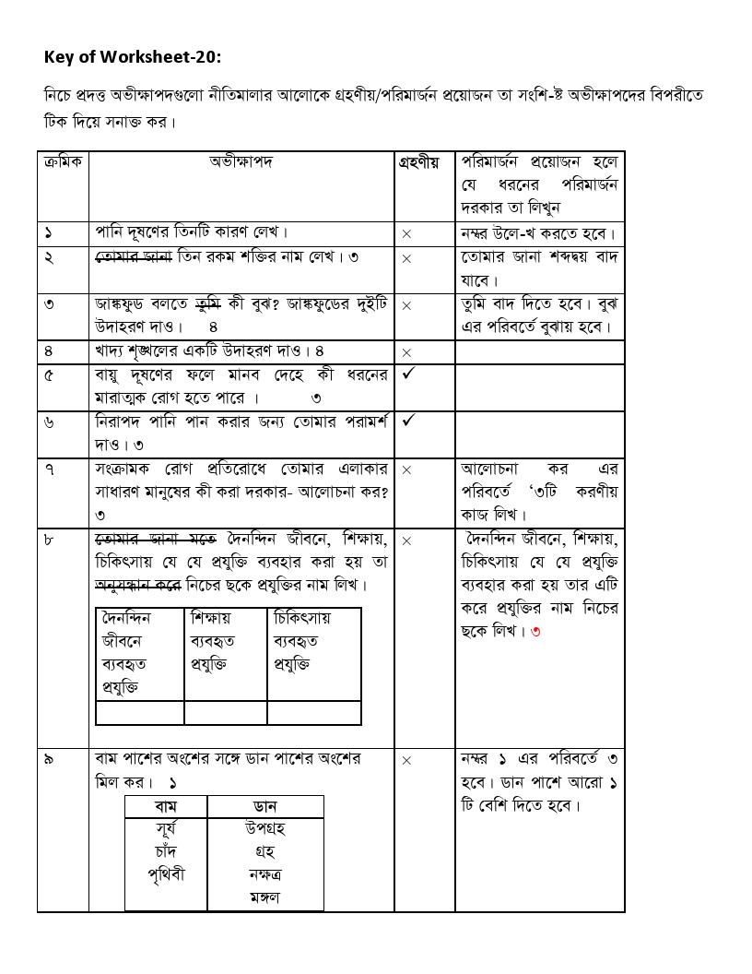

Slide 36
Activity-4: Constructing MCQ and CRQ items to assess learners’ learning
Explain Bloom’s taxonomy of cognitive domain with example using the Resource Paper-39.

Slide 37
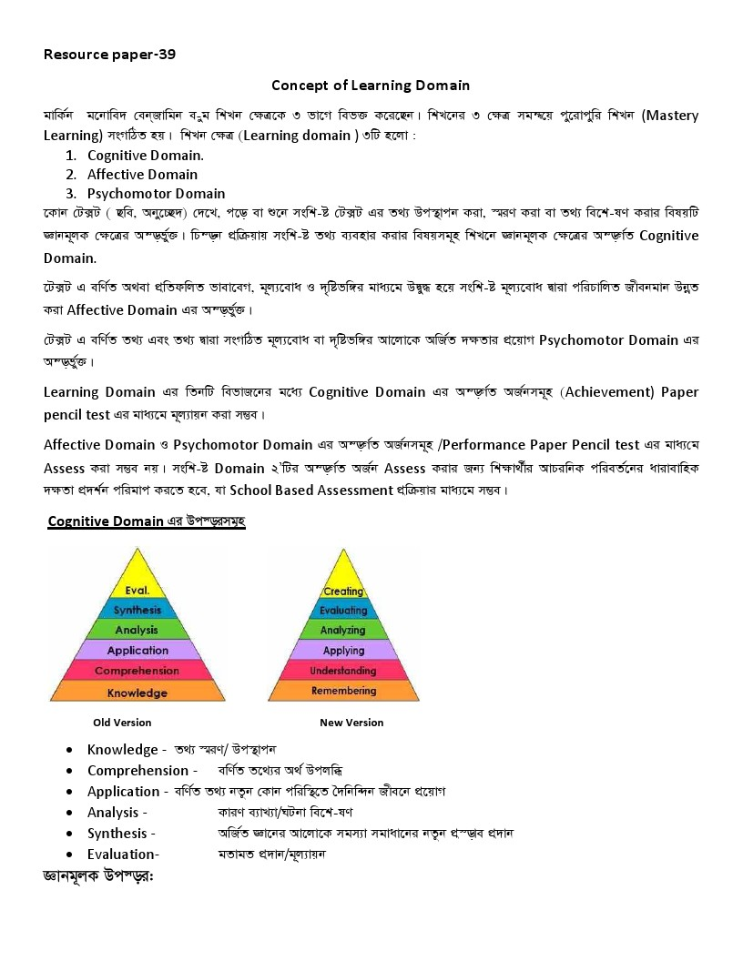

Slide 38
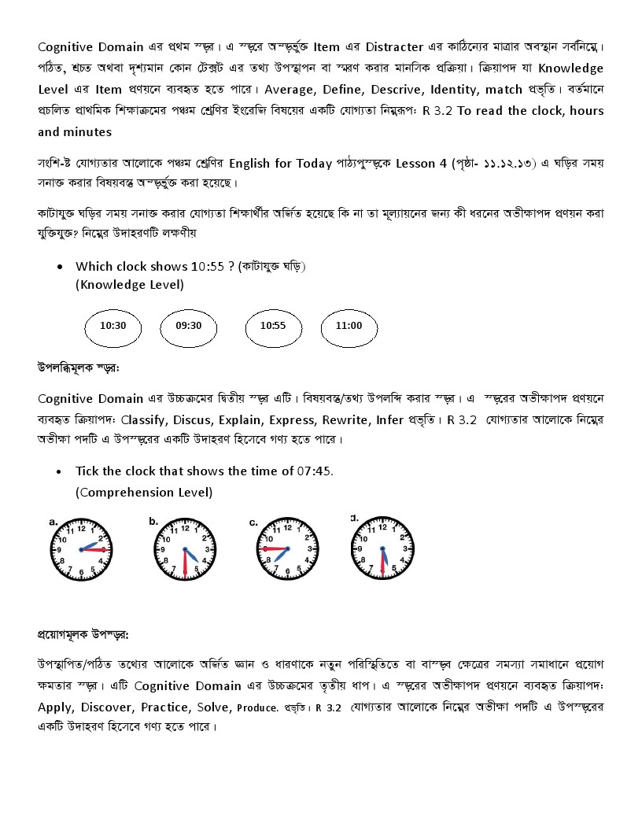

Slide 40
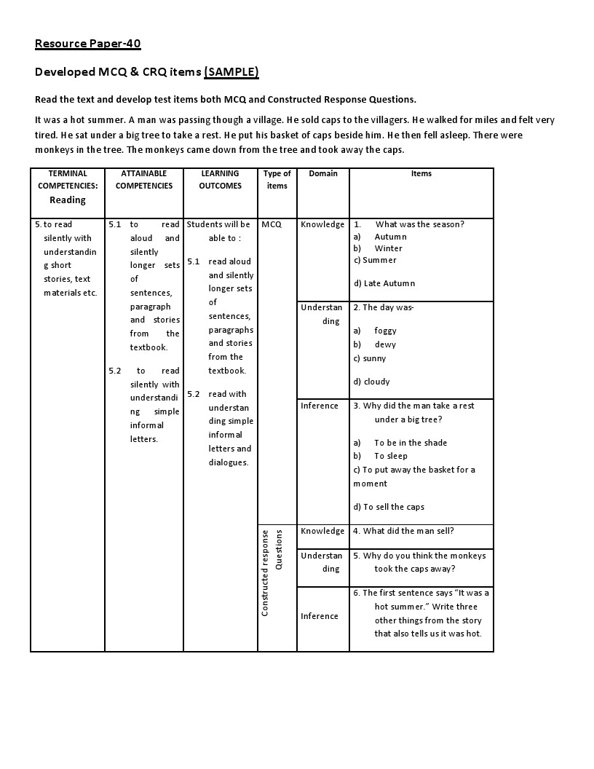
Give them developed MCQ and CRQ items (Resource Paper-40) for better understanding. Ask them to analyse the items in accordance with cognitive domain (Knowledge, understanding and Inference/application), MCQ and CRQ items constructing guidelines.

Slide 41
Day- 5
Session - 4
Teachers’ professional development
Activity-1: Warm up
Learning is a dynamic and continuous process. Learning needs and styles are changing for the development of modern science and technology. The teacher is key person to fulfill students’ needs and interest using appropriate methods and techniques including modern technology in teaching-learning. Teacher’s well preparation with subject knowledge and pedagogical knowledge help him/her to present a lesson effectively. Professional development is a continuous process. Self-motivation and commitment to the job helps to develop professional skills. Teacher is a life-long student. He can develop his professional skills by reading books, educational researches and journals. While teaching, teacher faces some problems e.g. students are not responding, they are making noise, and they are not actively participating. To solve these problems teacher can do an Action Research or self-assessment and self-reflection. Peer supervision and supportive feedback is also a way of professional development.

Slide 42
Now can you say-
Here, what is subject knowledge?
What is Pedagogical knowledge?

Slide 43
CK
PK
PCK

Slide 44
Content knowledge (CK)
"Knowledge about the actual subject matter that is to be learned or taught".
Pedagogical knowledge (PK)
Deep knowledge about the processes of teaching and learning or methods
Pedagogical content knowledge (PCK/Teacher)
"Knowledge of pedagogy that is applicable to the teaching of specific content".

Slide 45
Activity-2: Identifying subject knowledge and pedagogical knowledge required for an English teacher of Primary school
Organise the participants into 4 groups. Name the 4 groups according to 4 skills.
Ask them to identify what sorts of subject knowledge and pedagogical knowledge is required to teach respective skill in the primary school. Give them 20 minutes to do the activity.

Slide 46
Worksheet-21
Give each group worksheet-19 respective terminal competencies.
Terminal Competencies: Listening | Required Subject knowledge | Required pedagogical knowledge
1. to recognize basic English sound differences, stress and intonation. 2. to understand simple commands, instructions and requests and carry them out. 3. to understand simple questions and statements. 4. to listen to, understand and enjoy simple rhymes, poems and stories.

Slide 47
Terminal Competencies: Speaking | Required Subject knowledge | Required pedagogical knowledge
1. to use English sounds, stress and intonation appropriately . 2. to exchange greetings and farewells and to make introductions. 3. to ask and answer questions . 4. to recite rhymes and poems. 5. to say the names of the days of the week and the months, and to tell the time. 6. to talk about simple things and actions. 7. to give instructions, commands and to make requests. 8. to take part in conversations on topics related to students’ daily life.

Slide 48
Terminal Competencies: | Required Subject knowledge | Required pedagogical knowledge
1. to read aloud texts with proper pronunciation, stress and intonation. 2. to recognize and read both cardinal and ordinal numbers. 3. to read the names of the days of the week, the months and the time. 4. to read aloud poems with proper stress and intonation. 5. to read silently with understanding paragraphs, stories and other text materials. 6. to read instructions and carry them out. 7. to recognize punctuation marks and read accordingly.

Slide 49
Activity-3: Ways of teacher’s professional development
Ask the participants to complete the grid individually. Tell them to write the ways to acquire knowledge other than training.
Area of SK & PK | Required to acquire knowledge | Way to acquire Knowledge
Now make 3 groups. Ask to discuss what individual needs is and how she/he want to develop himself/herself.

Slide 50
Tell them how they could develop their professionalism in accordance with the Resource Paper-41.
Resource Paper-41
Elements of SK &PK:
Subject Knowledge: | Pedagogical Knowledge:
Have a strong background in subject area Subject area content knowledge Understand major concept, assumption, debate, content or subject knowledge that they teach Linkage with curriculum Sequence of contents they teach Subject specific technology | Developmental theory of learning Understand how learning occurs How social group works Diverse cultural environment Methods and techniques Effective classroom management Effective teaching practice Effective assessment Curriculum alignment Diversification of instruction Technological skill.

Slide 51
Resources for development of SK & PK:
News paper Magazine Weekly magazine Internet/websites Journals English books English reference books English program on TV or Radio English movies Dictionary

Slide 52
Activity-3: Micro teaching & Peer observation and giving feedback
Tell the participants that most effective way of pedagogical development in the training is micro-teaching and in school is peer observation. In peer observation presenter and observer both are colleagues. They observe each others’ lesson for mutual interest of professional development. Before the observation, they both discuss what he/she will observe. After the presentation they both sit together to discuss strength and weakness of the lesson with suggestion for further development (feedback).
Ask the participants to work in the same group to prepare a lesson plan for class 1-5
Ask one group to present their lesson/Micro Teaching.
Tell 4 participants to observe the lesson using the observation checklist.
After the presentation arrange a feedback session.

Slide 53
(Observation Format)
Class:
Lesson:
Lesson/Part of the Lesson Observed:
Taught/performed/simulated/demonstrated area:
Name of the teacher/performer/simulator/demonstrator:
Name of the observer:
Date:
Describe how the “teacher” has shown the indicators of the pre-determined area.
How do the peers (the students who play the role of primary school students) respond to each activity?
Write your remarks on the observed part of the lesson for the pre-determined area.

