Slide 1
Good morning

Slide 2
Prepared by
Muhammad Jane alam
Assistant teacher
West Rashidabad Government primary school.patiya,chittagong.

Slide 3
Class:4
Subject:English
Duration:40 minutes

Slide 4
Mental Preparation

Slide 5
How many people in you family?
What is your father?
What is your mother?
Do you have any brother or sister?
Ackowledge

Slide 6
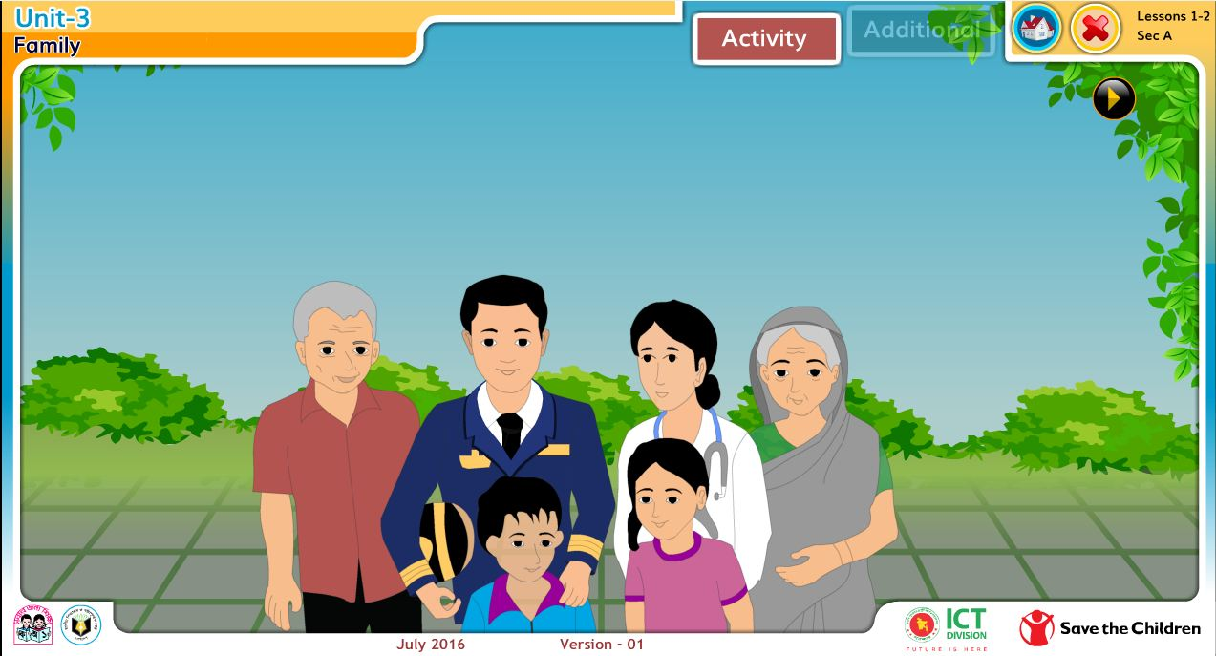
Look at picture of the family.
How many people are in the family ? What do you think the people do?

Slide 7
We are going to read today
Family
Unit:03
Lesson:1-2
Page no:06
Declaration of lesson

Slide 8
At the end of the lesson,the students will be able to
Listening:
3.2.1 understand questions about family about students.
3.4.1 understand statements made by teacher and students.
Speaking:
1.1.1 say words, phrases and sentences with proper sounds and stress.
1.1.2 say sentences with proper intonation.
Reading:
1.5.1 read words, phrases and sentences in the text with proper pronunciation, stress and intonation .
1.7.1 read paragraphs ,letters and other texts.
Learning outcomes

Slide 9
New words----- Family,Hospital,Patients,Job,Pilot , Biman ,Travel.
Listen carefully and read after me.
Family-People who live together
Hospital-An institution of serving sick people.
Patients-Sick people.
Job-Work.
Pilot-A person who drive a plane.
Biman-Plane.
Travel-Going to see a place.

Slide 10
Listen to me and read after me.
Farzana and Jamil are from Kushtia . They go to Chachua Government Primary School . Farzana is nine years old . She is in class 4 . Jamil is seven years old . He is in class 2 . They like school and they are good students .

Slide 11
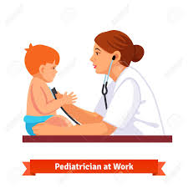
Farzana and Jamil’s mother is Rehana Parvin.She is 33 years old.She works at a hospital in Kushtia.She is a doctor. She takes care of many patients everyday.She likes her job very much.

Slide 12
Aziz Ahmed is Farzana and Jamil’s father.He is a pilot of Biman Bangladesh Airlines.He flies to other countries.He travels to India,Thailand and China often.He loves to travel.He is 39 years old.

Slide 13
Open your book at page 06.

Slide 14
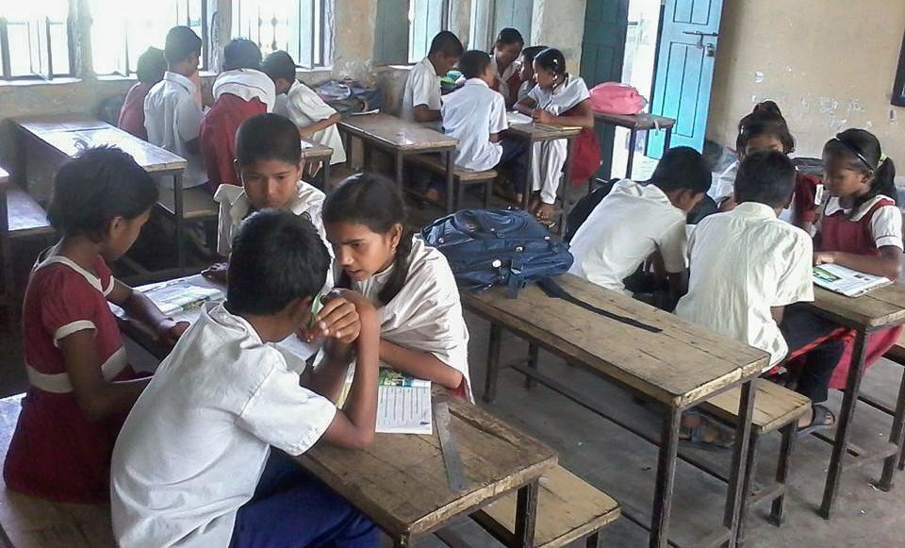
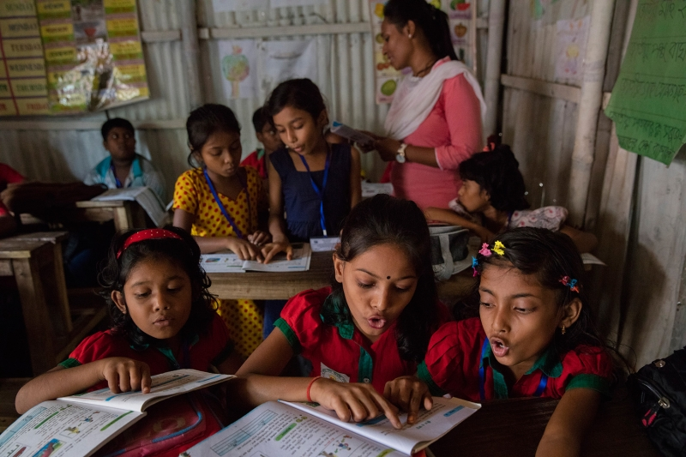
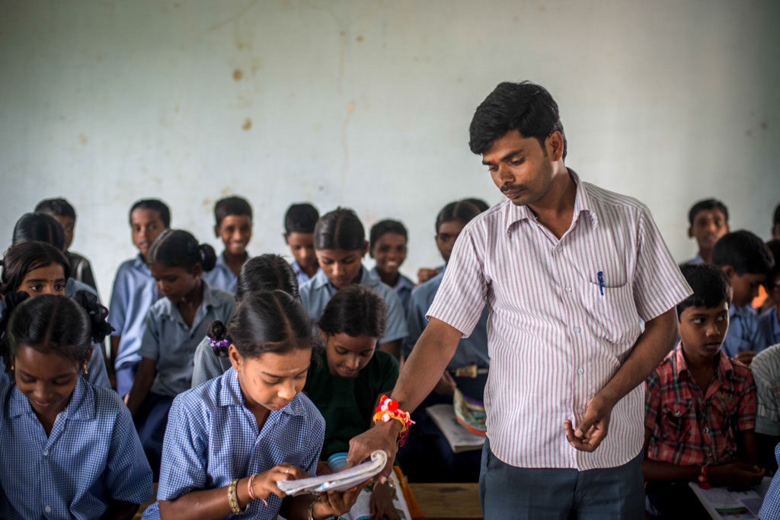
Group reading
Pair reading
Individual reading

Slide 15
Make sentence with the following words in group.
One is done for you.
Good----Rahim is a good student.
Patients---
Job---------
Pilot--------
Travel------
Take care--

Slide 16
Read and complete the chart with information about the family in pair. One is done for you.
Name | Age | Job | Workplace
Farzana | 9 | Student | Chachua G P S
Jamil
Rehana Parvin
Aziz Ahmed

Slide 17
Write a paragraph about your family individually in your exercise book.

