Slide 1
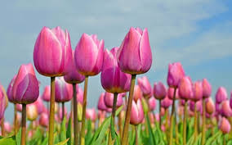
WELCOME

Slide 2
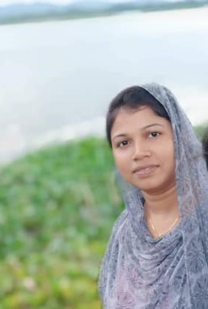
Rupa Mollik Rupu
Assistant Teacher
T and T gate Government primary school, Khagrachari

Slide 3
Let’s sing Look Look Look song

Slide 5
Today’s Lesson is----Animals
Unit:29
Lesson: 4-6
Page:59

Slide 7
Introducing new words
Favourite
Dearest
প্রিয়
Strong
Powerful
শক্তিশালী
Grey
Silver colour
ধূসর

Slide 8
Listen to the audio

Slide 10
Write about your favourite animal by answering the following questions.
Think about it
Which animal do you like?
What does it call?
Where does it live?
What does it eat?

Slide 11
Let’s go to your text book , Activity B

Slide 12
One day one word
Grey
ধূসর
A large grey cat was asleep.

Slide 13
Home Task

Slide 14
GOOD BYE

