Slide 1
W
E
E
O
L
M
C

Slide 2
Md. Afsar Ali
Senior Assistant teacher
Majhira Model High School
Shajahanpur, Bogura
Mob: 01719549949
afsar0903@gmail.com
Class-Eight
English for today

Slide 3
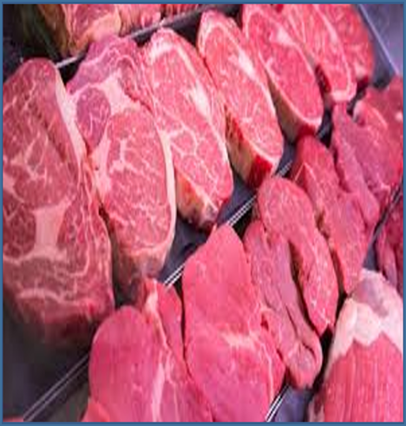
Look at the picture
There are many kinds of food.
What kinds of food are they?
The picture is about food.
What is the picture about?

Slide 4
Yes, your answer is quite correct.
Today we will learn “Kinds of food”
Unit:2 Lesson: 2 Page No: 12

Slide 5
Learning Outcome
After we have studied this lesson, the student will be able to
Read and understand texts through silent reading.
Ask and answer questions
Write answer to questions

Slide 6
Silent reading
Mrs. Rehena continues her talk about food. “We eat different kinds of food. And they contain different substances. There are six types of food substances.”
Carbohydrate: We get carbohydrate from rice, bread, potato and sugar.
Protein: Meat, fish, egg and some vegetables lie peas, beans and lentils are good sources of protein.
Fat: We have fat from butter, ghee, edible oil and nuts.
Vitamins: We get vitamins mainly from leafy vegetables and fruits, milk, fish and also contain vitamins.
Minerals: These are essential for good health. Milk fish, vegetables and fruits have a lot of minerals in them.
Water: Water is most essential for our body. We cannot live without it. We need to drink enough clean water every day.
Mrs. Rehena is very health conscious. She tries to avoid foods rich in carbohydrate. So she never takes sugar in her tea.

Slide 7
Main discussion
If we keep our body fit, we should eat right kind of food daily. The right kind of is that food which has all types of food substances. You have already known that six type of food substances are: Carbohydrate, protein, fat, minerals and water.
1. Carbohydrate: Carbohydrates have six major functions within the body:
i. Providing energy and regulation of blood glucose.
ii. Sparing the use of proteins for energy.
iii. Breakdown of fatty acids and preventing ketosis.
iv. Biological recognition processes.
v. Flavor and Sweeteners.
vi. Dietary fiber.
We get carbohydrate from rice, bread, potato and sugar.

Slide 8
Main discussion
2. Protein: Hair and nails are mostly made of protein. Our body uses protein to build and repair tissues. We also use protein to make enzymes, hormones, and other body chemicals. Protein is an important building block of bones, muscles, cartilage, skin, and blood.
Meat, fish, egg and some vegetables lie peas, beans and lentils are good sources of protein.

Slide 9
Main discussion
3. Fat: Fats are essential to give your body energy and to support cell growth. They also help protect our organs and help keep our body warm. Fats help our body absorb some nutrients and produce important hormones, too. Our body definitely needs fat.
We can get fat from butter, ghee, edible oil and nuts.

Slide 10
Main discussion
4. Vitamins: Vitamins and minerals are considered essential nutrients—because acting in concert, they perform hundreds of roles in the body. They help shore up bones, heal wounds, and bolster our immune system. They also convert food into energy, and repair cellular damage. We get vitamins mainly from leafy vegetables and fruits, milk, fish and also contain vitamins.

Slide 11
Main discussion
5. Minerals: Minerals help our body grow, develop, and stay healthy. The body uses minerals to perform many different functions — from building strong bones to transmitting nerve impulses. Some minerals are even used to make hormones or maintain a normal heartbeat. Milk fish, vegetables and fruits have a lot of minerals in them.

Slide 12
Main discussion
6. Water: Water forms the basis of blood, digestive juices, urine and perspiration, and is contained in lean muscle, fat and bones. As the body can't store water, we need fresh supplies every day to make up for losses from the lungs, skin, urine and faces. So, Water is most essential for our body. We cannot live without it. We need to drink enough clean water every day.

Slide 13
Summing up the topic
We know that health is wealth. If we remain healthy we should take the right kind of food daily and we called them good food. Good food contains all kinds of food substances. It is very important for our health. But we should not too much. We should eat a certain amount of food which is needed our body.

Slide 14
Now answer the following questions (Pair work)
1. How many kinds of food do we need?
2. What are they?
3. Which food contains carbohydrate?
4. What is the benefit of minerals?
5. What is the function of protein?

Slide 15
Answer
We need six kinds of food.
2. They are carbohydrate, protein, vitamins, minerals, fat and water.
3. We get carbohydrate from rice, bread, potato and sugar.
4. Minerals help our body grow, develop, and stay healthy. The body uses minerals to perform many different functions — from building strong bones to transmitting nerve impulses. Some minerals are even used to make hormones or maintain a normal heartbeat.
5. Hair and nails are mostly made of protein. Our body uses protein to build and repair tissues. We also use protein to make enzymes, hormones, and other body chemicals. Protein is an important building block of bones, muscles, cartilage, skin, and blood.

Slide 16
Main discussion
Choose the best answer from the alternatives. (Evaluations)
1. Foods are divided into classes according to their ……………..
Colours and taste (b) shapes and sizes
(c) substances they contain (d) water they contain
2. Fishes contain a lot of……………
Carbohydrate (b) protein
(c) Vitamins (d) minerals
3. Butter and ghee are a good source of ……………..
Protein (b) fat
(c) Vitamins (b) carbohydrate
4. Minerals are present in……………………….
Nuts (b) peas
(c) Milk (d) water
5. Which food has the most carbohydrate?
Sugar (b) rice
(c) Fruits (d) vegetables

Slide 17
Home work
What may happen if we do not eat proper food?

Slide 18
Thank you everybody
See you again

