Slide 1
Welcome

Slide 2
Identity
Md. Shahjahan Alam Khan
Assis: Teacher
Kajihati Paleha Govt. Primary School
Mohangonj, Netrakona.

Slide 3
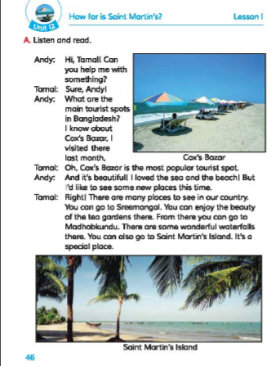
Text Inrtoduction
EFT
Class: 5
Unit:12
How far is Saint Martin’s

Slide 4
Learning outcomes
Student will be able to-
1.3.1- Recognize which words in a sentence are stressed
1.1.1- Say words,phrases and sentences with proper sound and stress
6.2.1- Talk about people,objects and events on appropriate topics
1.5.1- Read the text with correct pronunciation
9.1.1- Take dictation of short and simple paragraph

Slide 5
Let’s watch a video

Slide 6
Let’s see some pictures

Slide 8
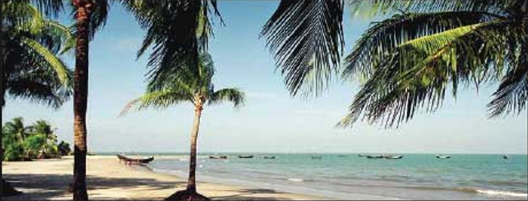
Lesson Declaration
How far is Saint Martin’s?

Slide 9
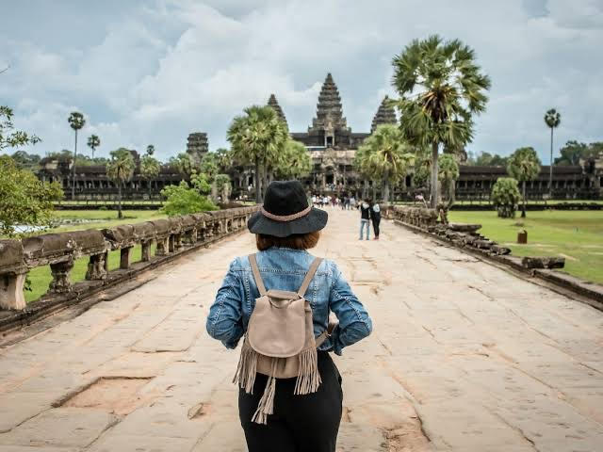
Let’s see some words with their meaning
Beach =
= Sandy shore of the sea
= A person who visits a place for pleasure
Tourist =

Slide 10
= Stream flowing down a hill
Waterfall =
= A piece of land completely surrounding by water
Island =

Slide 11
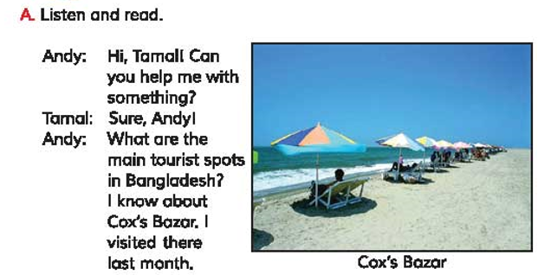
Teacher’s reading

Slide 12
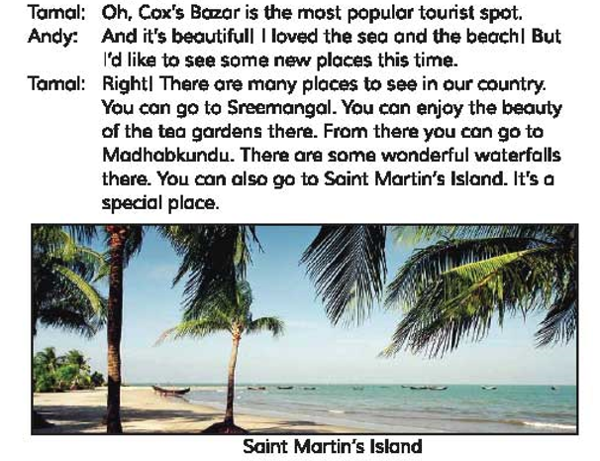

Slide 13
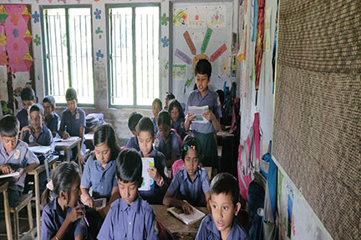
Student’s reading
In this stage two students read the dialogue.They act like Tamal & Andy

Slide 14
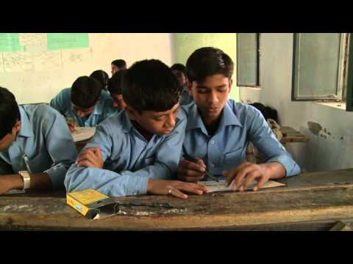
Pair work
Two students make a conversation like Tamal & Andy.They change some words Sundarbans,Paharpur,Rangamati instead of Cox’s Bazar,Sreemangal,Saint Martin

Slide 15
Write “True” for correct statement or “False” for wrong one
Andy visited Cox’s Bazar last year.
Cox’s Bazar is the most commercial place of Bangladesh.
Sreemangal has tea gardens.
Waterfalls are found in Madhobkundu.
St. Martin’s is a special place.

Slide 16
Evaluation
Write down the answers of the questions:
Who is the tourist in the text?
What are the main tourist spots in Bangladesh?
Which is the most popular tourist spot in Bangladesh?
What is Sreemangal famous for?

Slide 17
Homework
Write a short composition about ‘ Tourist spots in Bangladesh’. You have to write it at least 5 sentences.

Slide 18
Good Bye

