Slide 1
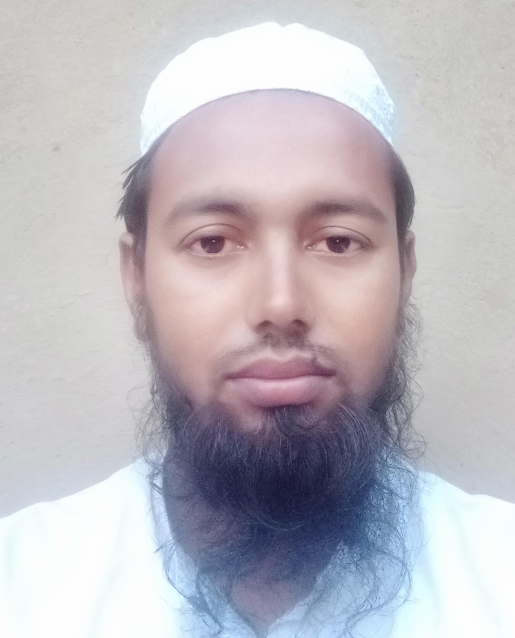
Shamsur Rahman, Assistant teacher, M M Dakhil Madrasa, Sakhipur, Tangail.

