Slide 1
Welcome everybody to our today’s session

Slide 2
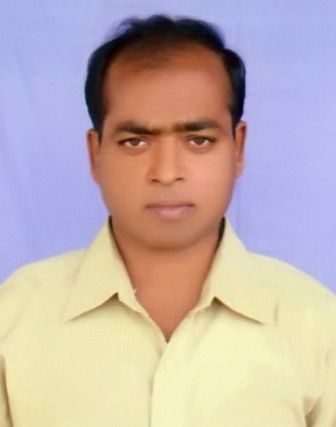
This is to
Mad Sazzad Hossain
Assistant Teacher
Santhia Govt. Pilot Model High School,
Santhia- Pabna.

Slide 3
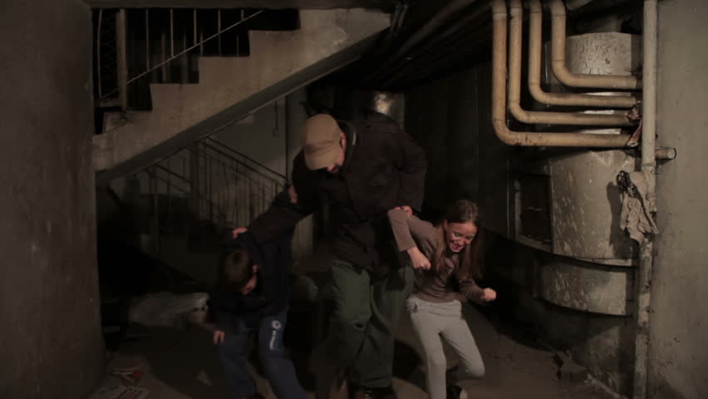
Do you like to thank them?

Slide 4
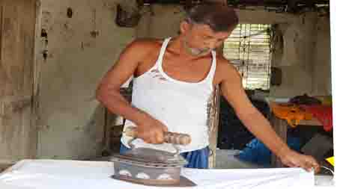
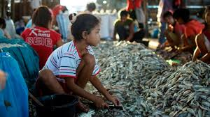
They deserve thank from us because they work for a better society.

Slide 5
Dear boys and girls, our today’s session is on
Lesson5
Thanks for your work
After completing the lesson students will be able to-
Talk about people, places and familiar objects in short and simple sentences
Ask and answer questions
Participate in short dialogues and conversations on familiar topics
Write short paragraphs

Slide 6
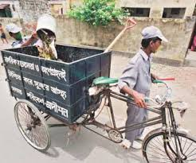
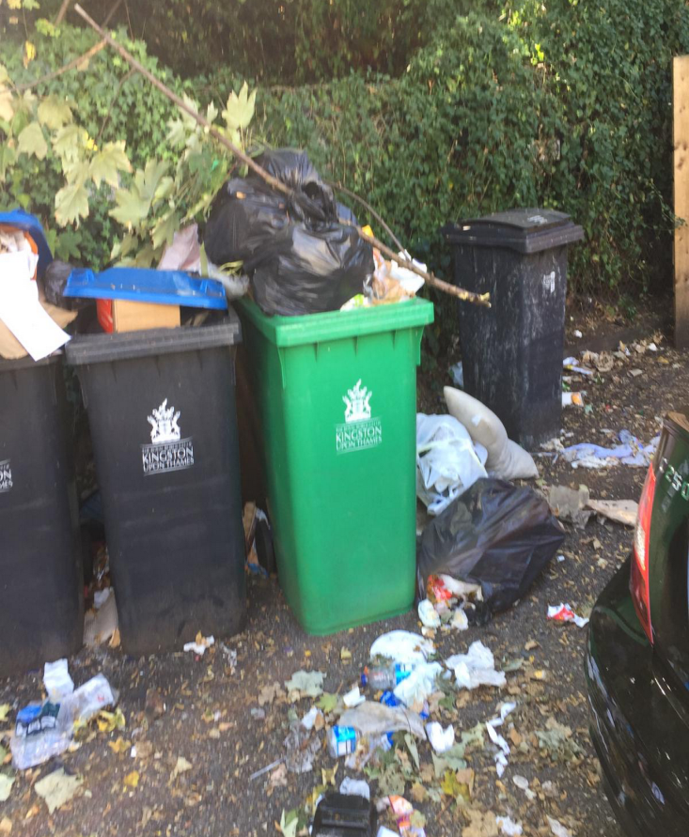
Bulbul collects rubbish from the Sankar area in Dhaka . Every morning, he wakes up at 5o’clock and walks along the streets of Sankar to collects rubbish. People of Sankar put their rubbish in plastic bins and leave them in front of their houses.

Slide 7
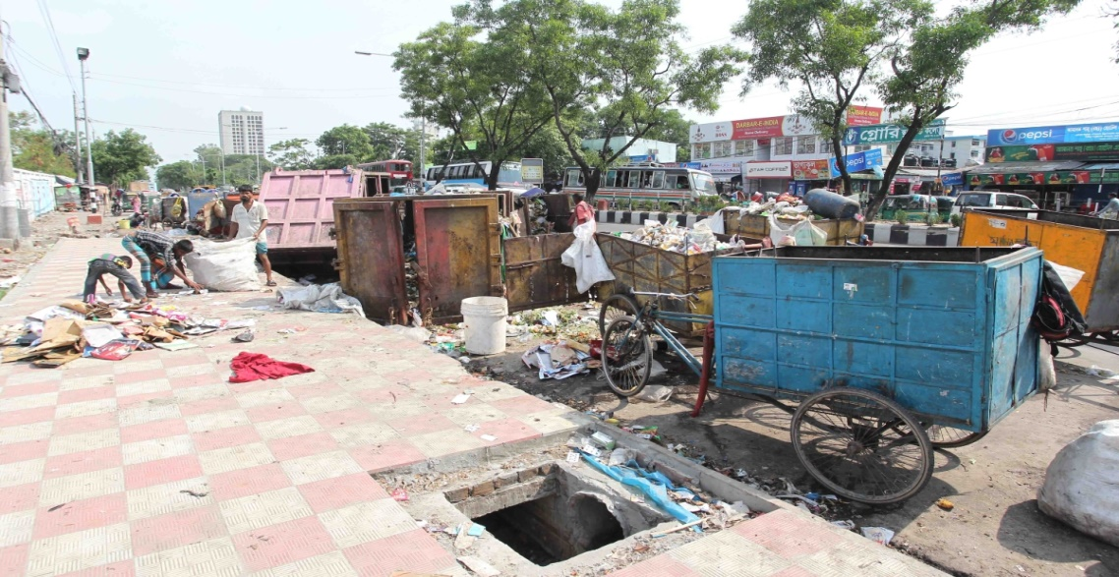
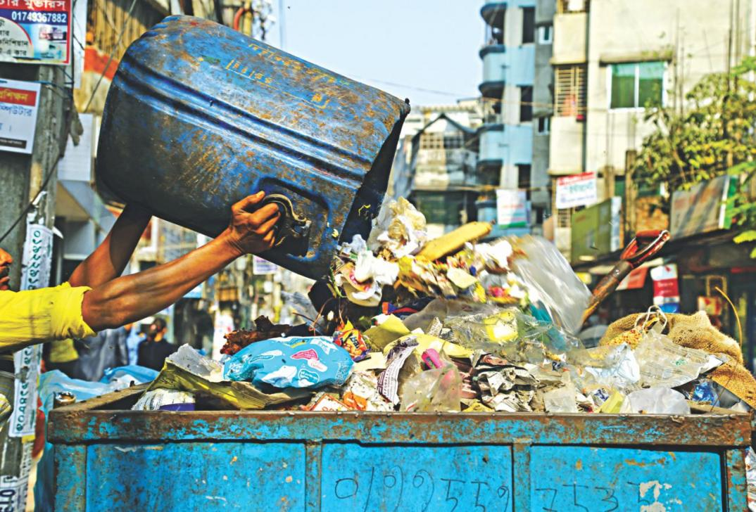
Bulbul walks from door to door to collect them. Sometimes the bins are very dirty and they smell bad. But Bulbul does not mind. He takes out everything from the bins and puts them in his van . He believes that all jobs are important.

Slide 8
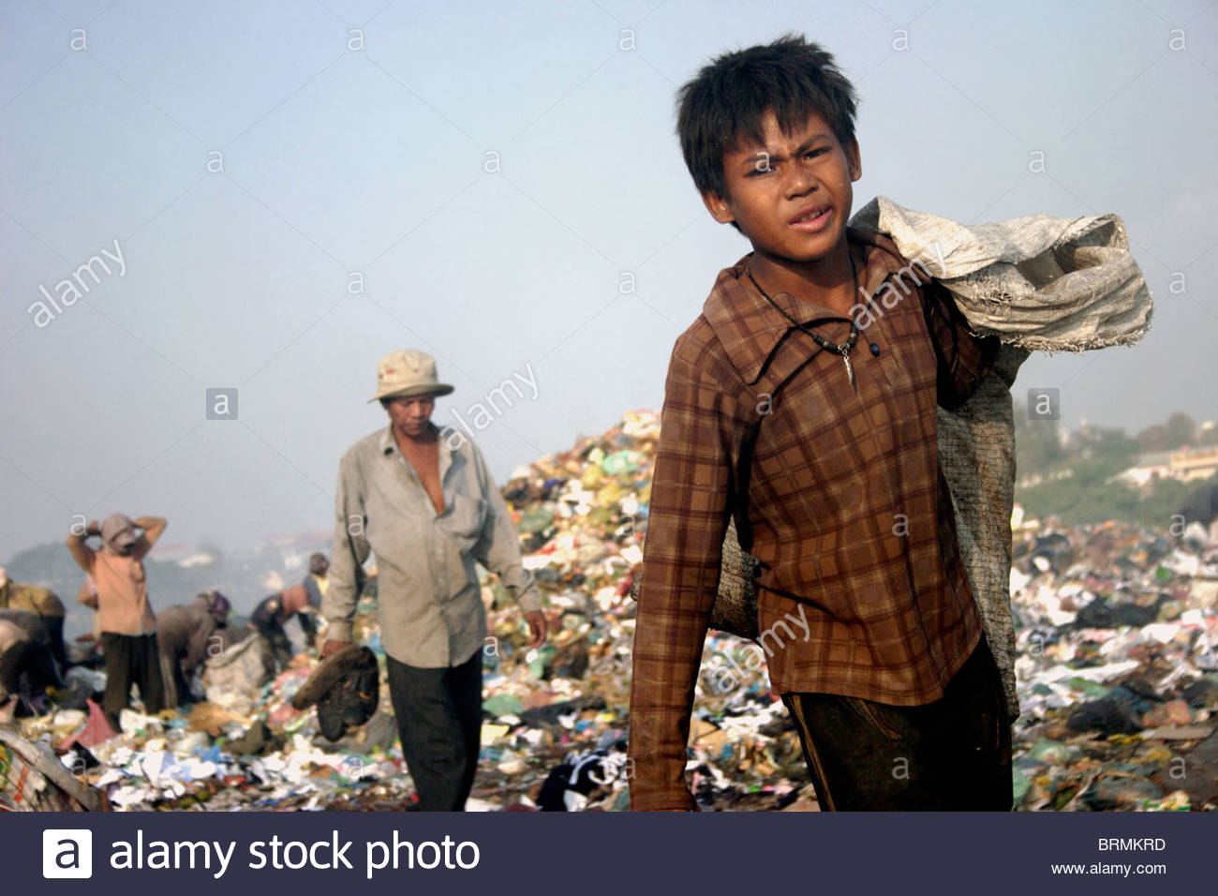
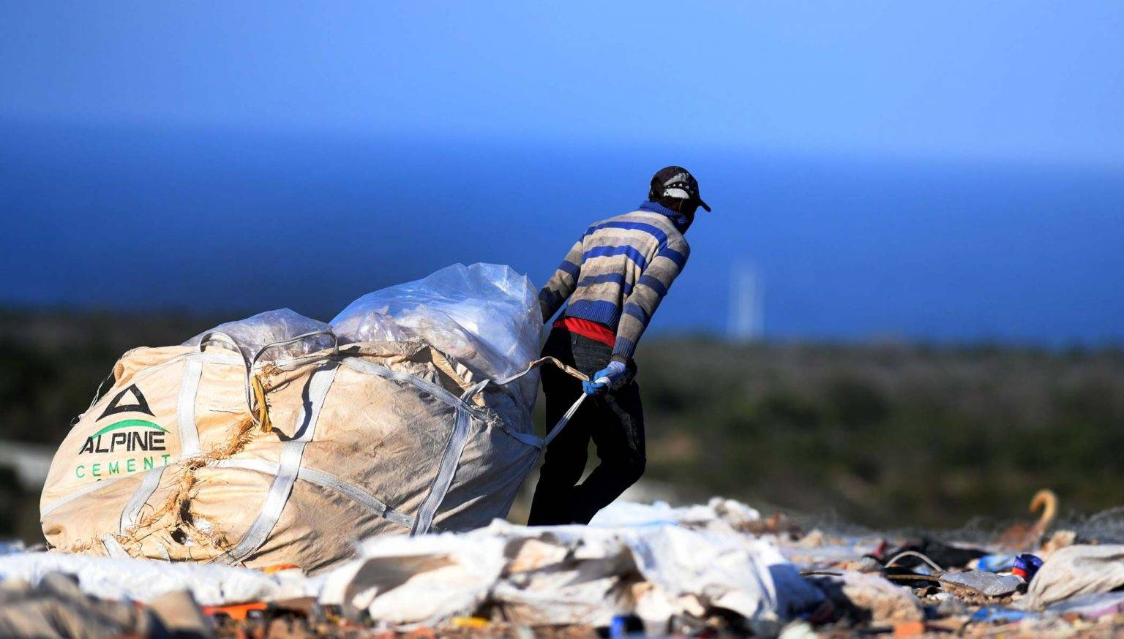
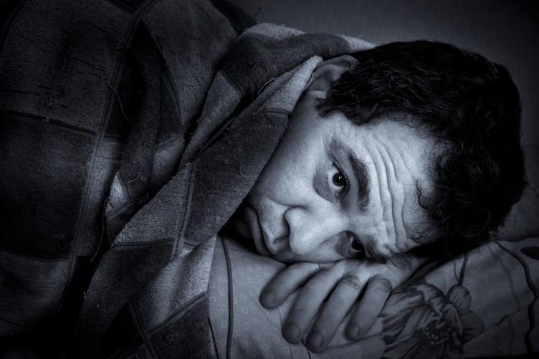
He works hard every day. To keep this area clean. Last three months Bulbul was sick for two days . So, he could not come to collect the rubbish.

Slide 9
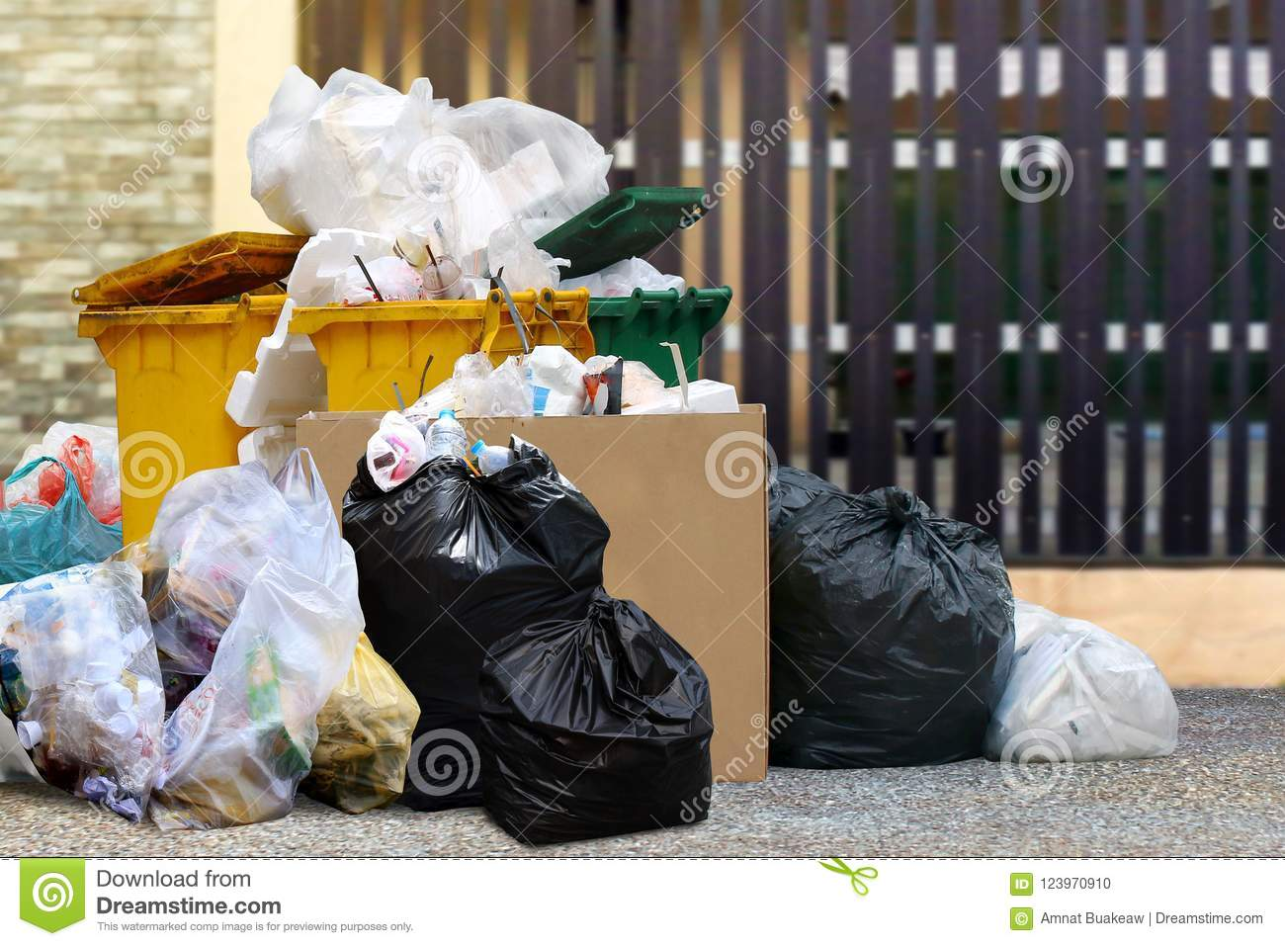
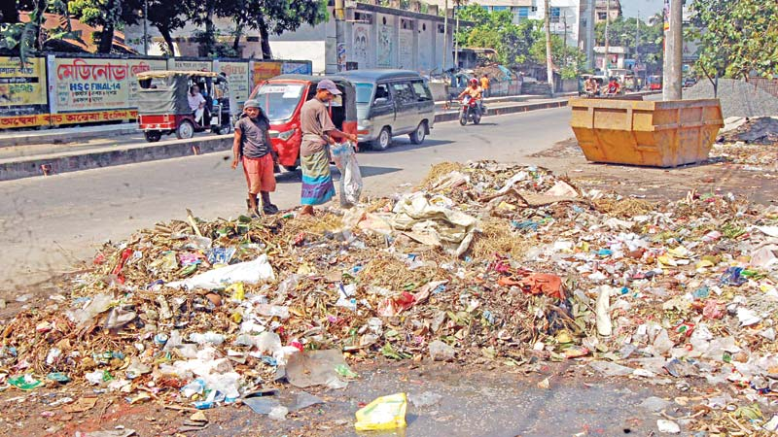
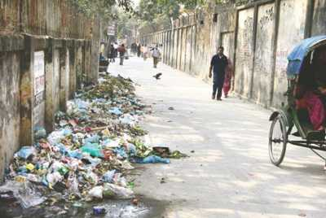
The people of Sankar were in great trouble. They got piles of rubbish waiting in front of their houses. The whole area became dirty and unhygienic.

Slide 10
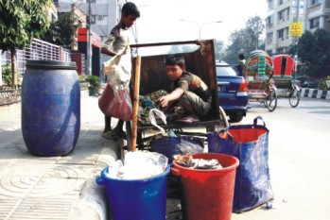
When Bulbul got well, he came back to Sankar. He collected every thing from all the bins. Bulbul does not want to fall sick again.

Slide 11
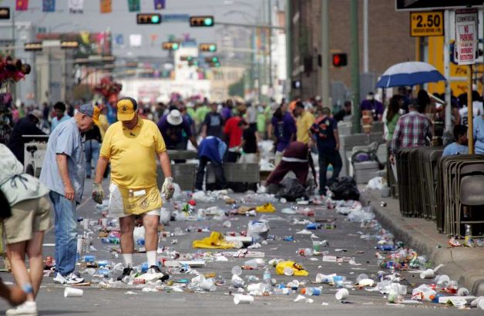
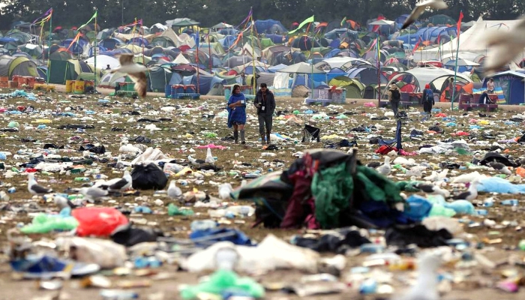
He realizes, if he stops working even for a few days only, the whole area will turn into a big dustbin.

Slide 12
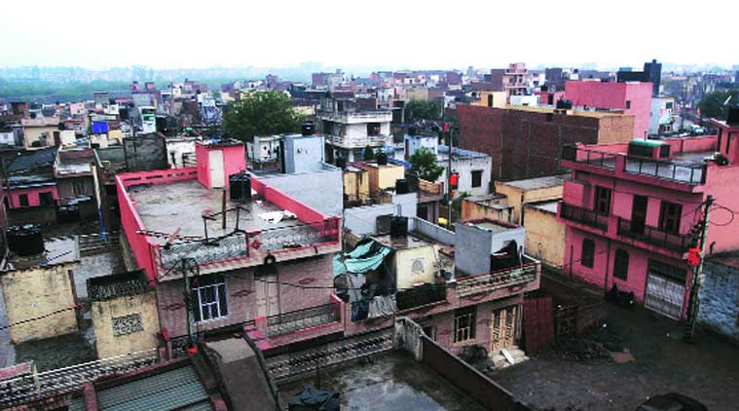
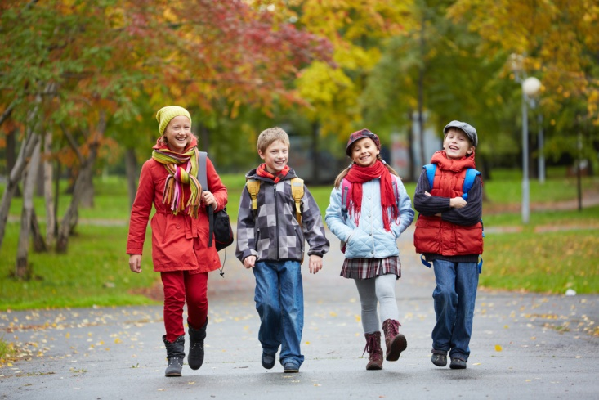
Dear boys and girls, open your text book and read the passage again. Now choose the best answer from the given alternatives:
a) Bulbul collects rubbish from the Sankar area- here area means
i) Reservoir ii) state iii) place iv) territory
b) Bulbul walks from door to door to collect them.– the synonym of walks is---
i) Footprint ii) comes out iii) treads iv) merriment

Slide 13
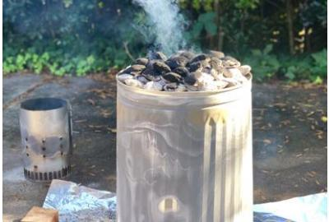
c) He takes out everything from the bins.– the synonym of takes out is---
i) Delivery ii) forgive iii) look for iv) discard
d) he could not come to collect the rubbish.– the synonym of rubbish is-
i)Transition ii) filth iii) wastage iv) bunkum
e) the whole area will turn into a big dustbin.– the synonym of dustbin is---
i) Trash can ii) basket iii) container iv) tin

Slide 14
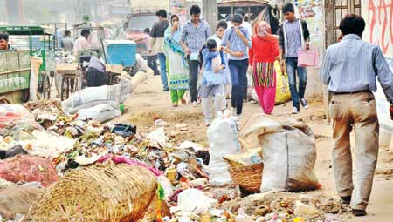
Read the passage silently again and answer the following questions:
a)When did Bulbul start his day?
b)Where did people of Sankar put
their household rubbish?
c)How did Bulbul collect the rubbish?
d)Why did people of Sankar face a trouble?
e)Do you think all jobs are important? How?

Slide 15
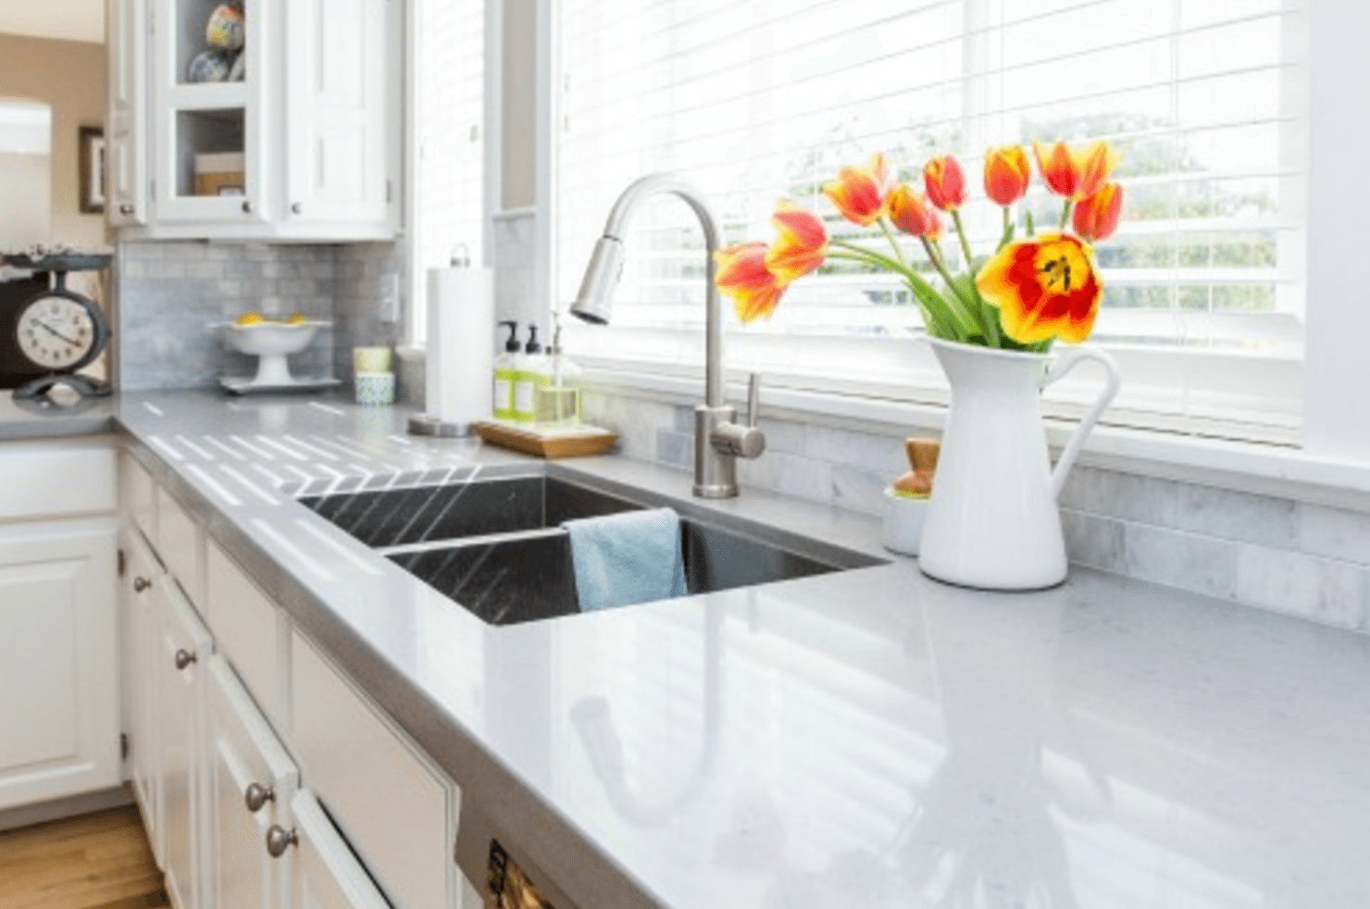
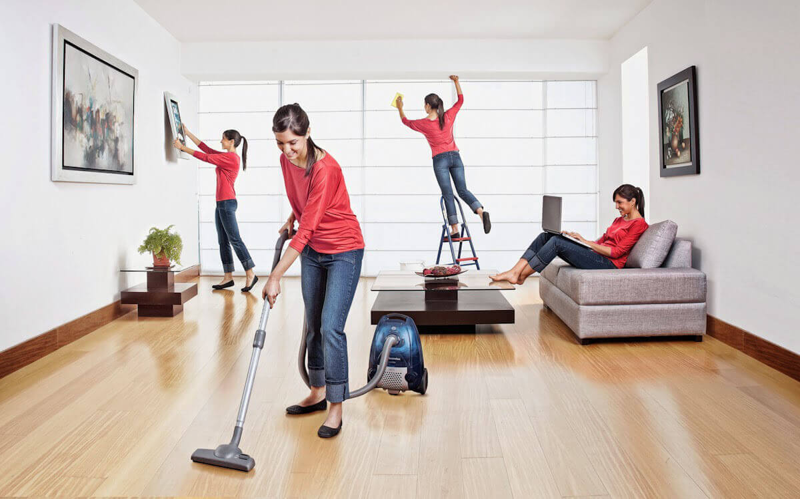
Suppose you live in a small town. Your friend has come to visit you. He is happy to see the hygienic environment of your house. Make a dialogue between you and your friend on hygienic.

Slide 16
We have almost reached at the end of our session.
Write a short on the Necessity of
Cleanliness answer to the following question:
a)What is cleanliness?
b) How can we keep ourselves personally clean?
c)Where should we keep our domestic wastages?
d) Why do people become sick frequently?
e) When do you specially take part in cleanliness?
f) How do feel living in a clean environment?
g) What do you want other people to do for the cleanliness?

Slide 17
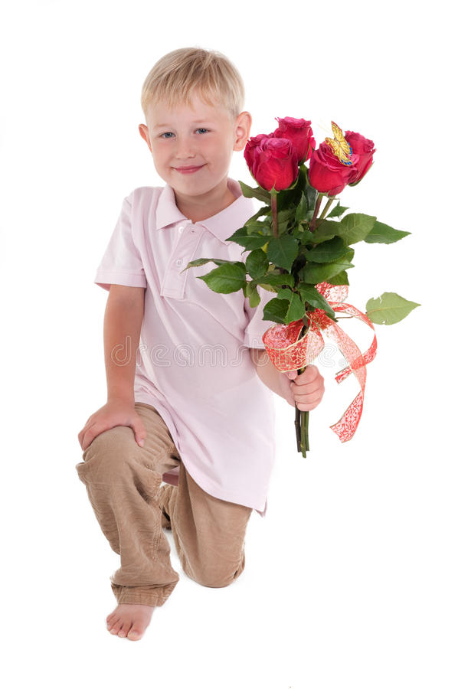
And here our session comes to

