Slide 1
Welcome

Slide 2
Introduction
Class: Nine
Subject: English First Paper
Unit: One
Lesson: 2
Duration: 45 Minutes
Oviram Chasa
Assistant Teacher(ICT)
Chhoto Dhamai High School
Juri, Moulvibazar.

Slide 3
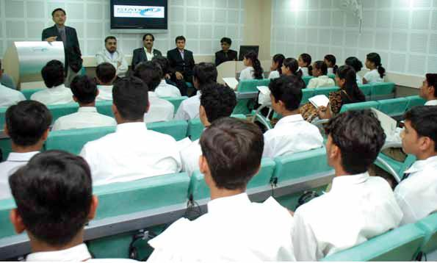
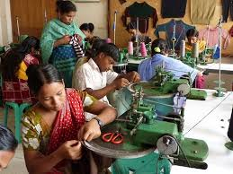
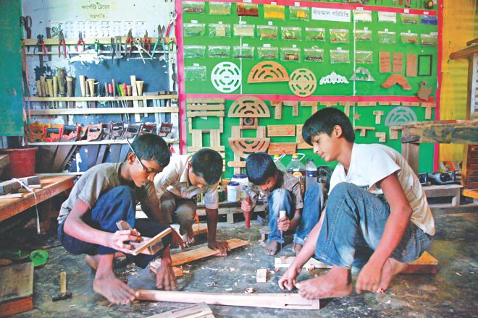
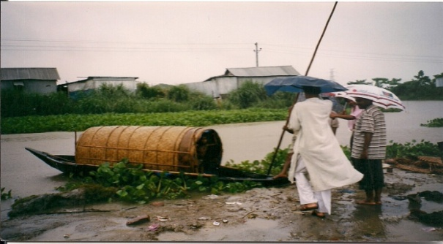
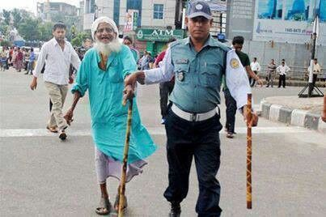
Enlightened Societal Aspects
Knowledge
Figure1. Books -Source of knowledge
Figure 2. Acquiring knowledge
Skills
Figure 3. Technical and Vocational Skills Dev.
Figure 4. Hands on activity
Attitudes
Figure 5. Helping to cross a small river
Figure 6. Police helping to cross a road

Slide 4
Knowledge, skills and attitudes

Slide 5
Learning outcomes
By the end of the lesson, students will be able to ---
listen and understand others.
participate in discussions.
use linking words in real life situation.
describe the characteristics of being a good citizen.

Slide 6
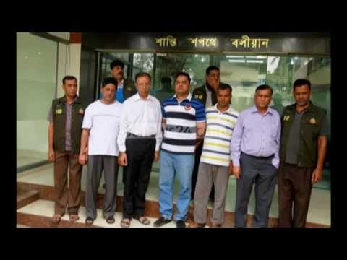
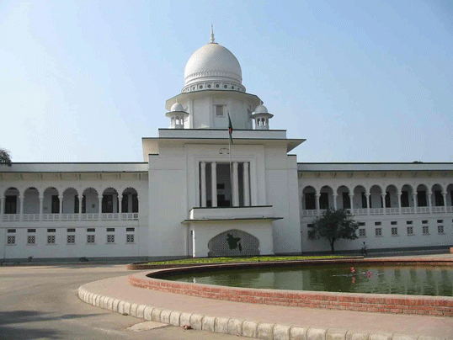
Let’s know the meaning of some new words
Constitution
A set of principles by which a state or an organization is governed
Relating to or having the power to put plans or actions into effect
Executive
Legislative
Having the power to make laws

Slide 7
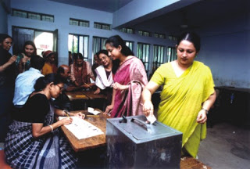
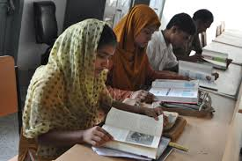
Let’s know the meaning of some new words cont.
Judicial
Administrative of justice
Attitude
A feeling or opinion about something or someone
Democratic
The principle of political or social equality for all i.e. education for all

Slide 8
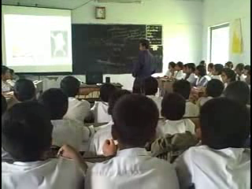
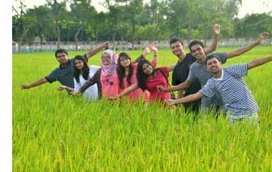
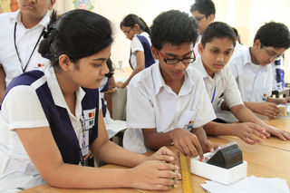
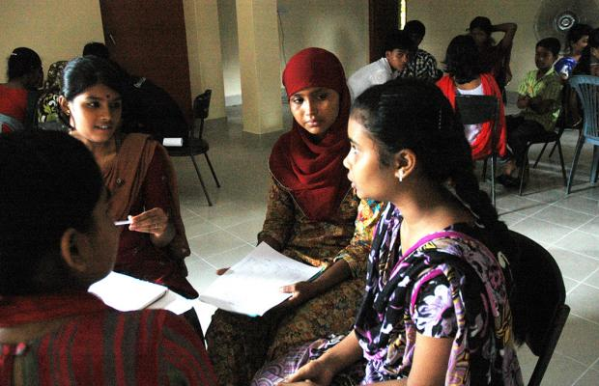
Look at the pictures and say what they are about:
Figure 1. Students in a classroom acquiring knowledge
Figure 2. Students in a study tour to know culture and history
Figure 3. Students in a lab trying to investigate a theory
Figure 4. Students in a group activity

Slide 9
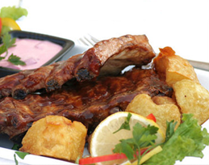
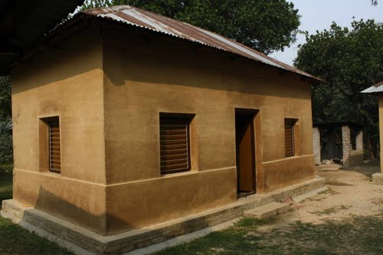
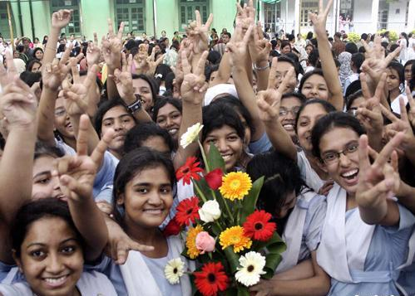
Pair work
Look at the pictures and tell what they are about.
Food
Shelter
What do you need in addition to food, shelter, accompany? Make a list except these.
Accompany

Slide 10
Grammar Focus
Although the man is rich, he is unhappy.
Finally, we won the match.
What do the two italic words Although and Finally indicate?
Linking words help us to connect ideas and sentences so that people can follow our ideas.
Let’s know about some examples of linking words:
Sequencing ideas
The former, … the latter, Firstly, secondly, finally, The first point is, Lastly, The following
Example: Firstly, … secondly, … finally (or lastly) are useful ways to use our times .
.

Slide 11
Group Work
Write and tell how K (Knowledge), S (Skills) and A (Attitudes) can be shown in the following topics:
Group A
Group B
Group C
Orsaline
Debate
E-mail

Slide 12
Evaluation
1. What do you mean by knowledge?
2. Why should you acquire different facts of learning?
3. What will happen if you share with your friends of your problems and prospects?
4. How will you make illiterate people aware to cast their votes to the corrupt free people?

Slide 13
Home work
Write a paragraph about
‘How to be a good citizen’

Slide 14
Thank you

