Slide 1
WELCOME
TO
OUR MULTIMEDIA CLASS

Slide 2
Teacher’s Identity
Tapati Rani Sarkar
Assistant Teacher
Lalmohan Secondary Girls School
Email: tapatisarkar0101@gmail.com

Slide 3
Class Introduce
Class: Nine
Section: A
Chapter: Tag Question
Date: 03/07/2020
Time: 50 Minutes

Slide 4
Declare The Class
Today our class is Tag Question

Slide 5
Let start
I give you some example.
1. He goes to school,…………….
2. They are playing in the field,……..
3. Bipul is not singing a song,……….
4. She wrote a letter,………..
5. You want to write a pen,………

Slide 6
Listen to me
Rule 1. If at the end of any verb is s/es then we will use in tag question , doesn’t and subject.
Rule 2. If any auxiliary verb stay after any subject then we will use that auxiliary verb and subject .

Slide 7
Rule 3: If there is no subject, starting any sentence then we will use there will you.
Rule 3: If there is let us / let’s any sentence then we will use shall we.

Slide 8
Let’ we see a video
https://www.youtube.com/watch?v=7aJdWhZZbJg

Slide 9
Group Work

Slide 10
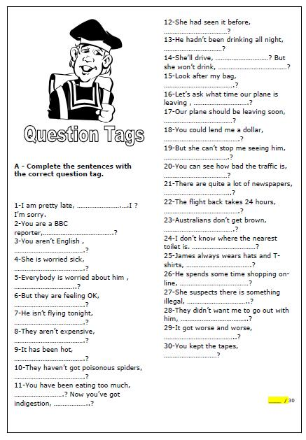
Home work

Slide 11
GOOD BYE

